Slide 1



Generalizing Constraint Models in Constraint Acquisition
CHAT-Opt
Dimos Tsouros, Steven Prestwich, Tias Guns
dimos.tsouros@kuleuven.be, s.prestwich@cs.ucc.ie, tias.guns@kuleuven.be
02/09/2024

Slide 2
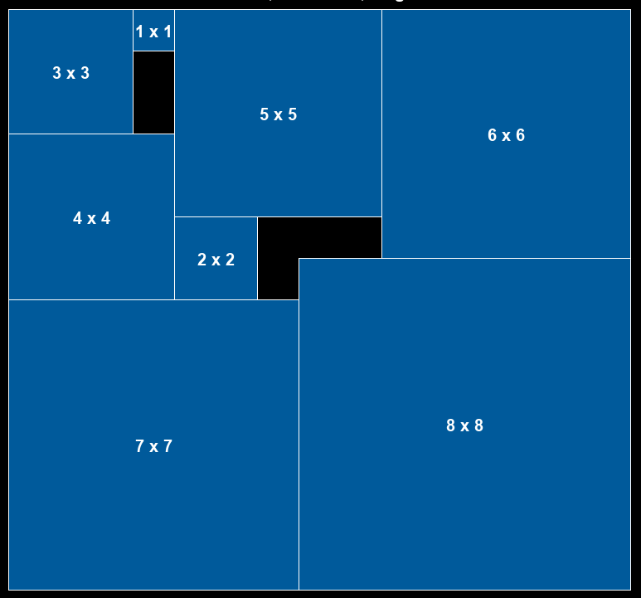
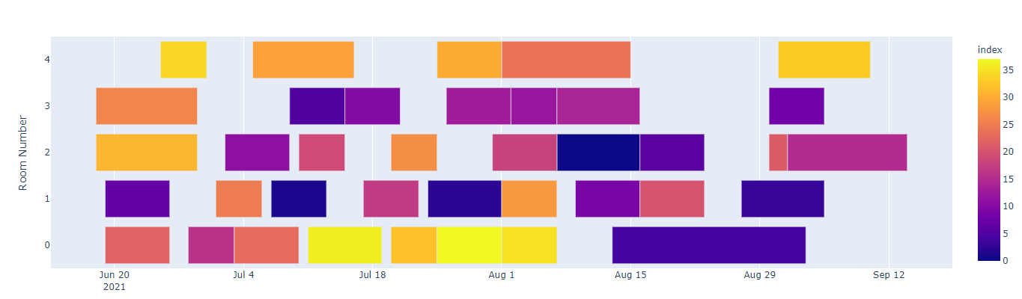
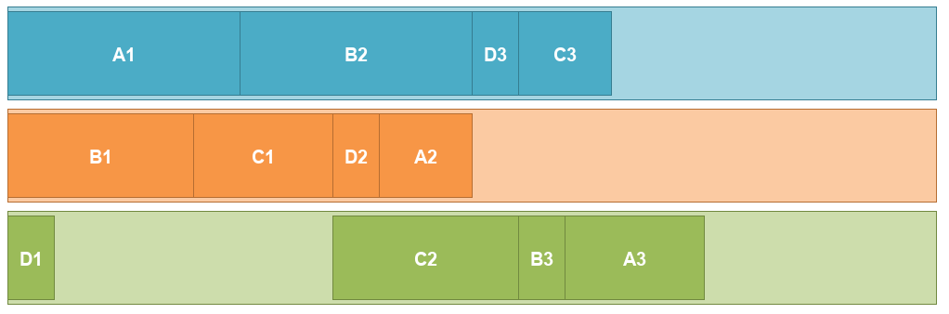
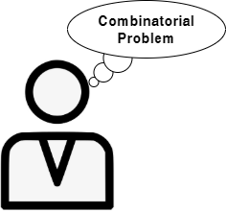

Introduction
Constraint programming (CP)
Solving combinatorial problems in AI
Job-shop scheduling Bin-packing Room assignment
Model + Solve paradigm
Give model
Return solution

Slide 3
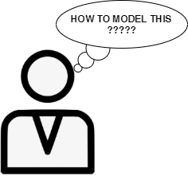


Introduction
Modelling is not always trivial
Requires expertise
Bottleneck for the wider use of CP
Constraint Acquisition
modelling

Slide 4

Constraint Acquisition
Passive acquisition: Using existing data
Examples
CSP Model
(Inter)active acquisition: Interact with the user
Answers
Queries
CSP Model
Constraint Acquisition, C. Bessiere et al., AIJ, 2017

Slide 5
Constraint Acquisition workflow
Create candidate set
B
Constraint Acquisition system
C_{L}
Vocabulary (X,D)
Examples
Or
Answers
Queries
Use a set of candidate constraints B
Learn which of them are part of the problem
- Add them to C_{L}
Constraint Acquisition, C. Bessiere et al., AIJ, 2017

Slide 6
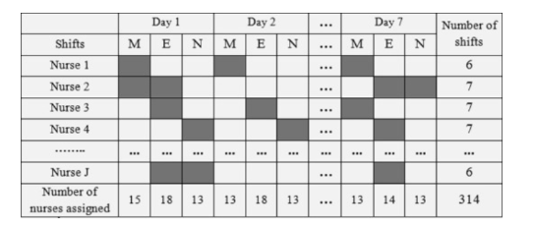
Important Limitation:
learning only instance-specific constraints
Most CA methods learn the model only of the given instance of the problem
Nurse rostering problem:
What if the instance changes?
- If the number of nurses changes
If we want to schedule on different timeframe
…
We will need to learn again the constraints for the new instance!!

Slide 7
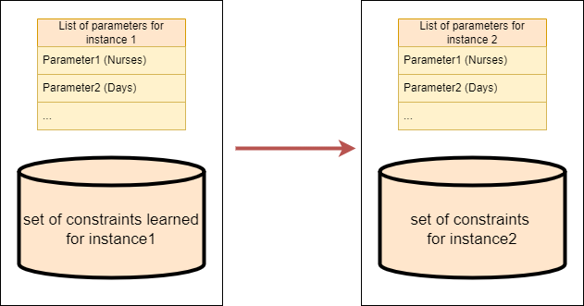
Important Limitation:
learning only instance-specific constraints
Most CA methods learn the model only of the given instance of the problem
But problems typically do not define a set of ground constraints:
But can be instantiated with different parameters
How can we generate new instances of the same problem?

Slide 8
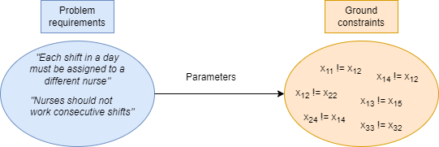
Important Limitation:
learning only instance-specific constraints
Problems are typically parameterizable:
Consist of a set of requirements
Can be instantiated with different parameters
Constraint specifications are constructed for each requirement:
Relation to be used
Variables partitioning
Possible sequence conditions
Constraint specification generators
in modelling languages:
Foreach shifts_in_day_i in shifts:
Foreach (shift1, shift2) in all_pairs(shifts_in_day_i)
c <- shift1 != shift2

Slide 9
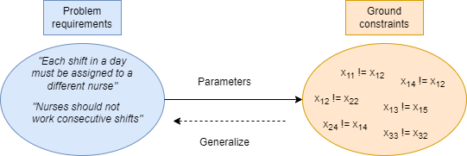
Important Limitation:
learning only instance-specific constraints
Problems are typically parameterizable:
Consist of a set of requirements
Can be instantiated with different parameters
Constraint specifications are constructed for each requirement:
Relation to be used
Variables partitioning
Possible sequence conditions
Can we generalize?
- Approximating the original constraint specifications

Slide 10
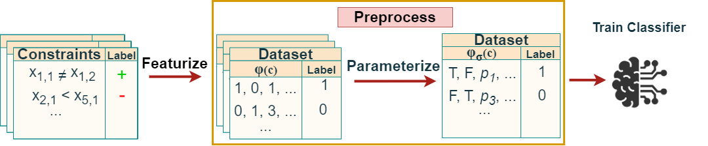
Generalizing constraint models
Learned using any CA method
Statistical ML methods can detect patterns of constraints
- Used to guide queries in active CA
We propose a classification-based method
- can implicitly learn the problem requirements in a parameterized way!
- based on given sets of constraints for instances of the problem
Create a (parameterized) dataset for the input instance:
c in input C: positive label
c not in input C: negative label
- Generate bias for non- constrained scopes
Train a classifier that can recognise which constraints are part of the problem

Slide 11
Generalizing constraint models
Learned using any CA method
To construct a constraint-level dataset we need a feature representation of constraints!
What do we need to capture in the features?
Elements of constraint specifications that we need to capture:
Possible relations (and their constants)
Ways to partition the variables
Sequence conditions
Proof-of-concept feature representation
Relation-based features | Partitioning features | Conditioning Features
Relation name (string) | Dim[i]_same (Bool) | Dim[i]_dist (float)
Constant value (int) | Latent_Dim[j]_same (Bool) | Latent_Dim[j]_dist (float)

Slide 12
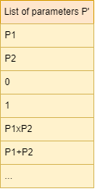
Parameterizable feature representation
Replace numeric features with named parameters to be able to generalize
Relation-based features
Relation name (string)
Constant value (int)
Partitioning features
Dim[i]_same (Bool)
Latent_Dim[j]_same (Bool)
Conditioning Features
Dim[i]_dist (float)
Latent_Dim[j]_dist (float)

Slide 13
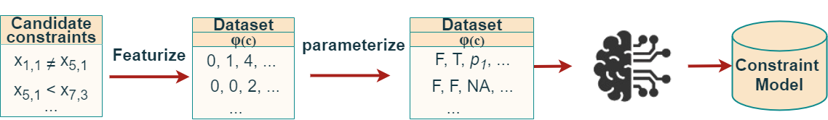
Extrapolating to new instances
We know that the classification function learned approximates the constraint specifications:
Can tell us which constraint is part of the problem or not
Use the classifier to generate-and-test constraints
Generate a set of candidates for the new instance
Then classify them to get the true ones

Slide 14
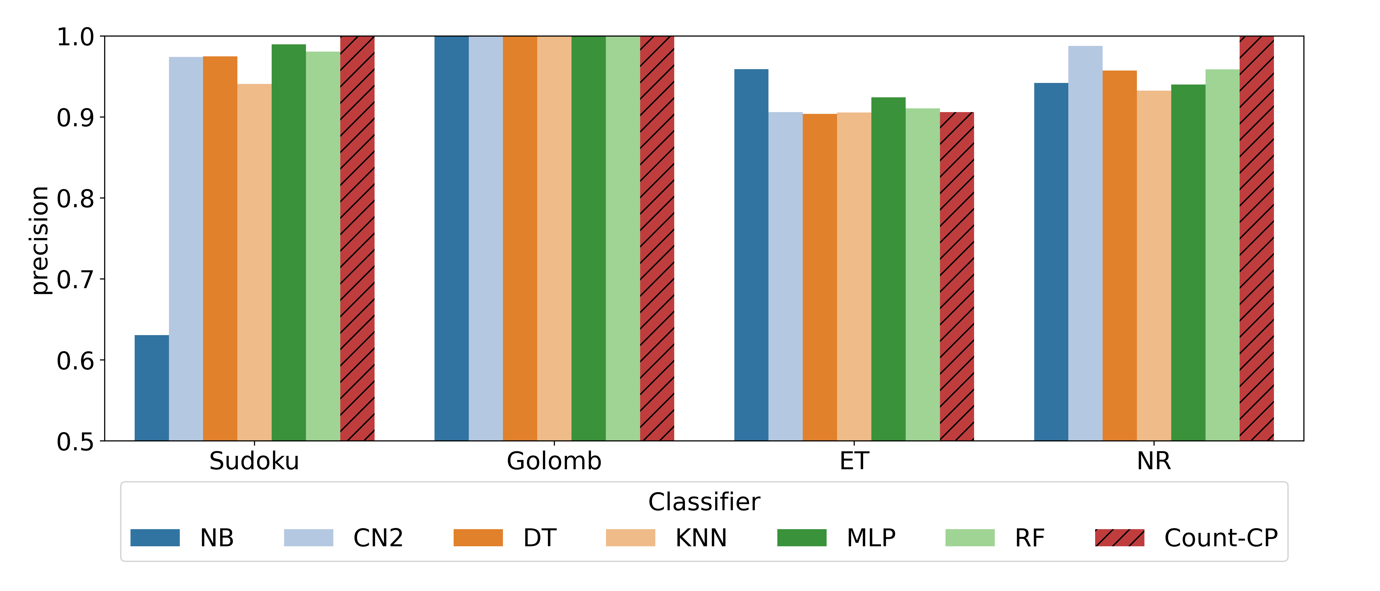
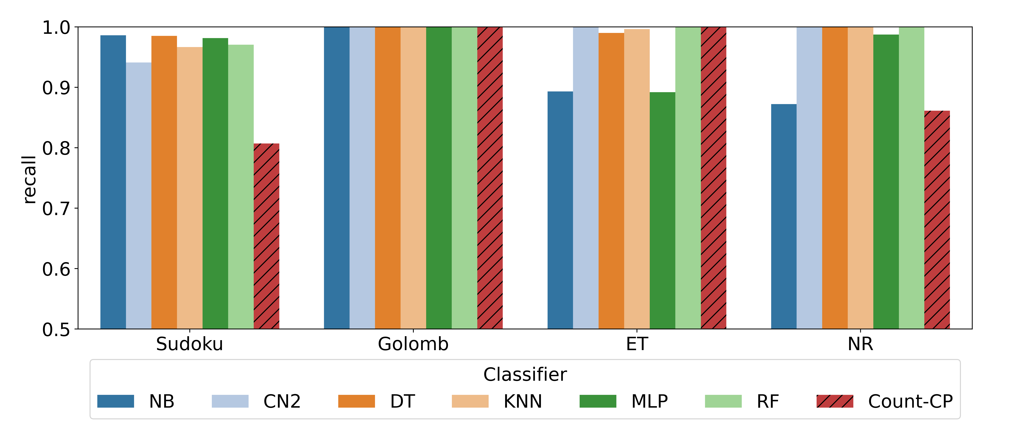
Experiments
Generalizing with leave-one-in cross validation in several benchmarks (10 instances each)
Comparing with the generalization step of Count-CP
Precision: soundness of identified constraints
Very high for most classifiers!
Similar to Count-CP
NB is failing due to the feature independency assumption
Recall: completeness of identified constraints
Very high recall, more than 90% for all
Much better recall than Count-CP: Due to the use of combination of features and sequence condition features

Slide 15
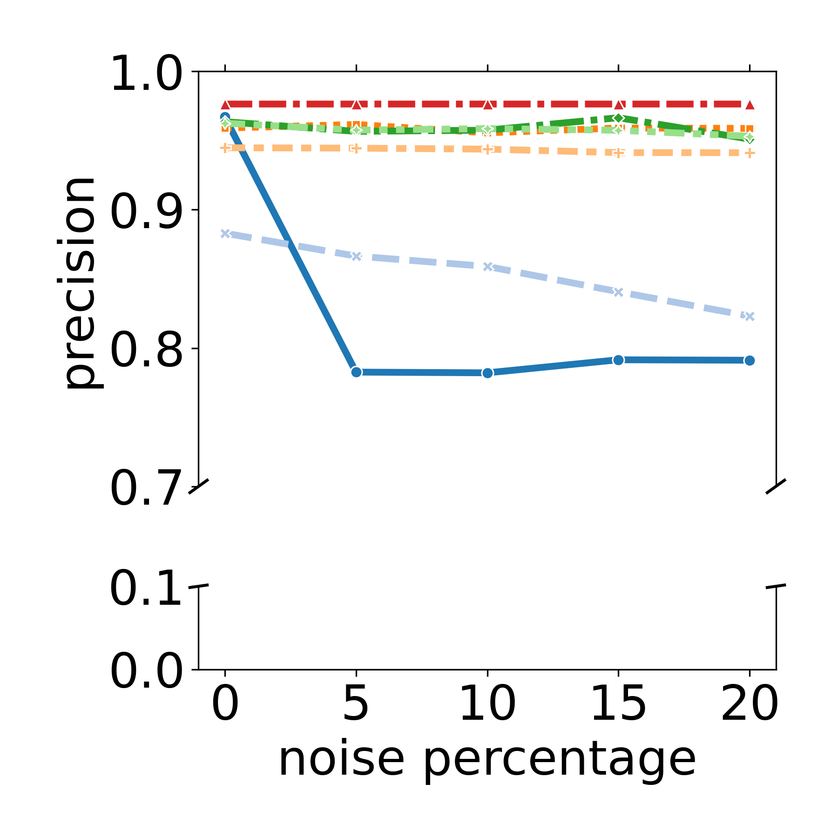
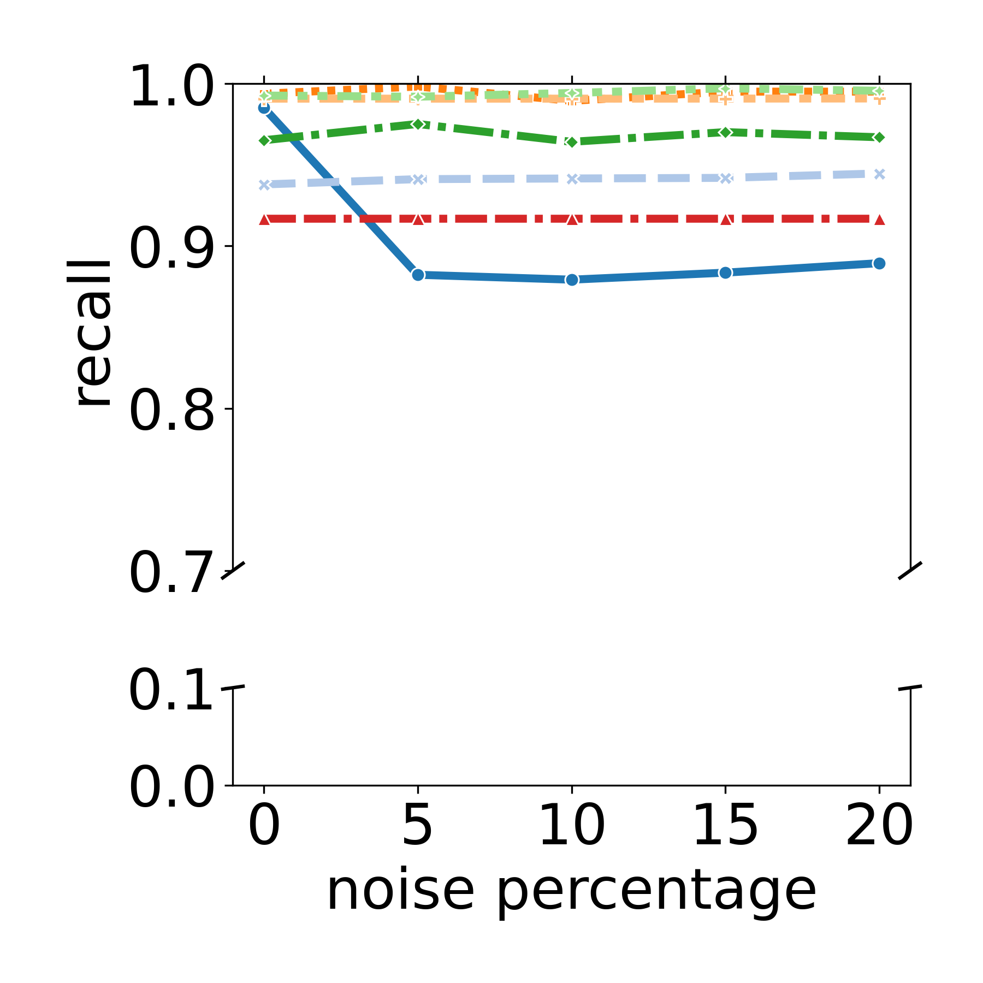
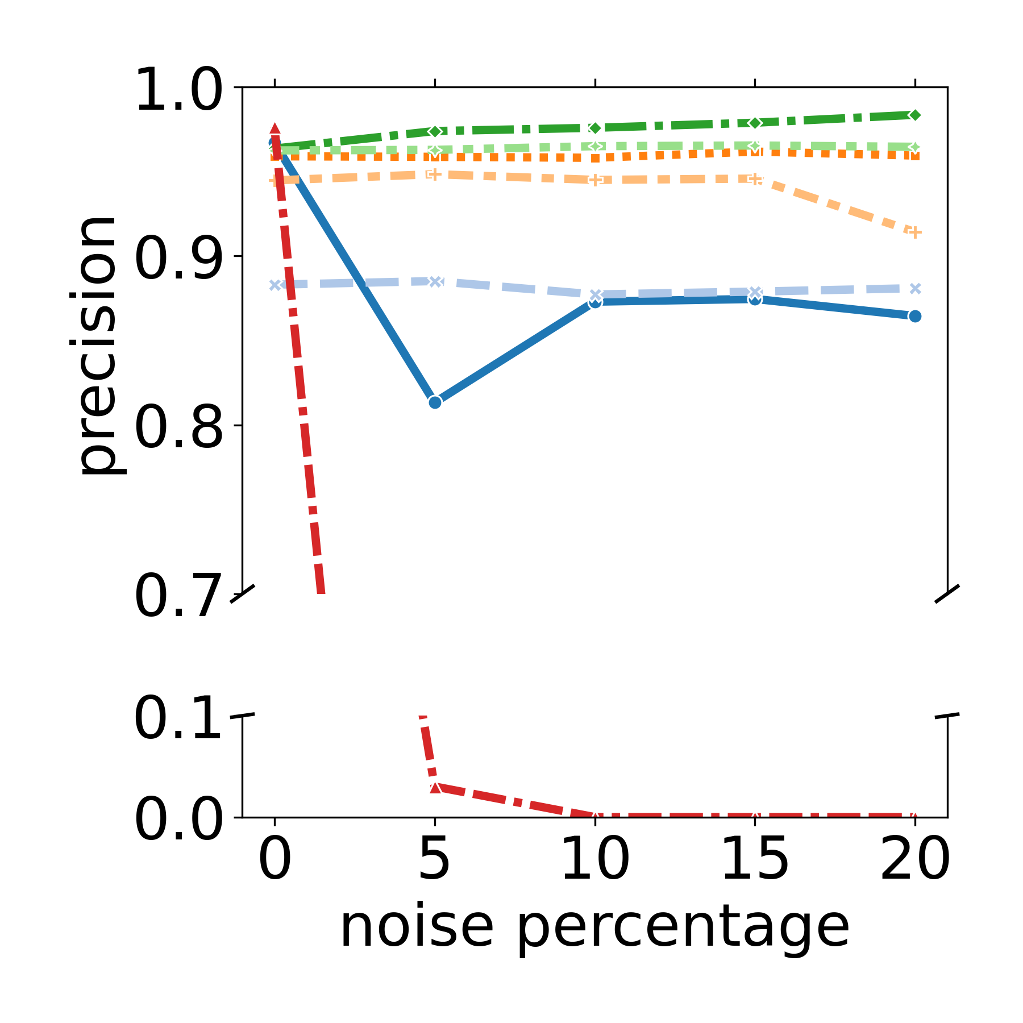
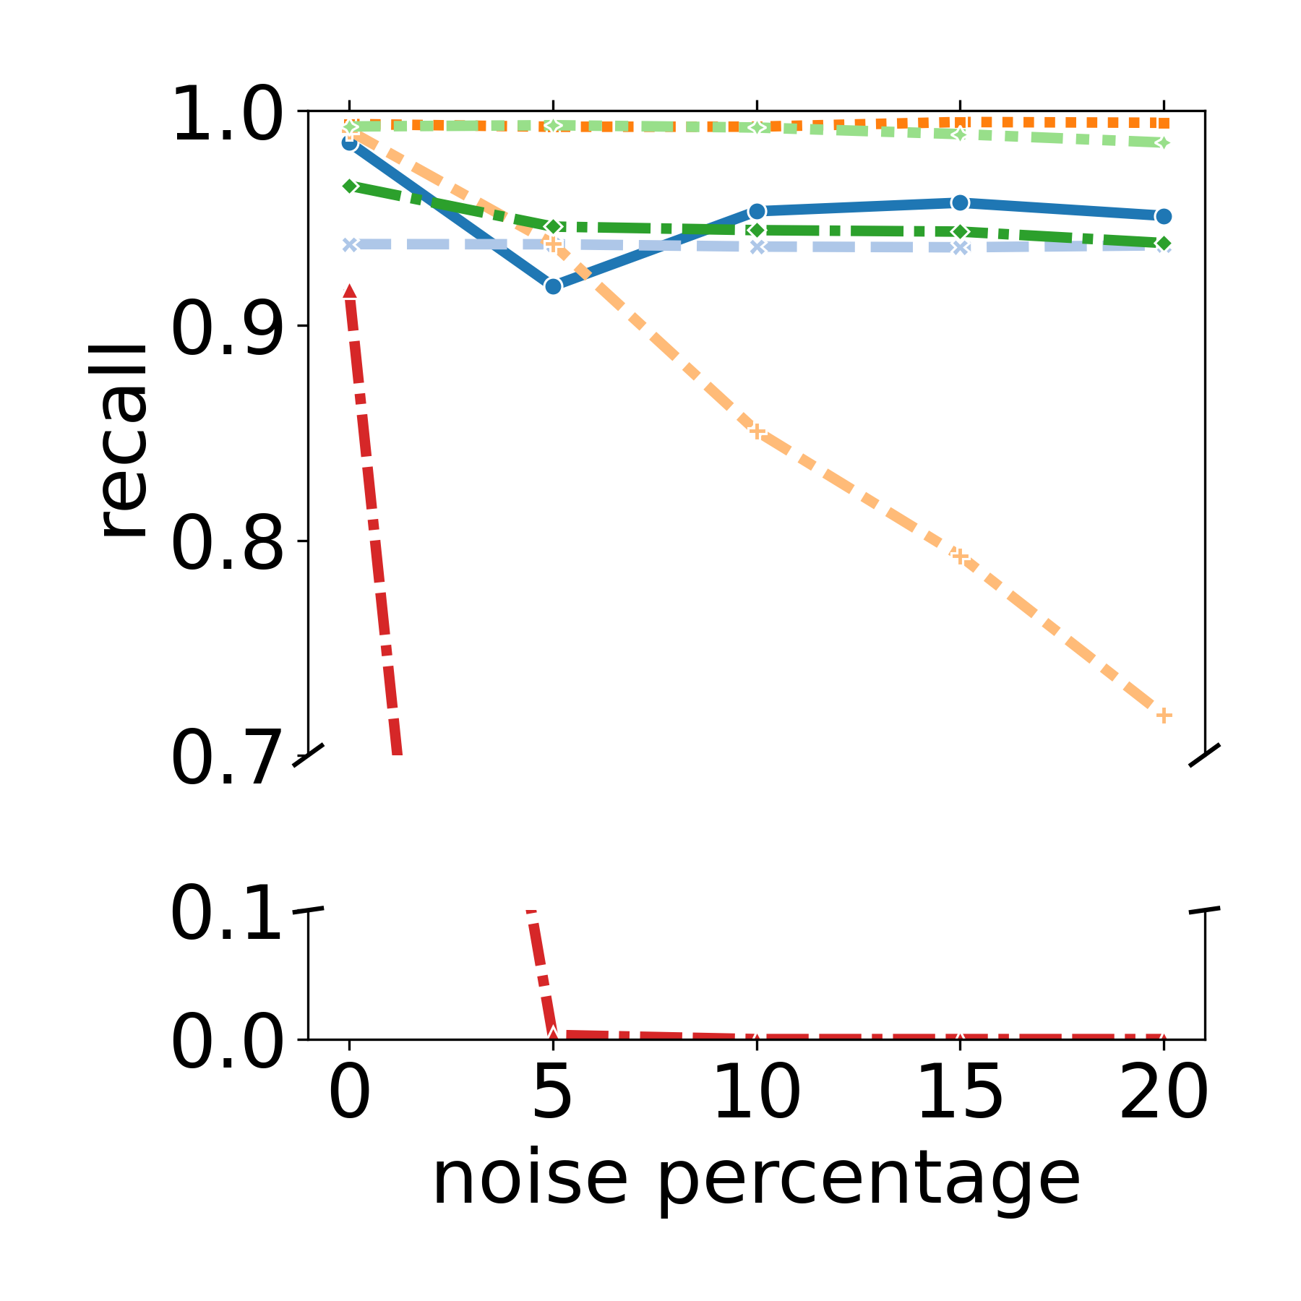
Experiments
Experiments with 2 types of noise (5%-20%):
False negative (FN) noise: constraints missing from the input set
False positive (FP) noise: wrong constraints included in the input set
FP Noise
FN Noise
Most classifiers: Very robust to the presence of noise (more than 95% even with 20% noise)!!
Much better than Count-CP in FN noise: fails to generalize even with 5% noise added.
Classification-based approach showing great potential

Slide 16
Conclusions
Statistical ML methods show great potential for generalization
Features should represent the possible constraint specifications
Very robust to noise, even on high percentages!
Can be exploited to enhance robustness during active and passive methods
Generalization capabilities can be exploited during active CA to reduce queries
Future work: Extracting constraint specifications directly

Slide 17
Thank you
For more on Constraint Acquisition, follow my tutorial: Thursday, September 5th
Questions?
Detailed introduction on CA methods
Introducing a new python repository for CA

