Slide 1

Customer Shopping Behaviour Analysis
End-to-end pipeline: Python → PostgreSQL → Power BI
3,900 TRANSACTIONS
18 COLUMNS
DATA-DRIVEN STRATEGY

Slide 2
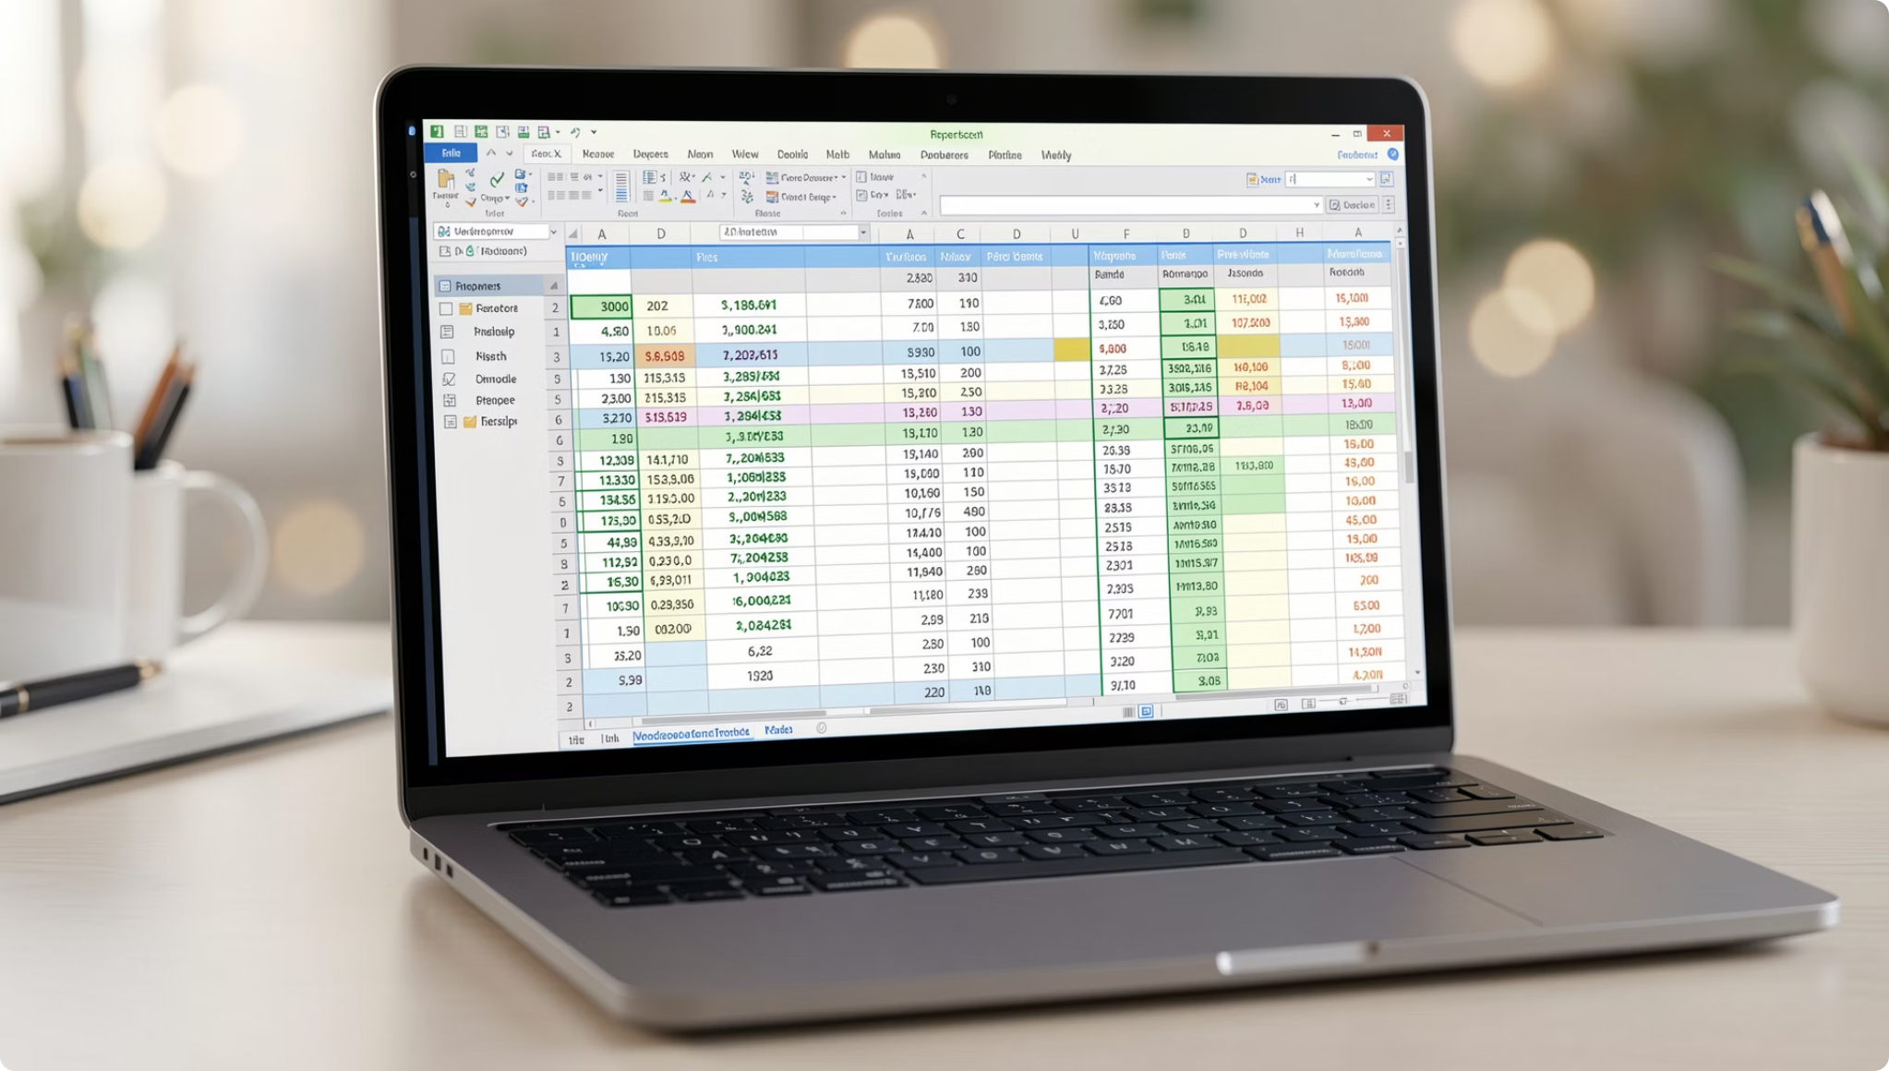

Dataset at a Glance
3,900
18
37
Transactions
Columns
Null Values
Review Rating only
Demographics
Age, Gender, Location, Subscription
Purchase Details
Item, Category, Amount, Season, Size, Color
Behaviour
Discount, Promo, Frequency, Rating, Shipping, Payment

Slide 3

Python EDA Pipeline
01
Load & Inspect
CSV → pandas, df.info(), df.describe()
02
Impute Missing Data
37 nulls → median per category
03
Standardise & Engineer
snake_case, age_group bins, frequency mapping
04
Consistency & Export
Dropped redundant promo_code_used, loaded to PostgreSQL via SQLAlchemy

Slide 4

SQL Analysis — Revenue & Discounts
Q1 · Revenue by Gender
Male vs. female spending volume
Q2 · High-Spending Discount Users
Discounts attract high-value buyers
Q6 · Discount-Dependent Products
Hat, Sneakers, Coat ~50% discount rate

Slide 5
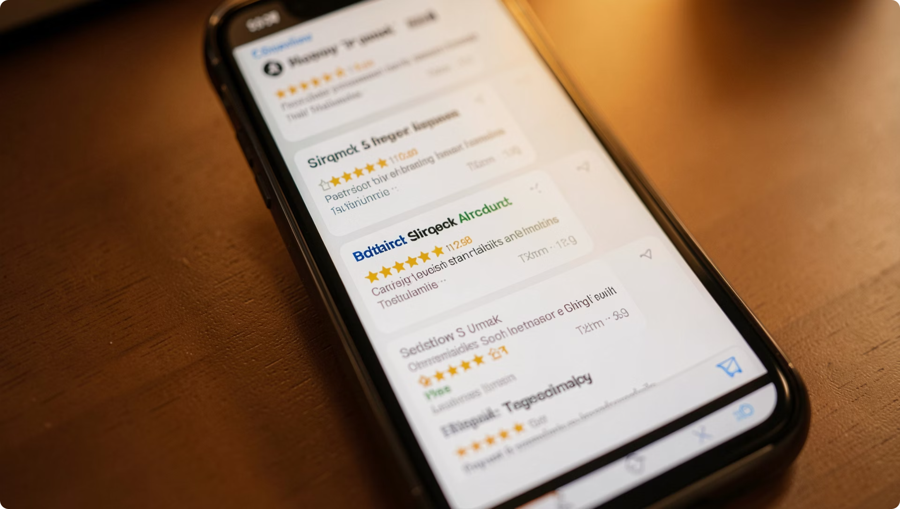
SQL Analysis — Products & Ratings
Q3 · Top 5 by Review Rating
Gloves, Sandals, Boots lead
Q4 · Shipping vs. Spend
Express buyers spend more
Q8 · Top 3 per Category
RANK() window function

Slide 6




SQL Analysis — Segments & Demographics
Q5 · Subscribers vs. Non-Subscribers
Q7 · Customer Segmentation
Q9 · Repeat Buyers & Subscriptions
Q10 · Revenue by Age Group
Avg spend & total revenue by subscription status
New · Returning · Loyal — by purchase history
5+ purchases → subscription likelihood
Young Adults lead at $62,143

Slide 7

Power BI Dashboard
3.9K Customers
$59.76 Avg Purchase
3.75 Avg Rating
27% Subscribed
Dynamic filters: Subscription · Gender · Category · Shipping

Slide 8
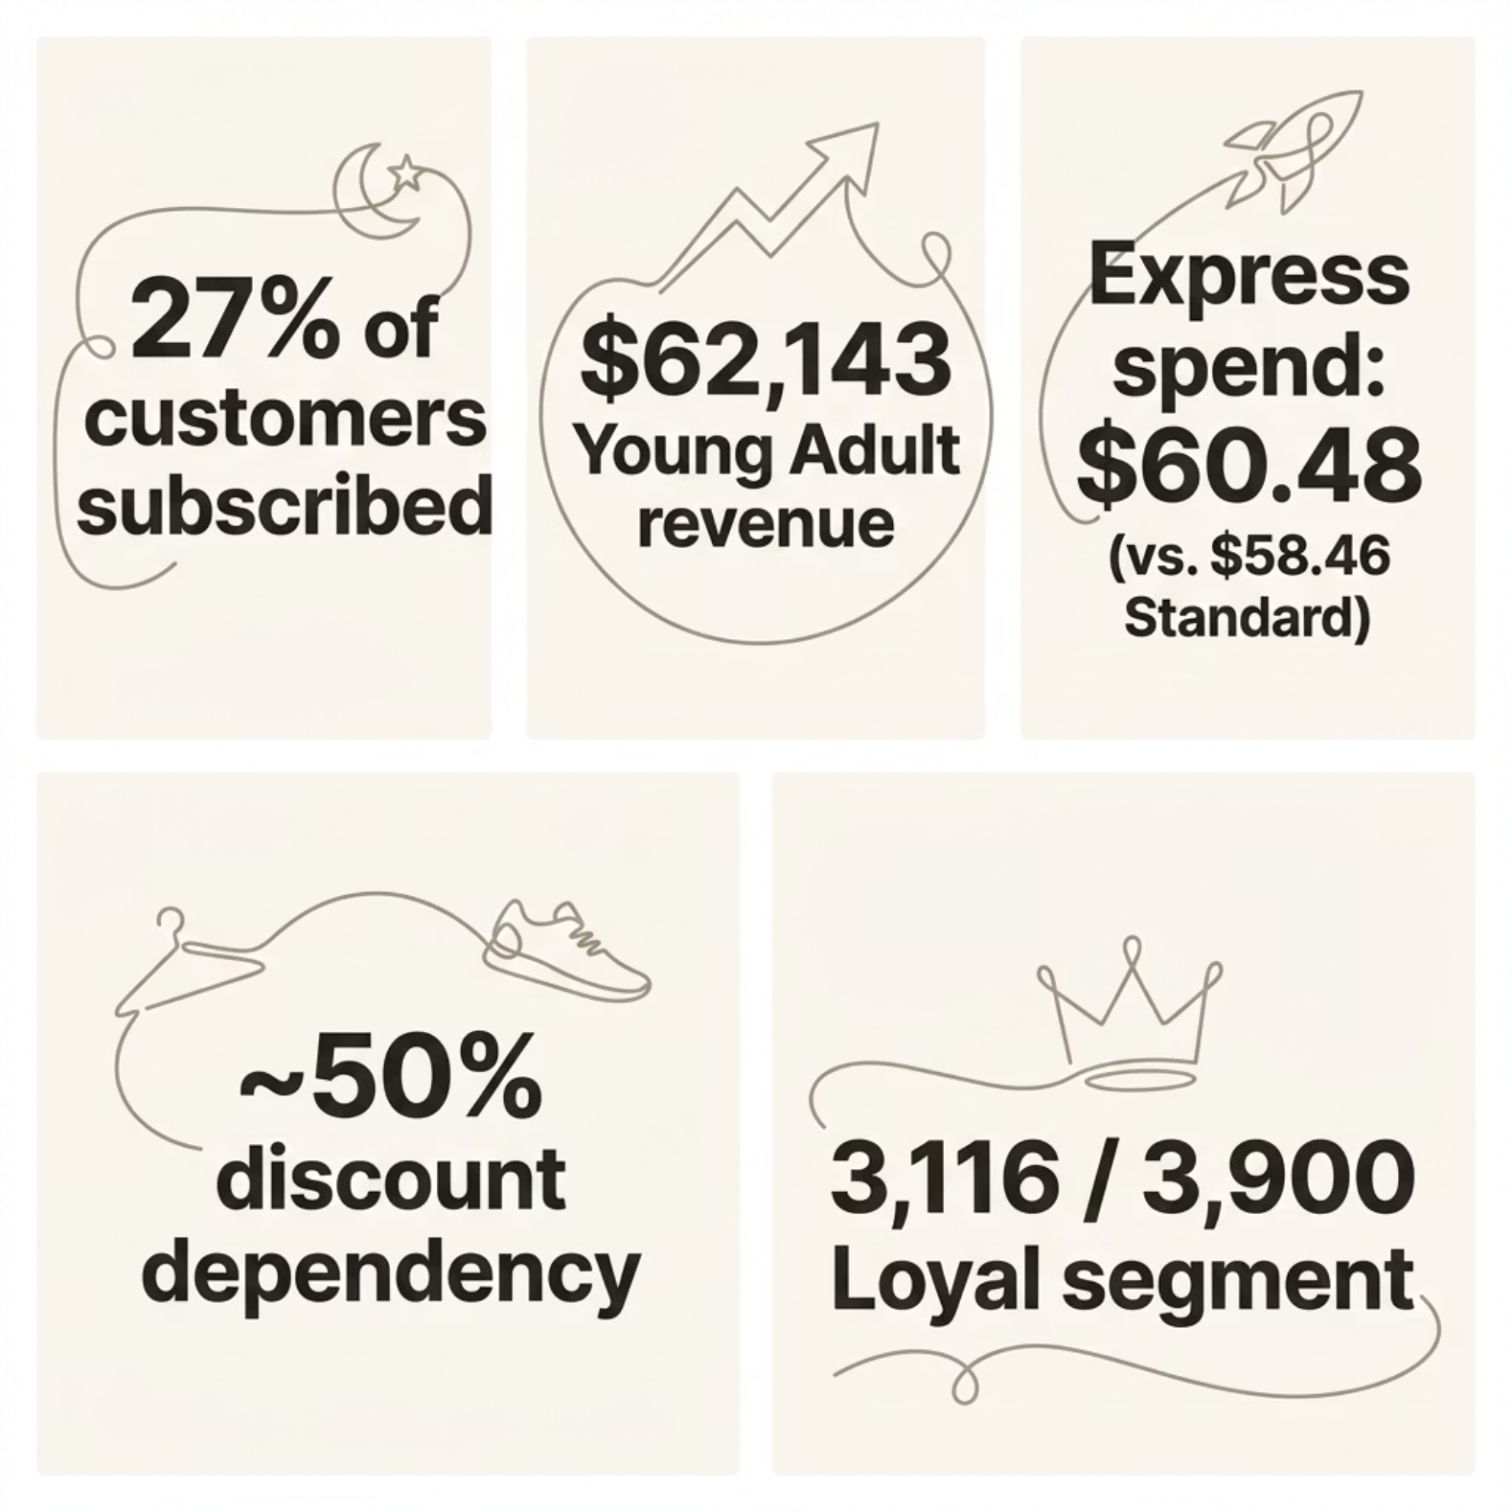
Key Findings
What the data tells us
Subscription conversion is the biggest untapped opportunity
Young Adults drive volume, not necessarily avg spend
Express shipping signals willingness to pay for convenience
Discount dependency on select products risks margins
Loyal base is strong — focus on converting Returning (701)

Slide 9
Business Recommendations
Boost Subscriptions
1
Exclusive benefits, early access, loyalty points
Loyalty Programmes
2
Target 701 Returning → Loyal
Review Discount Policy
3
Tiered or time-limited for Hat, Sneakers, Coat
Product Positioning
4
Feature Gloves, Sandals, Boots in campaigns
Target by Age & Shipping
5
Young Adults + Express premium bundles

Slide 10

Project Summary
Power BI Dashboard
PostgreSQL Analysis
Python Cleanup
From raw CSV to actionable strategy — a complete analytics workflow.
3,900 Transactions
10 SQL Queries
5 Recommendations

