Slide 1




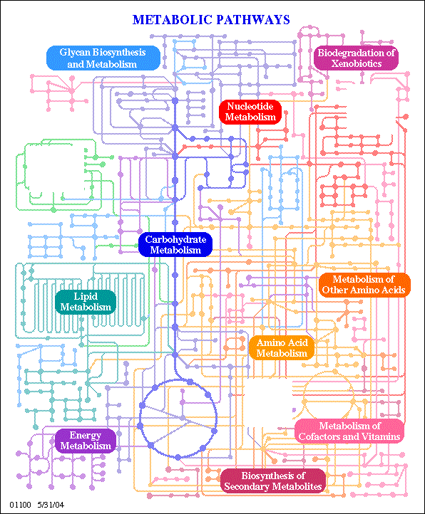


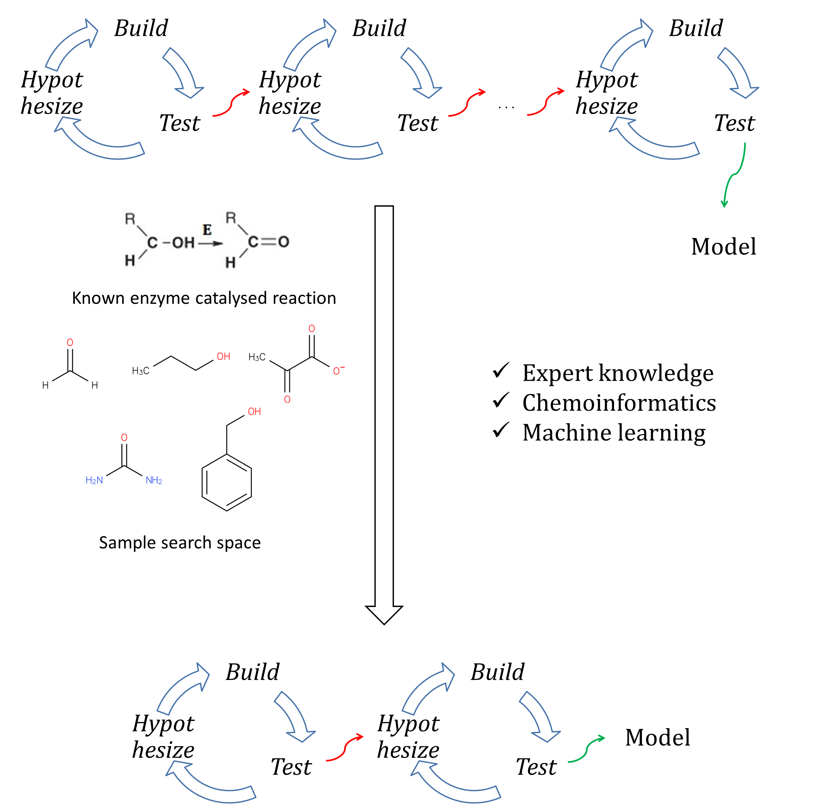

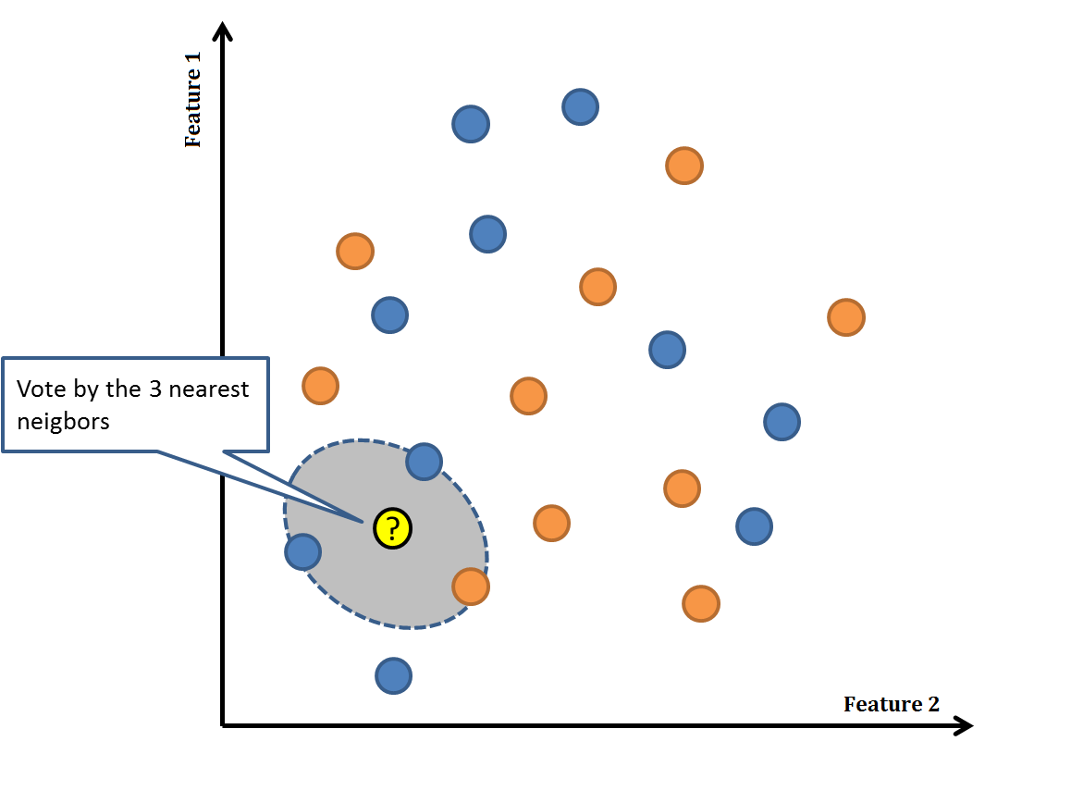
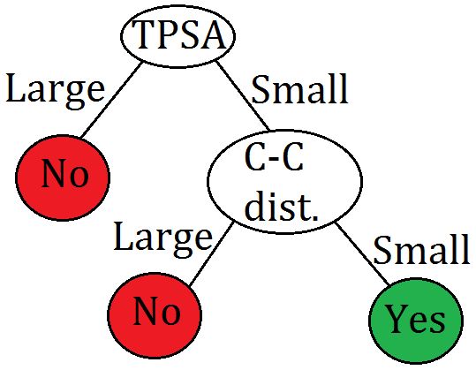
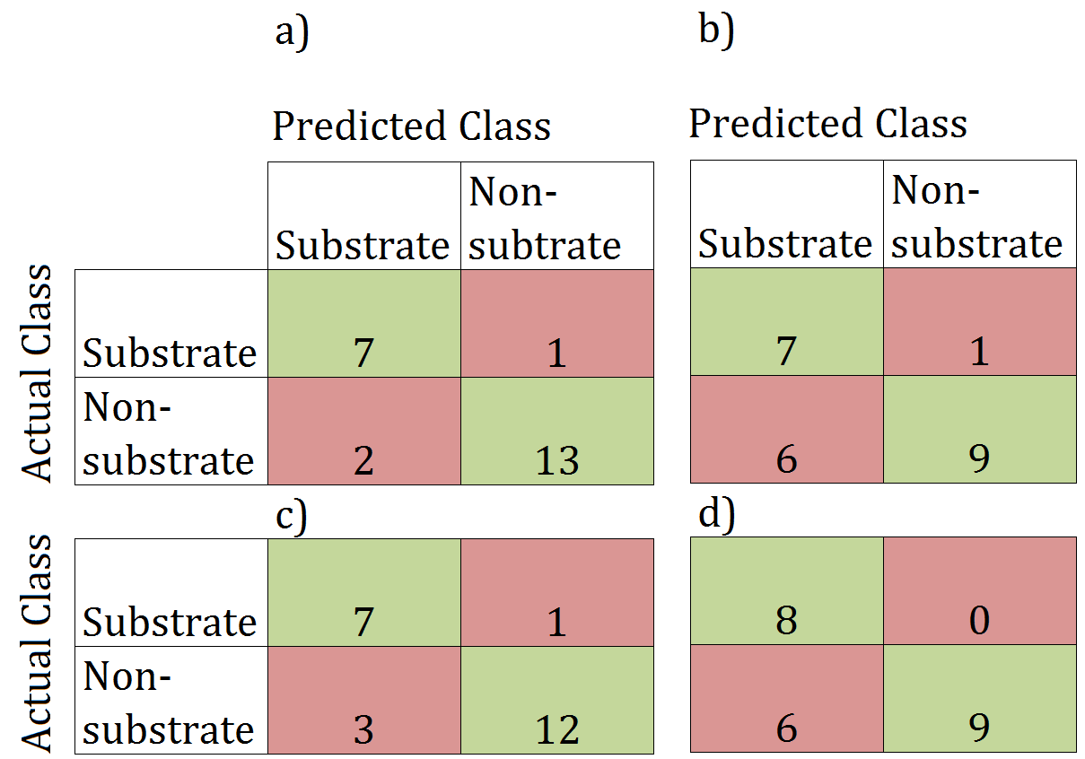
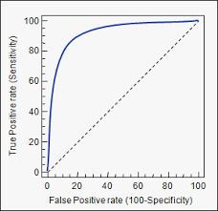
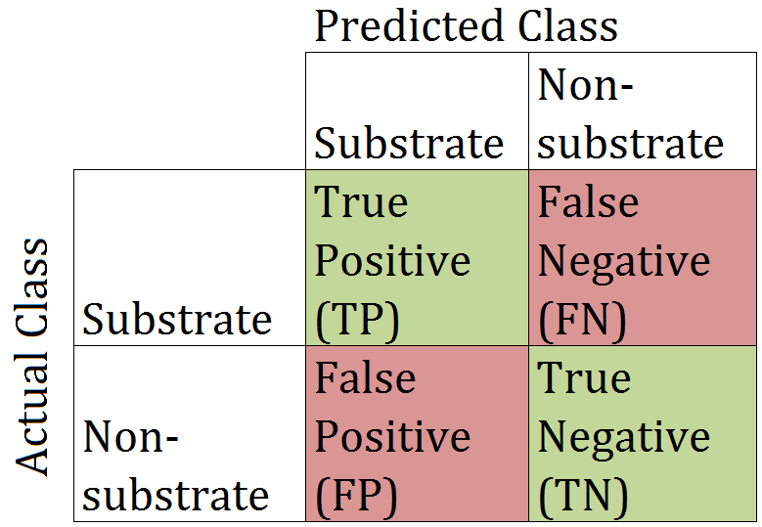
Machine learning methods as a tool to catalyze the systems biology workflow
Sanjan TP Gupta^{*1,2}, Parmesh Ramanathan³ and Jennifer L. Reed^{1,2}
¹Department of Chemical and Biological Engineering, UW-Madison, Madison, WI 53706
²Great Lakes Bioenergy Research Center, Madison, WI 53706
³Department of Electrical and Computer Engineering, Madison, WI 53706
Background:
Microbes have been engineered to overproduce a wide range of commodity chemicals
Metabolic knowledgebase is still incomplete – unable to harness full potential
Advances in synthetic biology have enabled engineering enzymes to catalyze novel reactions
.
.
.
Objectives:
Identify highly promising substrates for an enzyme
Test the novel reactions experimentally
Database of candidate reactions for each enzyme class
Challenges to be addressed:
a) b)
+
~ 1000 features
Unlabelled
Current approaches:
Fingerprint based method – uses compound similarity metrics - fast but results in many false positives [1]
Rule based methods – meaningful predictions but computationally intensive [2]
Feature selection
Choose data-points to label
Fig.4. Improving the reliability of learned models by using (a) feature selection and (b) building larger dataset by actively querying for labels
Methodology:
Computed compound based features (e.g. connectivity, stereochemistry & electronic properties)
Applied different classification based Machine Learning (ML) approaches
Analysed in terms of Receiver Operating Characteristic (ROC) curve and the number of misclassifications
Conclusions and future scope:
Preliminary results are highly promising for use of ML based approaches
Use of active learning methods might be highly beneficial for intelligently choosing the data points to label
Has huge potential to reduce the number of “design-test-build” iterations i.e. fasten SysBio workflow
Predicting novel biochemical reactions
a) b)
Results:
Table 1. Comparison of performance of different classifiers using 23 metabolites & 46 compound based features
Fig. 3. Confusion matrix indicating the number of TP, FN, FP & TN respectively for (a) J48 (b) IB1 (c) IBk with k =3 (d) IBk with k =5
Method | Correctly classified instances (out of 23 samples) | ROC Area
Decision tree (J48) | 20 | 0.796
Nearest Neighbor (IB1) | 16 | 0.738
k-Nearest Neighbor (IBk with k = 3) | 19 | 0.854
k-Nearest Neighbor (IBk with k = 5) | 17 | 0.883
Acknowledgements:
This work was funded by the U.S. Department of Energy Great Lakes Bioenergy Research Center (DOE BER Office of Science DE-FC02-07ER64494)
We would like to thank Prof. David Page, Dept. of Biostatistics & Medical Informatics and Dept. of Computer Sciences, UW –Madison for his valuable suggestions.
Fig. 1. Schematic showing (a) k-Nearest Neighbour (with k=3) and (b) Decision Tree algorithms
a) b)
References:
Mu F et al (2011) doi:10.1093/bioinformatics/btr177
Campodonico MA et al (2014) doi:10.1016/j.ymben.2014.07.009
Dong J et al (2015) doi:10.1186/s13321-015-0109-z
Fig. 2. Representative figures showing (a) ROC plot wherein True Positive Rate = TP/(TP + FN) and False Positive Rate = FP/(TN + FP) (b) Confusion matrix

