Slide 1




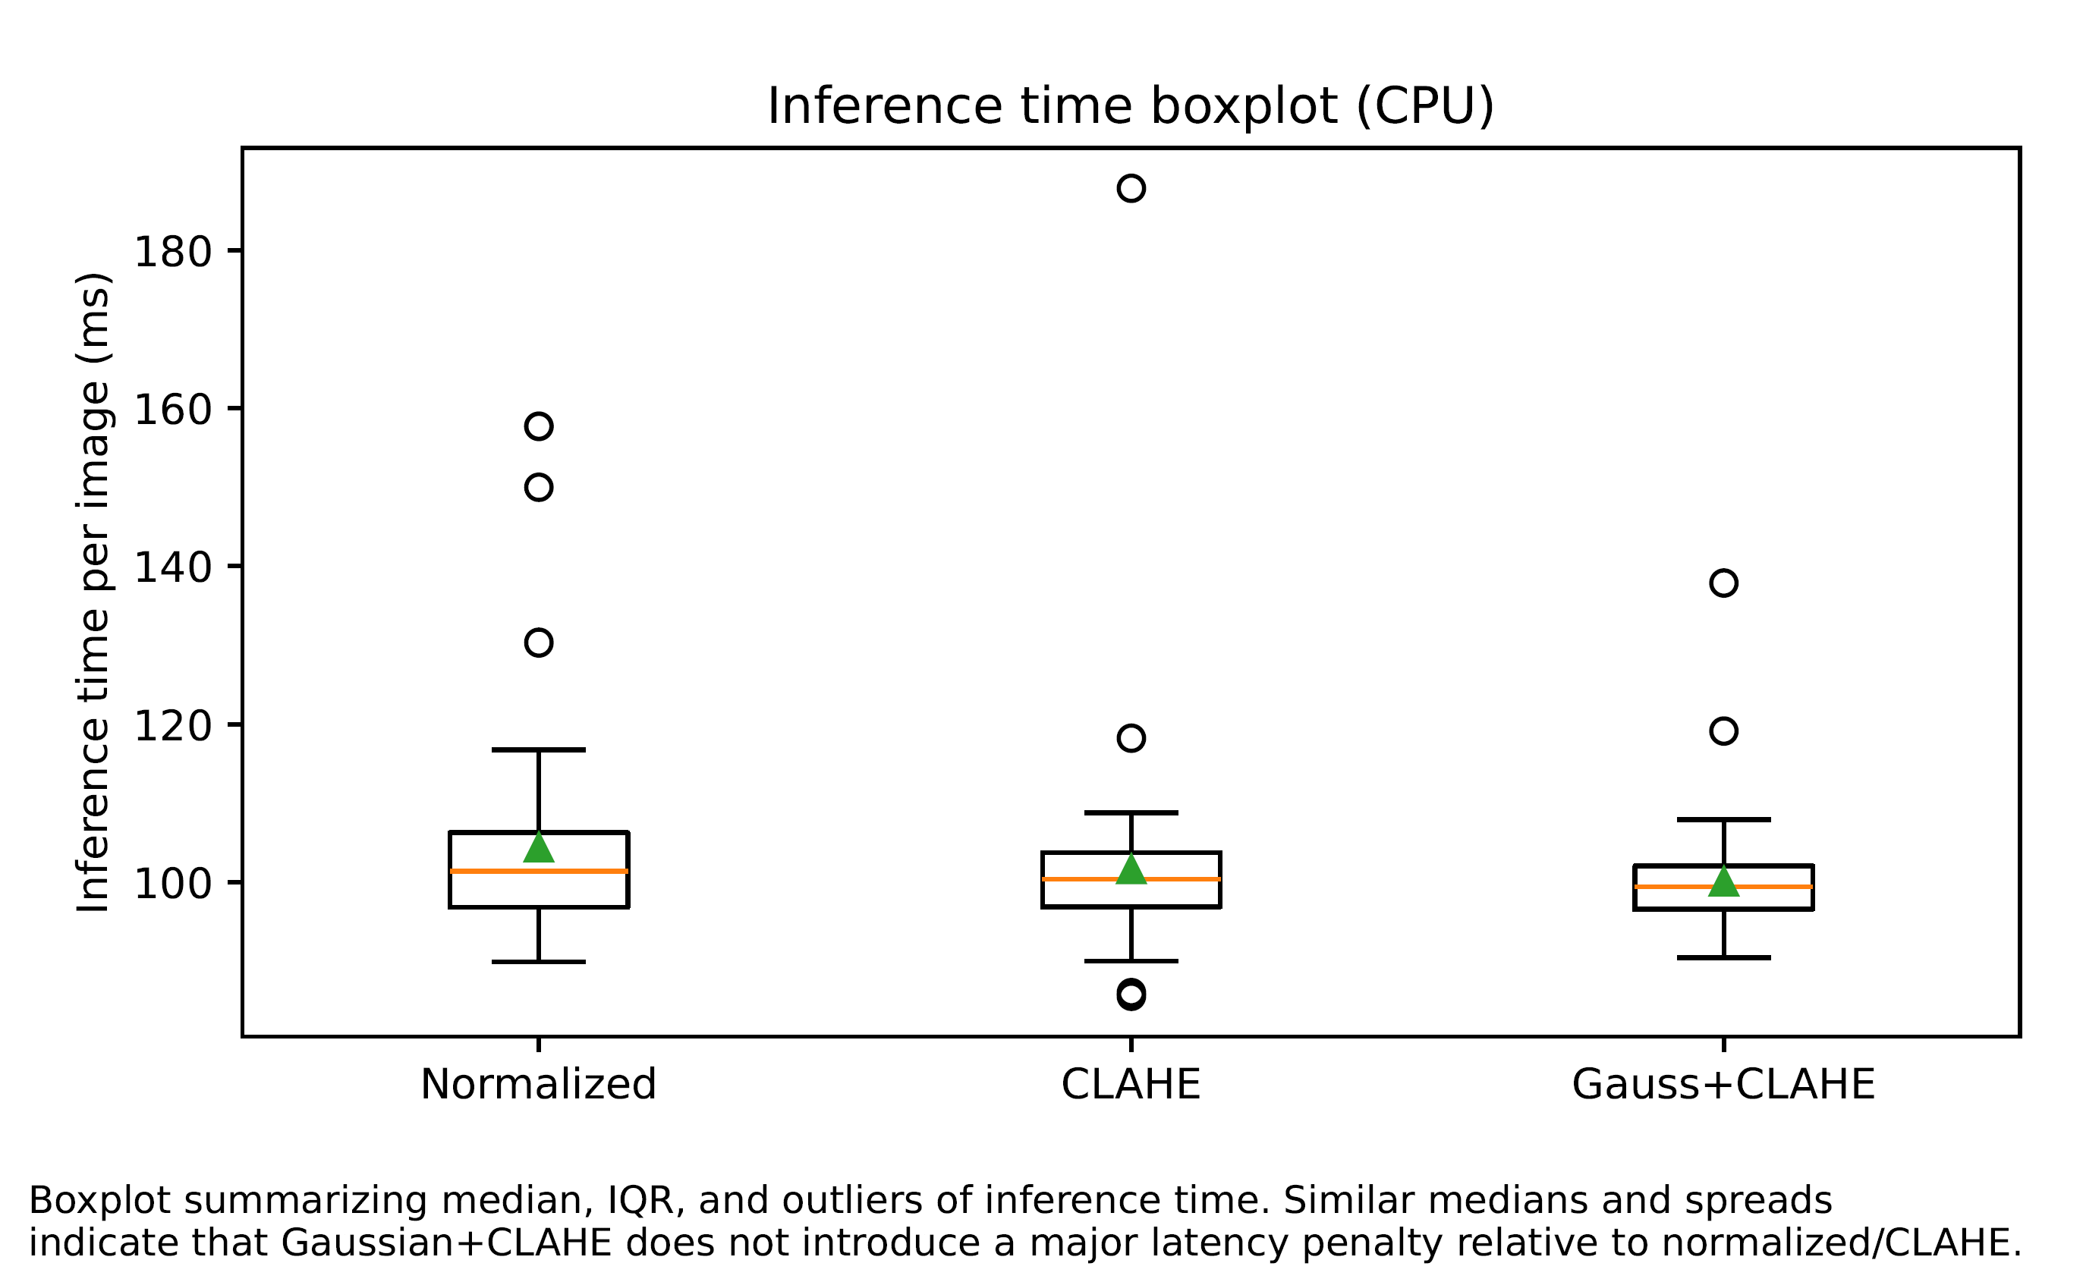
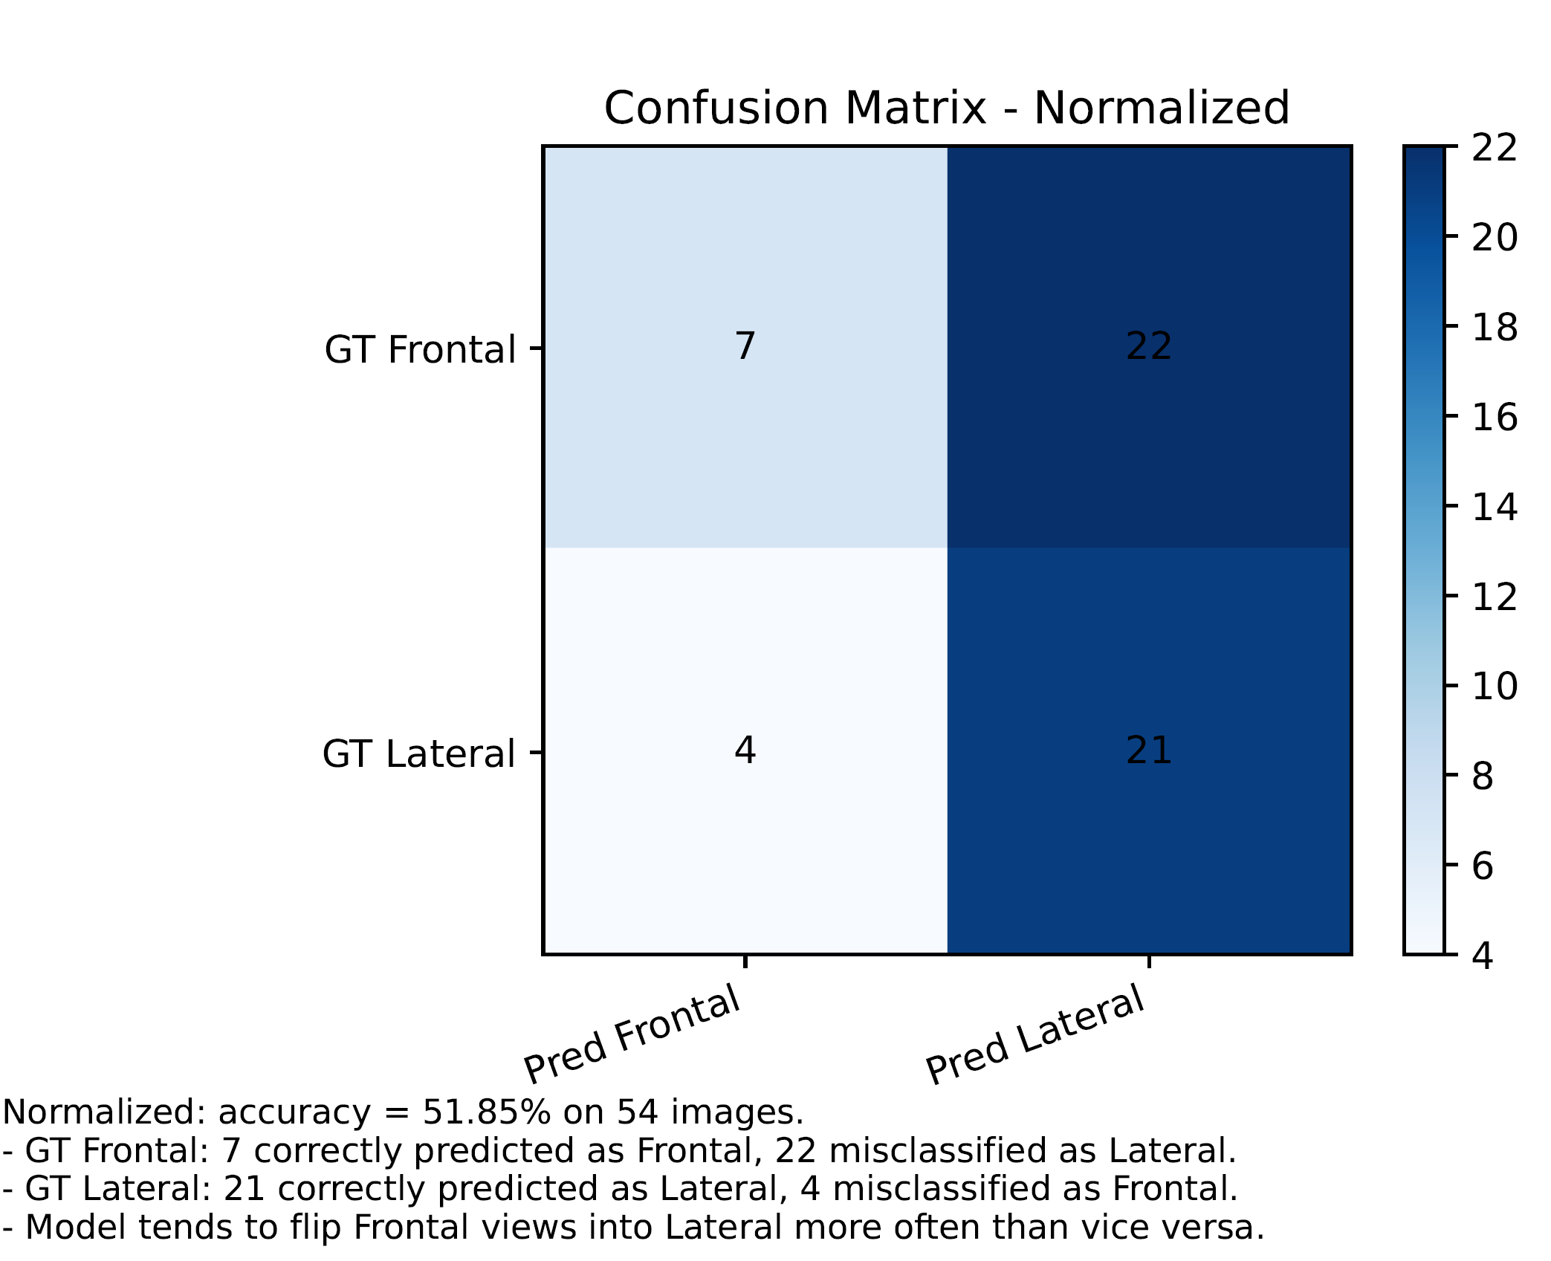
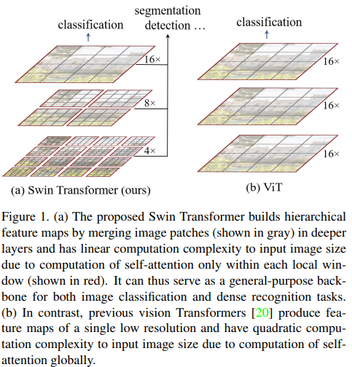
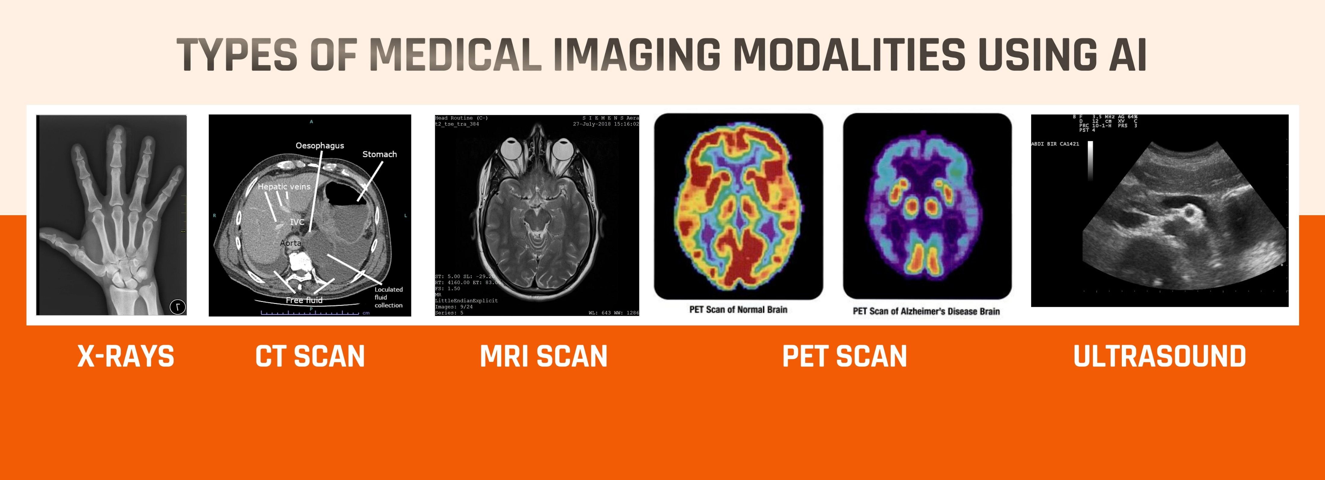

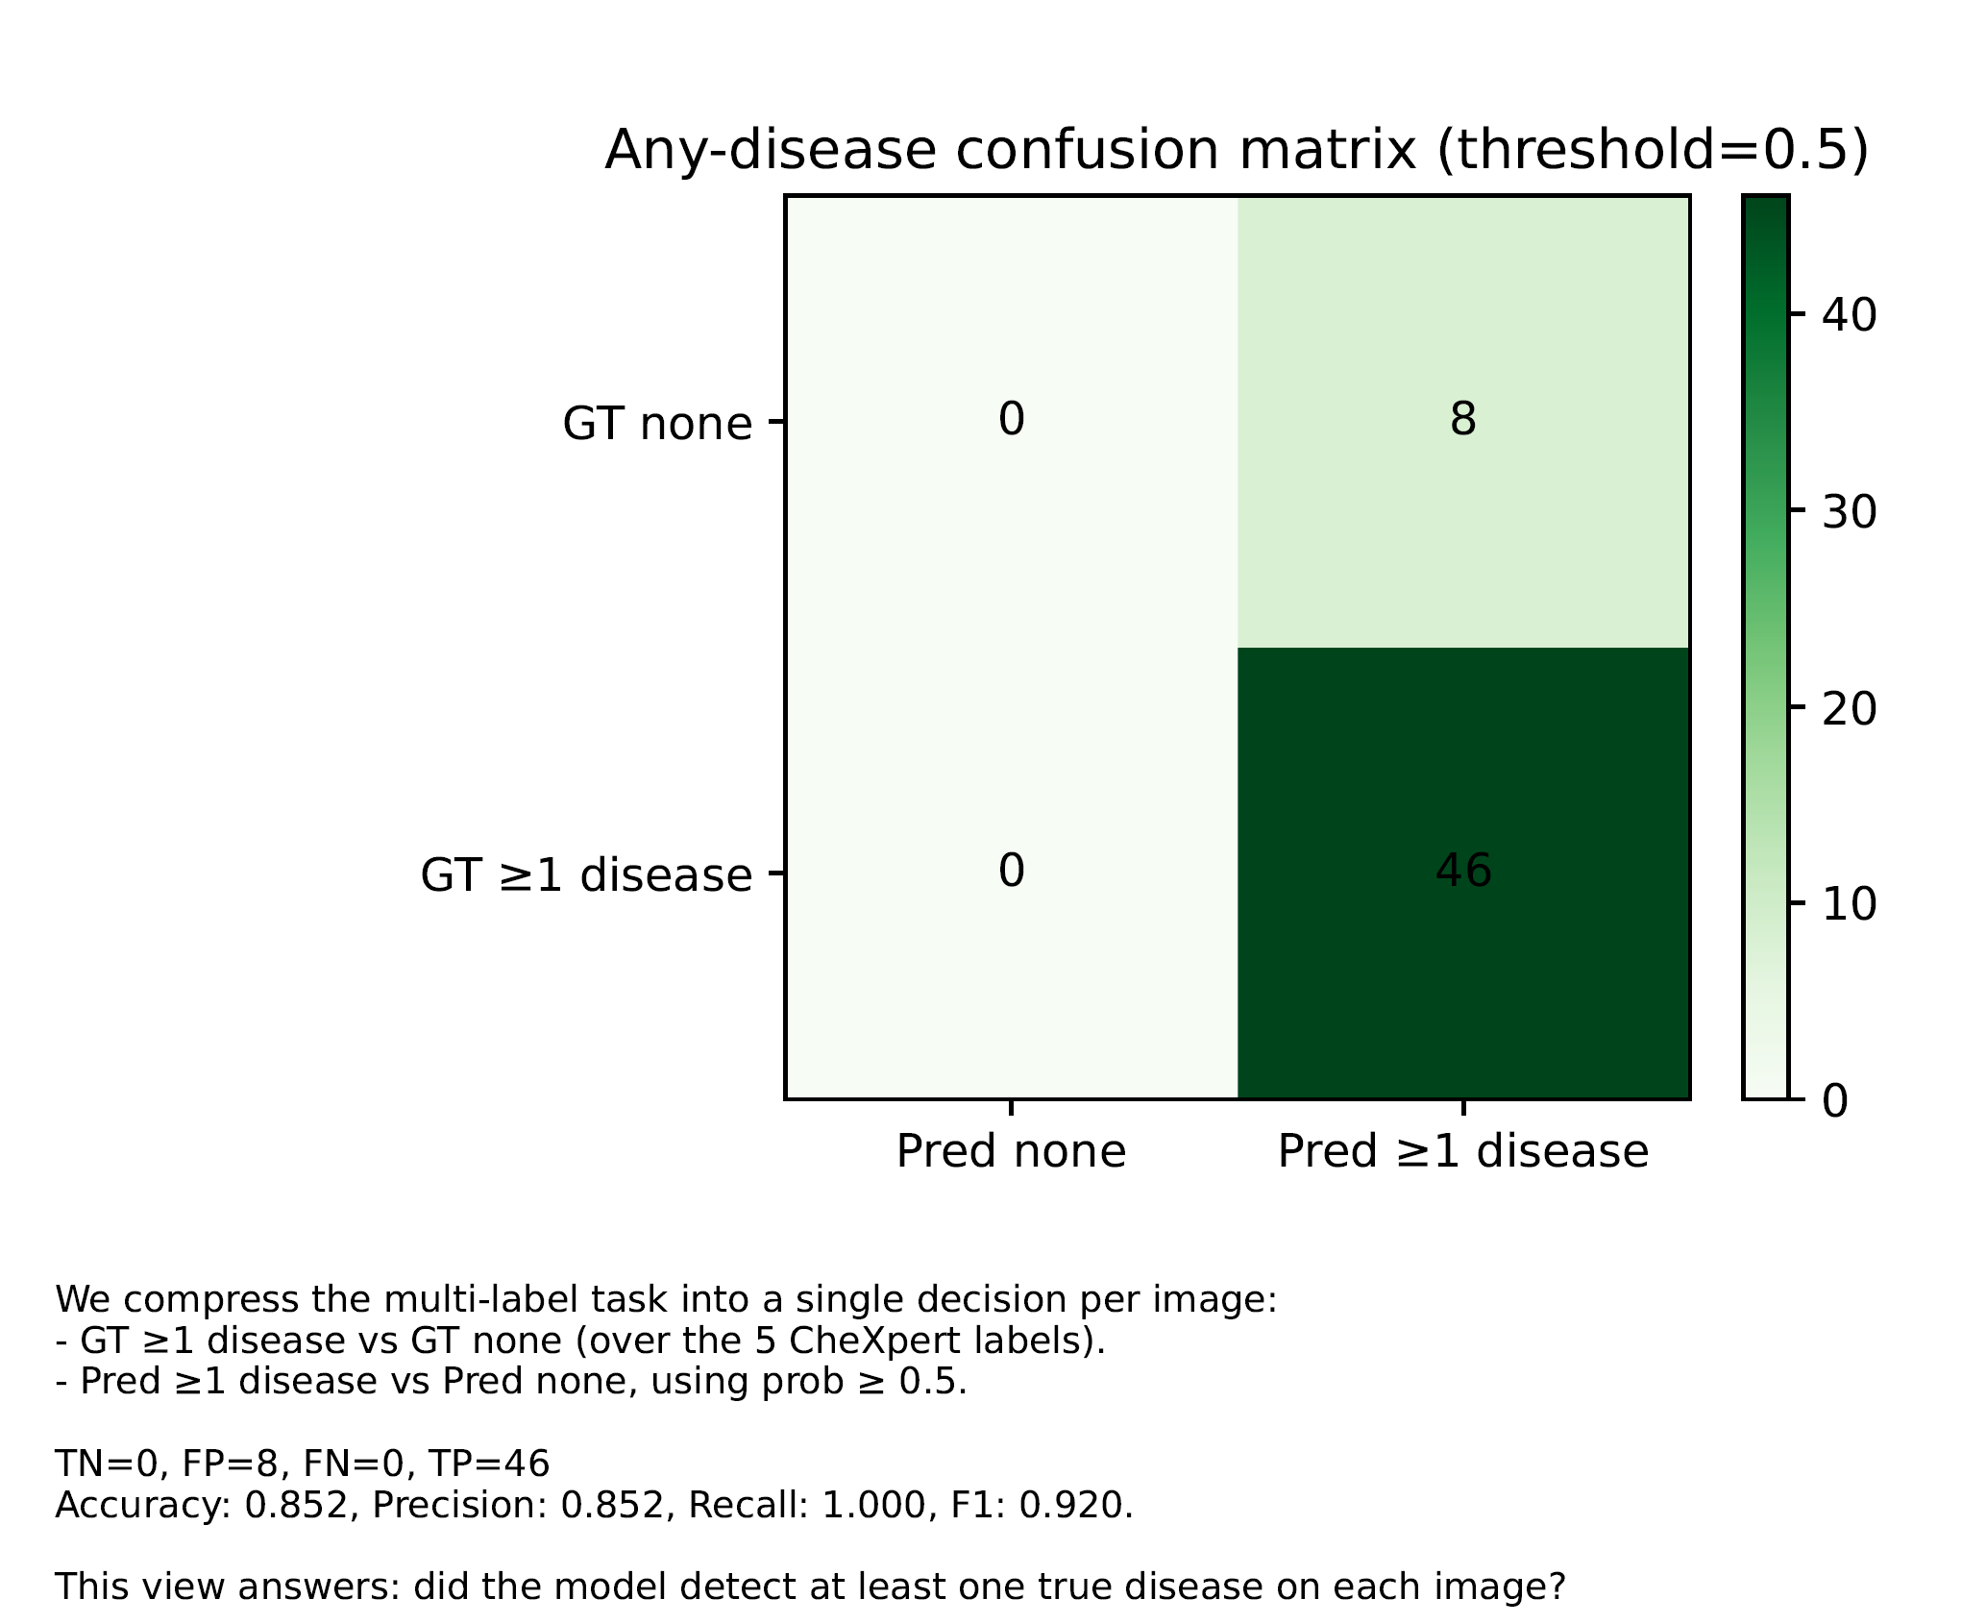
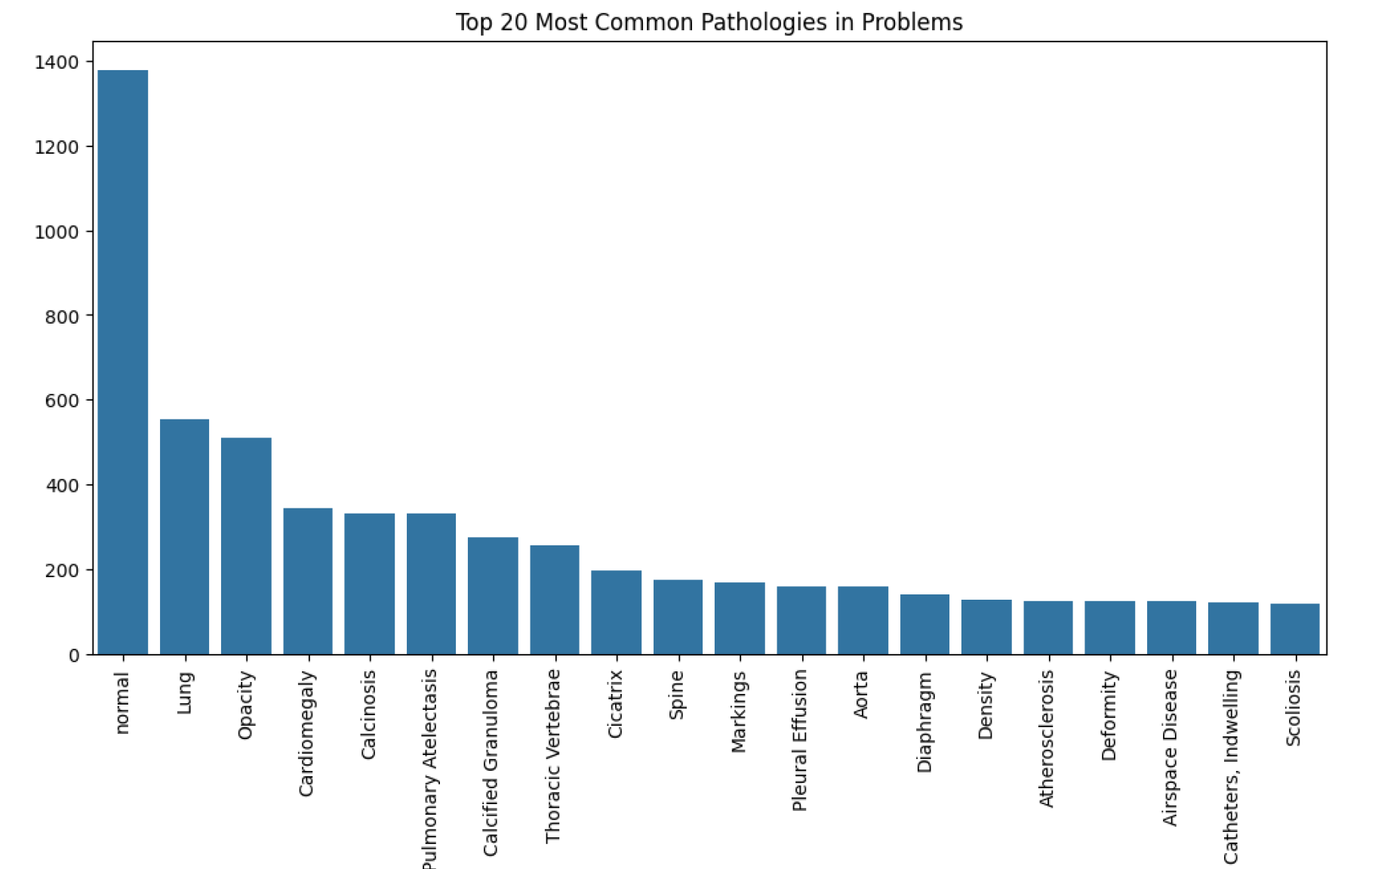
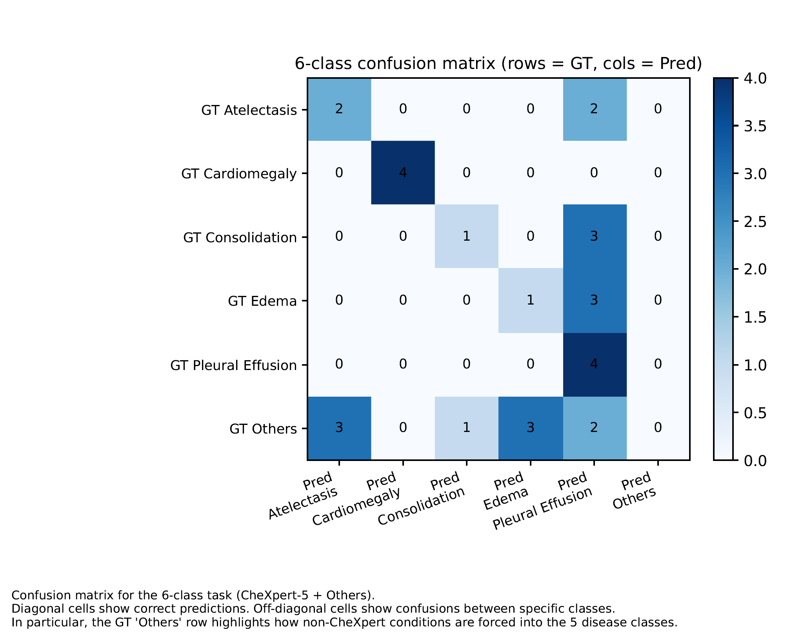
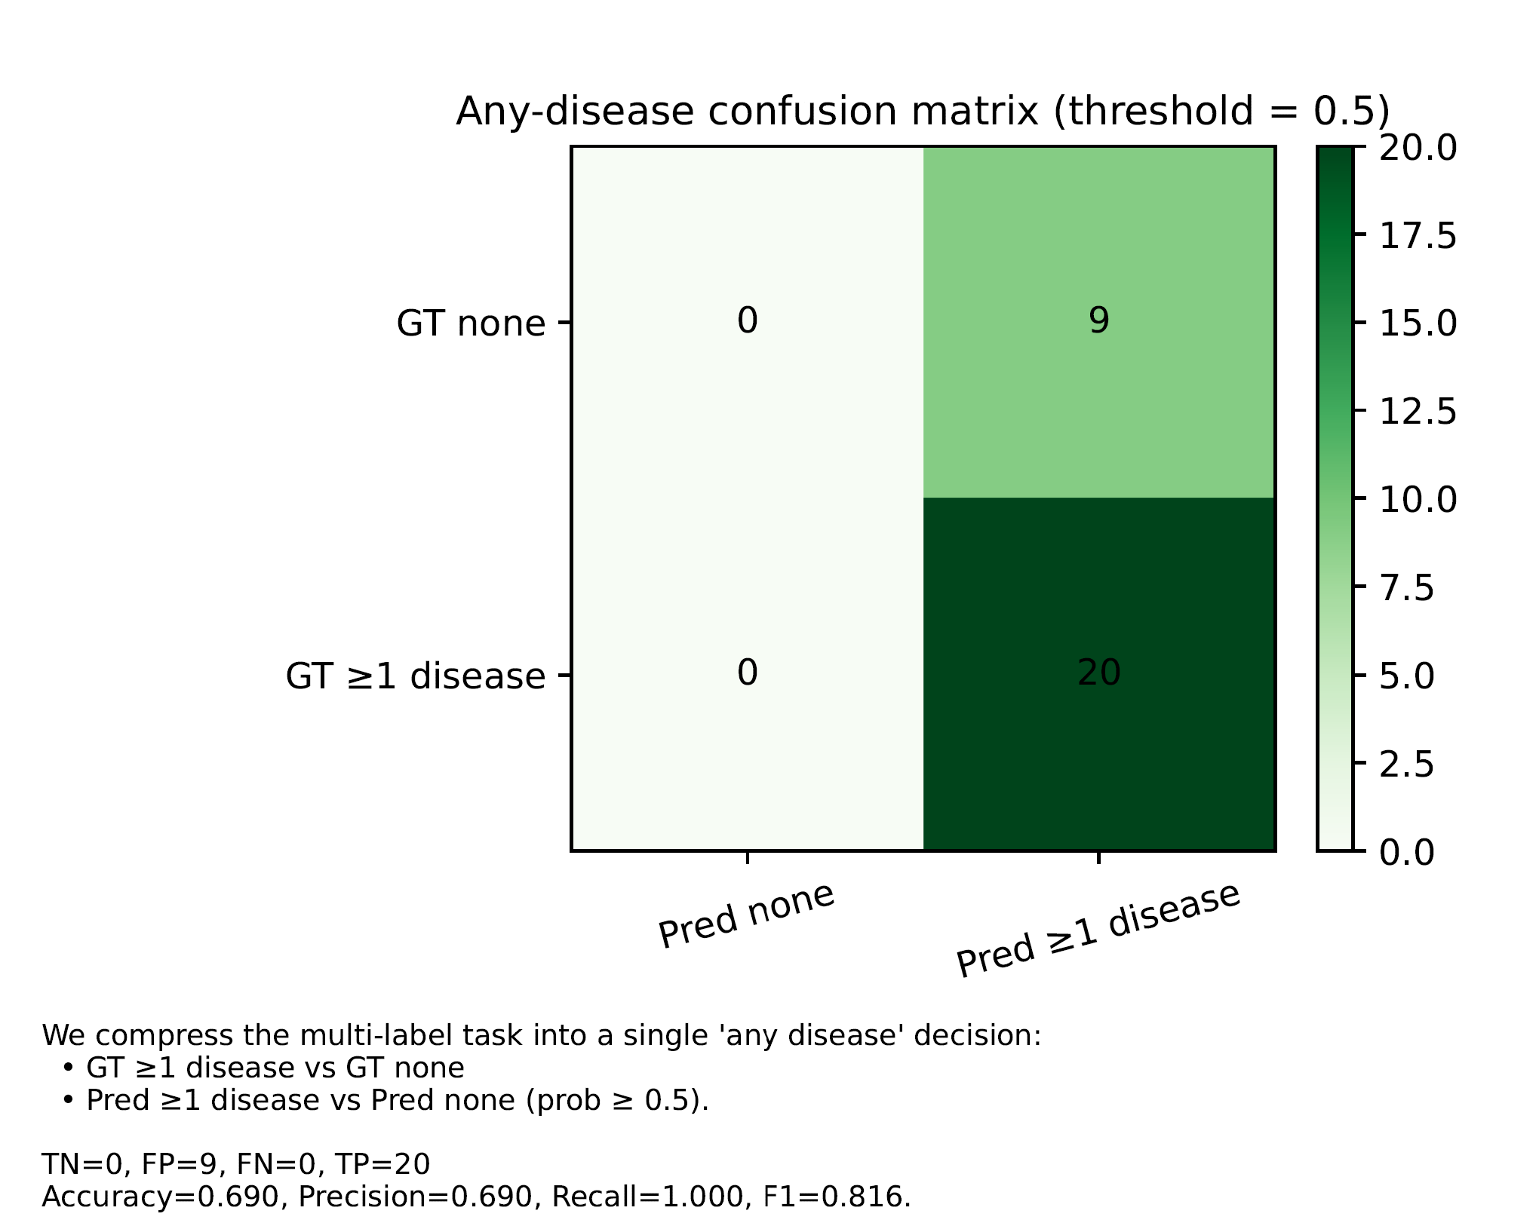
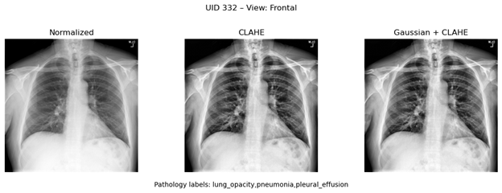


Towards Comprehensive Benchmarking of Medical Vision Language Models
Dimple Khatri¹, Sanjan TP Gupta²
¹ University of Maryland Baltimore County, USA, ² Indian Institute of Technology Madras, India
1. Background & Motivation
  Severe global radiologist shortage: India has 1 radiologist per 100,000 people, with even fewer in Tier-2/3 and rural regions.
  WHO reports complete absence of radiologists in parts of Africa, requiring tele-radiology for all interpretation.
  Even developed countries (UK, Japan, Singapore) face scan backlogs and radiologist fatigue, impacting diagnostic turnaround time.
  AI-assisted interpretation supports rapid triage, generates EHR-ready summaries, and improves diagnostic consistency.
4. Methodology
4.1 Model Architecture
  Vision Encoder – Swin Transformer:
  MedCLIP uses a hierarchical Swin Transformer backbone that computes self-attention within local windows, enabling efficient scaling to high-resolution medical images.
  Figure-3: Swin vs ViT figure here; shows local window attention and hierarchical feature maps.
  Text Encoder – BioClinicalBERT:
  A domain-tuned language model trained on clinical notes and radiology reports, providing medically grounded text embeddings.
  Alternate Vision Backbone – ResNet-50:
  Used in comparative experiments to evaluate MedCLIPVisionModel performance differences.
  Activation Function – GELU:
  Smoother and more stable than ReLU; standard in transformer-based architectures.
4.2 Zero-Shot Evaluation Pipeline
    Feed RAW X-ray images into MedCLIP.
    MedCLIP’s internal image pipeline automatically performs:
      Loading & resizing
      Center cropping
      Normalization to pretrained mean/std
      Tensor conversion
    Images and prompts (e.g., “Frontal view”, “Lateral view”, “Cardiomegaly”) are encoded into a shared contrastive space.
    Classification is computed through prompt similarity ranking or a 0.5 threshold for multi-label detection.
4.3 Preprocessing Variants (External to MedCLIP)
  To study interpretability and latency, three input variants were evaluated before MedCLIP’s internal preprocessing:
    RAW (labeled “Normalized” in figure; no external enhancement)
    CLAHE-enhanced RAW (contrast improvement)
    Gaussian Denoise + CLAHE (noise reduction + contrast)
  MedCLIP still applies its default preprocessing after these variants are passed into the model.
5. Experiments & Results
5.1 View Classification (Frontal vs Lateral)
Key Result:
MedCLIP achieves ~52% accuracy on view identification.
No significant latency difference across RAW, CLAHE, Gaussian+CLAHE variants.
Insights:
Model often flips Frontal → Lateral, but rarely the reverse.
Indicates weak global shape reasoning in zero-shot mode.
Visual enhancement steps do not add computational burden on CPU.
5.2 Multi-Label Disease Detection
Key Result:
Model shows strong ranking ability (AUROC ↑), but low specificity (many false positives).
Metrics:
Recall = 1.00 (no disease missed), Precision = 0.69–0.85,
F1 = 0.82–0.92
5.3 Single-Label Disease Classification
Key Result:
Model performs well on frequent diseases (e.g., Effusion) but poorly on rare long-tail categories.
Interpretation:
Highlights label imbalance and zero-shot limitations in fine-grained diagnosis.
5.4 Forced Single-Label Classification for 6-Class
When mapping multi-label disease predictions → 6 exclusive classes (CheXpert-5 + Others):
  Accuracy ~41%
  Heavy confusion in Others class (not modeled by MedCLIP).
Demonstrates task–model misalignment, not model failure.
6. Conclusions
  MedCLIP is strong at ranking disease likelihoods (AUROC↑).
  Threshold-based classification is weak due to over-triggering (recall↑, specificity↓).
  View classification reveals challenge in recognizing anatomical geometry.
  Strict single-label experiment highlights fine-grained limitations of zero-shot MedCLIP.
Figure-5: View classification confusion matrix (Frontal vs Lateral).
Figure-6: Inference latency boxplot for three preprocessing variants.
Figure-1: Examples of major medical imaging modalities, ranging from 2D grayscale X-rays to 3D CT/MRI volumes, PET functional scans, and real-time Ultrasound. These modalities differ in dimensionality, noise characteristics, and clinical use, motivating tailored AI approaches and the choice of X-rays as the starting point for Medical VLM benchmarking
2. Objective
Establish a Phase-1 reproducible baseline for MedCLIP using the IU-CXR dataset, focusing on zero-shot image understanding.
Evaluate how image preprocessing variants (RAW → MedCLIP preprocessing, CLAHE, Gaussian+CLAHE) affect interpretability and inference latency.
Benchmark MedCLIP across three core classification tasks:
  View Identification: Determine whether an X-ray is Frontal or Lateral.
  Multi-Label Disease Detection: Identify all diseases present in an image, allowing multiple findings per X-ray.
  Single-Label Disease Classification: Use a stratified dataset with exactly one dominant pathology per image to measure strict diagnostic accuracy.
Note: Multimodal retrieval and report summarization from the full MedVLM benchmarking framework will be introduced in Phase-2.
Figure-7: Any-disease confusion matrices (zero-shot threshold = 0.5)
3. Datasets
  IU-CXR (Indiana University Chest X-ray Dataset):
  Public dataset of paired chest X-ray images and radiology reports.
  Used for all Phase-1 experiments in this study.
  Image Characteristics:
    2D grayscale chest radiographs
    Mixture of Frontal and Lateral views
    Includes diverse pathologies and normal cases
    Raw PNGs provided in varying resolutions
  Label Sources Used:
    View labels: Derived from IU-CXR metadata
    Disease labels: Extracted using CheXpert-style keyword rules
  Custom Stratified Subset:
    Constructed to evaluate single-label disease classification
    Each image assigned one dominant pathology for strict evaluation
    Balances class distribution for fair comparison across diseases
Figure-2: Top-20 pathology histogram
Figure-8: 6-class confusion matrix [Exp. 5.4]
Figure-9: Strict single-label disease classification confusion matrix. [Exp. 5.3]
Figure-4: Visual comparison of three preprocessing variants evaluated in Phase-1: RAW (labeled “Normalized”), CLAHE-enhanced, and Gaussian Denoise + CLAHE. These variants are used only for experimental analysis; MedCLIP’s internal code still performs its default resizing and normalization during inference.
Future Works:
Expand benchmarking to additional modalities and multi-center datasets to evaluate generalization beyond IU-CXR.
Introduce full multimodal tasks such as retrieval, report summarization, and structured RadGraph grounding.
Assess trustworthiness through calibration, rare-pathology performance, and robustness to perturbations.
Explore efficiency techniques (quantization, qLoRA, adapters) to balance accuracy with latency and memory use.
Extend benchmarking experiments to CT, MRI, ophthalmology datasets.
Scan Here to connect on LinkedIn
Project Codebase Link Scan Here
**Open to research opportunities and collaborations

