Slide 1
EE-735 Assignment 4

Slide 2
Diffusion
What is diffusion?
It is defined as movement of particle from a region of higher conc. to a region of lower conc.
Diffusion is driven by concentration gradient
Observed everywhere from atoms (in doping), electrons and holes (diffusion current) to ions in bio-molecular processes.

Slide 3
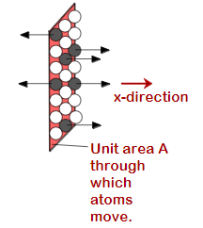
Flux
The flux of diffusing particles J is used to quantify how fast the process is.
It is defined as no of particles diffusing per unit cross-sectional area per unit time.
J=(1/A)dN/dt

Slide 4

Fick’s First Law (steady-state diffusion)
The diffusion along a fixed direction is proportional to the concentration gradient.
where D is the diffusion coefficient called Diffusivity.it is a material property.
The minus sign indicates that the diffusion is in the direction of decreasing concentration.

Slide 5
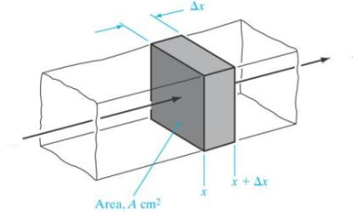


Fick’s Second Law (Non-steady state diffusion)
If a flux of particles in entering at x at time t and leaving at x+Δx at
time t+Δt
The concentration change
dC= (J(x+Δx)-J(x))dtA /Adx
This reduces to

Slide 6



The diffusion equation
The diffusion equation is
(3-D)
where D is diffusivity.
If the concentration is time-independent the equation reduces to
Continuity equation

Slide 7


Solving the equation numerically
The diffusion equation
Any differential equation of the type
Of(x)=g(x)
where O is the differential operator f(x) is the response and g(x) is the source . If g(x)=0 the equation is homogeneous.
There can be various sources of non-homogeneity

Slide 8




The equation can be written numerically
So diffusion equation becomes
Where i and m are indices in position domain and time domain.
For some source the equation will become

Slide 9

Problems
Solve the diffusion equation for the case of delta source ? Two kinds of solution exist analytical and numerical, compare both the solution.
The analytical solution is
Start with diffusion equation
Write it in the form of Of(x)=g(x)

Slide 10


Contd..
Let here the source term be a delta function in space at time t=0
To find the impulse response take fourier transform of spacial co-ordinates
The equation becomes
The solution is

Slide 11

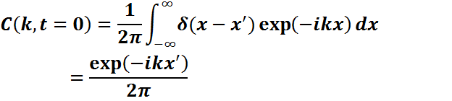


Putting initial condition at t=0
C(k,t=0) is nothing but the fourier transform of the point source.
The C(x,t) is the inverse fourier transform of C(k,t)
The integration gives

Slide 12
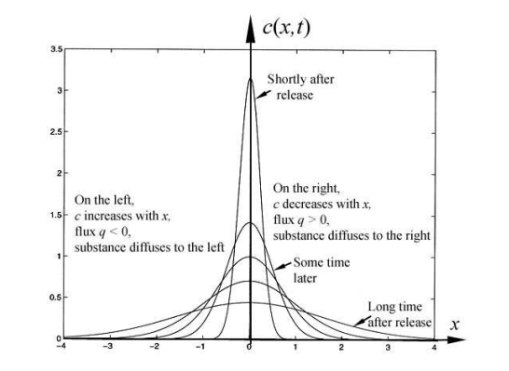

Slide 13

If you know the impulse response we can find the solution for any source by a simple integration.
Suppose we have an infinite source at g(0,t)=M for all t>0
Solve the integral, report the answer analytically and compare it with the numerical solution.
Answer : C(x,t) will be complementary error function.

