Slide 1
BUSINESS INTELLIGENCE REPORT
Adventure Works
Sales Performance Analysis
FY 2017–2020 | B2B Sales Analytics | AdventureWorks Dataset
Prepared by: Data Analytics Team | May 2026

Slide 2
Executive Summary
Key Performance Indicators | FY 2017–2020
$77.5M
$77.0M
$1.0M
1.3%
3,616
Total Revenue
Total Cost
Net Profit
Profit Margin
Total Orders
KEY FINDINGS
📈
Revenue grew 202% from 2017→2018 and 34% from 2018→2019
🏆
Bikes category dominates with 83% of total revenue ($64M)
🌎
United States leads with $52M (67% of total) followed by Canada ($13.9M)
👤
Top performer: Linda Mitchell at $10.2M — 13% of all sales
🏭
Warehouse channel drives 48% of revenue ($37.4M)
⚠️
2020 shows a sharp -61% decline — requires further investigation

Slide 3
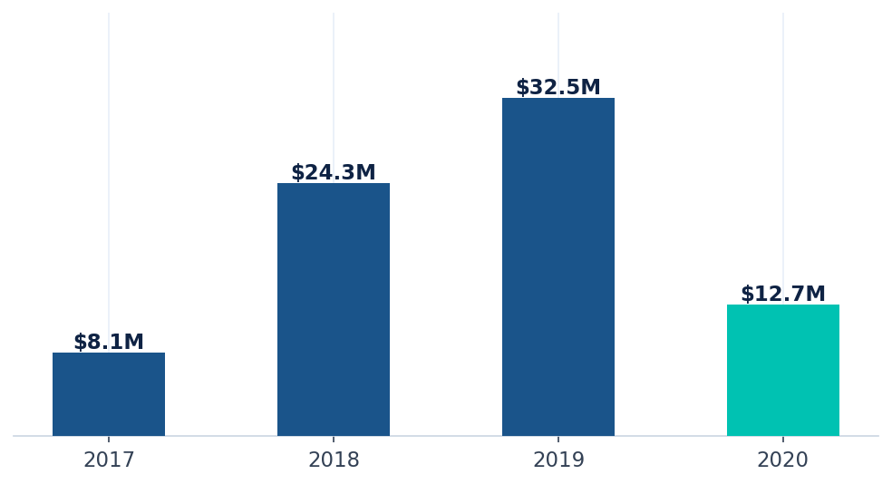
Revenue Trends
Year-over-Year Sales Performance | FY 2017–2020
+201.5%
Growth: 2017 → 2018
+33.6%
Growth: 2018 → 2019
-61.1%
Decline: 2019 → 2020
$32.5M
Peak Year: 2019
* 2020 data appears partial (Jan–Jun) which explains the sharp decline

Slide 4
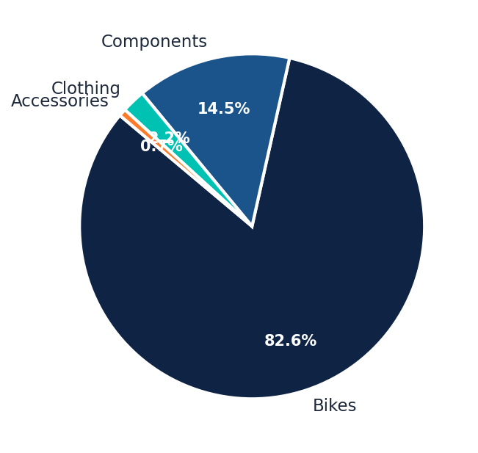
Product Category Analysis
Revenue breakdown by product category and subcategory
Top Subcategories by Revenue
Road Bikes
$28.7M
Mountain Bikes
$25.9M
Touring Bikes
$9.5M
Mountain Frames
$4.5M
Road Frames
$3.7M
📌 Category Insight
Bikes dominate with 83% of revenue. Components add 14%, while Clothing & Accessories are growth opportunities.

Slide 5
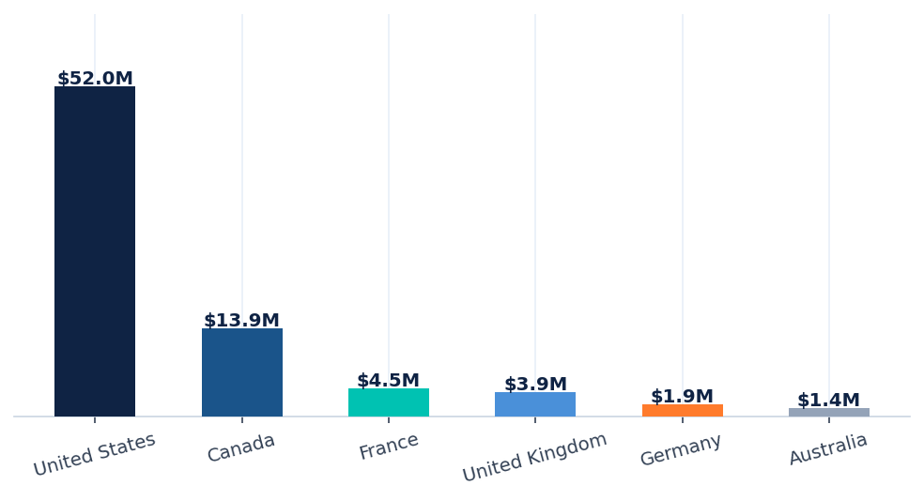
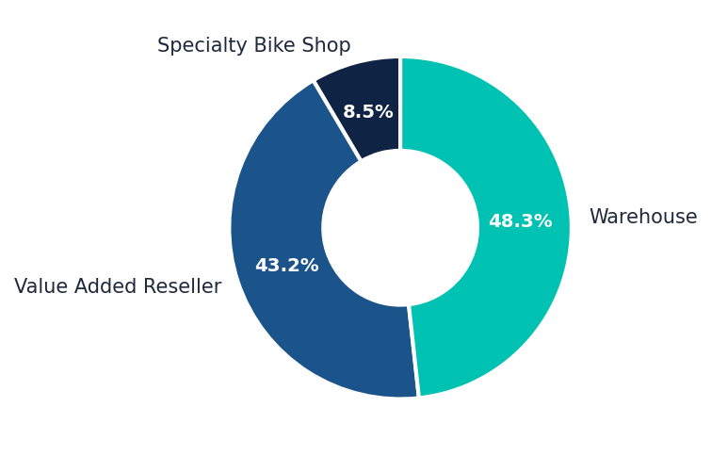
Regional Sales Performance
Revenue distribution by country and business channel
Country
Revenue
Share
Channel Distribution
United States
$52.0M
67.0%
Warehouse: 48% | Value Added: 43% | Specialty: 9%
Canada
$13.9M
17.9%
France
$4.5M
5.8%
United Kingdom
$3.9M
5.0%
Germany
$1.9M
2.4%
Australia
$1.4M
1.8%

Slide 6
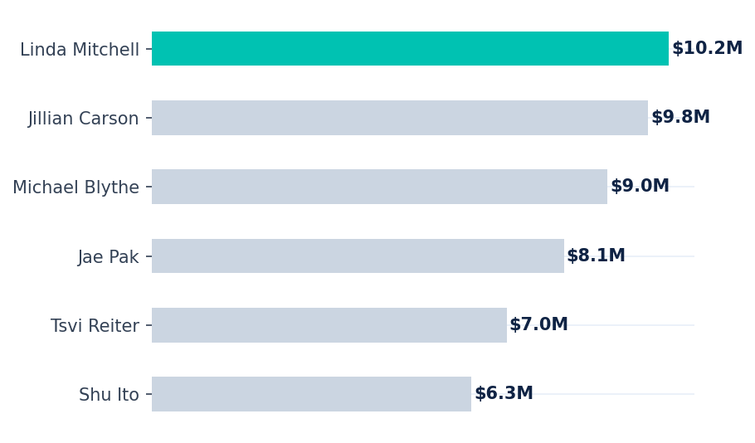
Salesperson Performance
Top 6 sales representatives by revenue generated
🏆 Top Performers Leaderboard
#1
Linda Mitchell
$10.2M (13.1%)
#2
Jillian Carson
$9.8M (12.6%)
#3
Michael Blythe
$9.0M (11.5%)
#4
Jae Pak
$8.1M (10.4%)
#5
Tsvi Reiter
$7.0M (9.0%)
#6
Shu Ito
$6.3M (8.1%)

Slide 7
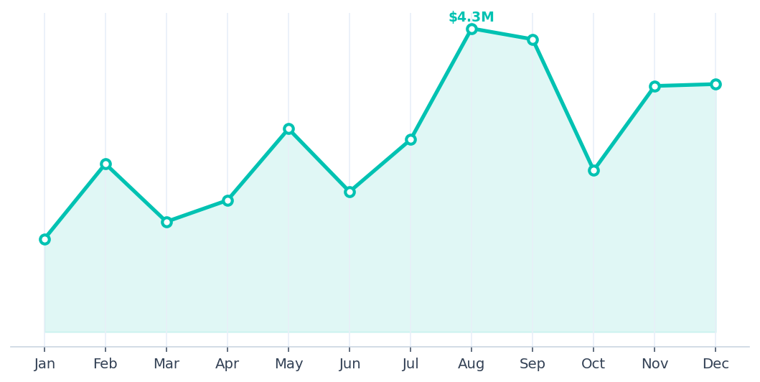
Monthly Sales Trend — FY 2019
Monthly revenue breakdown for peak year 2019
📊 2019 Highlights
📅 Peak Month
August: $4.3M
📅 Low Month
January: $1.3M
📈 H2 vs H1
H2 was +18% stronger
📊 Avg/Month
$2.7M monthly avg
💡 Trend
Strong Q3–Q4 surge
2019 Quarterly Breakdown
Q1
Q2
Q3
Q4
$5.3M
$6.7M
$11.2M
$9.3M
+18% YoY
+22% YoY
Peak quarter
Strong close

Slide 8
Recommendations & Next Steps
Data-driven actions to drive growth and optimize performance
🎯 Diversify Product Portfolio
📊 Investigate 2020 Revenue Drop
Clothing (2.2%) and Accessories (0.7%) are heavily under-monetized. Launch targeted promotions and bundle strategies to grow non-Bikes revenue to 25%+ within 2 years.
The 61% year-over-year decline warrants a full post-mortem — check if data is partial, or if macro / competitive factors are at play. Ensure CRM data completeness.
🌍 Expand into Emerging Markets
👥 Accelerate Top-Performer Learnings
Germany (2.4%) and Australia (1.8%) show low penetration despite strong bike culture. Targeted go-to-market plans with local reseller partnerships could unlock $5M+ in additional revenue.
Linda Mitchell and Jillian Carson collectively drive 25% of revenue. Document their sales playbooks, identify coaching opportunities for mid-tier reps, and close the performance gap.
🤝 Grow Specialty Bike Shop Channel
🔄 Investigate Margin Pressure
Only 9% of revenue comes from Specialty shops, which command higher margins. Strengthening these relationships with exclusive products and incentive programs could shift channel mix.
A net margin of just 1.3% on $77.5M revenue is critically thin. A granular cost analysis by product and channel is urgently needed to protect profitability.

Slide 9
Thank You
Adventure Works | Sales Analytics Report | FY 2017–2020
Data Source: AdventureWorks B2B Dataset Prepared by: Data Analytics Team | May 2026
57,851
3,616
701
18
Sales Transactions
Unique Orders
Active Resellers
Sales Reps

