Slide 1


Duke vs. Boilerplate. Epic battle.

Slide 2
How cope with situation when a project is full of non-functional, boilerplate code? Getters/Setters, logging, NPE validation, exception handling – it makes difficult to read the code, understand the core business logic, support and extend functionality. Tend to write as little code as you can, isolate different aspects of code in special places is a good habit. This workshop is not only about some technics, but about way of thinking and coding.

Slide 3
Table of Contents
1
What is the boilerplate code? What is the ideal code?
2
Samples of boilerplate code
3
4
Patterns
5
Lombok project
6
7

Slide 4
What is the boilerplate code? What is the ideal code?
What are the attributes (features) of good code?
What is the boilerplate code?
What tools, technics, methods we have to achieve it?
Samples of boilerplate code
Getters/Setters
Constructors
toString, equals/hashCode
Unnecessary validations
Builders
Try/catch
Logging
NPE checks

Slide 5
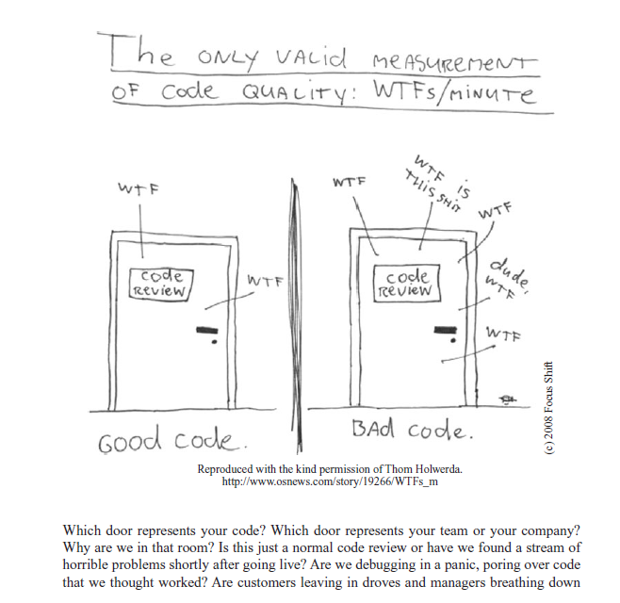
“Clean Code” by Robert Martin

Slide 6
Samples of boilerplate code
com.three60t.otc.reportingapi.models.ems.QuoteData
com.three60t.integration.orderapi.models.tradeintention.TradeIntention
com.three60t.marketdatasource.base.MockConsumer
com.three60t.api.models.config.autodealer.routing.AutoDealerTreeConfiguration.Builder
com.three60t.otcreporting.ems.negotiation.RelationProperties

Slide 7
Patterns
Hierarchy of inheritance;
Template method;
Strategy;
Composite;
Command;
Event/Event Listener;
Abstract factory;
Factory method;
Delegate;

Slide 8
Project Lombok
<dependency> <groupId>org.projectlombok</groupId> <artifactId>lombok</artifactId> <version>1.18.2</version> <scope>provided</scope> </dependency>
https://projectlombok.org/ https://github.com/dimpon/fight-boilerplatecode-tutorial
Annotation processor for auto generation boilerplate code in compile time, It implements patterns, reduces complexity, increases readability.
Getters/Setters
Constructors
Equals/hashCode, toString
Builder
Loggers
NPE checks
Cleanup, SneakyThrows
Accessors, FieldDefaults, UtilityClass
Delegate
Usage in real code

Slide 9
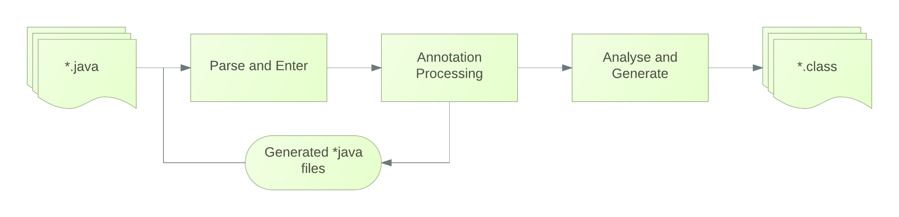
A Theory.
RetentionPolicy.SOURCE
Annotation Processor scans code in compile time and process annotations with RetentionPolicy.SOURCE
Lombok reads annotation and patches AST. Actually, creates java code before final compilation.

Slide 10
Setup a project
WIFI: QH85!Tr3t2
mvn archetype:generate -DgroupId=com.boilerplate.tutorals -DartifactId=boilerplate-tutoral -DarchetypeArtifactId=maven-archetype-quickstart -DinteractiveMode=false https://projectlombok.org/setup/intellij
https://projectlombok.org/setup/eclipse
<dependency> <groupId>org.projectlombok</groupId> <artifactId>lombok</artifactId> <version>1.18.2</version> <scope>provided</scope> </dependency>
<dependency> <groupId>org.slf4j</groupId> <artifactId>slf4j-api</artifactId> <version>1.7.25</version> </dependency> <dependency> <groupId>org.slf4j</groupId> <artifactId>slf4j-simple</artifactId> <version>1.7.25</version> </dependency>

Slide 11
Let’s go coding!
Play with DTO classes. https://github.com/dimpon/fight-boilerplatecode-tutorial/tree/master/src/main/java/com/dimpon/tutorals/lombok/dto
Small task: write Singleton.
NPE
https://github.com/dimpon/fight-boilerplatecode-tutorial/tree/master/src/main/java/com/dimpon/tutorals/lombok/npe Small task: Add @NotNull to DTO
val & var https://github.com/dimpon/fight-boilerplatecode-tutorial/tree/master/src/main/java/com/dimpon/tutorals/lombok/valandvar

Slide 12
Builders
https://github.com/dimpon/fight-boilerplatecode-tutorial/tree/master/src/main/java/com/dimpon/tutorals/lombok/builders Small task: create builder which contain some configuration.
Delegates
https://github.com/dimpon/fight-boilerplatecode-tutorial/tree/master/src/main/java/com/dimpon/tutorals/lombok/delegation
Utilities & Miscellaneous
https://github.com/dimpon/fight-boilerplatecode-tutorial/tree/master/src/main/java/com/dimpon/tutorals/lombok/ulility

Slide 13
Real task
You have a map of keys-values (FIX data?) you need to build new DTO object, based on these Map.
Write transformer class, which accept source object and return result object. The transformation must be split on independent granular reusable functions. The types of object
are any. The transformer must be type safe – the function for another types can not be used by mistake.
How can we improve it?
…………..
Wrap you logger object to the wrapper in order to be lazy initialized. (the object of real logger can be created only if some method is invoked)
How can we create a lazy-init wrapper for arbitrary class?

