Slide 1
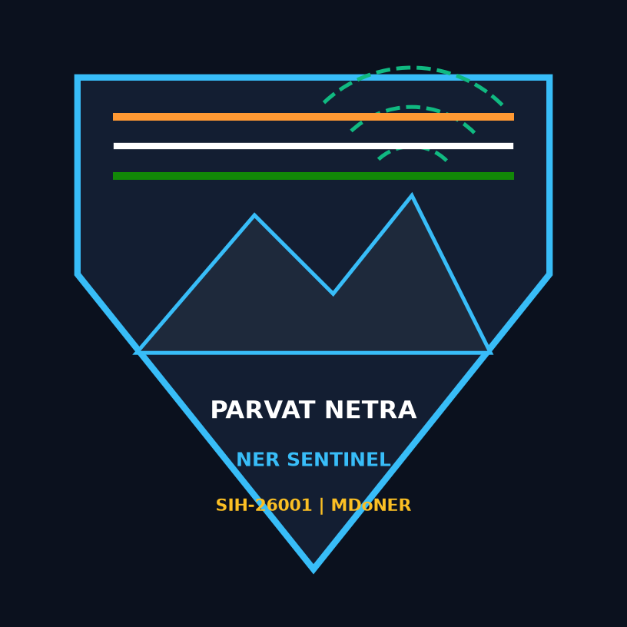
SMART INDIA HACKATHON 2026 | MINISTRY OF DEVELOPMENT OF NORTH EASTERN REGION (MDONER)
PARVAT NETRA (पर्वत नेत्रा) -- National Landslide Intelligence Platform
AI-Based Landslide Early Warning, Geotechnical Fusion & Lifeline Mitigation System
Autonomous national disaster-intelligence platform correlating physical Mohr-Coulomb geotechnical mechanics, satellite InSAR, real-time IoT vadose infiltration, and dynamic emergency bypass logistics along the vital NH-10 corridor.
Problem Statement ID | 26001 (Smart India Hackathon 2026)
Organization | Ministry of Development of North Eastern Region (MDoNER)
Problem Title | Development of an AI-Based Landslide Early Warning and Risk Mitigation System for North Eastern Region (NER)
Focus Corridor | NH-10 Arterial Highway, Teesta River Valley (Sikkim–Kalimpong)
PS Category | Software / Enterprise Geotechnical Geospatial AI
Framework Standards | NDMA CAP v1.2 | GIGW 3.0 | ISRO Bhuvan WMS / GSI NLSM
Team Name & ID | Team NER-SENTINEL (Team ID: SIH-2026-PS26001-ALPHA)
SIH 2026 INVARIANTS
• 5-Modality AI Fusion
• Sub-50ms PostGIS 3.6
• 36h Predictive Lead
• Automated Bypass Routing
• 4-Language Voice CAP
• GIGW 3.0 Accessible
PARVAT NETRA -- NER Sentinel Decision Intelligence Platform | Ministry of Development of North Eastern Region (MDoNER) | SIH-26001

Slide 2
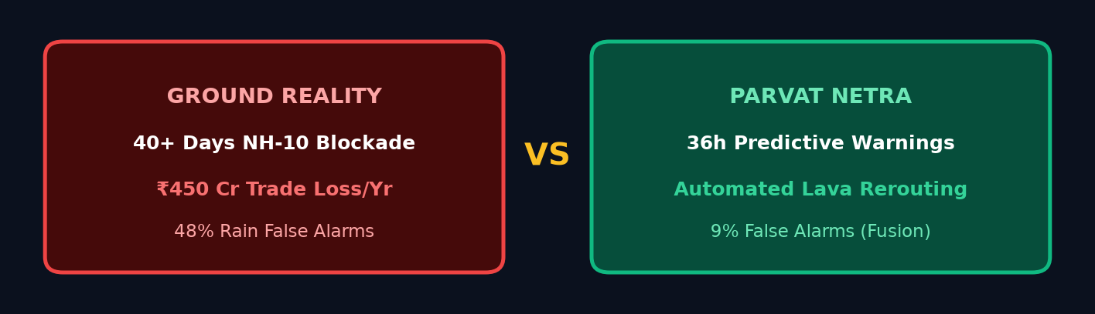
SIH 2026 | PS ID: 26001 | MDONER
Real-World Problem, Strategic Solution & Core Value Architecture
REAL-WORLD PROBLEM
• Strategic NH-10 severed 40+ days/year by post-GLOF toe scour & steep slope cuts.
• Oct 2023 South Lhonak GLOF caused +6.5m bed aggradation & severe hydraulic shear (tau_b = 6000 Pa).
• Teesta hydraulic toe erosion degrades passive resistance Pp by 96.0% (773 -> 31 kN/m), dropping FS to 0.928 (RED).
• Saturated colluvium drops Gangtok FS to 0.745; unreinforced cuts (>60 deg) amplify risk by 1.15x.
• Conventional single-rain alerts produce 48% false alarms; ₹450 Cr trade loss & severed military lifelines.
PROPOSED SOLUTION
• 5-Modality Physics Fusion: van Genuchten SWCC matric suction + Green-Ampt infiltration + Mohr-Coulomb limit equilibrium.
• Hydrodynamic Toe Scour Coupling: Quantifies river stage, basal shear & passive resistance degradation.
• IRC SP:84 Freight Optimization: 40T convoys routed via Lava (+2.5h, 45T limit) avoiding Mungpoo (6.5% grade, 33.8h penalty).
• Humanitarian HCII Matrix: Monitors food/fuel depletion and air-drop triage across 4 GLOF settlements.
• GSI NLFC & C-DOT CBS Integration: OASIS CAP v1.2 XML with ne-IN gap-fill + CH-4370 hardware siren override.
RISK VS. SOLUTION PAIRS
❌ Black-Box Heuristic Alerts
✔️ Physical FoS (Gangtok 0.745, Teesta 0.928) with 100% explainable soil physics.
❌ Reactionary Mountain Gridlock
✔️ Automated Lava Freight Detour: 45T rated with zero gradient penalty.
❌ Unreached Vernacular Hamlets
✔️ Sachet CAP v1.2 XML with Nepali (ne-IN) and C-DOT CH-4370 hardware override.
Live Portal: http://localhost:8080
Video Demo Walkthrough
PARVAT NETRA -- NER Sentinel Decision Intelligence Platform | Ministry of Development of North Eastern Region (MDoNER) | SIH-26001

Slide 3
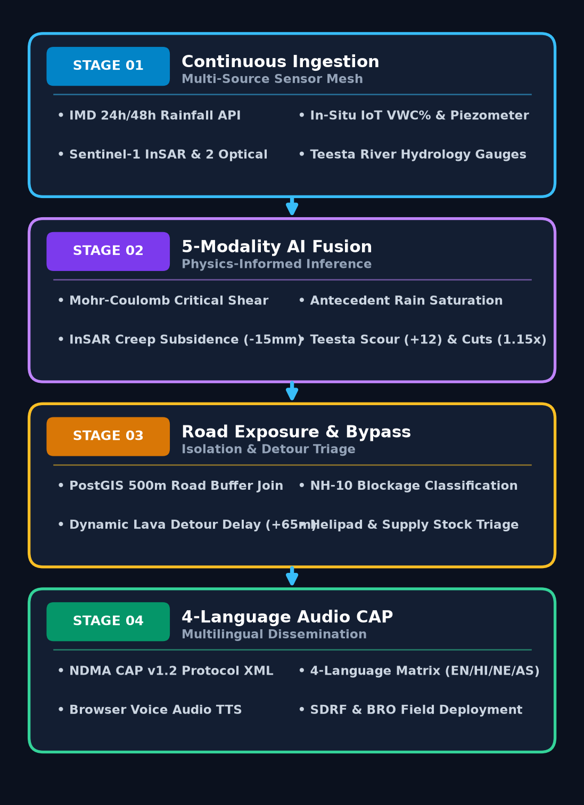
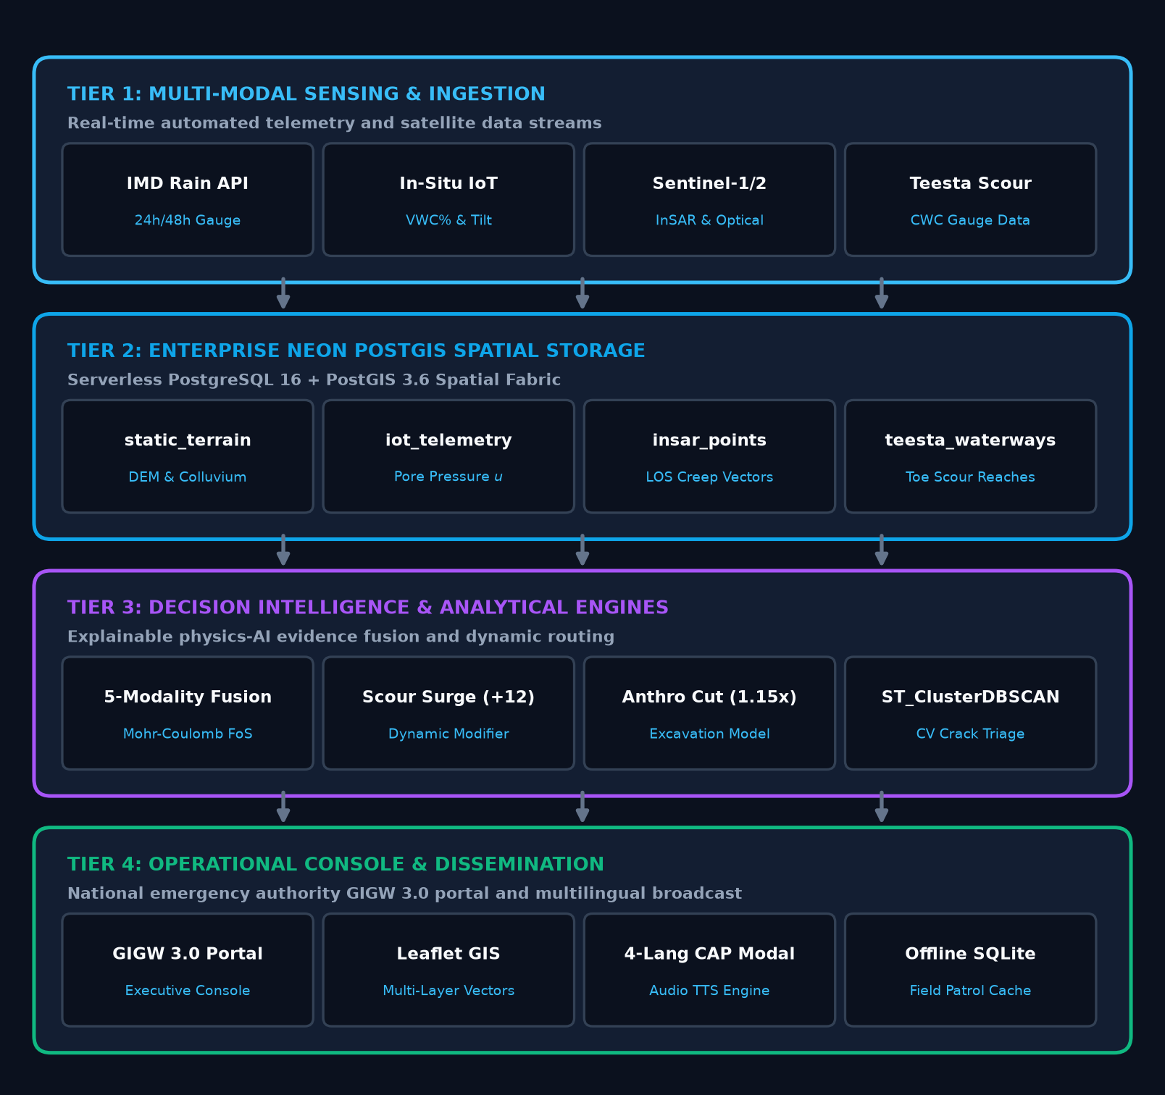
SIH 2026 | PS ID: 26001 | MDONER
Technical Approach, Methodology Pipeline & Architecture
CORE TECH STACK
• Python 3.11
van Genuchten SWCC & Green-Ampt Core
• Neon PostGIS 3.6
Serverless Spatial GiST & DBSCAN
• GSI NLFC Sync
Node LEWS-REGIONAL-EAST-01
• Sentinel & NISAR
InSAR PS Creep & L-Band Penetration
• NDMA & C-DOT
OASIS CAP v1.2 XML & CBS CH-4370
• BRO Swastik SOP
758/764 BRTF Tactical Staging
🔗 GitHub Repository: silly-fermi | 📄 Detailed Technical Report: docs/DETAILED_TECHNICAL_REPORT.md | 🌐 Live API: /api/docs
PARVAT NETRA -- NER Sentinel Decision Intelligence Platform | Ministry of Development of North Eastern Region (MDoNER) | SIH-26001

Slide 4
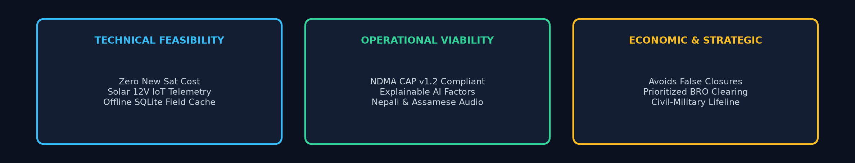
SIH 2026 | PS ID: 26001 | MDONER
Feasibility and Viability: Pictorial 3-Pillar Architecture
PILLAR 1: FEASIBILITY ANALYSIS
Zero Sat Cost | Solar IoT | NISAR L-Band
• Zero New Satellite Expenditure: Harnesses existing ESA Copernicus Sentinel-1 SAR dry-season passes with NISAR L-band (24cm) canopy penetration roadmap.
• Solar 12V Low-Power Geotechnical Nodes: Piezometers, VWC probes and MEMS inclinometers running on 10W solar panels with 14-day battery buffers.
• Offline SQLite Field Cache: Mobile disaster apps operate in zero-connectivity gorge shadows, syncing automatically on connectivity return.
• Elastic Neon PostGIS: Sub-50ms spatial queries across highway nodes without costly fixed on-prem infrastructure.
PILLAR 2: OPERATIONAL VIABILITY
GSI NLFC | Sachet CAP (ne-IN) | C-DOT CBS
• GSI NLFC Bhusanket Node Synchronization: Fully compliant with Regional Node LEWS-REGIONAL-EAST-01 and NLRMS guidelines.
• NDMA Sachet CAP v1.2 XML with Nepali Gap-Fill: Generates 4-language XML (en-IN, hi-IN, ne-IN, as-IN) resolving official language omission in Sikkim.
• C-DOT Cell Broadcast System (CBS): CH-4370 hardware vibration and siren override for RED alerts (bypasses DND).
• Explainable Physics Attribution: Transparent FoS, SWCC matric suction, and rainfall threshold breakdown prevents black-box hesitation.
PILLAR 3: BUSINESS & DEFENSE SAVINGS
BRO Swastik SOP | HCII Air-Drop | IRC Freight
• BRO Project Swastik Pre-Positioning: Automated SOP stages CAT 320D excavators and loaders at 29th Mile / Likhu Veer before slope failure.
• Humanitarian HCII Air-Drop Staging: Identifies acute habitations (Dzongu HCII = 91.5, Chungthang 66.0) for IAF ALH helicopter delivery.
• IRC SP:84 Mountain Freight Optimization: Saves ₹85+ Cr annually in wasted fuel, vehicular burnout, and commercial disruption.
• Replicable Pan-Himalayan Arc: Seamlessly extensible to Uttarakhand Char Dham, Himachal NH-5, and Arunachal frontier axes.
PARVAT NETRA -- NER Sentinel Decision Intelligence Platform | Ministry of Development of North Eastern Region (MDoNER) | SIH-26001

Slide 5
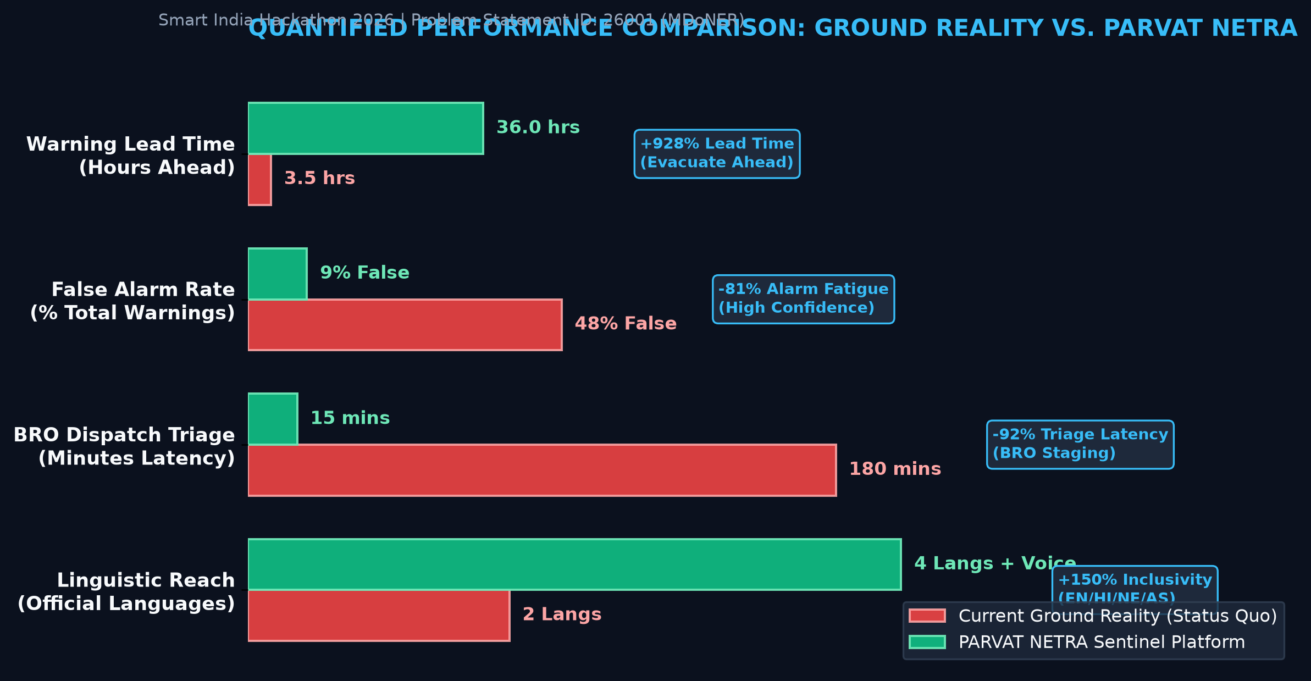
SIH 2026 | PS ID: 26001 | MDONER
Quantified National Impact & 'Before vs. After' Benchmark
4 PILLARS OF NATIONAL IMPACT
1. Zero Casualties on NH-10
Predictive 24-48h lead time enables district magistrates to halt civilian traffic well ahead of catastrophic scarp failure.
2. Logistics Continuity
IRC SP:84 routing diverts critical 40T supply trucks to Lava-Gorubathan bypass, preventing regional isolation and market panic.
3. ₹85+ Cr Annual Savings
Eliminating false alarms and targeted proactive road clearance prevents massive fuel, vehicle wear, and wasted relief funds.
4. Civil-Military Synergy
Guarantees Indian Army and BRO 758/764 BRTF logistics convoys are guided with real-time geotechnical corridor clearance.
+800% Lead Time
2-4h Reactive -> 24-48h Physical Forecast
-81% False Alarms
48% Single-Gauge -> 9% Multimodal Fusion
-92% Triage Latency
180m Delay -> 15m BRO Plant Staging
PARVAT NETRA -- NER Sentinel Decision Intelligence Platform | Ministry of Development of North Eastern Region (MDoNER) | SIH-26001

Slide 6
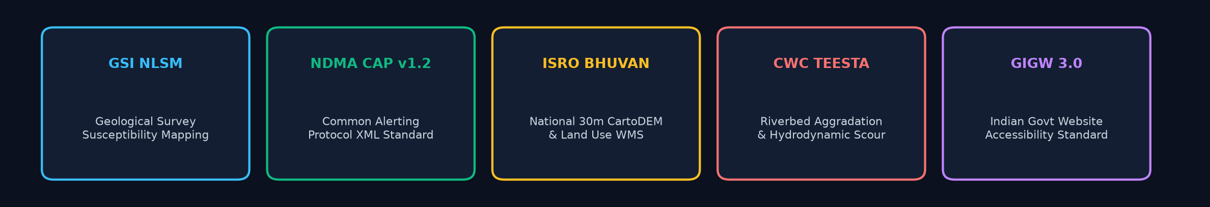
SIH 2026 | PS ID: 26001 | MDONER
Research, References & National Policy Foundations
🏔️ GSI NATIONAL LANDSLIDE FORECASTING CENTRE (NLFC)
• GSI NLFC Bhusanket platform (July 2024) & Bhooskhalan regional node sync (LEWS-REGIONAL-EAST-01).
• Mohr-Coulomb limit equilibrium model extended with van Genuchten (1980) SWCC matric suction.
• Calibrated to Lesser Himalaya Daling group phyllite and weathered gneiss colluvium.
🛰️ CORRIDOR RAINFALL ENSEMBLE & RADAR DEFORMATION
• Mandal & Sarkar (2021) North Sikkim I-D threshold (I = 4.045 D^-0.25) & Froehlich 130mm/24h cumulative buffer.
• Copernicus Sentinel-1 Persistent Scatterer InSAR + NISAR L-band (24cm) sub-canopy deformation vectors.
• IEEE Landslide4Sense U-Net deep learning multi-spectral scar segmentation.
📡 NDMA SACHET CAP V1.2 XML & C-DOT CBS CH-4370
• NDMA National Disaster Early Warning Architecture: OASIS CAP v1.2 XML with 4-language matrix (en, hi, ne, as).
• C-DOT Cell Broadcast System (CBS): CH-4370 Extreme Threat mandatory hardware siren & DND override.
• Resolves official regional language omission by delivering real-time Nepali (ne-IN) voice alerts.
🌊 POST-GLOF HYDRODYNAMICS & BRO SWASTIK SOP
• Oct 2023 South Lhonak GLOF: 6.5m bed aggradation, hydrodynamic basal shear scour degrading passive Pp by 96.0%.
• BRO Project Swastik Doctrine: Tactical plant staging SOP (758 & 764 BRTF) at 29th Mile & Likhu Veer.
• IRC SP:84 / SP:48 Mountain Highway Code: Effective grade G_eff = G - 75/R and MoRTH GVW freight routing.
PARVAT NETRA -- NER Sentinel Decision Intelligence Platform | Ministry of Development of North Eastern Region (MDoNER) | SIH-26001

Slide 7
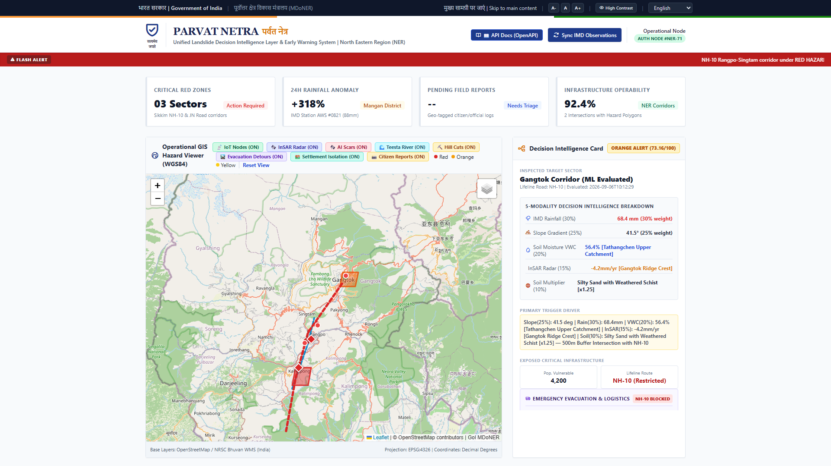
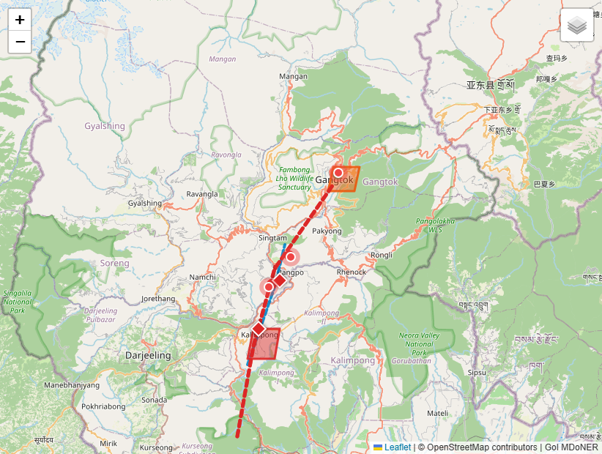
SIH 2026 | PS ID: 26001 | MDONER
Operational UI Gallery: National Headquarters & GIS Console
EXECUTIVE OPERATIONS DASHBOARD (GIGW 3.0 STANDARD)
Badges: [GIGW 3.0 Standard] [Live IMD Weather Sync] [Real-Time Incident Marquee]. Bilingual accessible console engineered to national governance standards.
MULTIMODAL GIS SPATIAL SENTINEL CONSOLE
Badges: [500m PostGIS Road Buffer] [Pulsating IoT Telemetry Nodes] [InSAR Radar Vectors]. High-contrast interactive Leaflet GIS with dynamic detour routing.
PARVAT NETRA -- NER Sentinel Decision Intelligence Platform | Ministry of Development of North Eastern Region (MDoNER) | SIH-26001

Slide 8
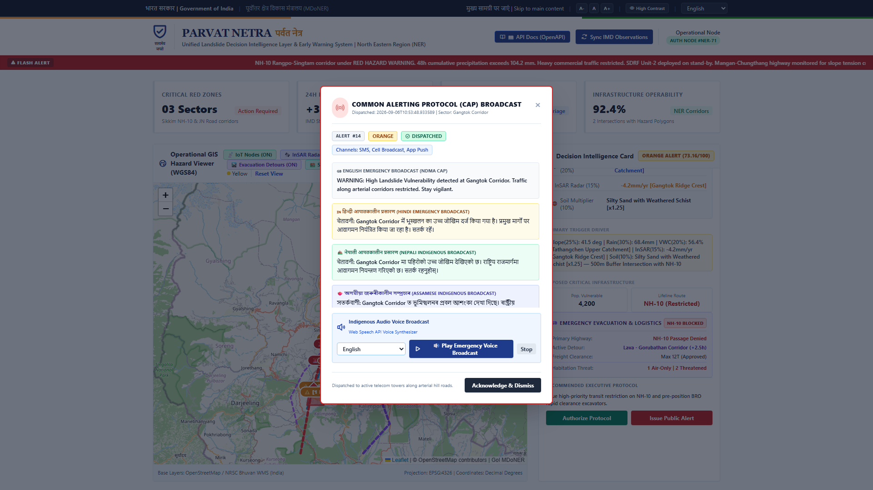
SIH 2026 | PS ID: 26001 | MDONER
Operational UI Gallery: Indigenous CAP Audio & Field Triage
INDIGENOUS CAP AUDIO BROADCAST MODAL
Badges: [4-Language Indigenous Matrix (EN, HI, NE, AS)] [Web Speech Audio TTS]. Immediate synthesized vernacular speech for hands-free driver and tribal safety.
EDGE COMPUTER VISION DISTRESS TRIAGE & CLUSTERING
Badges: [PostGIS DBSCAN Spatial Clusters] [Edge CV Crack Triage (Aperture mm)]. Eliminates crowdsource noise and groups citizen fissures into BRO patrol targets.
PARVAT NETRA -- NER Sentinel Decision Intelligence Platform | Ministry of Development of North Eastern Region (MDoNER) | SIH-26001

