Slide 1
Intro to OpenStack Software Platform and Community
Davanum Srinivas and Amrith Kumar

Slide 2
What we’re going to talk about
What is OpenStack
Components of OpenStack
Architecture of OpenStack (the Software)
Architectural considerations
Architecture of OpenStack (the Community)
Architectural considerations
Questions and Answers

Slide 3
Who we are
Davanum Srinivas
OpenStack Technical Committee
Former PTL for OSLO
Active in a number of projects including Nova, Keystone, Magnum and the Release team
Works at Huawei
Amrith Kumar
Currently: Fellow at Verizon
Former PTL of Trove
Former CTO, Tesora
Active contributor to OpenStack

Slide 4
What is OpenStack
The OpenStack Mission: to produce the ubiquitous Open Source Cloud Computing platform that will meet the needs of public and private clouds regardless of size, by being simple to implement and massively scalable.
OpenStack is open source, openly designed, openly developed by an open community.
https://wiki.openstack.org/wiki/Main_Page

Slide 5
What is OpenStack
Software that operates a cloud
Let’s compare this with another well known cloud, Amazon Web Services
Both AWS and OpenStack have components that provide all the building blocks of a computing infrastructure in the cloud.
Amazon Web Services
Compute: EC2
Block Storage: EBS
Object Storage: S3
DNS: Route53
Databases: RDS
…
OpenStack
Compute: Nova
Block Storage: Cinder
Object Storage: Swift
DNS: Designate
Databases: Trove
…

Slide 6
So what’s different?
Amazon Web Services is a Public Cloud
OpenStack is software that enables a cloud
OpenStack gives you this software and exposes these API’s
VM’s
Storage
Amazon exposes this API to users
Network
Cloud Operating System
Compute
Block Storage
Object Storage
…
…
Messaging
DNS
Networking
Real Hardware

Slide 7
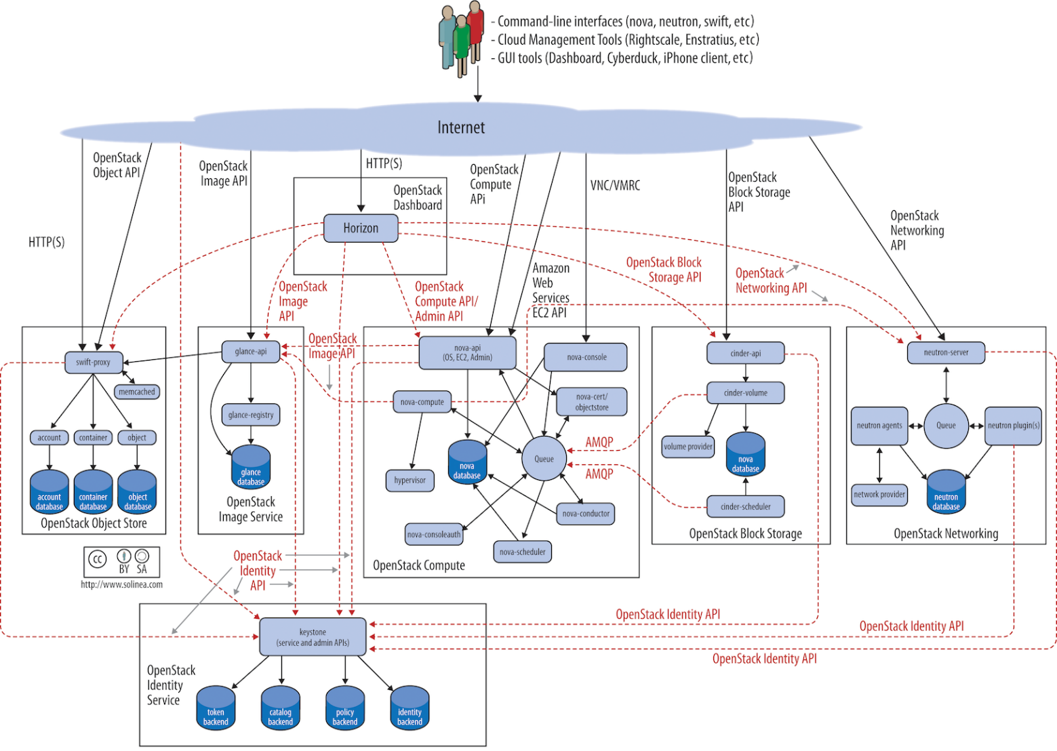
OpenStack Components
OpenStack contains all the tools you need to operate a cloud
OpenStack consists of many projects
Each project provides a specific service
Projects interact with each other on well defined API’s

Slide 8


Slide 12
OpenStack Components
OpenStack is
The Principles
The Projects
The software and release process
The Community
The individuals
The companies
The Governance Processes
The OpenStack Foundation

Slide 13
OpenStack Principles
OpenStack development model: All code is Apache 2.0 licensed, code reviews and roadmaps are public
Open design process: Every six months the development community holds a design summit to gather requirements and write specifications for the upcoming release. The summits are open to the public and attendees include users, developers, and upstream projects.
Open community: OpenStack is dedicated to producing a healthy, vibrant, and active developer and user community. Most decisions will be made using a lazy consensus model. All processes are documented, open and transparent.
https://www.openstack.org/assets/welcome-guide/OpenStackWelcomeGuide.pdf

Slide 14
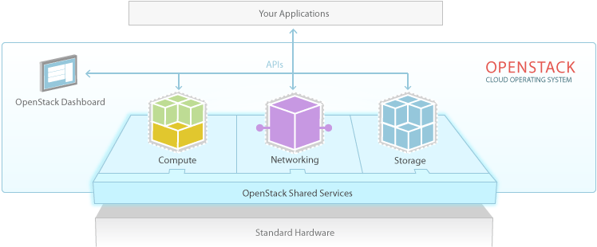
OpenStack Projects
OpenStack projects provide the capabilities of the cloud
Three major concepts
Compute
Storage
Networking

Slide 15
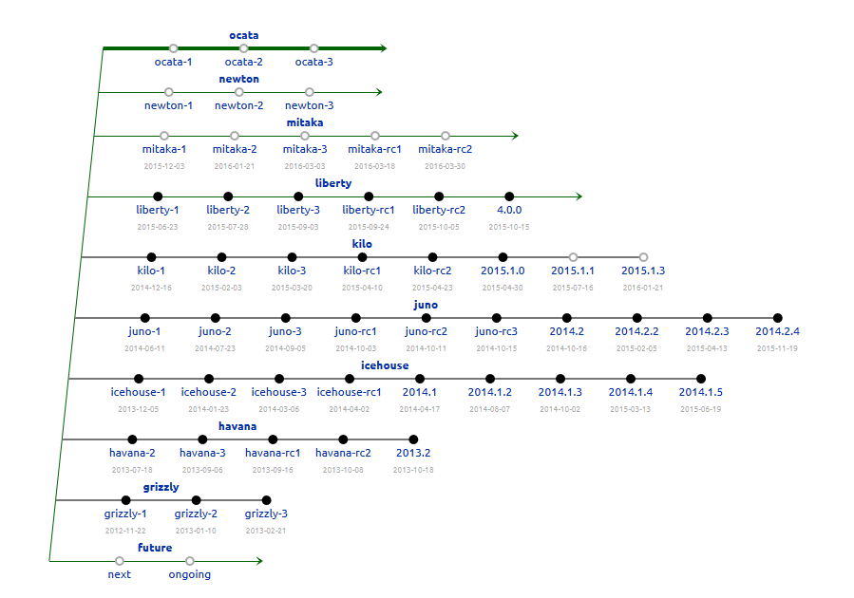
OpenStack release process

Slide 16
OpenStack Community
Individual contributors
Thousands of software engineers, technical writers, marketers, business managers, users and operators
Corporate sponsors
Companies who develop, sell, or operate OpenStack related products and services

Slide 17
The Governance Process
The OpenStack Foundation
http://www.openstack.org/foundation/
The bylaws of the OpenStack Foundation define:
The Board of Directors
The Technical Committee
The User Committee
A hierarchy of technical leadership
The Technical Committee
The Project Technical Leads
The Core reviewers
The reviewers and contributors

Slide 18
Community Roles
Contributor (Everyone)
Active Technical Contributor (Commit in last 2 releases)
Project Core (Approve changes in project)
Project Technical Leader (Management Lead for project)
Cross Project Liaisons (Contacts between projects)

Slide 19
Within a project
Each project has a Project Technical Lead (PTL)
Each project has a core reviewer team that has approval rights on code and reviews
Some projects have a driver team that has approval rights on specs/blueprints
Some projects (server projects) have a stable maintenance team that has approval rights on code and reviews against a stable branch of code

Slide 20
Cross Project Teams
Cross-project teams enable project contributors in areas of release management, documentation, string translation, infrastructure, and quality assurance
Some examples

Slide 21
The “Big Tent”
Not too long ago, the Technical Committee restructured policies around project management and organization
We removed the previous incubation and integration graduation processes and statuses
We removed the concept of programs, which were collections of like-minded project teams
We resolved to use finer-grained tags to describe projects
We made the process of being included in the openstack/ code namespace easier and more objectively defined

Slide 22
Synergies
Building loosely coupled software requires loosely coupled teams
Clearly defined interfaces, milestones and shared development procedures
Each OpenStack project has a team
A Project Technical Lead (elected every six months)
A group of Core Reviewers
A group of reviewers and contributors

Slide 23
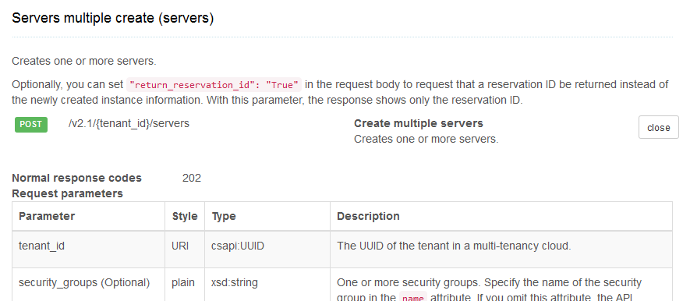
Clearly defined interfaces (API’s)

Slide 24
Clearly defined API’s
API’s must be stable across releases of the software
Rules for backward and forward compatibility must be strictly adhered to
Deprecation rules should be followed
API’s should be clearly documented
Services should only interact using API’s
No back doors, secret methods, …

Slide 25
Well defined milestones

Slide 26
Clear development procedures
Coding guidelines
Code review processes
Testing
Open Communication (IRC, Mailing List, …)
Automation
If you don’t automate, you will forget

Slide 27
Project Teams
The Project Technical Lead
Core Reviewers
Contributors and Reviewers

Slide 28







Community Support Programs
Free All-Access pass to Summits (for ATC’s)
Where are these summits?
Travel Support program
Google Summer of Code
Outreachy
OpenStack upstream Training

Slide 29
Tools: How do we do all these things
The Mailing List (ML)
All mailing lists managed by a Listman server on lists.openstack.org
Managed by the OpenStack Infrastructure Team
Preferred way of discussing topics on which you want feedback and naturally take a conversational or proposal format
Internet Relay Chat (IRC)
Like it or not, the communication medium of choice in the contributor community is IRC
Dozens of OpenStack channels on Freenode
Each project typically has its own IRC channel for the contributors to that project
e.g. #openstack-nova
Meetings are always on IRC
https://wiki.openstack.org/wiki/Meetings

Slide 30
Tools (2)
Launchpad
The bug tracking system
Gerrit
Code review and Git Tree Management System

Slide 31
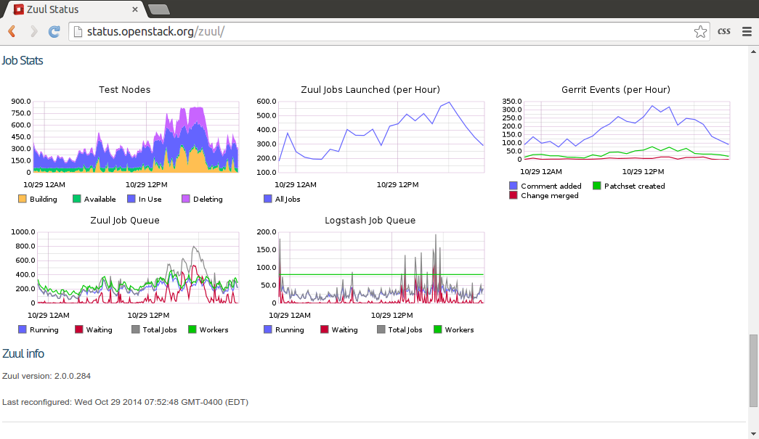
Tools (3): The OpenStack CI System

Slide 32
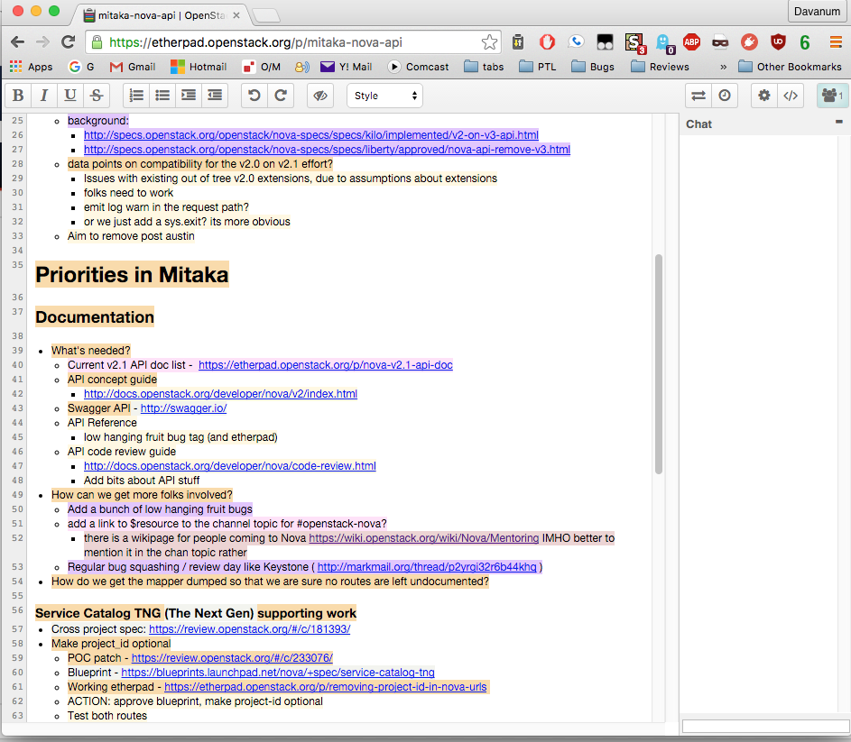
Tools (4): Collaborative Planning
Example:
https://etherpad.openstack.org/p/mitaka-nova-api
Summit Etherpads:
https://wiki.openstack.org/wiki/Design_Summit/Mitaka/Etherpads

Slide 33
Doing code reviews and spec reviews
Great way to build community karma
Most common complaint from new contributors is long review wait times, so you can greatly help in this area
Anyone may vote -1/0/+1 on any code review in any project
Review specs as well as code patches
Operator feedback on blueprint specifications is extremely valuable
Nobody knows everything about everything
Provide helpful commentary on areas you do feel comfortable with
Ask questions on reviews about areas you aren’t yet comfortable with

Slide 34
Making friends and influencing people
Think Small
Break work into small pieces; Make progress continuously
Participate
Ask questions, show up for meetings, respond to the mailing list, talk to others working in the same area
Identify the Problem
The specifications process is an open process to flesh out the problem domain, and think through alternatives; be data driven
Identify Natural Incentives
Divide potential work amongst stakeholders, be willing to compromise
Code Talks
Push code often and set “Workflow to -1” (Work in Progress)

Slide 35
Continuous Evolution
Product
Process
Rigid processes yield Rigid products

Slide 36
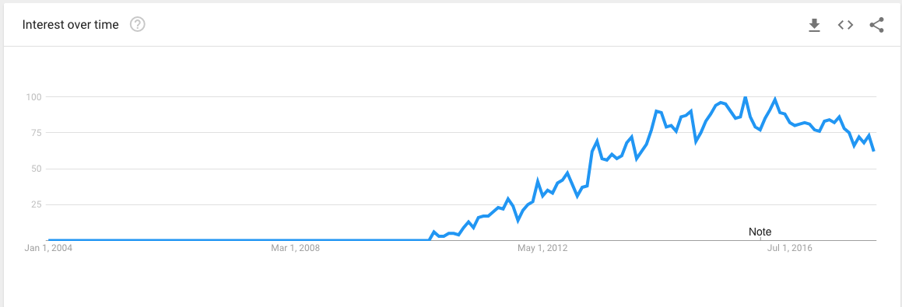
Closing thoughts
OpenStack is a rapidly growing* community, platform, collection of projects, …
Rapid growth brings serious challenges
The software and the processes must be aligned and flexible
Google Trends for the term “openstack”

Slide 37
Questions and Answers
Learn more at https://wiki.openstack.org
Contact us at
Davanum Srinivas
IRC: dims
Email: davanum@gmail.com
Amrith Kumar
IRC: amrith
Email: amrith.kumar@gmail.com

