Slide 1
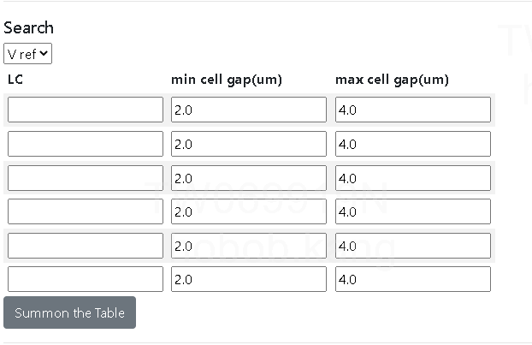

Slide 2
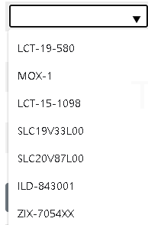
http://10.56.216.45:3000/
輸入介面
LC
PI
Sealant
下拉選單式

Slide 3
輸出Summary
Y軸項目 | LC | PI | Seal | Y軸數值
Δangle | 1336 | NRB-U238 | NA | 0.13
Δangle | 1336 | RB-205 | NA | 0.04
Δangle | 1336 | NRB-U238 | NA | 0.18
Δangle | 1336 | RB-205 | NA | 0.08
AC IS | 1336 | NRB-U238 | NA | 1.90%
AC IS | 1336 | RB-205 | NA | 1.20%
VHR | 1336 | NRB-U238 | NA | 97.30%
VHR | 1336 | RB-205 | NA | 95%
VHR | 1336 | NRB-U238 | NA | 96.10%
VHR | 1336 | RB-205 | NA | 97%
VHR | 1336 | NRB-U238 | NA | 96.10%
VHR | 1336 | RB-205 | NA | 97.00%
VHR | 1336 | NRB-U238 | NA | 95.70%
VHR | 1336 | RB-205 | NA | 95.30%
VHR | 1336 | NRB-U238 | V386 | 96.20%
VHR | 1336 | NRB-U238 | V386 | 91.90%
VHR | 1336 | NRB-U238 | V386 | 95.80%
VHR | 1336 | RB-205 | V386 | 96.80%
VHR | 1336 | RB-205 | V386 | 89.70%
VHR | 1336 | RB-205 | V386 | 95.70%
Adhension test | NA | NRB-U238 | V386 | 8.00
Adhension test | NA | RB-205 | V386 | 5.90
Adhension test | NA | NRB-U238 | K1M | 7.70
Adhension test | NA | RB-205 | K1M | 1.20
Adhension test | NA | NRB-U238 | 7142T | 7.60

