Slide 1
Math model of MgO shock velocity estimation
Zixuan Ye

Slide 2


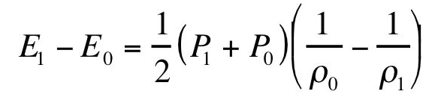
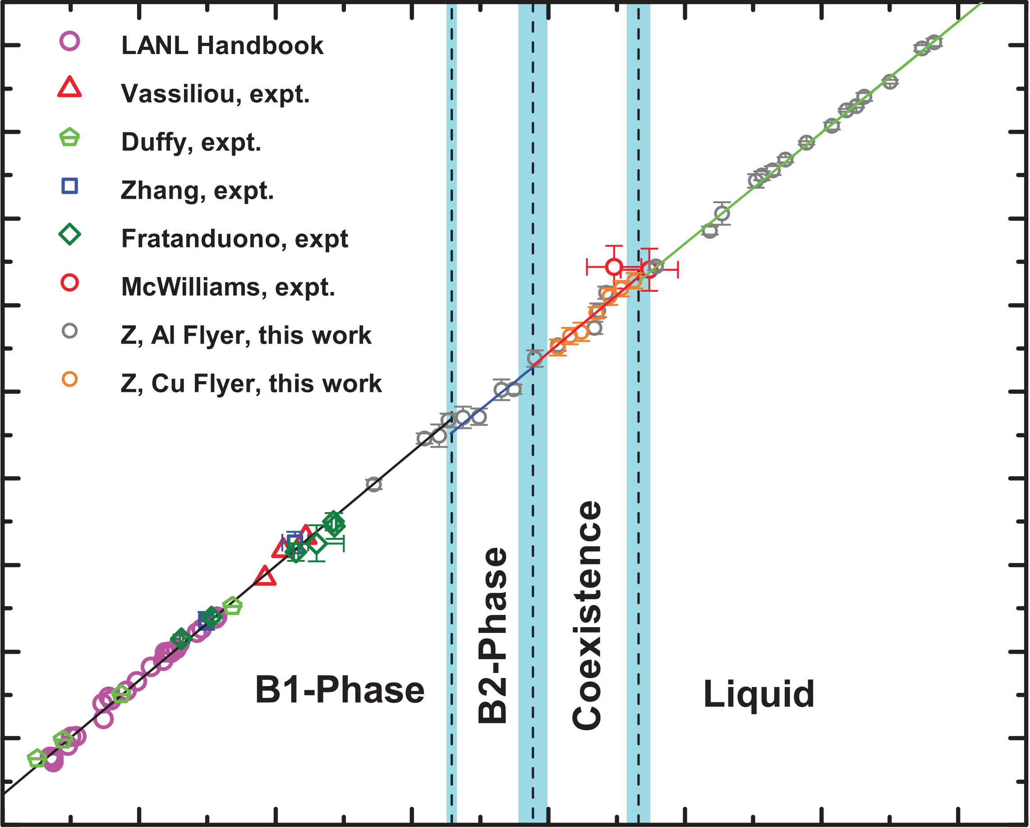
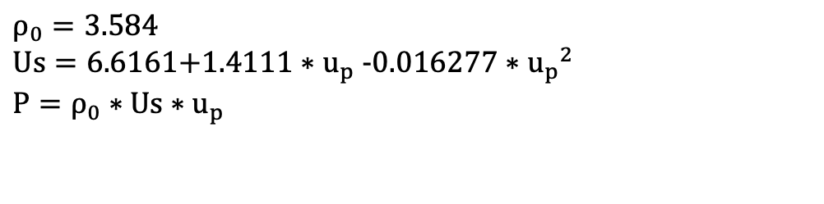
Step 1: Shock from ambient to MgO Hugoniot
Rankine-Hugoniot Relations
Sound speed measurements have defined the relationship between shock velocity and pressure along the MgO Hugoniot (Root et al., 2015)
$$ρ_{0}=3.584$$
$$Us=\text{6.6161+1.4111}{∗u}_{p}\text{-0.016277}∗{u_{p}}^{2}$$
$${P=ρ}_{0}∗Us∗u_{p}$$
22
B1 Hugoniot
Shock velocity (km/s)
14
6
0
7
14
Particle velocity (km/s)
Root et al., 2015

Slide 3
Data fit for Us up:
Please see the excel file

Slide 4
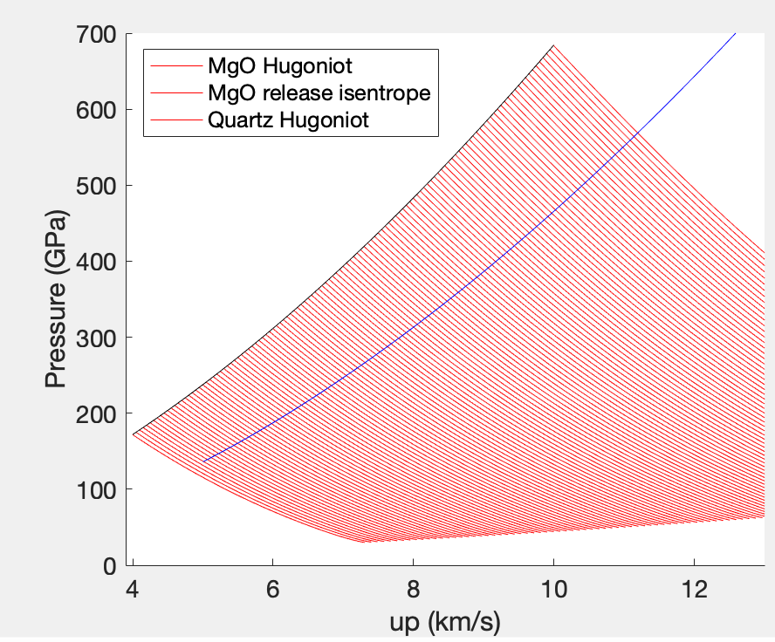
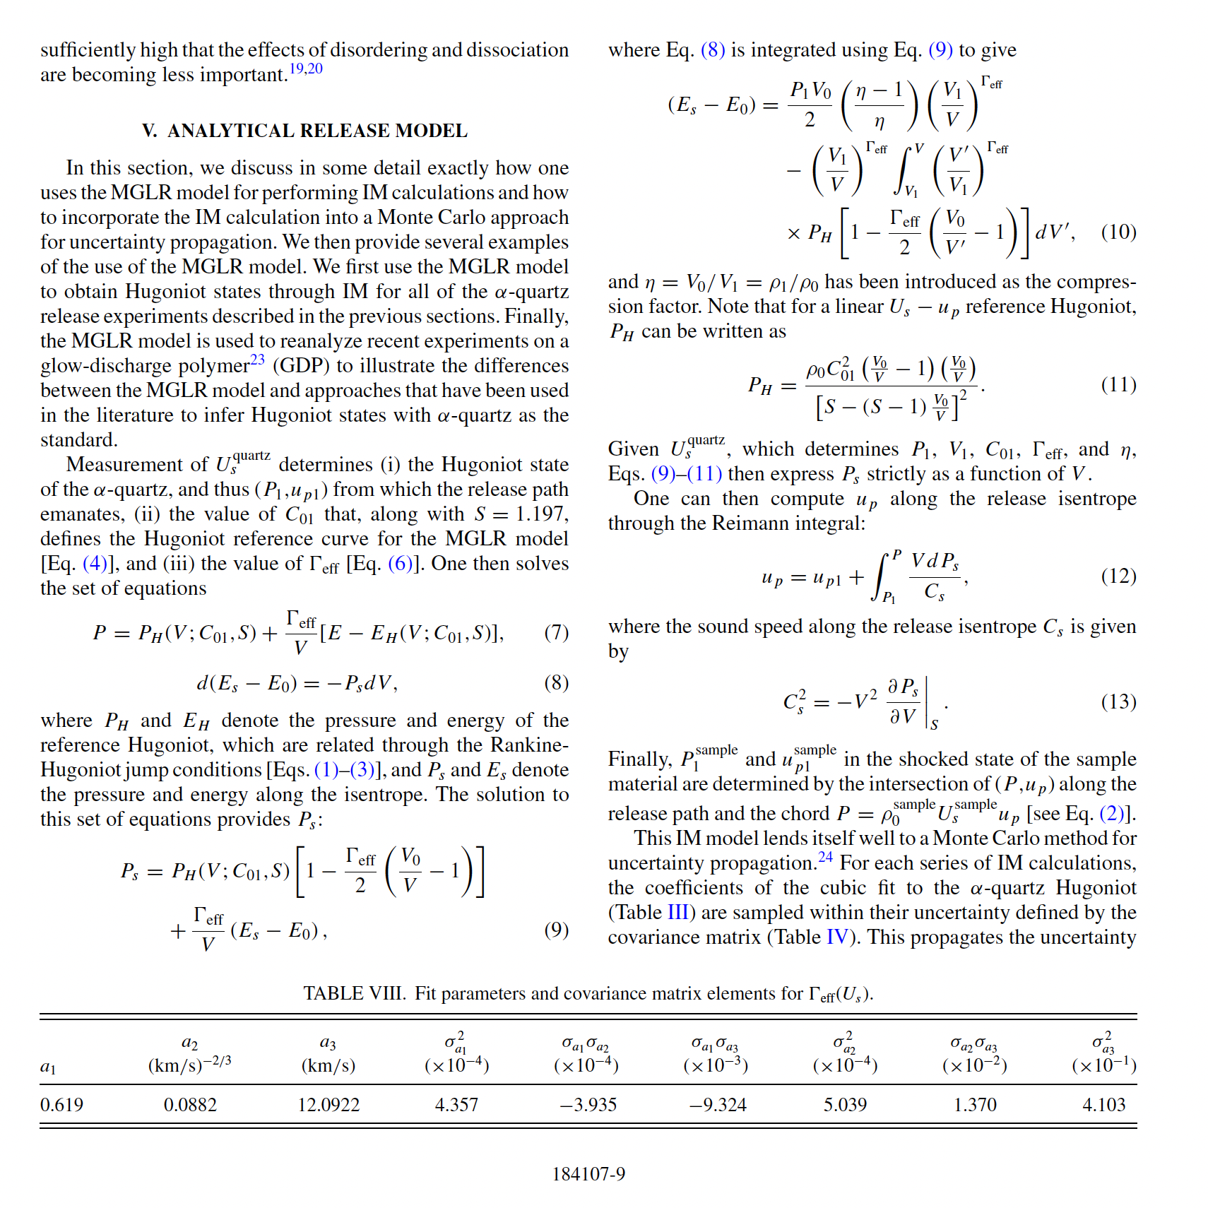


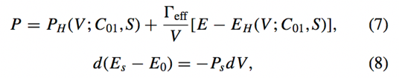

Step 2: Release from MgO Hugoniot state along isentrope
See more details of implementation please see the MATLAB code
$$Γ_{eff}=1.1$$
more details see Knudson et al. 2013

Slide 5
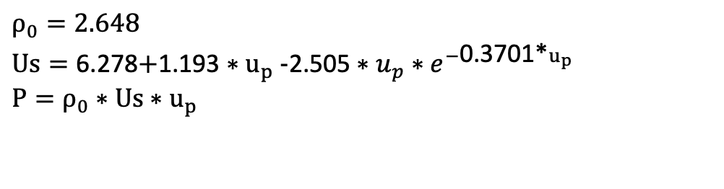
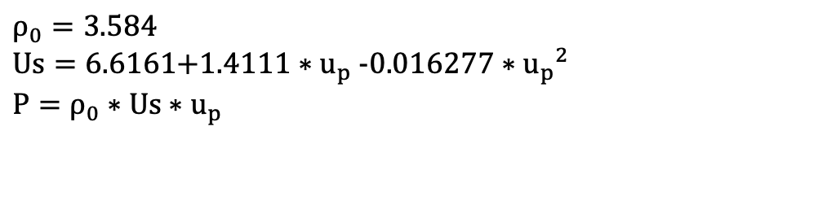
Step 3: Released MgO should have same pressure as shock in Quartz window---intersect with Quartz Hugoniot in P_up plane
MgO Hugoniot:
Quartz Hugoniot:
$$ρ_{0}=3.584$$
$$Us=\text{6.6161+1.4111}{∗u}_{p}\text{-0.016277}∗{u_{p}}^{2}$$
$${P=ρ}_{0}∗Us∗u_{p}$$
$$ρ_{0}=2.648$$
$$Us=\text{6.278}\text{+}\text{1.193}{∗u}_{p}\text{-}\text{2.505}∗{u_{p}∗e}^{−\text{0.3701}\text{*}u_{p}}$$
$${P=ρ}_{0}∗Us∗u_{p}$$

