Slide 1


An Electronic Database to Manage Activities and Files.
Graduation project 2020
SUEZ CANAL UNIVERSTY
FACULTY OF SCIENCE
MATHIMETICS DEPARTMENT
“COMPUTER SCIENCE"

Slide 2

PRESENTED BY
Madleen Atef
Ghada Mohammed
Esraa AbdUlrasoul
Dina Abdallah
SUPERVISED BY
Dr.Mohamed Ali

Slide 3
AIM OF THE PROJECT
Seamless screens for data entry and display the results that can be referred to in decision-making for the department’s management and its various programs.

Slide 4
Importance of program
The program measures a set of indicators that facilitate obtaining the appropriate measurements required by the college or useful in the quality management process.
The database facilitates access to data for students, faculty, and their assistants.
The database facilitates the monitoring of custody and the state of the halls and laboratories, which facilitates maintenance or forecasting.

Slide 5
Facilitate communication with the graduates of the department.
Knowing the minutes and numbers of councils dealing with a specific topic.
Make an inventory of faculty members, their assistants, and students according to specific criteria.
Facilitate obtaining the various documents received from or issued to the department.
Facilitate communication with civil society institutions.

Slide 6
Development tools
2014 SQL Server | A rational Database management system developed by a Microsoft.
Microsoft Visio 2013 | ER diagram, Use case diagram, block diagram, dataflow diagram, activity diagram, flowchart, Gantt chart and context diagram design tool
Microsoft Word 2010 | Write our documentation
Visual Studio 2017 | an integrated development environment for Microsoft Windows

Slide 7
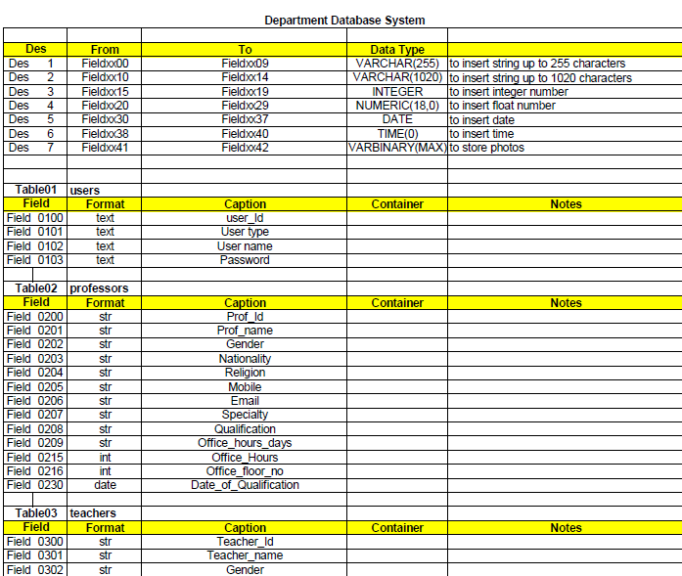
Tables

Slide 8
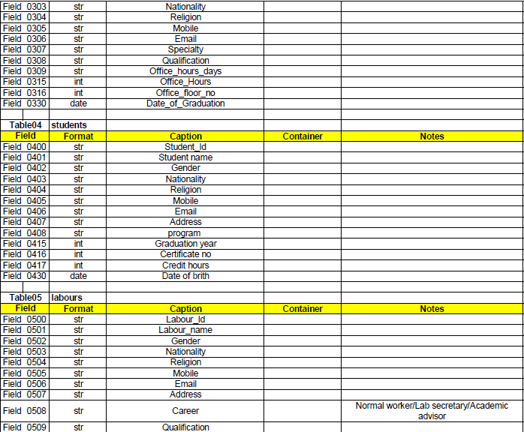

Slide 9
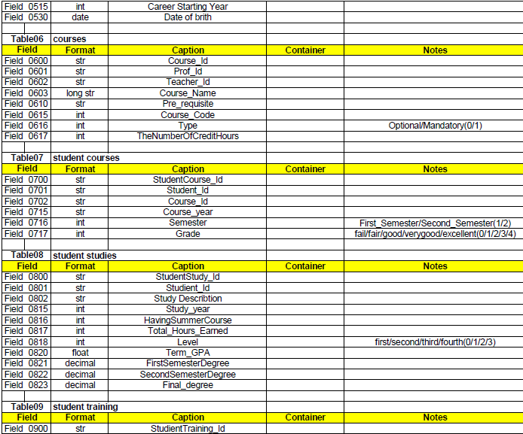

Slide 10
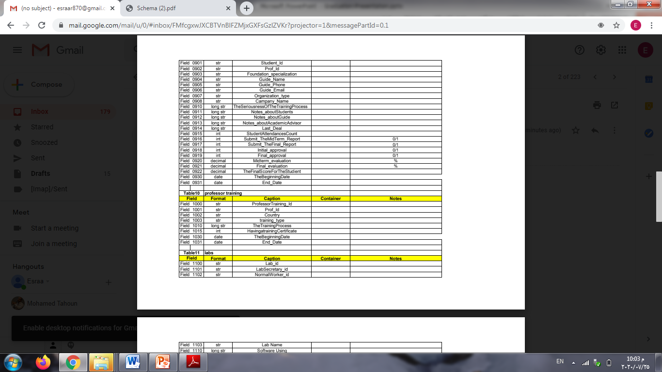

Slide 11
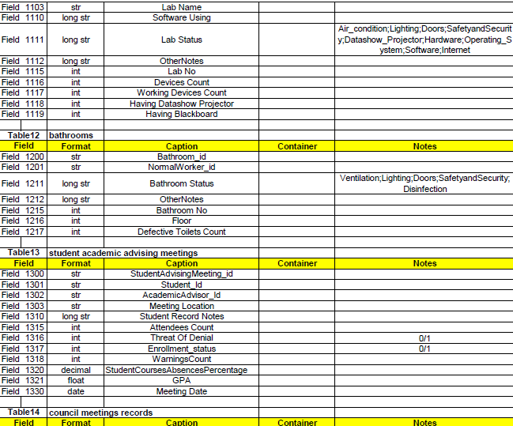

Slide 12
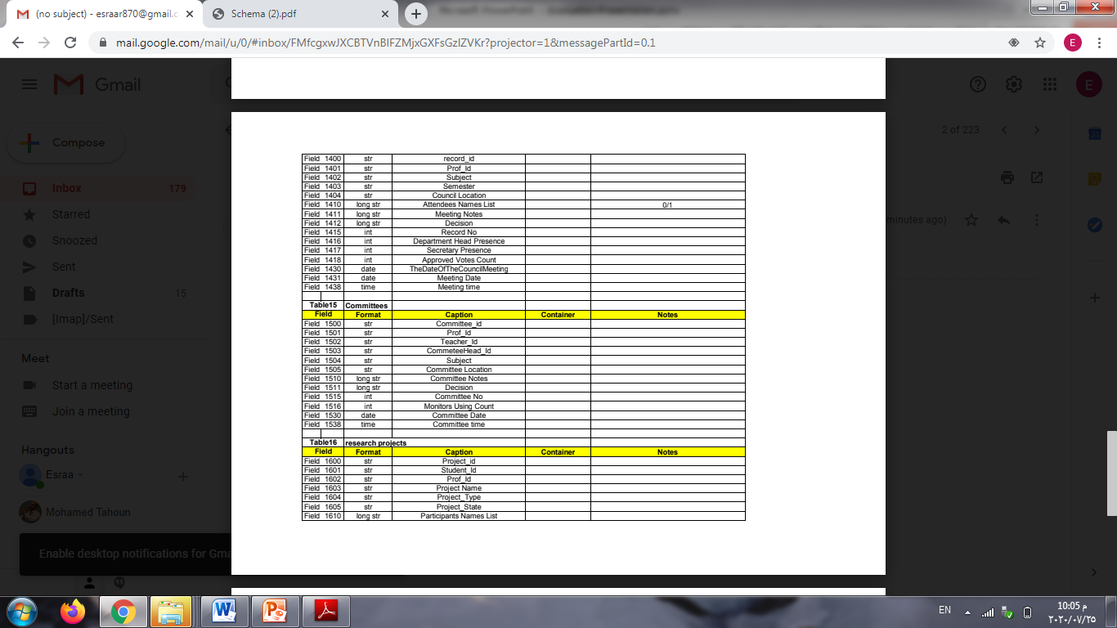

Slide 13
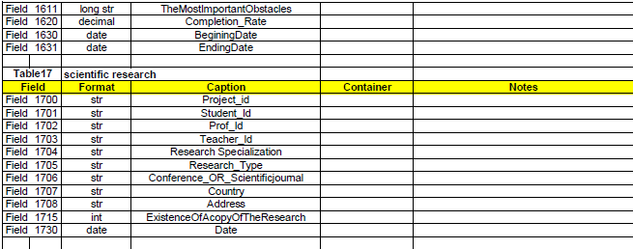

Slide 14
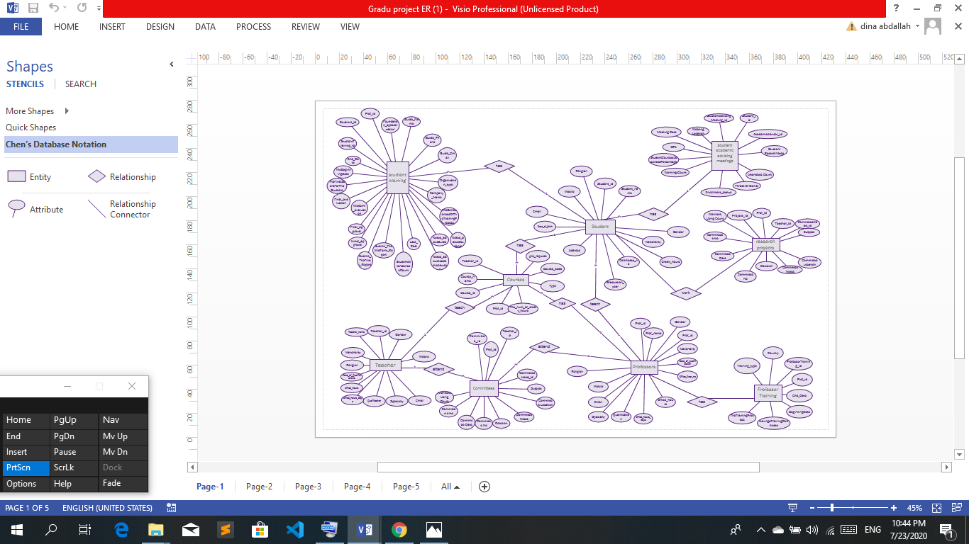
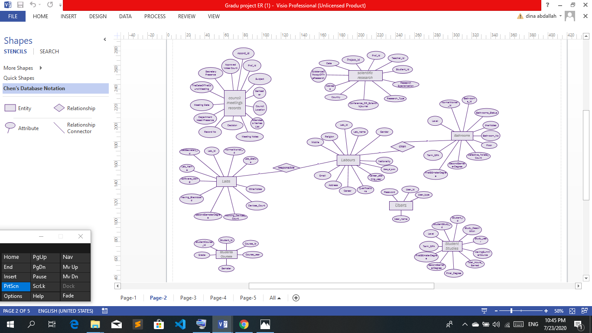
ER Diagram

Slide 15
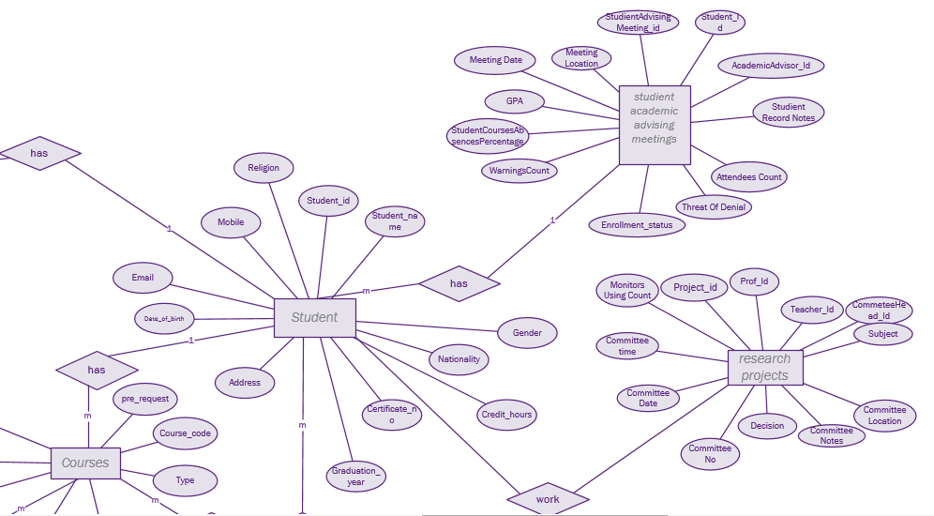

Slide 16
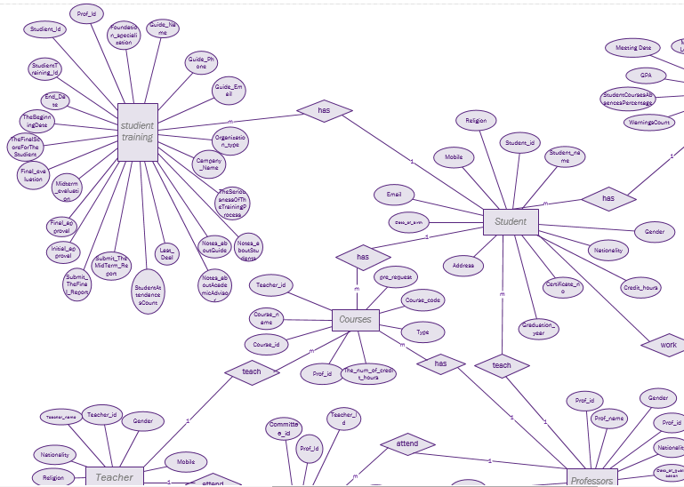

Slide 17
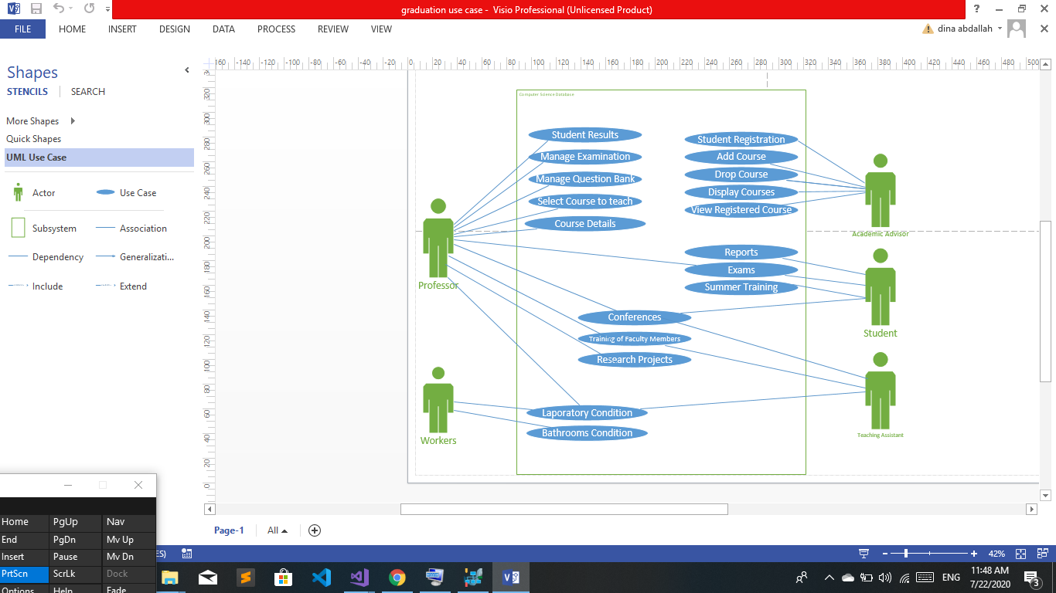
Use Case Diagram

Slide 18
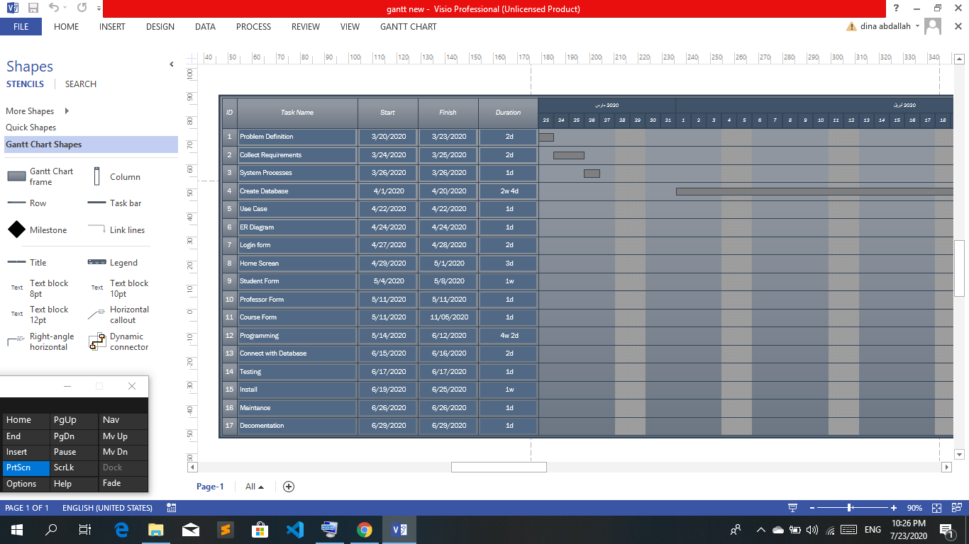
Gantt Chart

Slide 19
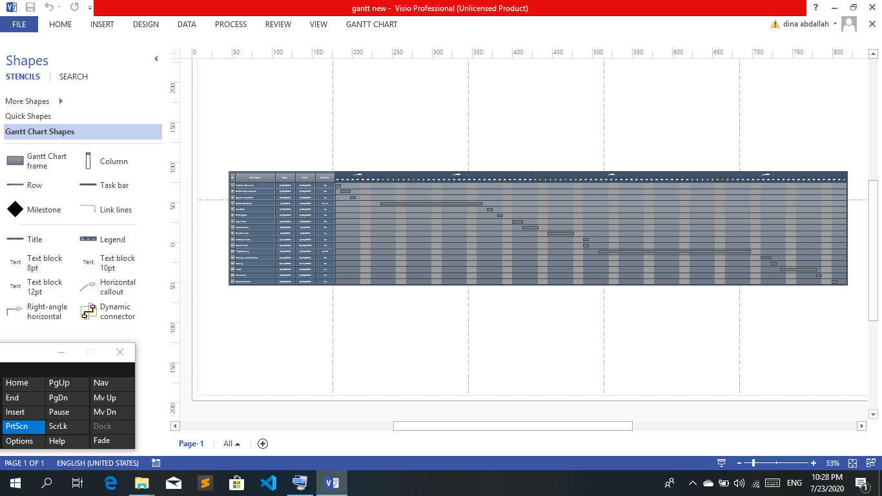
Cont. Gantt Chart

Slide 20

Conclusion
We Made This Project To Upload Database to Server of Mathematics Department.
Facilitate communication with civil society institutions.

Slide 21
Future Work
improving database design
improving program forms
Adding other tables showing the details of the department

Slide 22
References
https://www.tutorialspoint.com/sql/index.htm
Fundamentals_of_Database_Systems,_6th_Edition book (http://www.cvauni.edu.vn/imgupload_dinhkem/file/CSDL/Fundamentals_of_Database_Systems,_6th_Edition.pdf)
http://csharp.net-informations.com/data-providers/csharp-sql-server-connection.htm
System.Data.SqlClient library )https://www.oreilly.com/library/view/adonet-in-a/0596003617/ch36.html(
https://www.tutorialspoint.com/csharp/index.htm
https://www.w3schools.com/cs/

Slide 23


