Slide 1
Cloud Rocket Anomaly Detection and Mitigation using ML and LLM
By Team Rocket(3531)

Slide 2
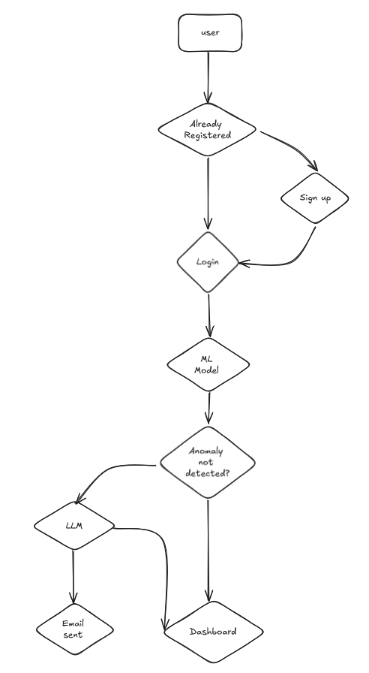
Introduction
A SaaS platform to monitor cloud infrastructure in real-time, detect anomalies using ML algorithms, and provide mitigation measures via LLMs by sending automated alerts.
Features:
Real-Time Monitoring: Continuous tracking of infrastructure matrices via cloud API.
Anomaly Detection Using One-Class SVM model to detect abnormal behavior and performance issues.
Custom Mitigation Anomalies prediction and remedial suggestion using customized open-source LLM.
Automated Alerts: Real-time alerts with detailed anomaly info and solutions through emails
Data Visualization & Reports: Visual insights and customizable reports for performance trends and anomalies.

Slide 3
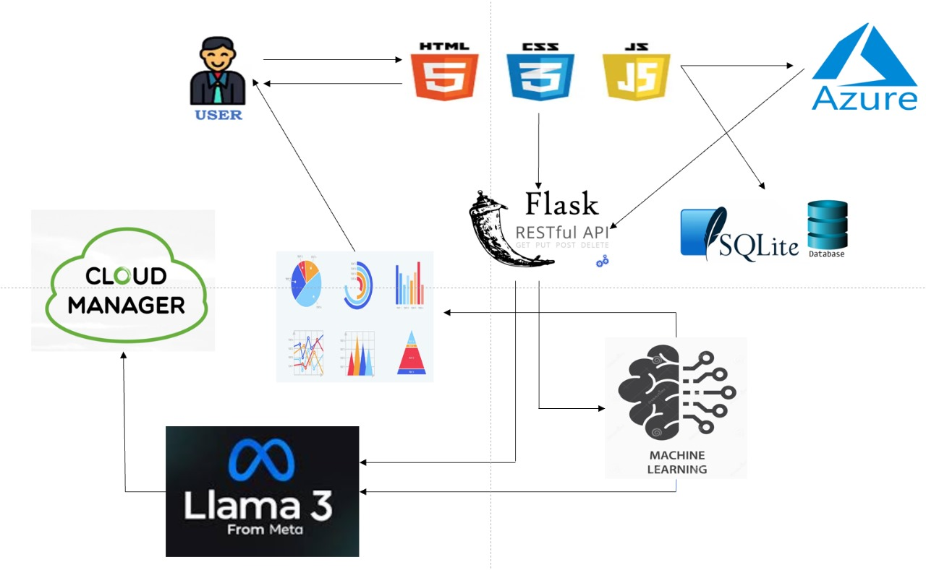
Technical Approach
Frontend:
HTML, CSS, JavaScript for interactive UI.
Cloud Platform:
Azure for real-time infrastructure data collection.
Backend & API:
Flask with RESTful API
Database:
SQLite3 (Upgradable to PostgreSQL)
Machine Learning Model:
One-Class SVM using Pandas, Numpy, Scikit-learn
LLM for Mitigation:
LangChain with open source LLaMA
Email Alerts:
Flask-Mail.

Slide 4
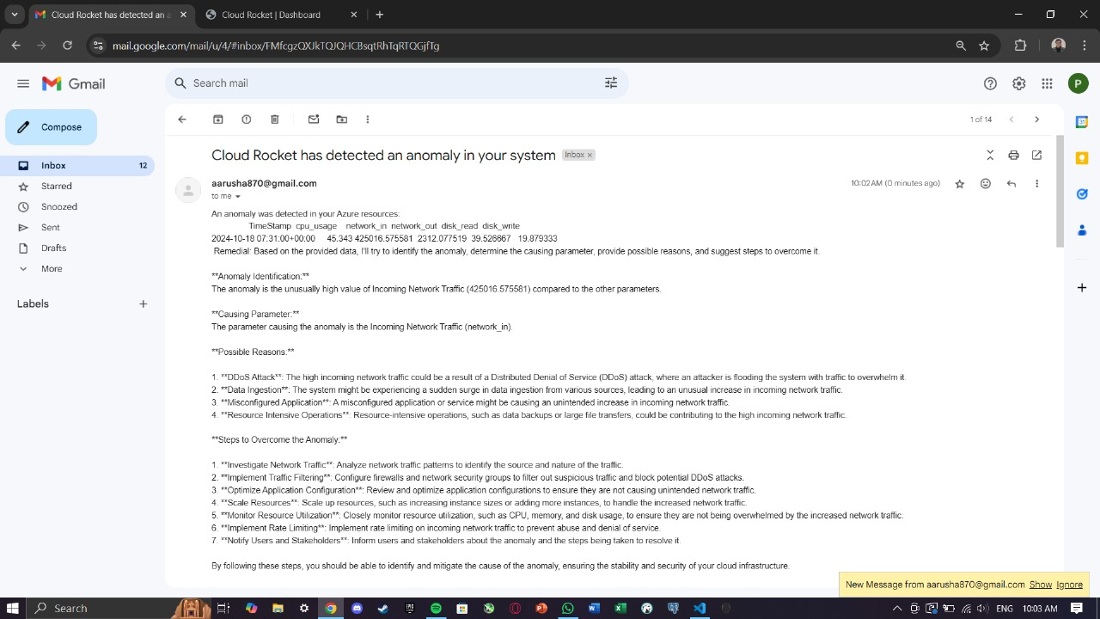
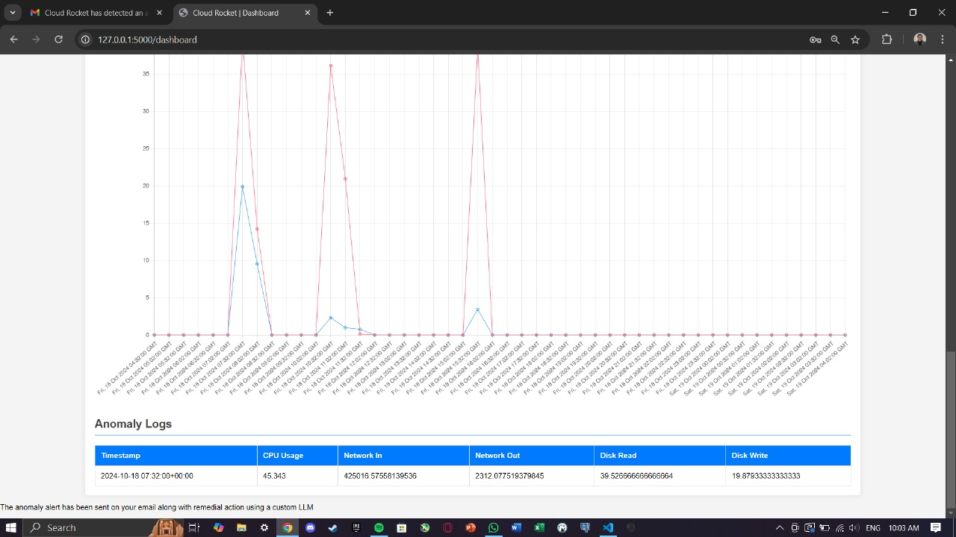
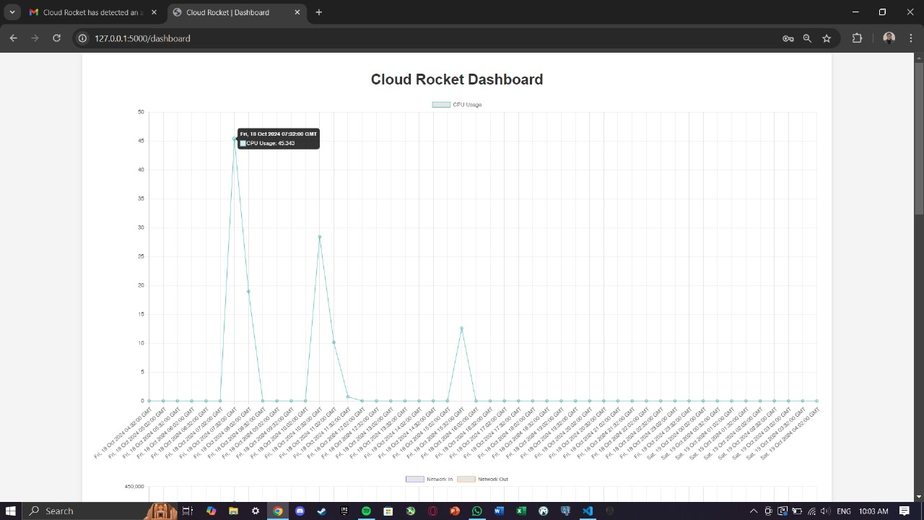

Slide 5
Feasibility and Viability
Technical Feasibility
Azure's well-documented API and scalability make it a reliable choice.
Flask and RESTful APIs ensure smooth communication.
The app is cloud and database agnostic as it can be scaled on any cloud and database with minimal changes .
Operational Feasibility
Reduced operational overhead by minimizing manual intervention.
Easy to use interface and requires minimal knowledge of cloud computing for effective use.
Economic Feasibility
Real-time cloud monitoring and anomaly detection are critical as cloud usage grows.
High success rate due to less competition.
Challenges and solution
Handling large volumes of real-time data
Solution: Implement efficient data streaming and processing using Azure’s scalable infrastructure and optimize the ML model for real-time performance.
Ensuring low technical knowledge requirement for users
Solution: Develop a simple, user-friendly interface with clear easy-to-follow alerts, requiring minimal cloud expertise.
Accurate anomaly detection
Solution: Continuously train and fine-tune the One-Class SVM model with new data to improve detection accuracy over time.

Slide 6
Impacts and Benefits
Impacts
Improved System Reliability: Real-time anomaly detection helps prevent cloud infrastructure failures, ensuring higher uptime and performance.
Data-Driven Decision Making: Continuous monitoring and detailed analytics provide insights that enhance decision-making processes.
Operational Efficiency: Automated alerts and solutions reduce the need for manual intervention, freeing up IT resources for other tasks.
Benefits
Cost Savings: Preventing outages and performance degradation lowers operational costs and reduces revenue loss due to downtime.
Enhanced Security: Early detection of anomalies minimizes potential security risks, safeguarding sensitive data and systems.
Scalability: The platform's ability to integrate with multiple cloud platforms allows it to grow alongside the organization’s infrastructure needs.
User-Friendly Interface: Easy-to-use interface with minimal cloud knowledge required.

