Slide 1

Leveraging In-Memory Data Grid
Hazelcast IMDG
SWAT / Dina Bogdan
July 2020
@dinabogdan03

Slide 2
Agenda
What is IMDG?
Hazelcast IMDG
Cluster Discovery
Partitioning & Replication
Data Structure Overview
User-Code Deployment & Hazelcast-Spring
Demo time!

Slide 3
What is an In-Memory Data Grid (IMDG) ?
A Data Grid is a system of multiple servers that work together to manage information and related operations in a distributed environment.
The servers from the grid can be located in the same location or distributed across multiple data centers.
An In-Memory Data Grid is a grid that stores data entirely into RAM.

Slide 4
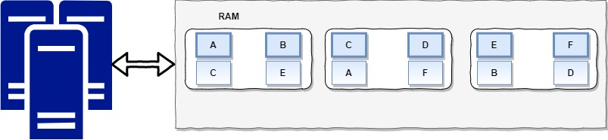
What is an In-Memory Data Grid (IMDG) ?

Slide 5
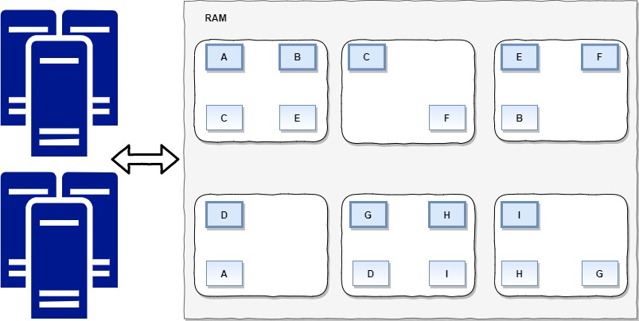
What is an In-Memory Data Grid (IMDG) ?

Slide 6


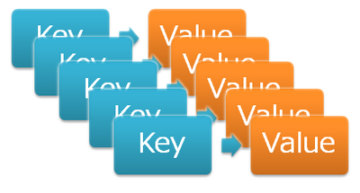
Why to use an In-Memory Data Grid?
Performance
Data Structure/Handling
Operations
Access data 1000x faster than a database
Low latency for batch and stream processing
Non-relational key-value
ACID compliance
Scalability
Redundancy for HA

Slide 7

When to use an In-Memory Data Grid?
Using bullets with indent button
Use the indent button to create the text levels with the appropriate bullet.
Data Cache
Eliminates data store bottlenecks
Eliminates slow network connections
Long-running blocking calculations
Data Service Fabric
Real-time integration
Compute grid
Message broker
Examples
Analytics (Risk, Fraud-detection)
Trading Systems (FX Trading, Stock Exchange)
eCommerce
Online Gaming

Slide 8
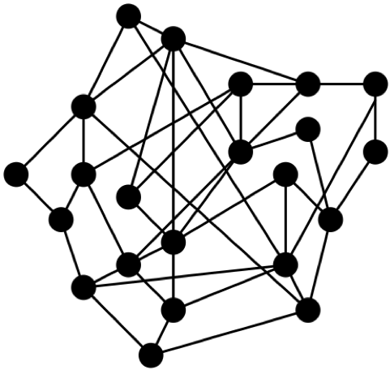
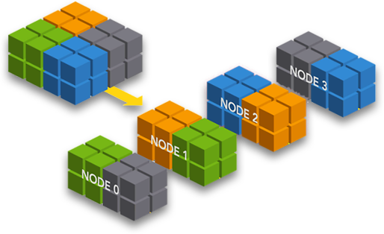

Basic operations of an In-Memory Data Grid
Using bullets with indent button
Use the indent button to create the text levels with the appropriate bullet.
Cluster
Discovery
Data distribution
Spreads data across all cluster members
Scalable to thousands of members/TB of data
Fault tolerance through data backups
Form
Find
Join
Replication/Mirroring
Partitioning/Sharding

Slide 9
Replication vs Partitioning
Replication
Partitioning
Pros
High availability
Workload scalability
Cons
Replication negative performance impact
Data inconsistency
Failure recovery
Memory scalability issues
Pros
Workload scalability
Failure recovery
Cons
Migration negative performance impact
Large memory requirements
Memory scalability
Good synchronization performance

Slide 10
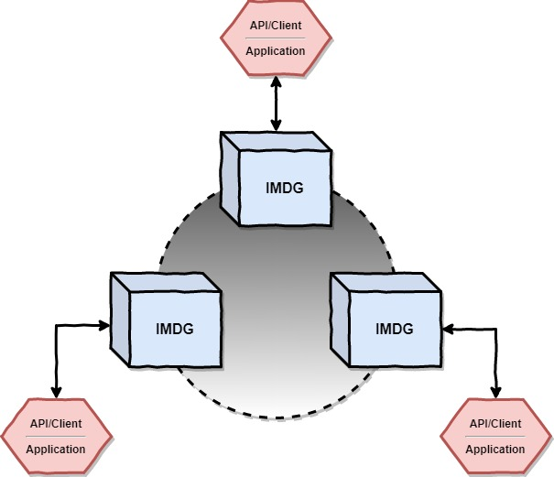
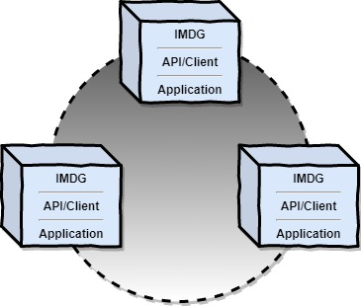
Deployment options
Embedded IMDG
Client-Server

Slide 11
Hazelcast IMDG
Characteristics

Slide 12

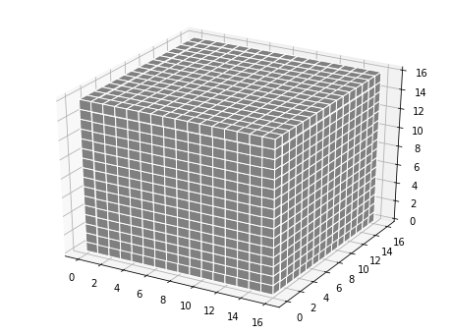


Why to choose Hazelcast IMDG?
Market Leader
Rich API
Ease of use
Distributed data store & computation system
Hazelcast IMDG is market leader among In-Memory Data Grid solutions
APIs in various programming languages: Java, C#.NET, Python, etc.
Powerful features
Huge user base – open source project
Simple to use key-value data store
Standard data structures: Map, List, Queue, etc.
Clients for many programming languages
Redundancy/fail-over/scaling built in
Distributed data store
Distributed computation near stored data

Slide 13
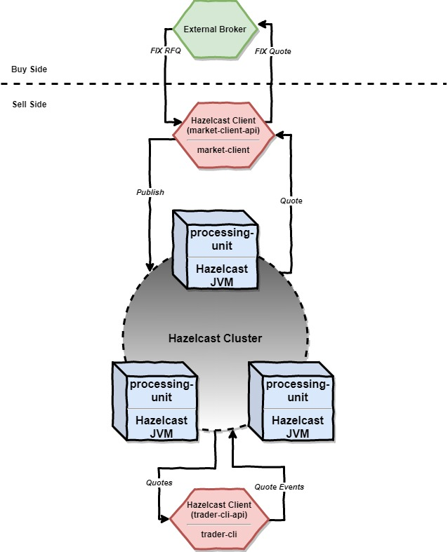
Business scenario and HLA - overview
Business scenario:
We will use Hazelcast IMDG for developing a Foreign Exchange Quotation Management System.
The system is consisting from:
Two Spring Boot microservices: market-client and trader-cli which are basically Hazelcast clients and are communicating with the grid via APIs
One Spring Boot microservice called processing-unit which is basically a Hazelcast server member that will join the cluster when started

Slide 14
Hazelcast features used
Deployment model:
Client-Server
Cluster discovery mechanism:
TCP/IP unicast discovery
Data structures used:
Replicated Map
Partitioned Map
Message broker:
MapEntryListener

Slide 15
Client-Server Deployment Model
Hazelcast Client
Hazelcast Cluster Member
For creating a Hazelcast Client Java application we must add the following dependencies:
Prior to Hazelcast 4.x:
com.hazelcast:hazelcast:3.x
com.hazelcast:hazelcast-client:3.x
For projects which are using Hazelcast 4.x:
com.hazelcast:hazelcast:4.x
For creating a Hazelcast Cluster Member Java application we must add the following dependency:
com.hazelcast:hazelcast

Slide 16
Hazelcast Cluster Discovery
There are multiple ways to establish a discovery mechanism inside our Hazelcast cluster:
TCP/IP multicast
TCP/IP unicast
Discovery plugins for Cloud:
Eureka
Zookeeper
Kubernetes
OpenShift
Pivotal Cloud Foundry (PCF)
Google Cloud Platform (GCP)
AWS
Azure
Custom discovery mechanism via Discovery SPI

Slide 17
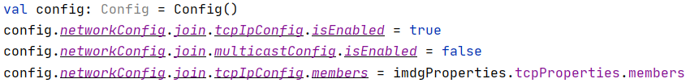
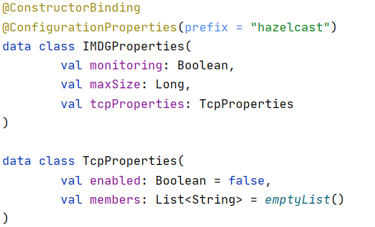
Hazelcast Cluster Discovery
In our cluster member we use TCP/IP unicast discovery.
For doing this we should use the following configuration:

Slide 18
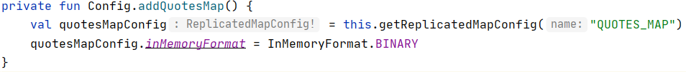
Hazelcast Replicated Map
In the processing-unit Hazelcast Cluster Java application we are using a replicated map data structure for storing the quote prices published by the market-client.
The map must have a name, which in our case is “QUOTES_MAP” and is stored in binary format in each cluster member instance.
The necessary code for creating this map is next.

Slide 19
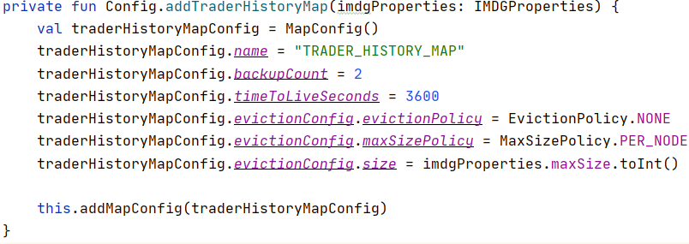
Hazelcast Partitioned Map
In the processing-unit Hazelcast Cluster Java application we are using a partitioned map data structure for storing the all commands (Buy and Sell) for each trader.
The commands are published by the trader-cli microservice and are distributed in partitions across all cluster members.
The map must have a name, which in our case is “TRADER_HISTORY_MAP” and each member of the cluster store only a partition (shard) of the data stored by the map.

Slide 20
User code deployment
Hazelcast-Spring

Slide 21
User code deployment
Not enabled by default.
Allows us to load client classes inside cluster members.
There are necessary configurations that must be done in both the client and the cluster member.

Slide 22
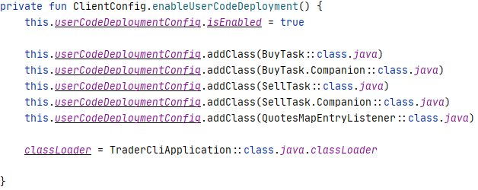

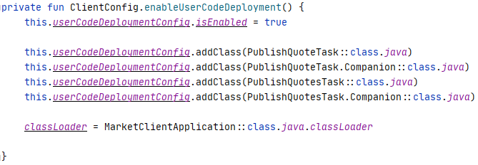
User code deployment
Client configuration
Cluster Member Configuration

Slide 23
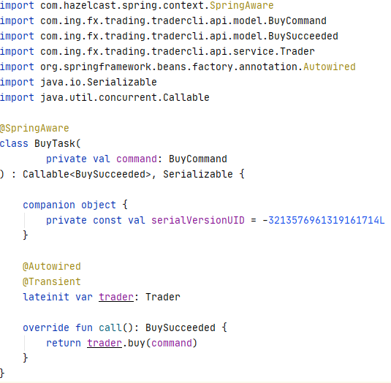
Hazelcast-Spring
Can be used by adding com.hazelcast:hazelcast-spring to both the client and the cluster member.
Allows us to use a Dependency Inversion approach in the communication between Hazelcast Client and Hazelcast Cluster.
Introduce the Java annotation @SpringAware, which in combination with Hazelcast user-code deployment allows us to inject implementations that are not available in the current project.

Slide 24
Demo Time !

Slide 25
Thank you !
Source-code available at: https://github.com/dinabogdan/ing-hazelcast-demo.
Follow me on Twitter: @dinabogdan03.

