Slide 1





Financial Data project

Slide 2

Table of content
This is the material point that will be delivered in the presentation.
01
data sources and objectives
02
data cleaning & transformations
03
Handling large files
04
EDA & Visualization
05
key insights & recommendations

Slide 3


Data Sources
project goals :
cards data:
id(0-6145)-primary key
client_id(0-1999):~2000 special clients ,Each client can have more than one card.
num_card_issues:(1-3):
each customer have 1-3
card.
clean and standadize datasets for reliability.
perform EDA and build visualizations.
Derive actionable insights and prepare a reproducible workflow.
data sets:(transactions ,cards,users)
source: kaggle
Environment:python (pandas) for cleaning
numpy,seaborn,plotly,matplotlib for visualization.
users data:
Transactions data:
credit_score(300-850).
current_age:
main:45 year
max:101 year
min:18 year
Retirement_age:
avg:66year
range:50-79
id :7.4m-23.7m
client_id:2000 distinguished clients, each client has completed thousands of transactions.
Card_id(0-6144):6000 different card.
Merchant_id(1001-99928):
more than 100000 merchants.

Slide 4
Recommendations & Next Steps
Active Dashboard using power bi.
plots showing relations
between columns
Statistics extracted
from the data.
Real plots showing
the geographical
distribution

Slide 5


SOME PLOTS FROM ANALYSIS
Next Slide

Slide 6
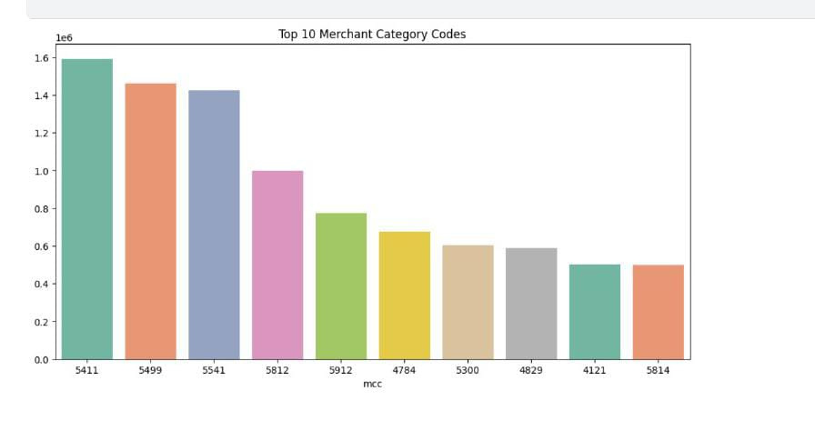

$2000
Top 10 Merchant category codes.

Slide 7

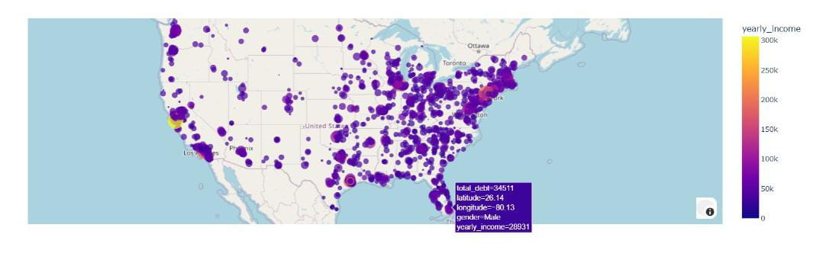
Geographical distribution of individuals based on yearly income (color) and total debt (size)

Slide 8
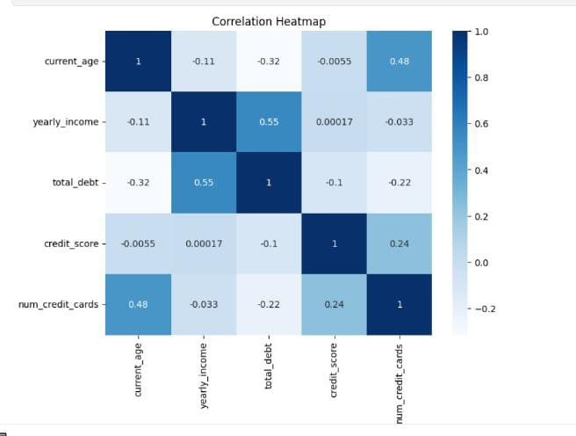
Correlation heatmap showing the relationships between age, income, debt, credit score, and number of credit cards."

Slide 9
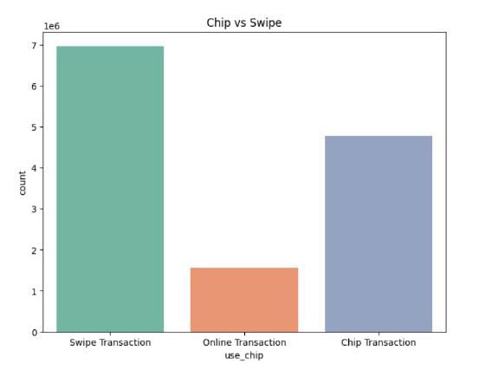

Comparison of the number of transactions performed using chip technology versus traditional swipe method."

Slide 10

POWER BI Dashboard

Slide 11
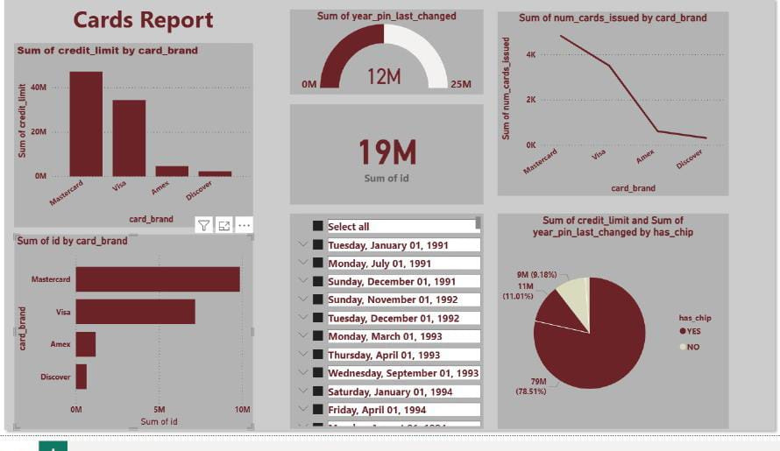

Slide 12
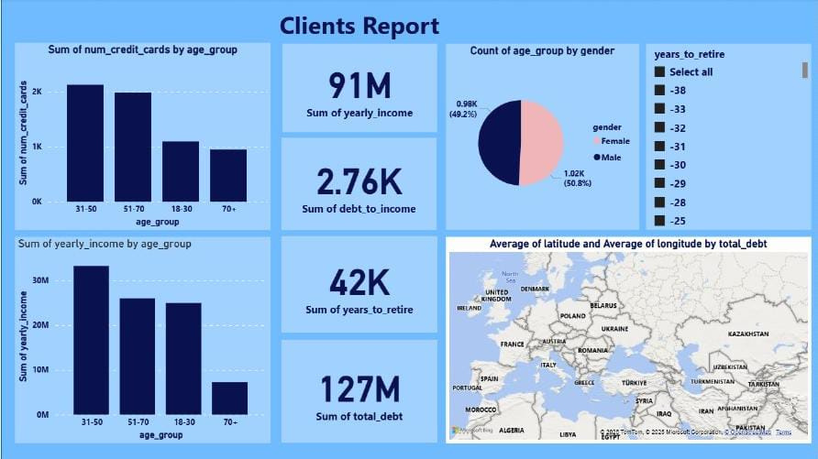

Slide 13
