Slide 1

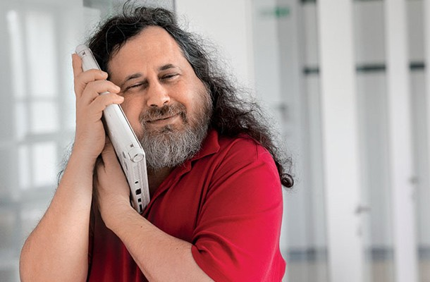
Hacker Ethic
Pouya.b
@dynamic

Slide 2
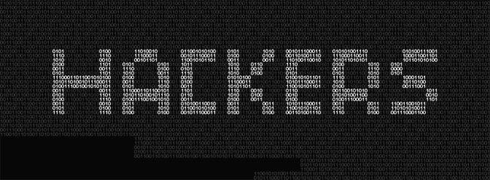
Notes:
First, Who are they?

Slide 3
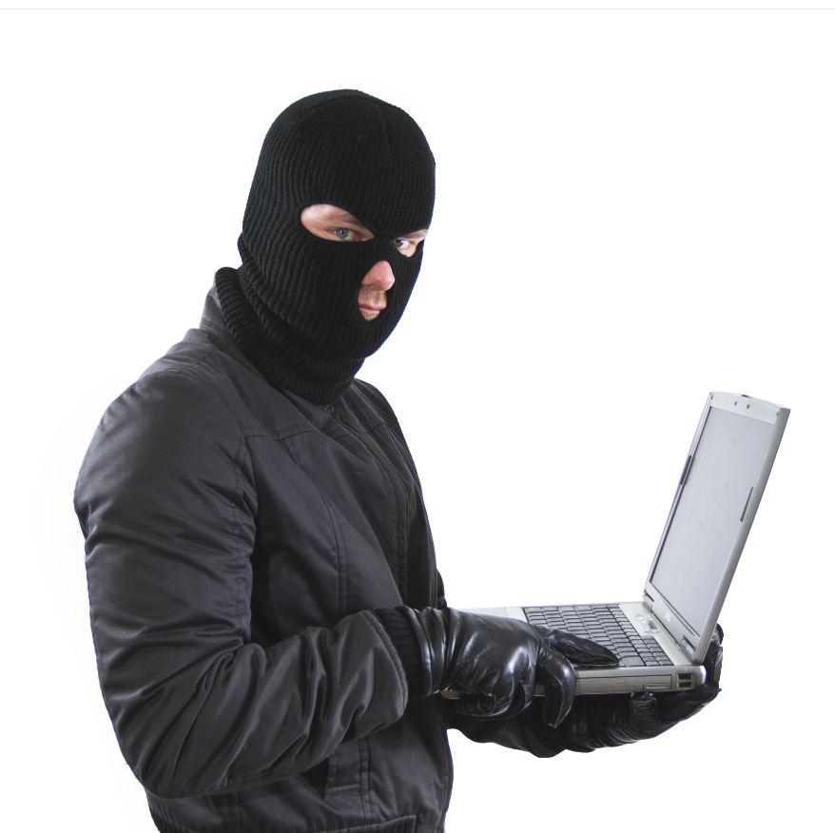

Slide 4


Slide 5


Slide 6
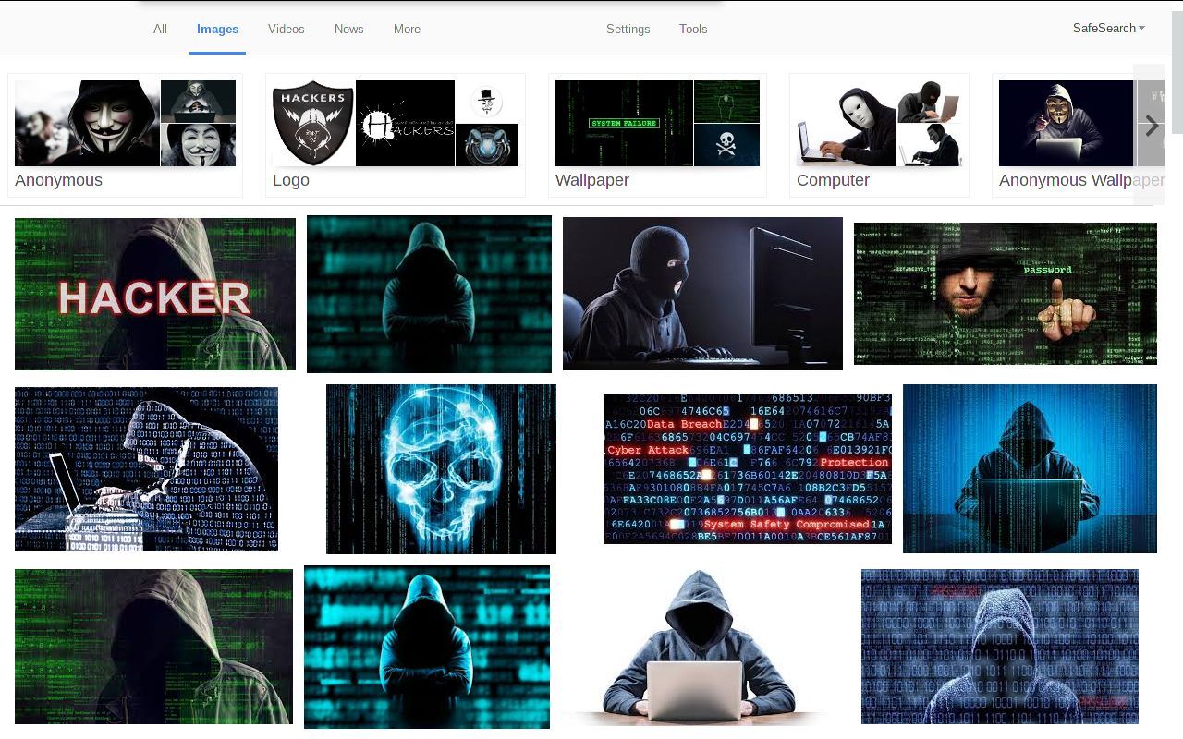

Slide 7



Slide 8
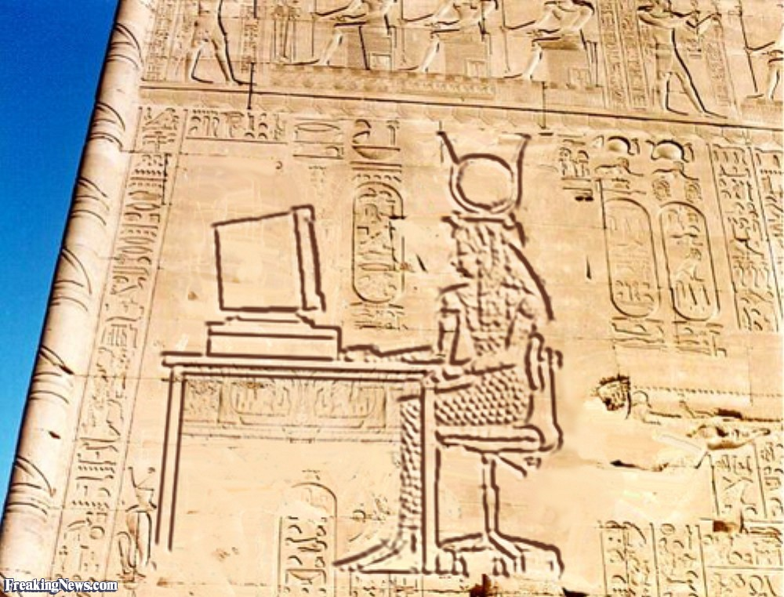
Talk about Ancient !

Slide 9
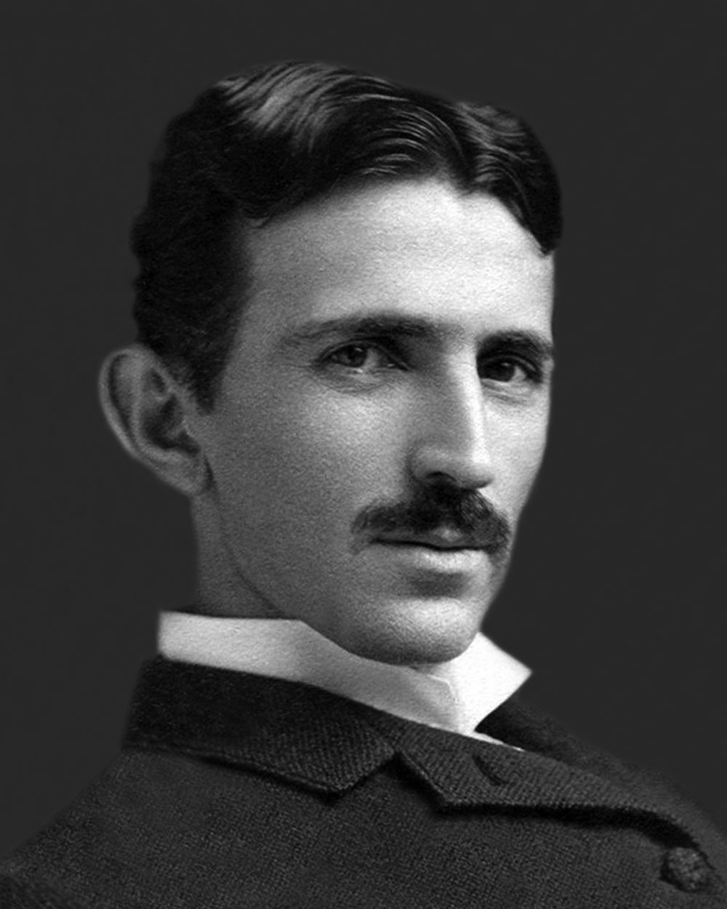
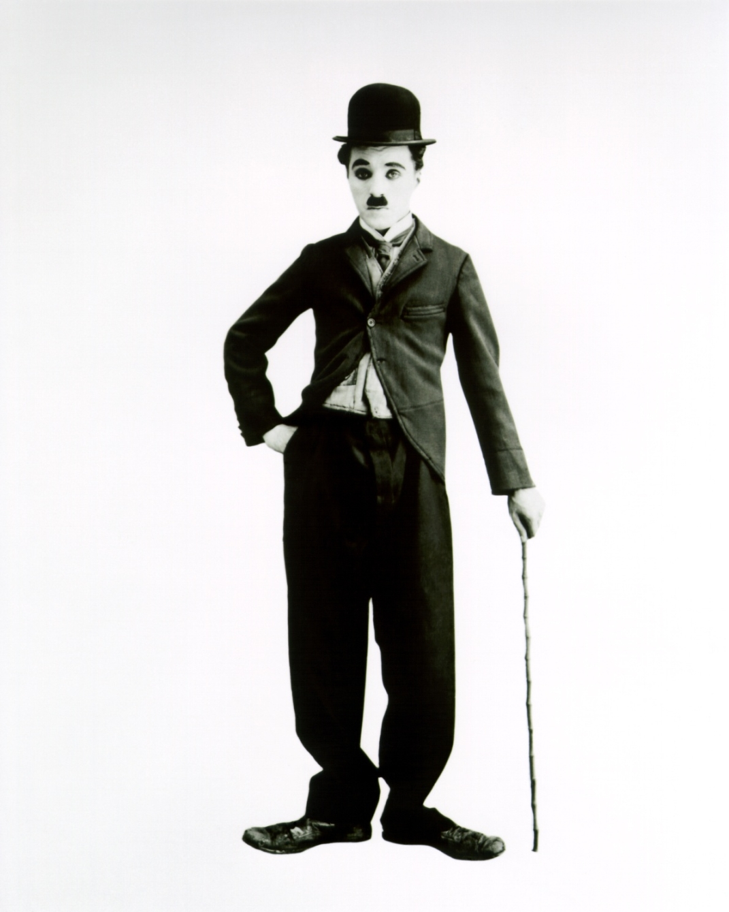
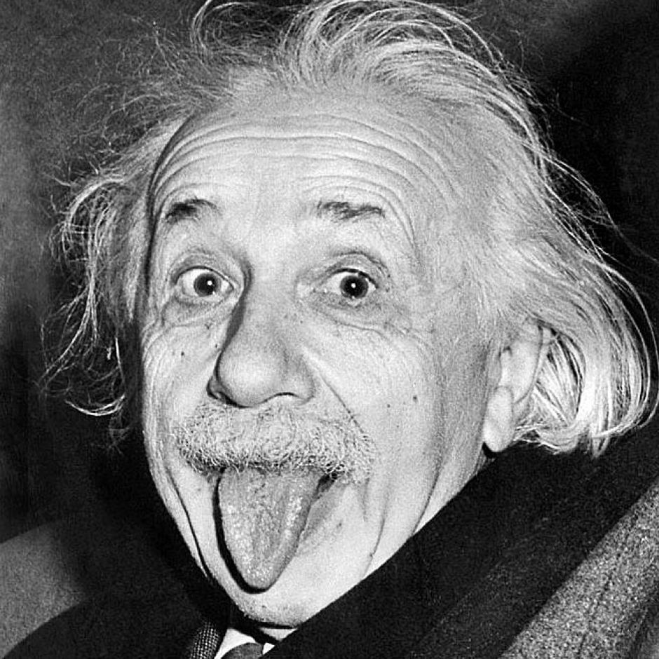
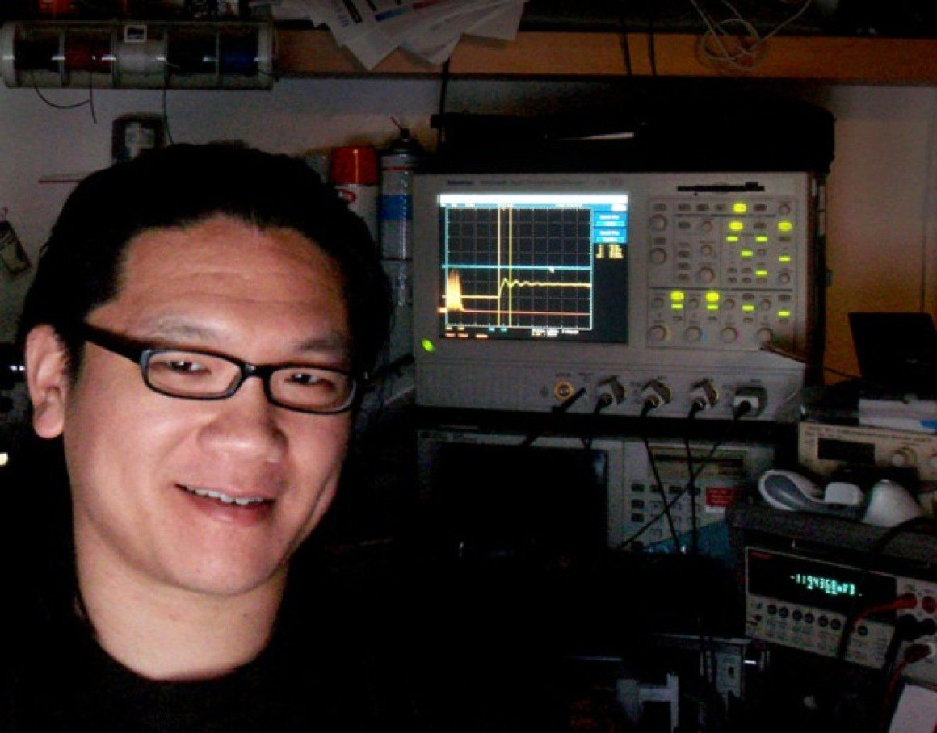
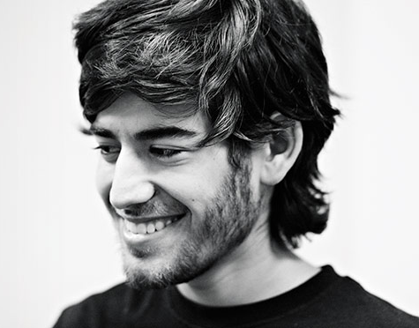
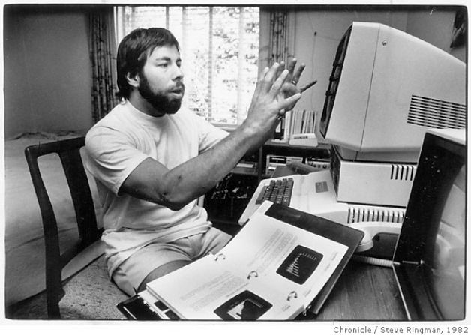

Slide 10
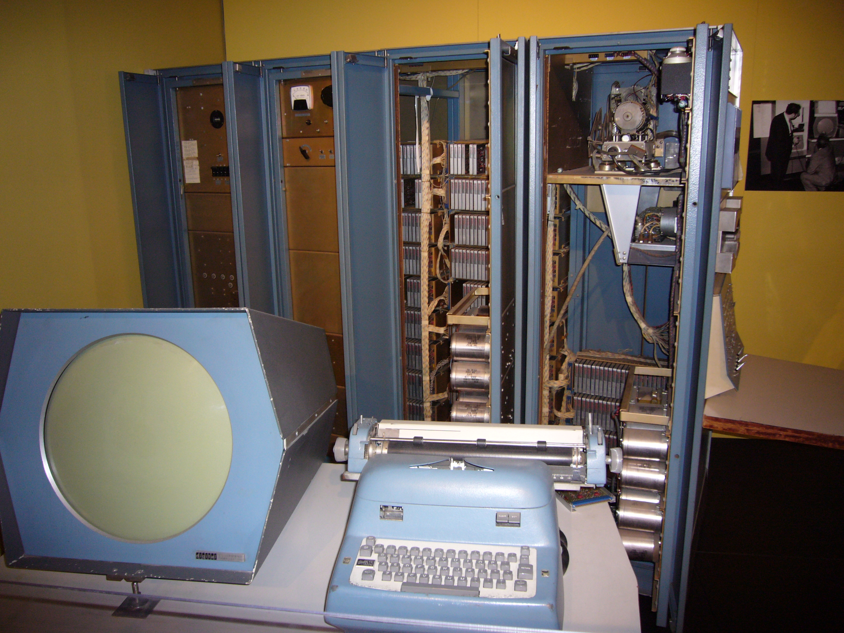
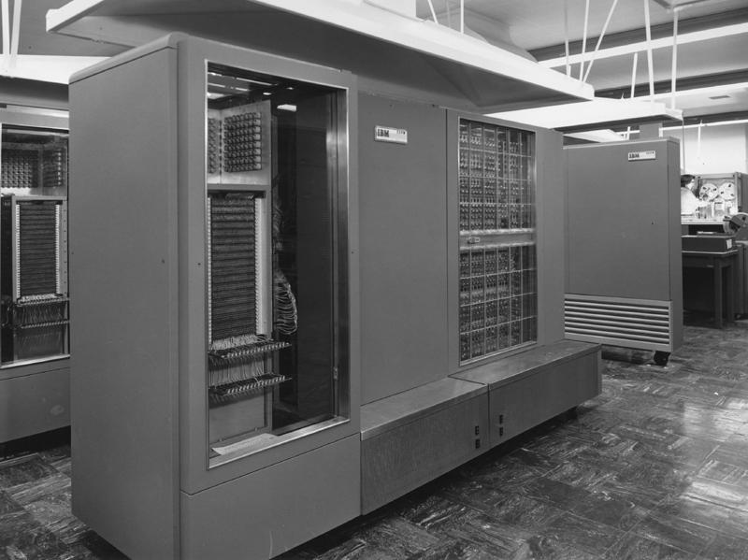
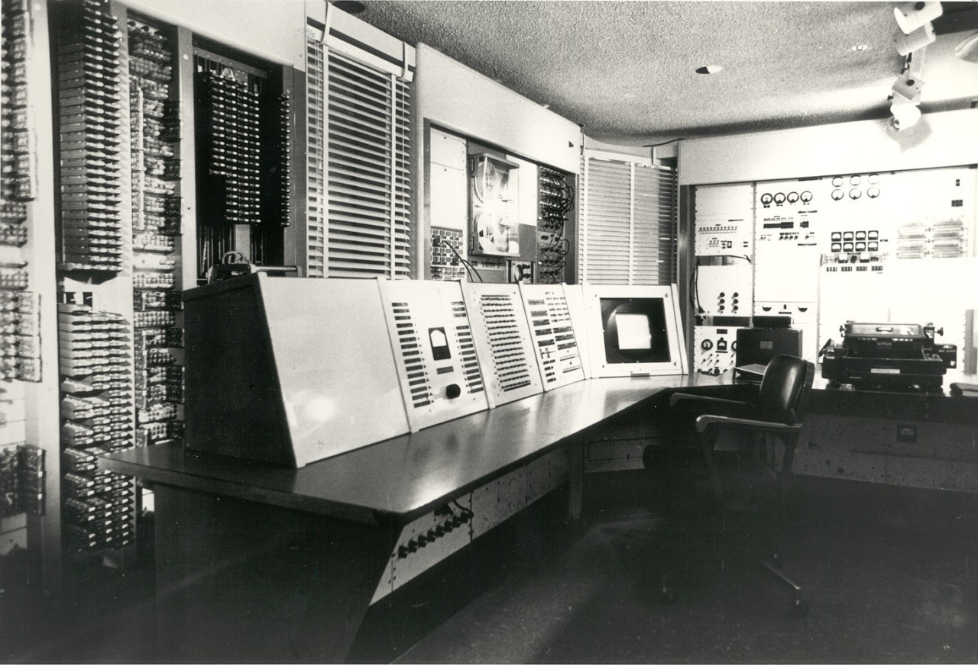

Slide 11
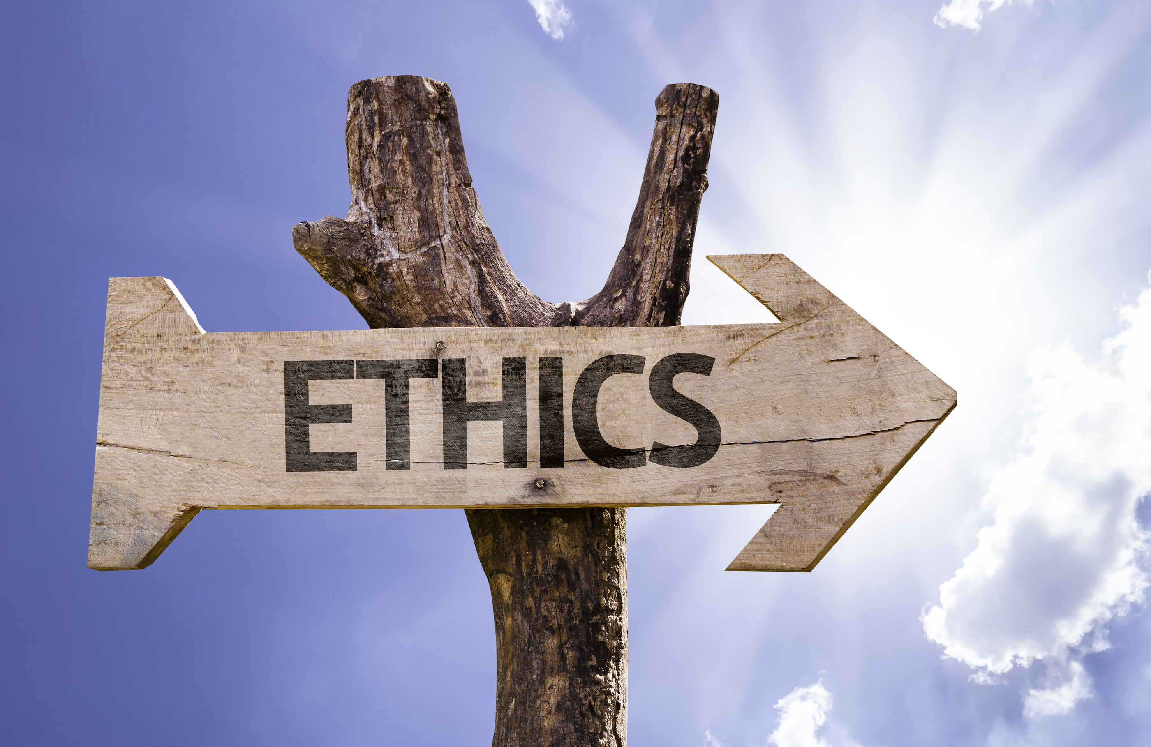
Hacker’s

Slide 12

Yield to
’Hands on’
Imperative

Slide 13

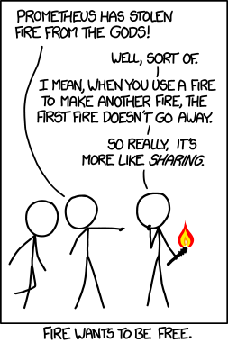
‘All information should be free’

Slide 14
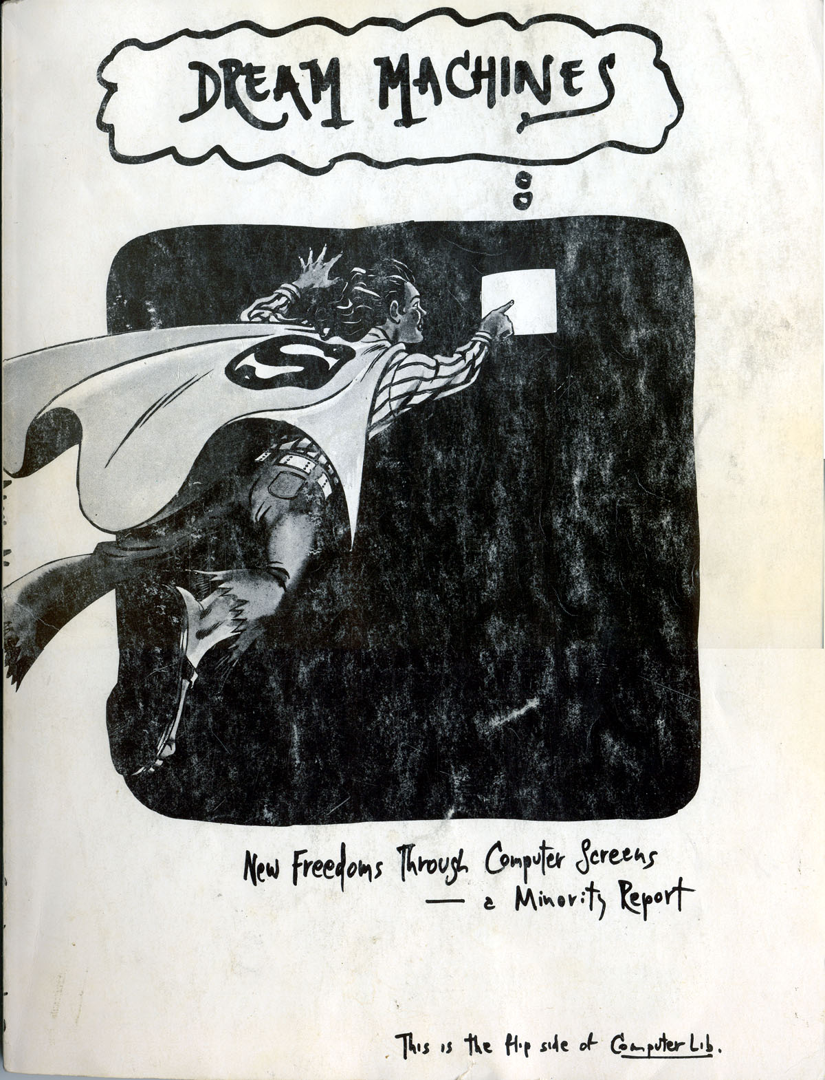
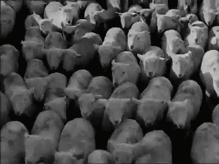
Mistrust authority
promote decentralizaion

Slide 15

Hackers are judged by Their hacking

Slide 16

You can Create
Art and beauty
on a computer

Slide 17

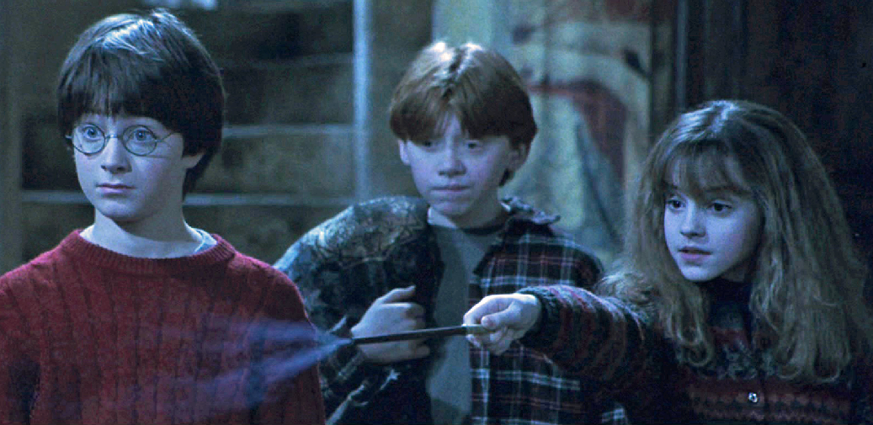
Computers can change your life!

Slide 18
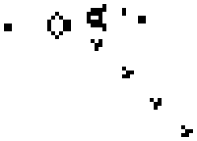
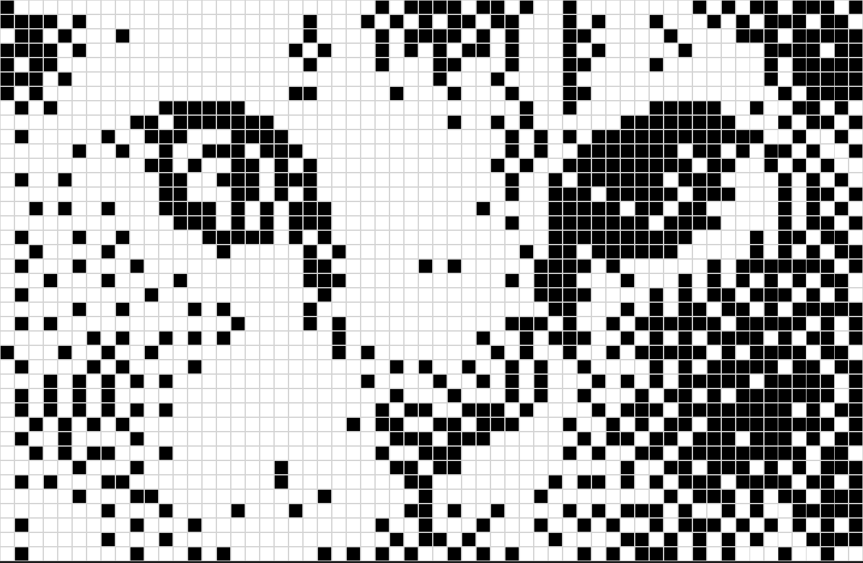
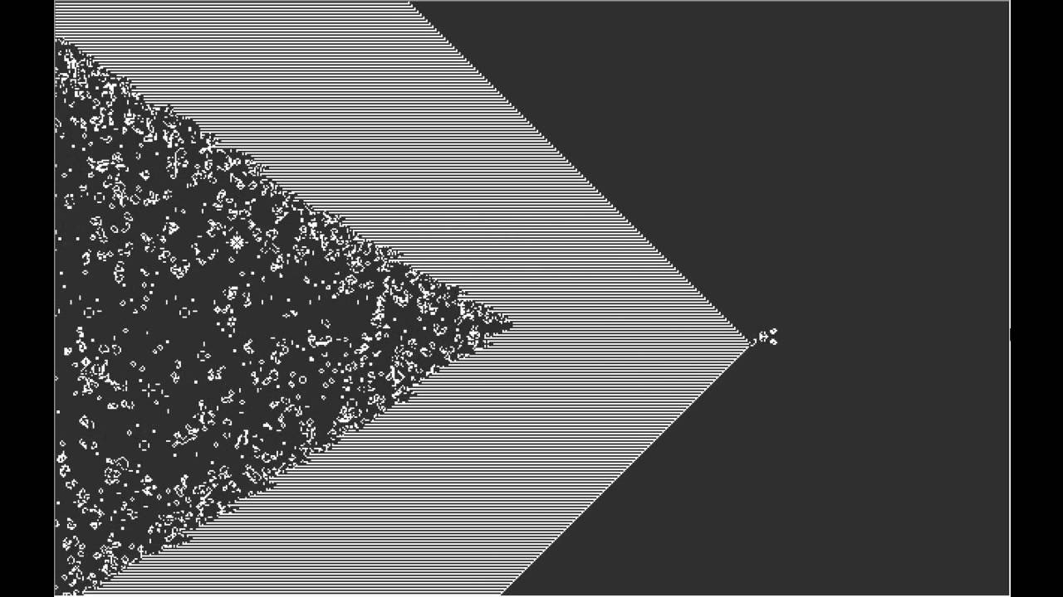
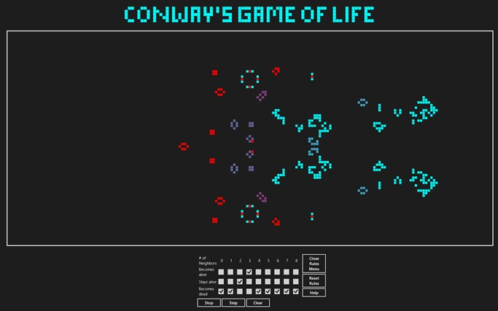

Slide 19
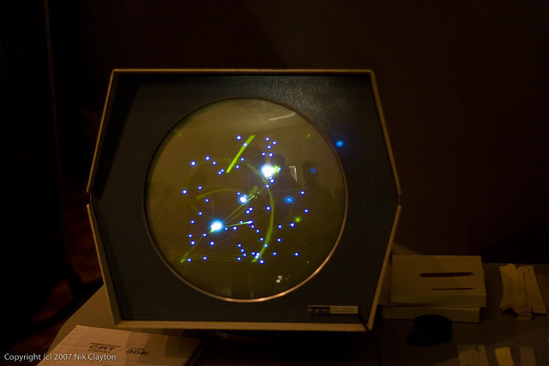
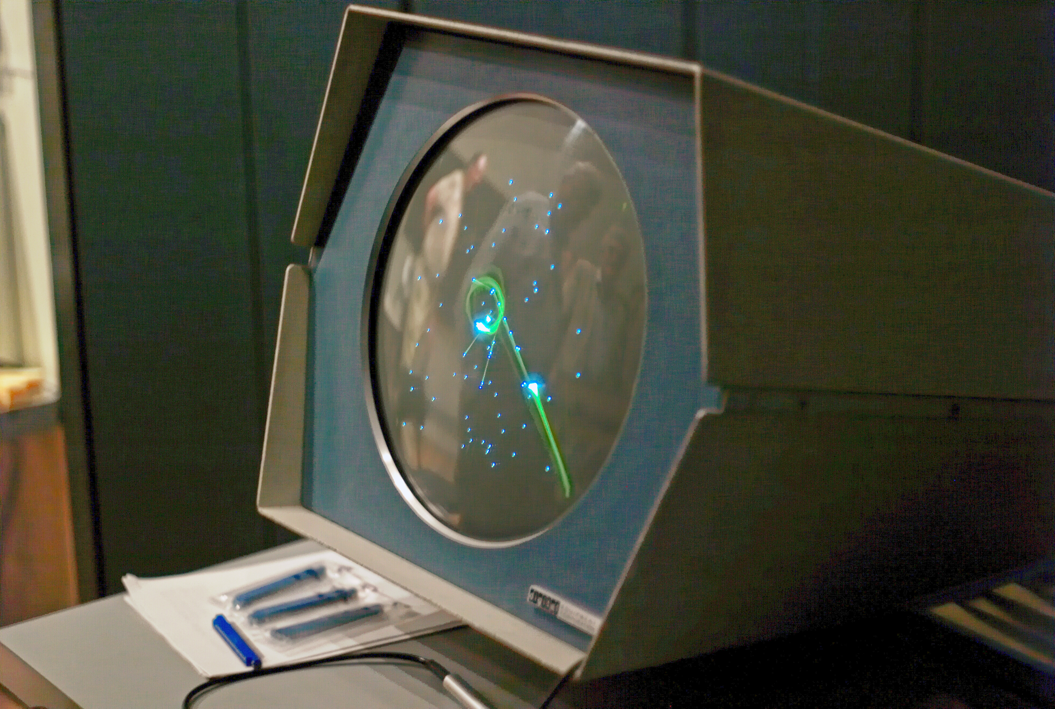
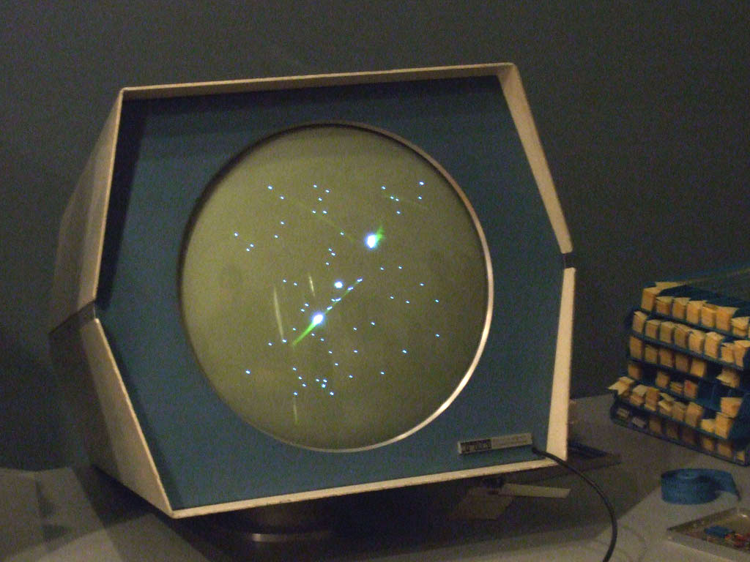
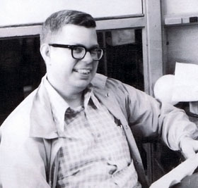
Space War!

Slide 20

Age? Not important!
Degree? Go to hell!
Gender? Poof!
Race? :|
Sickness? So what!
Neat Hacks
Bumming how Cool?
Art and Beauty
Share the Tools
…
Winners & losers ?

Slide 21
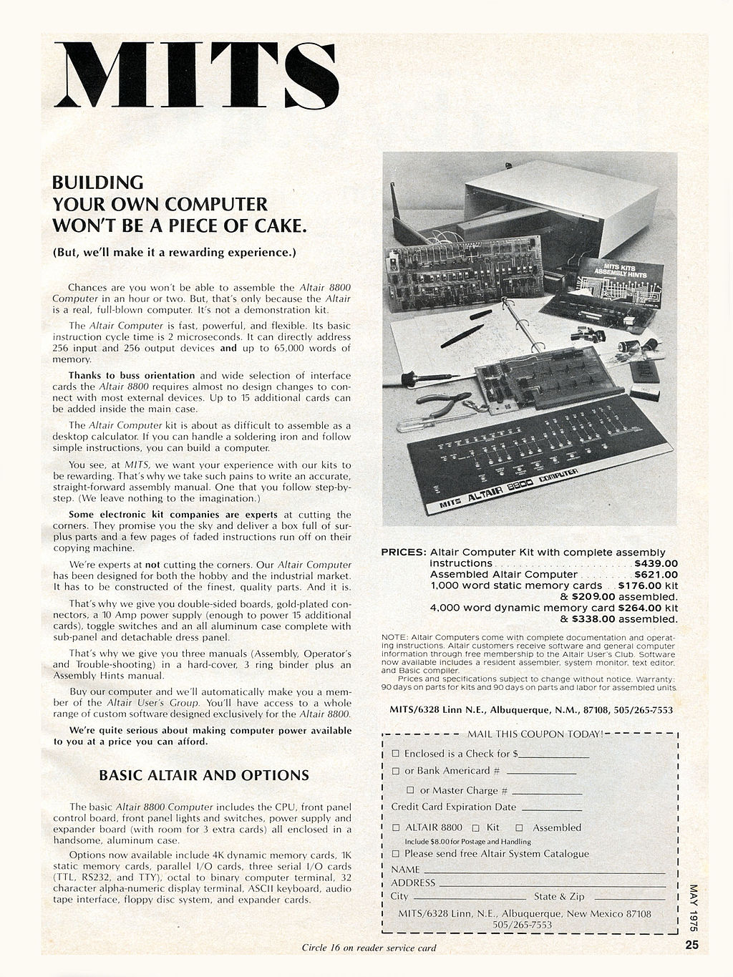
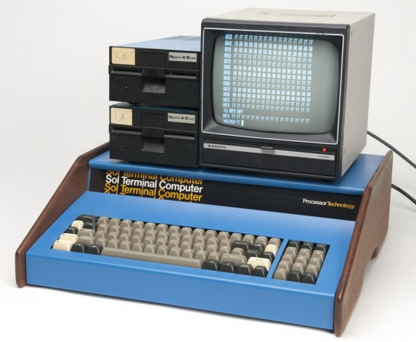
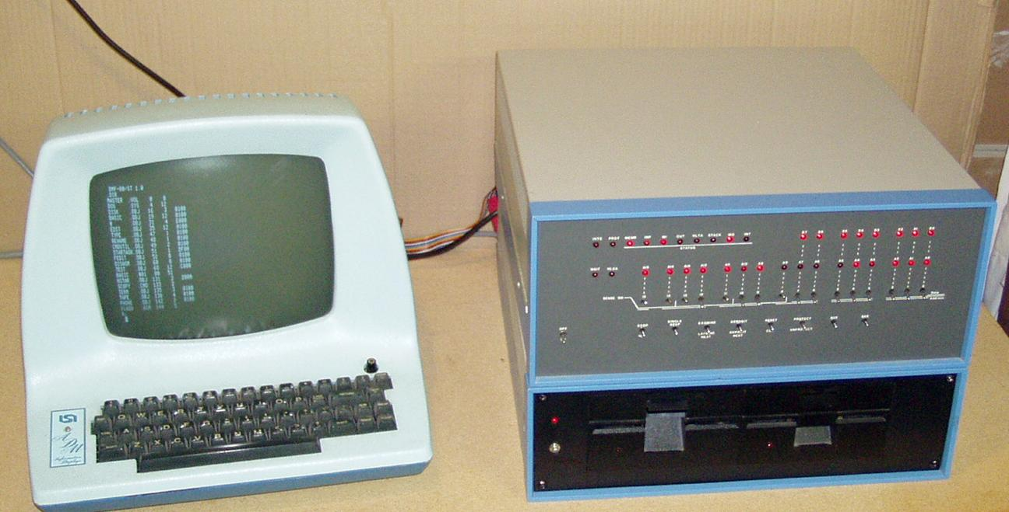

Slide 22
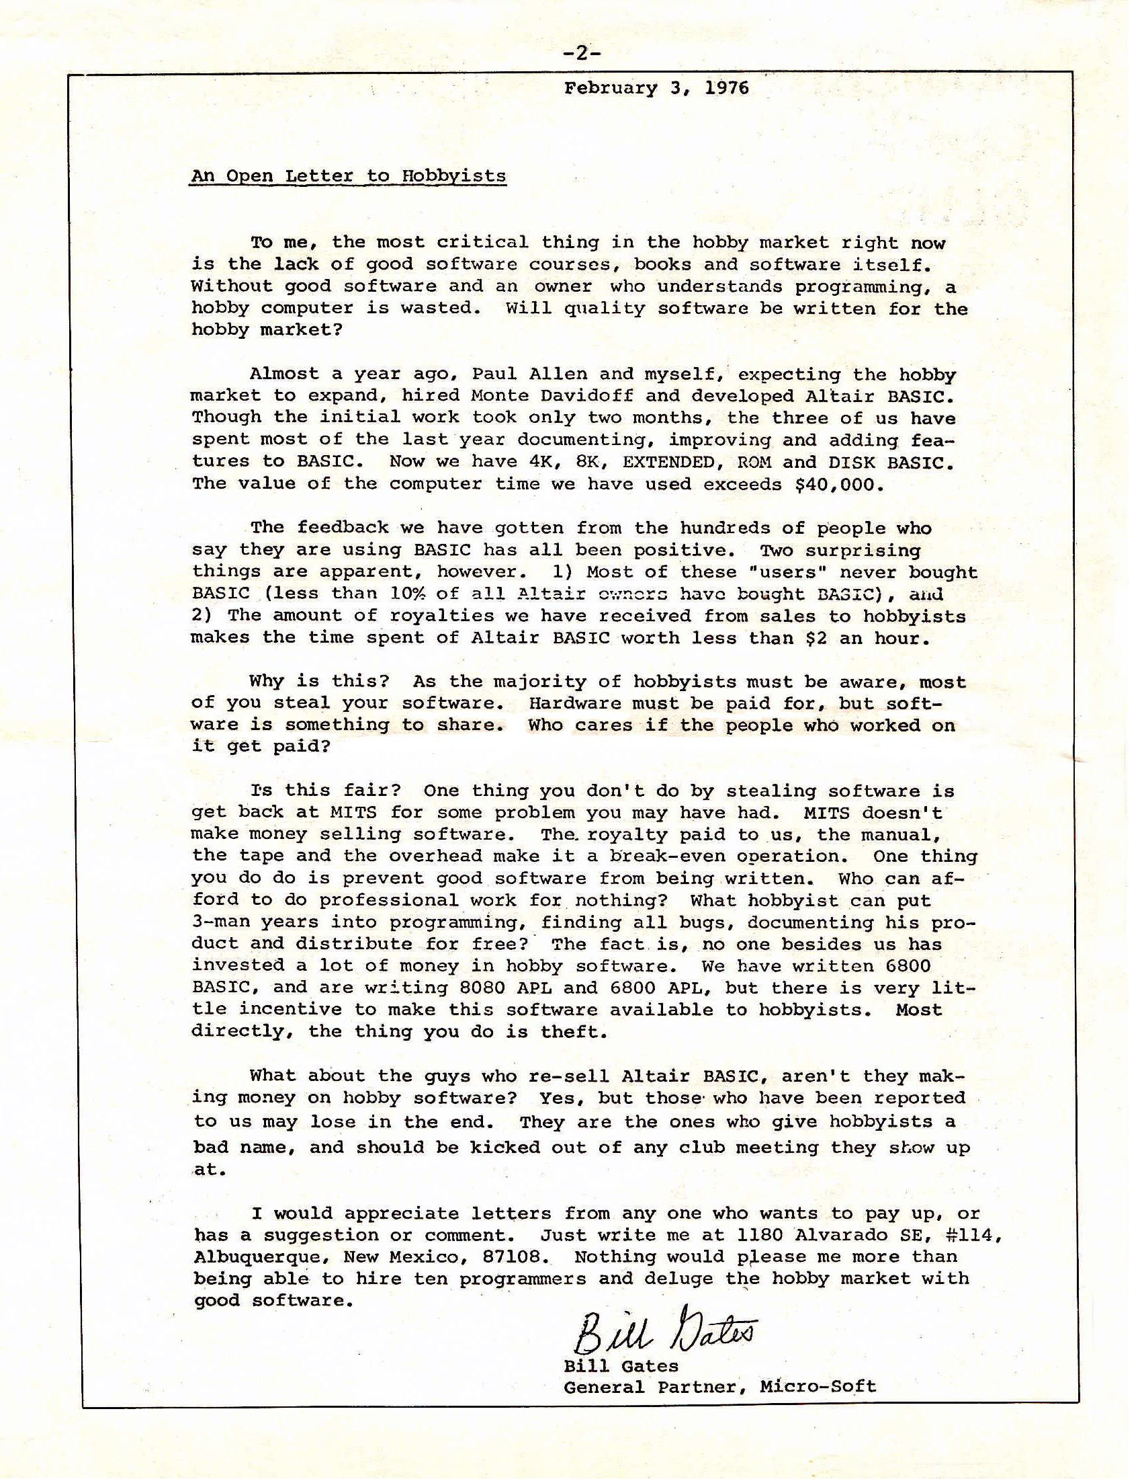
An Open Letter to Hobbyists
Quality <= Pay
Sharing | Stealing
Pay Up Time!
Comments & suggestions

Slide 23
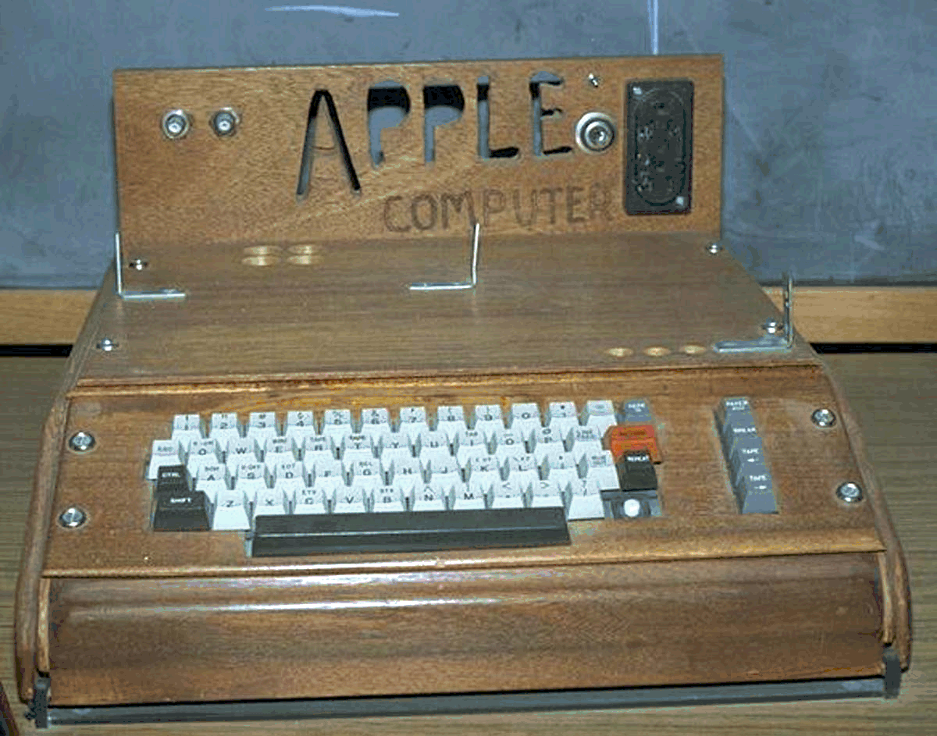
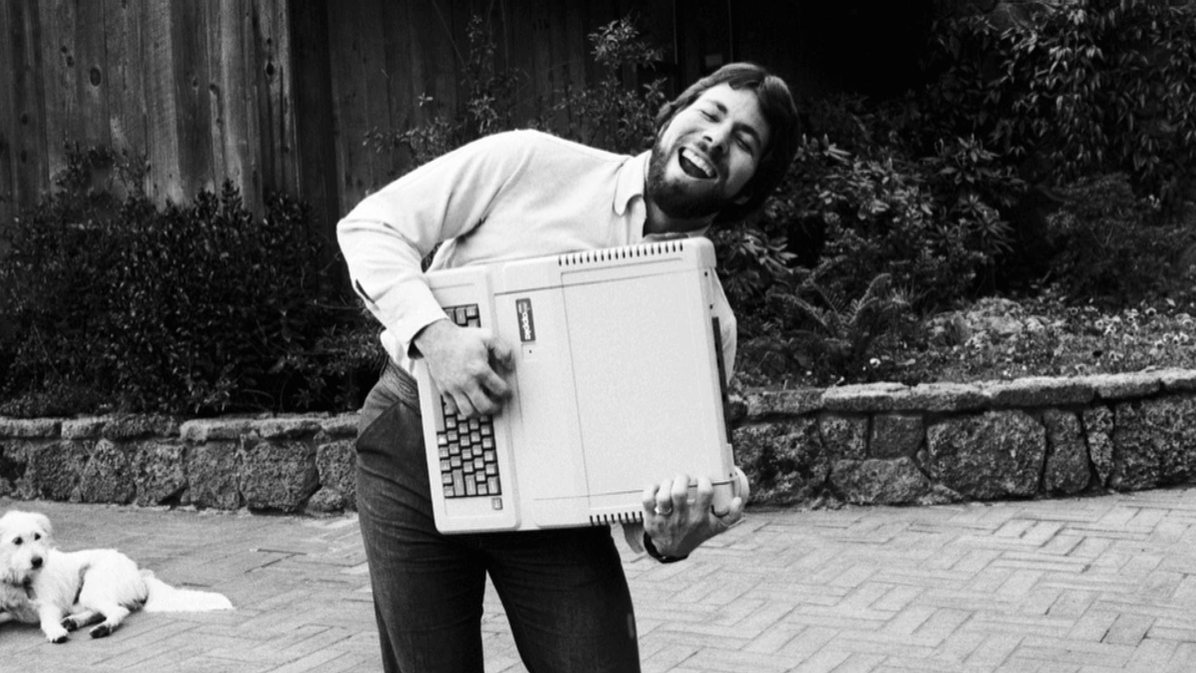

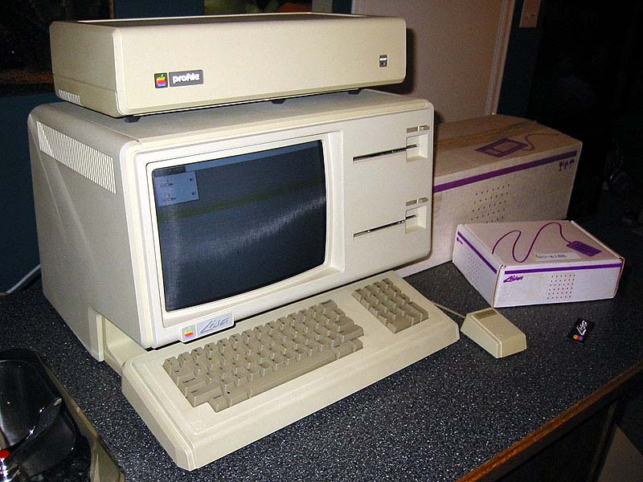
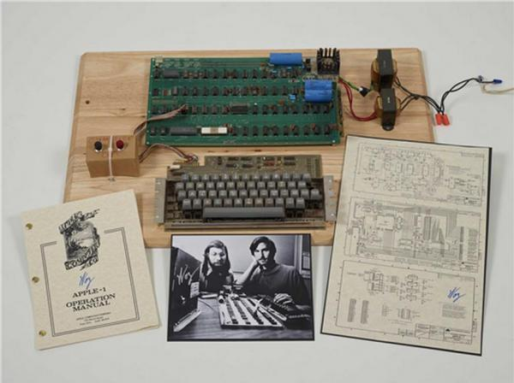

Slide 24

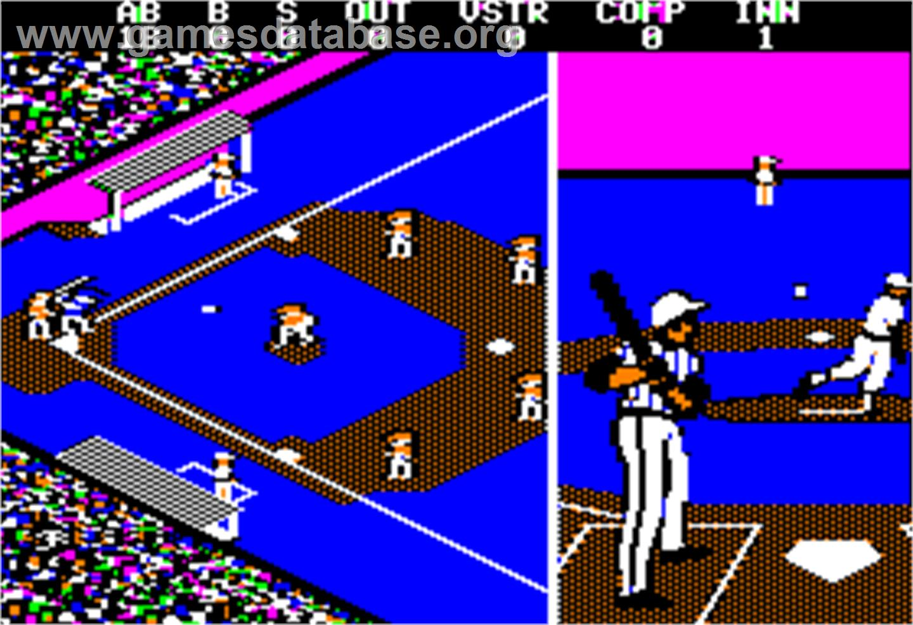
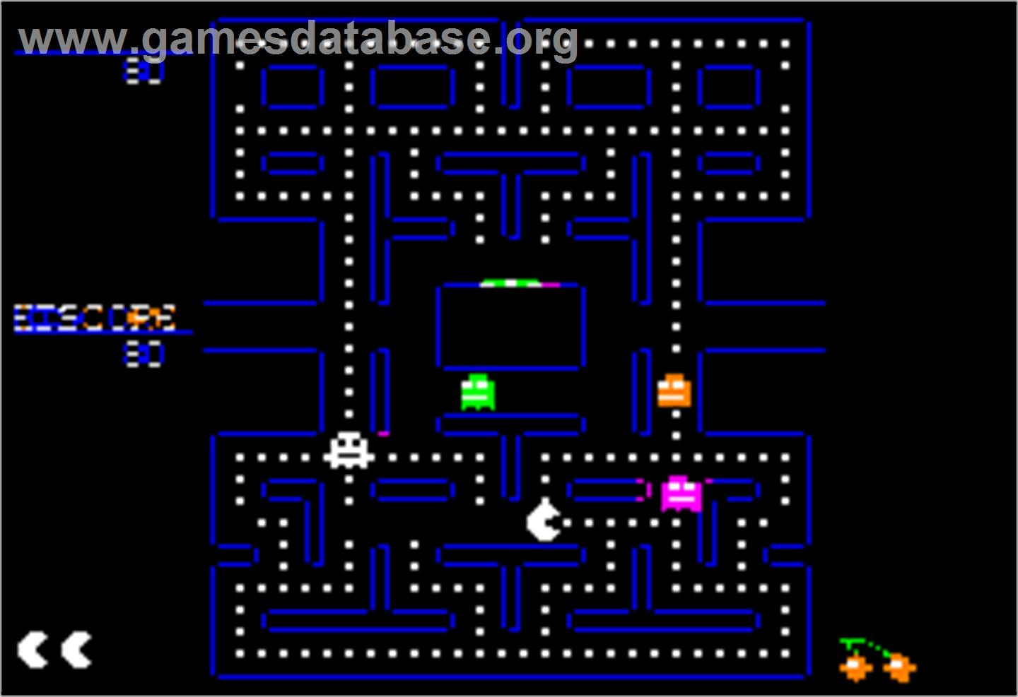
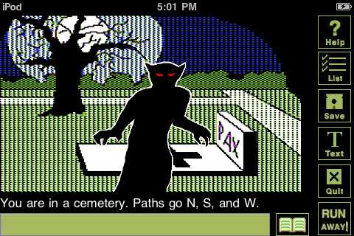
Third Generation;
Game Hackers!

Slide 25

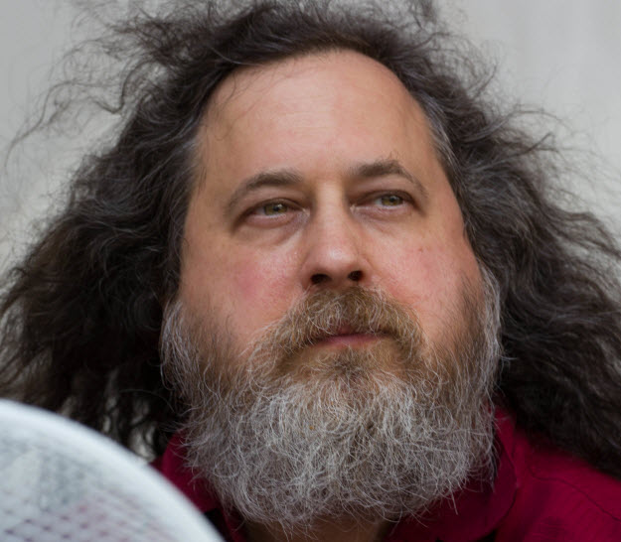
The Last True Hacker
:(
pursue The hacker Dream
GPL License
GNU OS
No
Linux,
Emacs
Gcc
Apache
PHP
Wikipedia
MySQL,
…
Without R.M.S

Slide 26
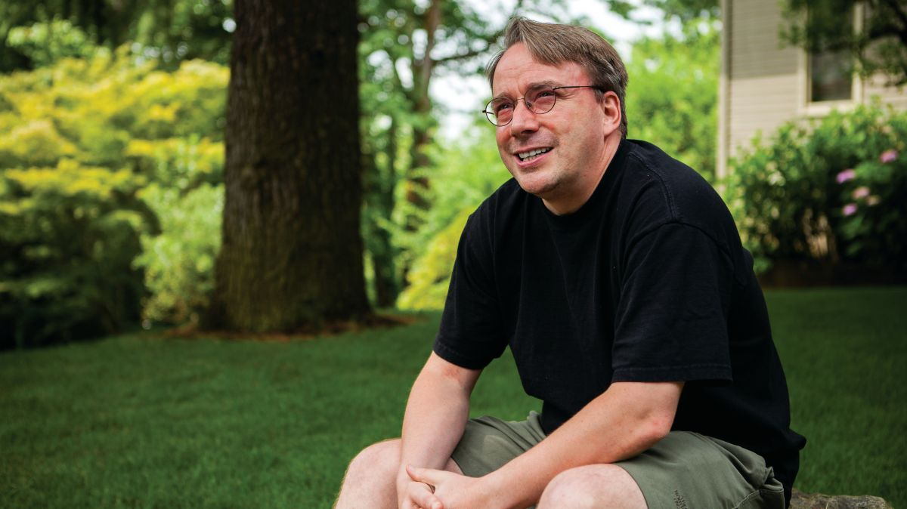
the Culture,
Huh?

Slide 27

&
Stay
Curious

Slide 28

Be Passionate

Slide 29

Open to Others

Slide 30


Slide 31
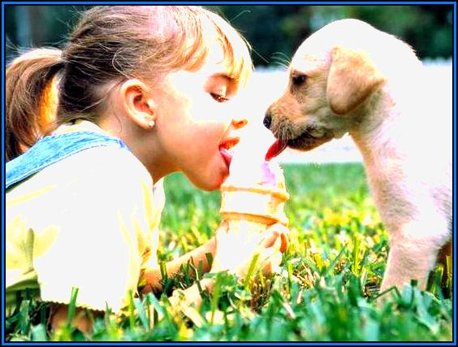
Share!

Slide 32
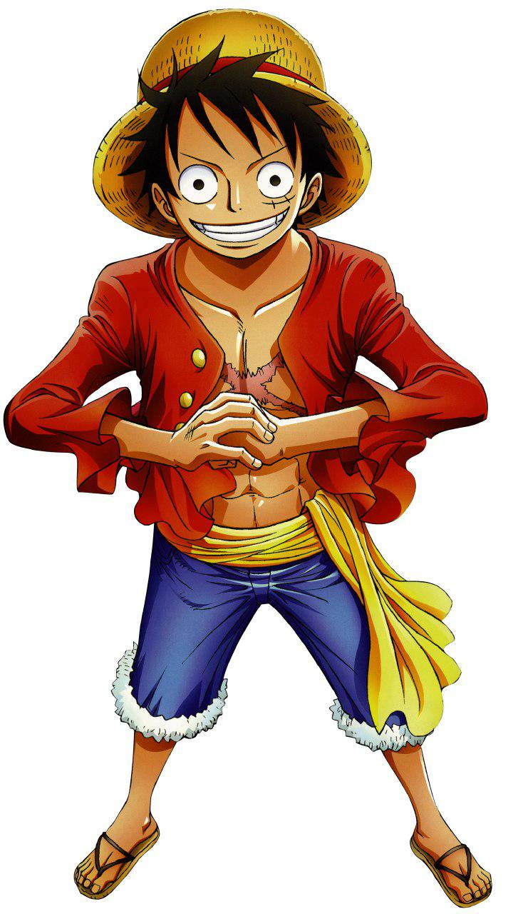
Be Brave!
Free People Should

Slide 33
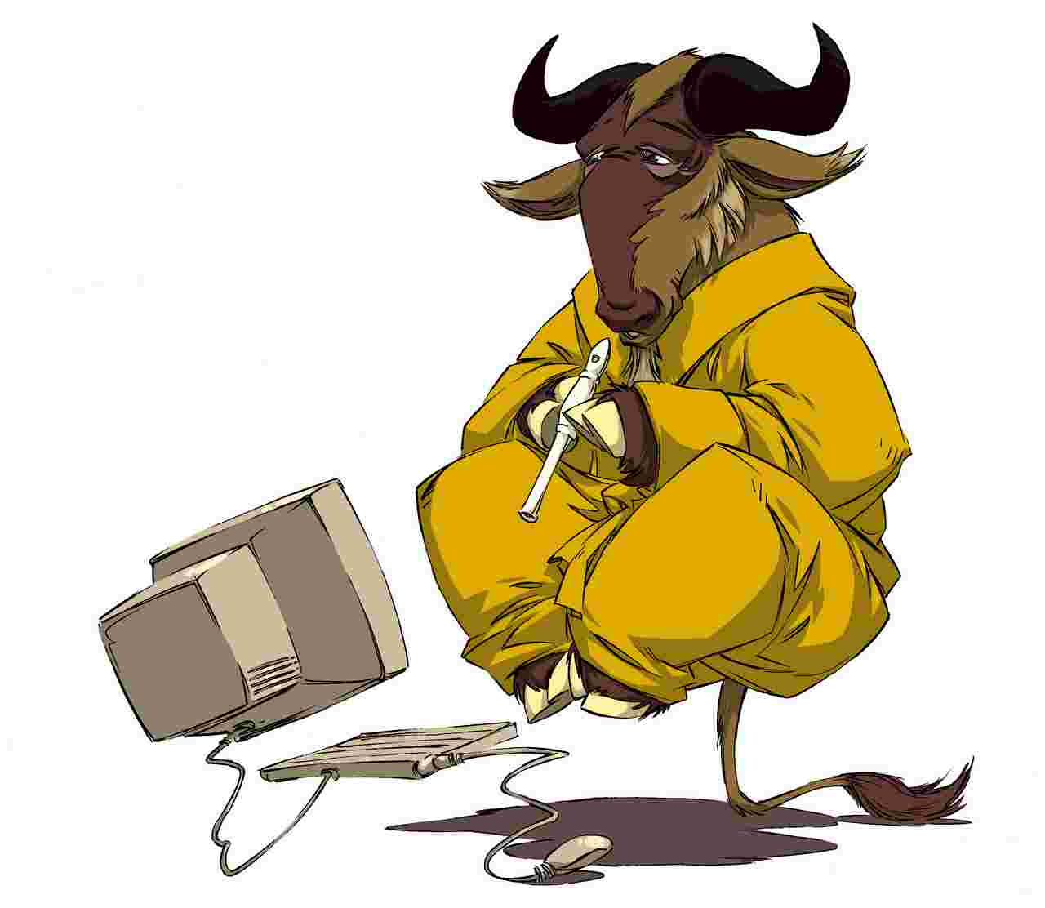
GNU Not Unix

Slide 34


Slide 35


Virtual Currency
Cryptocurrency
Decentralised
No Authorities
or Govs.
Each BTC $450 - $750
~15Million BTC

Slide 36




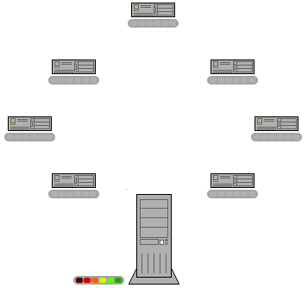
File Sharing!

Slide 37


Slide 38



