Slide 1
Adult Census Income Analysis Team 6
Lecturer: Dr. Arash Azarfar
Team members : Dina Omidvar Tehrani, Niloofar Tavakolian Nastaran Naseri, SeyedehMojdeh Haghighat Hosseini
Notes:
© Copyright PresentationGO.com – The free PowerPoint and Google Slides template library

Slide 2
overview of the problem
Have you ever wondered what key factors could propel your income to the next level?
Income Patterns
Income Prediction
Lighting Up Inequality & Empowerment
Demographic Insights
Probing Socioeconomic Dynamics
Dissecting Adult Income Factors
Date
Your Footer Here
2
Notes:
We are trying to Discover the answers with the enlightening insights from our Adult Census Income dataset."
we were curious to learn how 'Unlocking Income Patterns' can help us understand the factors influencing adult income levels.
Also how 'Income Prediction' could illuminate economic inequality and foster empowerment.
Leveraging this knowledge can empower individuals economically.
And filnally how 'Demographic Insights' can unravel the socioeconomic dynamics behind income levels?"
Income levels vary among different demographic groups, revealing challenges in our socioeconomic fabric.

Slide 3
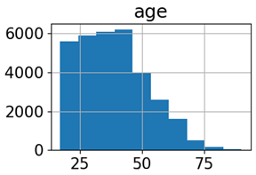
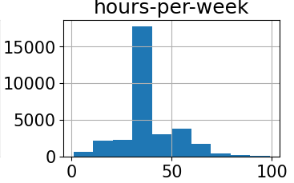
Dataset selection
Adult Census Income dataset
Kaggle(48,842 instances and 15 attributes)
target variable
indicates income level (<=50K or >50K)
Features
.
Demographic Factors
Age
Socioeconomic Factors
Education
Family and Personal Status
Marital-status
Sex
Race
Native-Country
Education-num (number of educational years completed)
Workclass
Relationship
Occupation
Hours-per-week
Capital-gain
Capital-loss
Fnlwgt
Income
Distribution of some numerical features
Economic and
Work Factors
Date
Footer Here
3
Notes:
The Adult Census Income dataset obtained from Kaggle consists of 48,842 instances and 15 attributes.
The target variable indicates income level (<=50K or >50K).
Features include demographic information, work-related factors, and socioeconomic characteristics of individuals in the United States.
the "fnlwgt" feature represents the final weight assigned to each observation in the census data. This weight is applied to ensure that the sample accurately represents the population and is a critical component in producing unbiased estimates.
Furthermore, the features "capital.gain" and "capital.loss" capture the financial gains and losses, respectively, that individuals have experienced. These features provide insights into the economic activities and investments made by individuals, which can significantly influence their overall income levels.
Here is Visualization some numerical features of the dataset using histograms to analyze the distribution of those features in the dataset.

Slide 4
Expectations and Goals
Developing a predictive model
Feature importance analysis
Evaluating model performance
Generating actionable insights
Comparing methodologies
Notes:
Developing a predictive model: Creating a machine learning model for accurate income level predictions.
Feature importance analysis: Identifying influential factors affecting income levels.
Evaluating model performance: Assessing accuracy, precision, recall, and F1-score using appropriate evaluation metrics.
Comparing methodologies: Evaluating different machine learning algorithms and deep learning approaches (e.g., CNN or RNN models) for predicting income levels.
Generating actionable insights: Informing policymakers, social scientists, and economists to address income disparities and promote economic equality.
© Copyright PresentationGO.com – The free PowerPoint and Google Slides template library

Slide 5
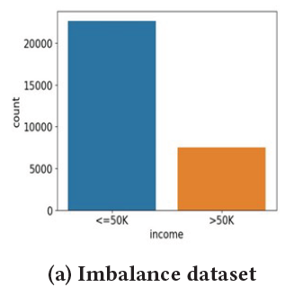
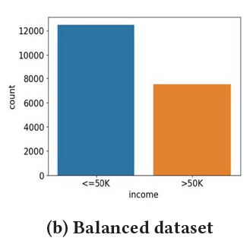
Pre-processing
Handling missing values
Dealing with class imbalance
Feature engineering
Interpreting and explaining results
5
Notes:
Challenges:
Handling missing values: Addressing missing data using appropriate techniques. The challenge of missing values in features like workclass and occupation was addressed by removing the corresponding samples from the dataset to maintain data integrity.
Dealing with class imbalance: Handling imbalanced income classes through oversampling or undersampling. The target variable exhibited a class imbalance, with a larger number of samples having income <= $50,000. To address this, downsampling of the majority class was performed to create a more balanced dataset, improving prediction accuracy.
Feature engineering: Extracting meaningful information and selecting relevant features for predicting income levels.
Interpreting and explaining results: Providing insights into income disparities and potential intervention strategies.

Slide 6




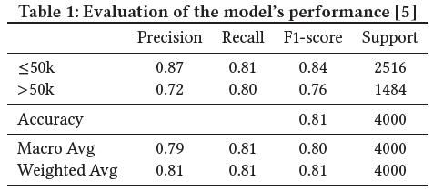
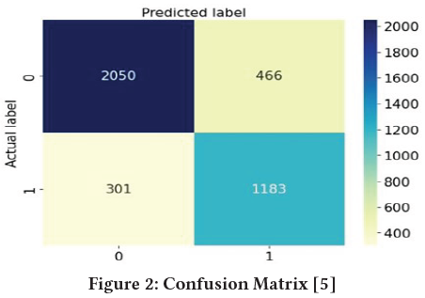
Supervised Learning: Decision Tree classification
Mixed data handling
Ensuring representation in datasets
Notes:
we have decided to employ a decision tree classifier as our model of choice for predicting income levels. We tried to address some challenges for training the Decision Tree Model.
Handling missing values: The challenge of missing values in features like workclass and occupation was addressed by removing the corresponding samples from the dataset to maintain data integrity.
Class imbalance: The target variable exhibited a class imbalance, with a larger number of samples having income <= $50,000. To address this, downsampling of the majority class was performed to create a more balanced dataset, improving prediction accuracy.
Mixed data handling: The dataset consisted of both numerical and categorical data, posing a challenge in training the decision tree classifier. One-hot encoding was used to transform categorical features into numerical representations compatible with the algorithm.
Ensuring representation in datasets: Extra measures were taken to verify that all categories within categorical features were adequately represented in the training, testing, and validation sets. This ensured the decision tree classifier learned from the entire range of categorical values without biases or performance disparities.
To ensure compatibility with the decision tree classifier, the categorical features in the dataset are encoded using one-hot encoding.
The table illustrates the model's performance assessment using suitable metrics including accuracy, precision, recall, and F1 score. Confusion matrix is also obtained based on predicted and Actual labels.

Slide 7
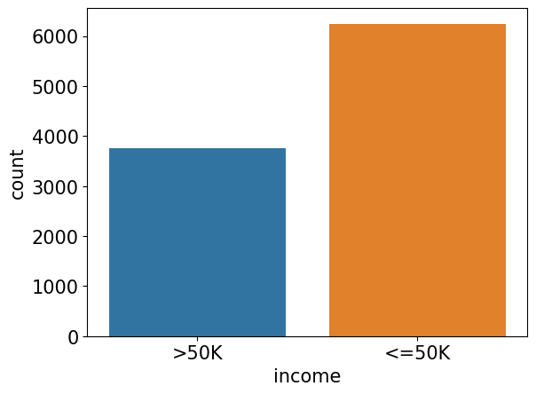
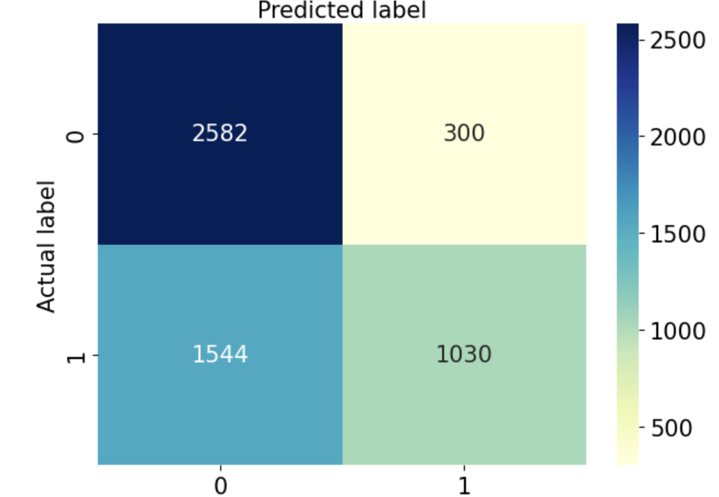
semi-supervised learning using a decision tree classifier
Training and Predictions on Labeled and Unlabeled Data
Probabilities for Predicted Labels
Setting Confidence Threshold
Identifying Confident Predictions
Adding Confident Predictions to Labeled Dataset
Removing Predicted Samples for Next Iteration
Calculating Accuracy of Combined Dataset
Appending Features to X_labeled
Date
Your Footer Here
7
Notes:
The code implements a semi-supervised learning algorithm using a decision tree classifier. It starts by splitting the labeled and unlabeled datasets into features (X) and target variables (y). The labeled data is used initially to train the decision tree classifier, and the unlabeled data is used for prediction.
The code then enters a loop for a specified number of iterations. In each iteration:
The decision tree is trained on the labeled data, and predictions are made on the unlabeled data.
Predicted labels are assigned probabilities using the predict_proba function.
A confidence threshold is set to determine which predictions are considered confident.
Confident predictions are identified based on the probabilities exceeding the confidence threshold.
The confident predictions, including their features and labels, are added to the labeled dataset.
The features of the confident predictions are appended to the labeled features (X_labeled).
The accuracy of the combined labeled and unlabeled dataset is calculated.
The confidently predicted samples are removed from the unlabeled dataset for the next iteration.
The purpose of this algorithm is to iteratively improve the model's accuracy by gradually incorporating confident predictions from the unlabeled data into the labeled dataset. This way, it takes advantage of both labeled and unlabeled data to train the decision tree classifier.

Slide 8
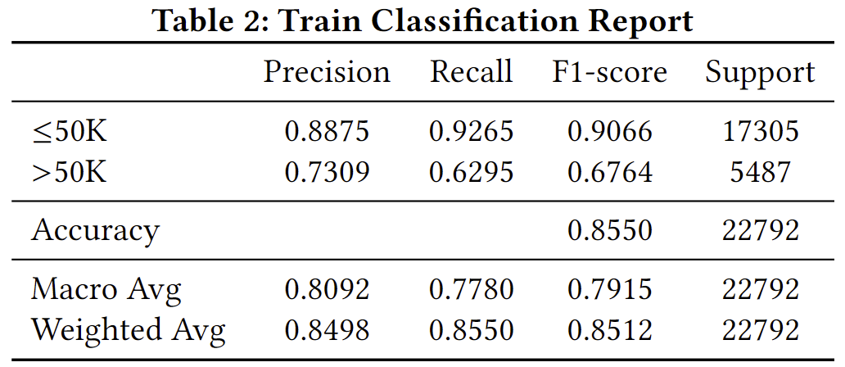
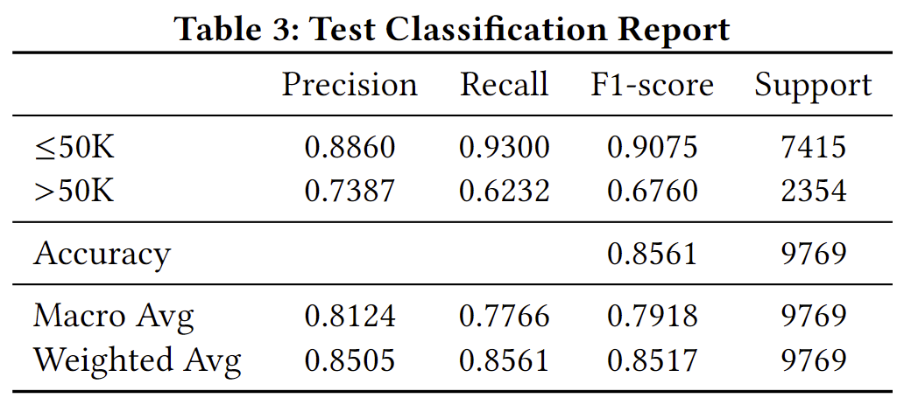
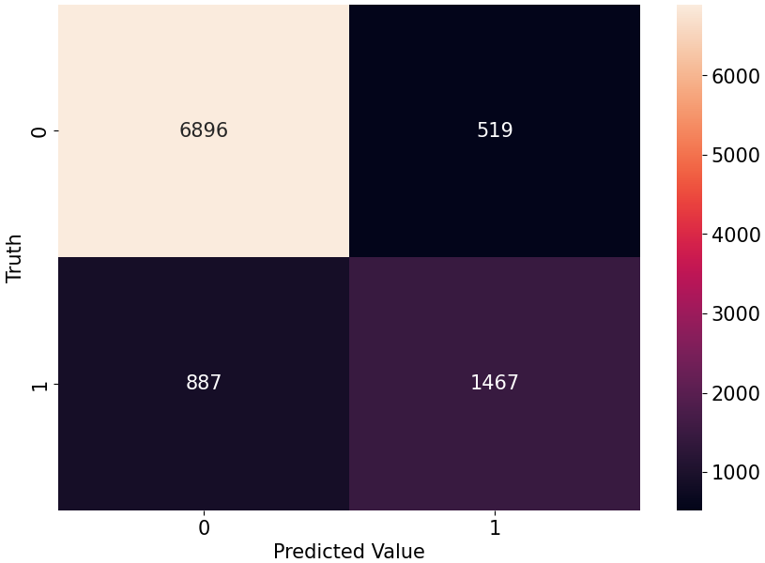
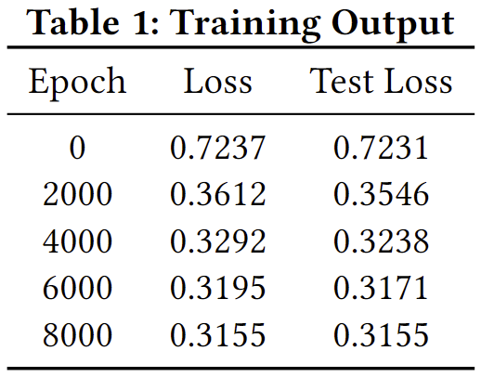
Supervised Learning: Classification with a deep learning model
Activation Function
Hyper-
parameters
Layers
DNN Model Architecture
Notes:
after data pre processing : handling missing values ( replacing the characters with NaN ), encoding categorical variables ( apply label encoding to each categorical column ) and splitting into features and target variables ( test size : 0.3 ), scaling the numerical features, Fit and transform the categorical features using one-hot,
apply only label encoding to target variable, Standardization to numerical variables,
Model : classification adultCensus : 4 layers, 34 in layer1 – 128 in layer 3 – 1 out 4th
Relu
Dropout
Optimizer : SGD ; lr: 0.01 ( trial amd error )
Criterion : BCEWithLogitsLoss
Manual seeding
#epochs : 10000
-------------------------------------------------------------------------------------------------------------------------------------------
Model Architecture
The input_shape is set to (X_train.shape[1],), which corresponds to the number of features.
The first dense layer has 64 neurons and uses the ReLU (Rectified Linear Unit)
activation function. It introduces non-linearity into the neural network, allowing it to learn complex patterns in the data.
The sigmoid activation function squashes the output between 0 and 1, making it suitable for binary classification problems.
The output value represents the probability of the input belonging to the positive class (income >$50,000).
Model Training
We use 'adam' optimizer , which is a popular optimization algorithm known for its efficiency and adaptive learning rate.
Also we use 'binary_crossentropy' as the loss function. It is suitable for binary classification tasks.
DNN : 3 layer; a Sequential model in Keras, composed of three dense layers. The first two dense layers each have 128 units and use the ReLU
activation function. The final layer has 10 units (one for each class) and uses a softmax activation function for the multi-class classification problem
Keras Tuner’s RandomSearch for hyperparameter tuning, focusing on learning rate, number of units in layers, and batch size.
The best model used a learning rate of 0.01, 128 units in the first two layers, and a batch size of 32.

Slide 9
Refrences
“Adult census income,” kaggle, https://www.kaggle.com/datasets/uciml/adult- census- income?resource=download.
“Handling missing data,” scikit-learn documentation, 2023, https://scikit-learn. org/stable/modules/impute.html.
D. Omidvar, N. Tavakolian, N. Naseri, and S. H. Hosseini, “Project github,” https: //github.com/dinaomidvartehrani/Applied- AI- .git.
“Resampling methods,” scikit-learn documentation, 2023, https://scikit-learn. org/stable/modules/classes.html#module- sklearn.utils.
J. Brownlee, “Why one-hot encode data in machine learning?” 2020, https://machinelearningmastery.com/why-one-hot-encode-data-in-machine- learning/.

Slide 10
Thank You!
Notes:
© Copyright PresentationGO.com – The free PowerPoint and Google Slides template library

