Slide 1
Adult Census Income Analysis Team 6
Lecturer: Dr. Arash Azarfar
Team members : Dina Omidvar Tehrani, Niloofar Tavakolian Nastaran Naseri, SeyedehMojdeh Haghighat Hosseini
Notes:
© Copyright PresentationGO.com – The free PowerPoint and Google Slides template library

Slide 2

Problem Statement, Application, and Associated Challenges
Unlocking Income Patterns: Analyzing Factors Shaping Adult Income Levels
Income Prediction: Illuminating Inequality and Driving Economic Empowerment
Demographic Insights: Exploring Socioeconomic Dynamics and Challenges in Income Levels
Handling missing values
Dealing with class imbalance
Feature engineering
Interpreting and explaining results
Notes:
-The Adult Census Income dataset analyzes factors contributing to income levels in the adult population.
-Predicting whether an individual earns more than $50,000 per year is important for understanding income inequality and developing economic empowerment strategies.
-The dataset helps explore the relationship between demographic factors and income levels, providing insights into socioeconomic dynamics and challenges faced by different groups.
Challenges:
Handling missing values: Addressing missing data using appropriate techniques.
Dealing with class imbalance: Handling imbalanced income classes through oversampling or undersampling.
Feature engineering: Extracting meaningful information and selecting relevant features for predicting income levels.
Interpreting and explaining results: Providing insights into income disparities and potential intervention strategies.
© Copyright PresentationGO.com –The free PowerPoint and Google Slides template library

Slide 3
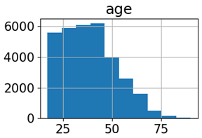
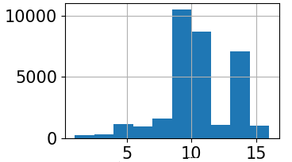
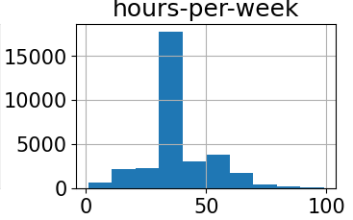
Dataset Selection
Adult Census Income dataset: Kaggle(48,842 instances and 15 attributes)
The target variable indicates income level (<=50K or >50K)
Features: age, workclass, fnlwgt, education, education-num, marital-status, occupation, relationship, race, sex, capital-gain, capital-loss, hours-per-week, native-country, income
Distribution of some numerical features
Notes:
The Adult Census Income dataset obtained from Kaggle consists of 48,842 instances and 15 attributes.
The target variable indicates income level (<=50K or >50K).
Features include demographic information, work-related factors, and socioeconomic characteristics of individuals in the United States.
the "fnlwgt" feature represents the final weight assigned to each observation in the census data. This weight is applied to ensure that the sample accurately represents the population and is a critical component in producing unbiased estimates.
Furthermore, the features "capital.gain" and "capital.loss" capture the financial gains and losses, respectively, that individuals have experienced. These features provide insights into the economic activities and investments made by individuals, which can significantly influence their overall income levels.
Here is Visualization some numerical features of the dataset using histograms to analyze the distribution of those features in the dataset.
© Copyright PresentationGO.com –The free PowerPoint and Google Slides template library

Slide 4
Expectations and Goals
Developing a predictive model
Feature importance analysis
Evaluating model performance
Generating actionable insights
Comparing methodologies
Notes:
Developing a predictive model: Creating a machine learning model for accurate income level predictions.
Feature importance analysis: Identifying influential factors affecting income levels.
Evaluating model performance: Assessing accuracy, precision, recall, and F1-score using appropriate evaluation metrics.
Comparing methodologies: Evaluating different machine learning algorithms and deep learning approaches (e.g., CNN or RNN models) for predicting income levels.
Generating actionable insights: Informing policymakers, social scientists, and economists to address income disparities and promote economic equality.
© Copyright PresentationGO.com – The free PowerPoint and Google Slides template library

Slide 5
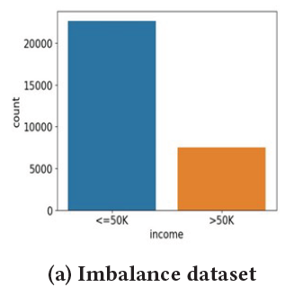
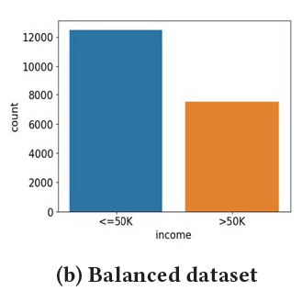




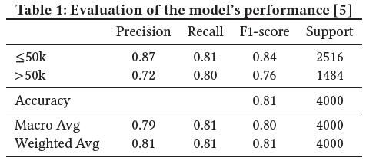
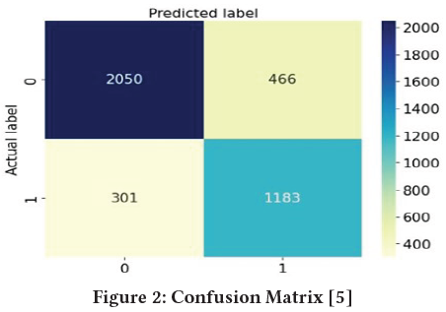
Supervised Learning: Decision Tree classification
Handling missing values
Class imbalance
Mixed data handling
Ensuring representation in datasets
Notes:
we have decided to employ a decision tree classifier as our model of choice for predicting income levels. We tried to address some challenges for training the Decision Tree Model.
Handling missing values: The challenge of missing values in features like workclass and occupation was addressed by removing the corresponding samples from the dataset to maintain data integrity.
Class imbalance: The target variable exhibited a class imbalance, with a larger number of samples having income <= $50,000. To address this, downsampling of the majority class was performed to create a more balanced dataset, improving prediction accuracy.
Mixed data handling: The dataset consisted of both numerical and categorical data, posing a challenge in training the decision tree classifier. One-hot encoding was used to transform categorical features into numerical representations compatible with the algorithm.
Ensuring representation in datasets: Extra measures were taken to verify that all categories within categorical features were adequately represented in the training, testing, and validation sets. This ensured the decision tree classifier learned from the entire range of categorical values without biases or performance disparities.
To ensure compatibility with the decision tree classifier, the categorical features in the dataset are encoded using one-hot encoding.
The table illustrates the model's performance assessment using suitable metrics including accuracy, precision, recall, and F1 score. Confusion matrix is also obtained based on predicted and Actual labels.

Slide 6
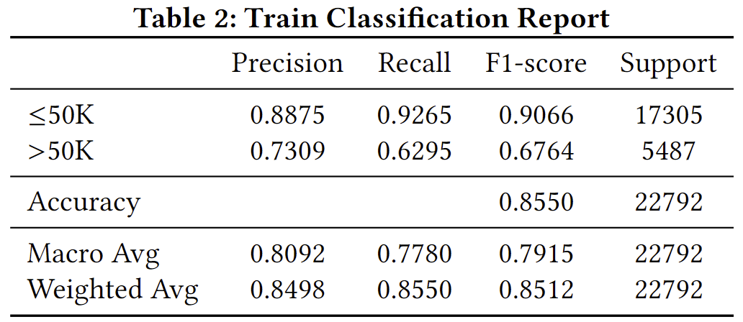
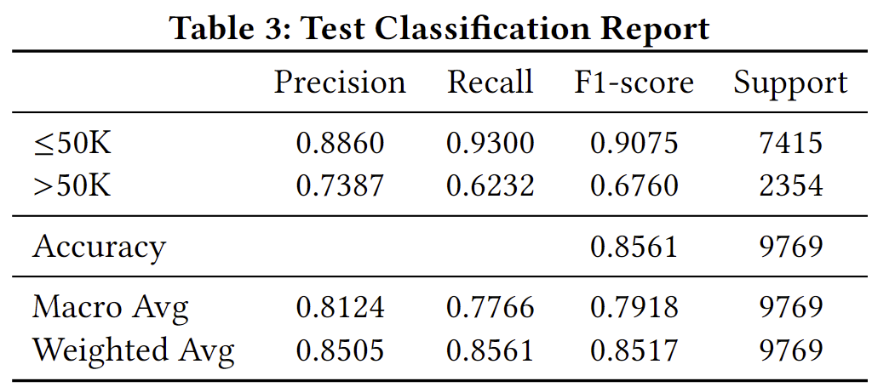
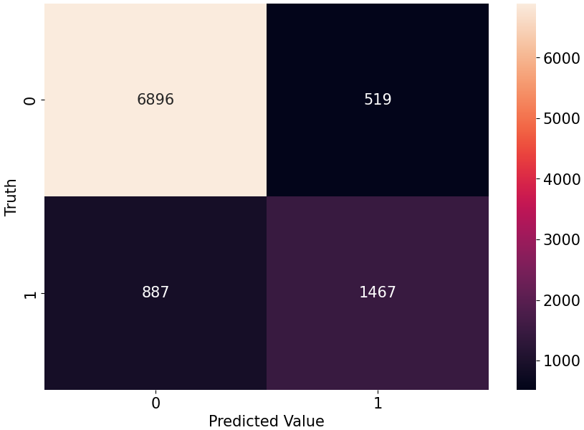
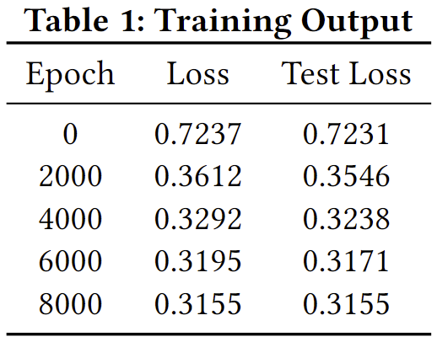
Supervised Learning: Classification with a deep learning model
Activation Function
Hyper-
parameters
Layers
DNN Model Architecture
Notes:
after data pre processing : handling missing values ( replacing the characters with NaN ), encoding categorical variables ( apply label encoding to each categorical column ) and splitting into features and target variables ( test size : 0.3 ), scaling the numerical features, Fit and transform the categorical features using one-hot,
apply only label encoding to target variable, Standardization to numerical variables,
Model : classification adultCensus : 4 layers, 34 in layer1 – 128 in layer 3 – 1 out 4th
Relu
Dropout
Optimizer : SGD ; lr: 0.01 ( trial amd error )
Criterion : BCEWithLogitsLoss
Manual seeding
#epochs : 10000
-------------------------------------------------------------------------------------------------------------------------------------------
Model Architecture
The input_shape is set to (X_train.shape[1],), which corresponds to the number of features.
The first dense layer has 64 neurons and uses the ReLU (Rectified Linear Unit)
activation function. It introduces non-linearity into the neural network, allowing it to learn complex patterns in the data.
The sigmoid activation function squashes the output between 0 and 1, making it suitable for binary classification problems.
The output value represents the probability of the input belonging to the positive class (income >$50,000).
Model Training
We use 'adam' optimizer , which is a popular optimization algorithm known for its efficiency and adaptive learning rate.
Also we use 'binary_crossentropy' as the loss function. It is suitable for binary classification tasks.
DNN : 3 layer; a Sequential model in Keras, composed of three dense layers. The first two dense layers each have 128 units and use the ReLU
activation function. The final layer has 10 units (one for each class) and uses a softmax activation function for the multi-class classification problem
Keras Tuner’s RandomSearch for hyperparameter tuning, focusing on learning rate, number of units in layers, and batch size.
The best model used a learning rate of 0.01, 128 units in the first two layers, and a batch size of 32.

Slide 7
Thank You!
Notes:
© Copyright PresentationGO.com – The free PowerPoint and Google Slides template library

