Slide 1
Final Report Convolutional Neural Networks for Sentence Classification
EMNLP’2014
Yoon Kim et.al.
New York University
yhk255@nyu.edu
Presented by A.Dinara
dinara_aliyeva@korea.ac.kr
2017.04.13

Slide 2
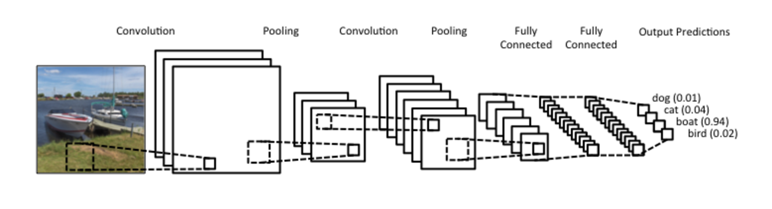
Motivation
Intuitive sentence representation (adopted from CNN in image classification)
Images are represented as consecutive data of pixels
Pixels close to each other are likely to be related (part of the same object)
Convolutional Layer
Fully Connected Layer
Notes:
Image can understand the consecutive data sentences of pixels as consecutive data of words

Slide 3
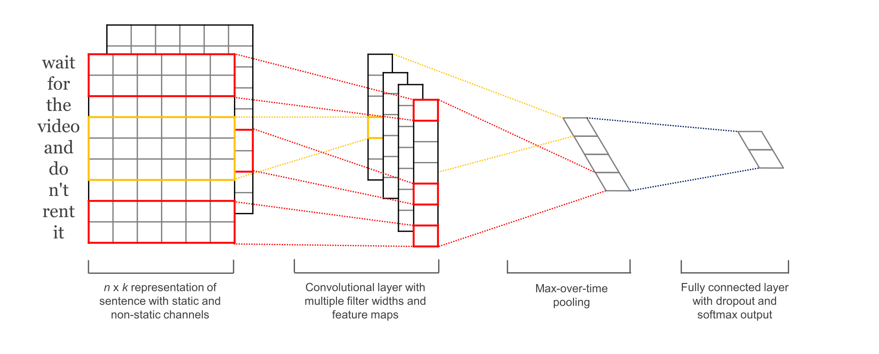
Motivation
Intuitive sentence representation (adopted from CNN in image classification)
Sentences are represented as consecutive data of words
Apply same to NLP : Words close to each other are likely to be semantically related (word2vec)
Convolutional Layer
Fully Connected Layer
Notes:
Image can understand the consecutive data sentences of pixels as consecutive data of words

Slide 4
Implementation
Pipeline
Process each dataset, divide into train/val/test sets
Map vocabulary word indices to word embedding matrix
Convolution + Max-pooling Layer
(LenetConvPoolLayer – Theano)
Regularize (dropout)
Embedding Layer
Convolutional Layer
Fully Connected Layer

Slide 5
Implementation
Models – CNN rand, CNN static, CNN nonstatic
One channel
Convolutional
Layer
Fully Connected
Layer
positive
I
like
this
negative
movie
sentence representation -
random/static/non-static
Convolution, max-pooling
Regularization -dropout, softmax classifier

Slide 6
Implementation
Models – CNN multichannel
Two channel
I
Static channel
like
this
Elementwise addition
movie
feature maps
I
like
Non-
static channel
this
feature maps from both channels
movie
feature maps

Slide 7
Implementation
Reproduced in Tensorflow (TF)
Pros: intuitive api
Cons: slower than Theano and not able to load big word2vec matrix used in paper (GoogleNews 3.5 gb~), so used lighter Glove embeddings on 2 datasets
Reproduced referencing Theano library
Pros: Rather stable library, much faster that TF
Cons: Not intuitive at all
Used Keras library api for TF and Theano (out of paper’s scope)
Multiclass (20 Newsgroup dataset) classification

Slide 8
Settings
Number of epochs: mostly ~ 25 (similar do author’s)
Embeddings: Word2Vec, and GloVe for 2 datasets (MR,CR)
Framework: Theano, and TensorFlow for 2 datasets (MR, CR)
Hyperparameters:
Filters: 3, 4, 5
batch- size: 50
Regularizer: Dropout

Slide 9

Evaluation
Metrics: Accuracy
Review datasets (binary classification – positively/negatively judged review, or on scale 0-4)
Example set: Movie Review (MR)
number of sentences: 10662
vocab size: 18765
Example:

Slide 10
Evaluation
From paper, in %
 | Movie reviews (pos. or neg.) | Customer reviews (pos. or neg.) | TREC (question judgement 5 topics) | MPQA (pos. or neg.) | SST-2 (pos. or neg.) | SST-1 (0,1,2,3,4 – 5 scale reviews)
rand | 76.1 | 79.8 | 91.2 | 83.4 | 82.7 | 45.0
static | 81.0 | 84.7 | 92.8 | 89.6 | 86.8 | 45.5
non-static | 81.5 | 84.3 | 93.6 | 89.5 | 87.2 | 48.0
multichannel | 81.1 | 85.0 | 92.2 | 89.4 | 88.1 | 47.4

Slide 11
Evaluation
From my implementation, in %
 | Movie reviews (pos. or neg.) | Customer reviews (pos. or neg.) | TREC (question judgement 5 topics) | MPQA (pos. or neg.) | SST-2 (pos. or neg.) | SST-1 (0,1,2,3,4 – 5 scale reviews)
rand | 94 (Tensorflow) | 56 (Tensorflow) | 91 | 81 | 90 | 63
static | 97 (Tensorflow – GloVe) | 92 (Tensorflow-GloVe) | 91 | 88 | 90 | 63
non-static | 81 | - | 92 | 89 | 90 | 62
multichannel | 52 | - | 92 | 57 | 91 | 56.7
*If not explicitly designated, then these results are produced with Theano lib.

Slide 12
Evaluation Comparison
Most similar result tendencies on following datasets:
 | TREC (question judgement 5 topics) | SST-2 (pos. or neg.) | SST-1 (0,1,2,3,4 – 5 scale reviews) | MPQA (pos. or neg.)
rand | 91.2 | 82.7 | 45.0 | 83.4
static | 92.8 | 86.8 | 45.5 | 89.6
non-static | 93.6 | 87.2 | 48.0 | 89.5
multichannel | 92.2 | 88.1 | 47.4 | 89.4
TREC (question judgement 5 topics) | SST-2 (pos. or neg.) | SST-1 (0,1,2,3,4 – 5 scale reviews) | MPQA (pos. or neg.)
91 | 90 | 63.2 | 81
91 | 90 | 63.1 | 88
92 | 90 | 61.9 | 89
92 | 91 | 56.7 | 57
From paper, in %
My implementation, in %

Slide 13
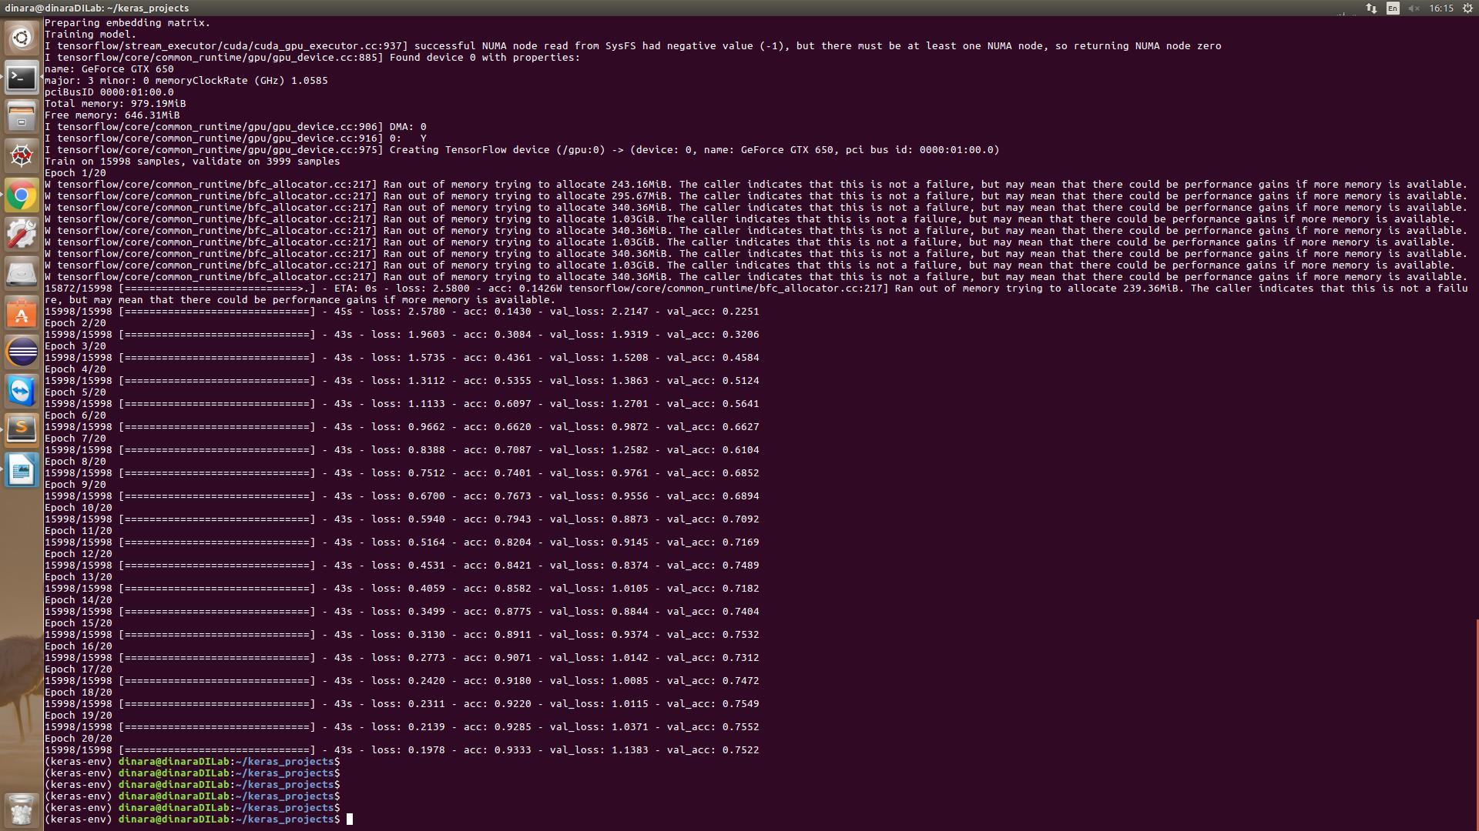
Additional Experiments
Multiclass classification
100-dimensional GloVe embeddings
20 Newsgroup dataset - 1000 documents in each of 20 classes
Unseen test data (val_acc) accuracy increases → so no overfitting

Slide 14
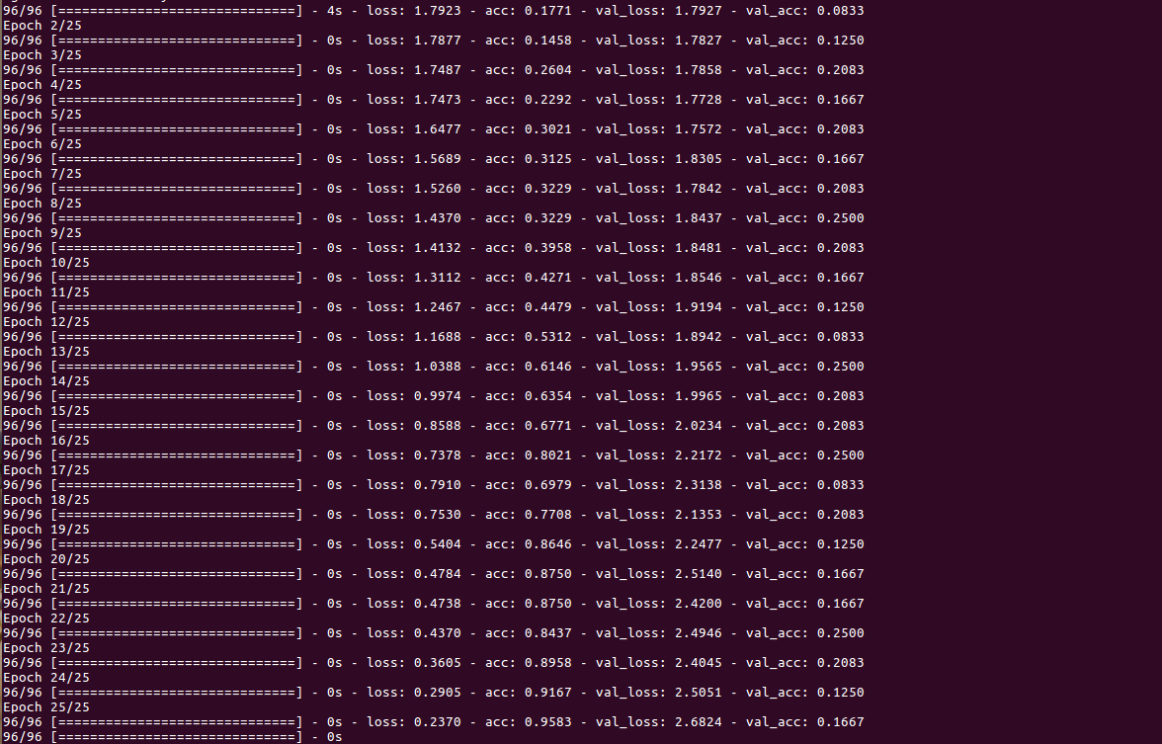
Additional Experiments
Multiclass classification
ODP + 1bil Benchmark trained model – 300 dim embeddings
Also tried with 100-dimensional GloVe embeddings (result even worse than shown)
NYT dataset - made dataset with only around 20 documents in each of 6 classes – sparse, rare characteristics
Unseen test data (val_acc) accuracy – no change → is overfitting
So, this might be limitation

Slide 15
Conclusions
Implemented CNN models in paper under similar settings
On most datasets achieved similar results, except for CR
Performed additional experiments related to multiclass classification
TO DO:
Research if possible to do multilabel classification using similar CNN models ( 1 doc → K categories for Precision@K evaluation)
Perform experiments with CNN related to rare, sparse (or even hierarchical) classification (alike ODP)

Slide 16
Thank you

