Slide 1
Music Generation. Individual project 2
Arseny Savchenko
Innopolis University

Slide 2
Requirements
The purpose of the project is to generate MIDI files, containing both melody and accompaniment. Rust language was chosen for the project because of its asyncrhonous API for IO operations, impressive runtime and the declarative style. MIDI reading/writing is implemented with Ghakuf crate. Asynchronous file management is done with Monoio crate, which is based on the native polling mechanism (epoll for Linux, kqueue for FreeBSD). Several libraries were used as utilities (pseudo-random, PI calculation, time management, etc.). All of them are listed here. Source code can be found on my GitHub. It contains all solutions that were implemented during the whole process. Project can be cloned and executed localy through the Rust project manager `cargo` with the standart `cargo run` command. It will produce `*.mid` files in the `./generated` folder. Files are named with the melody’s key, BPM and time when melody was generated.

Slide 3
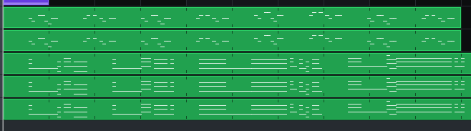
Implementation
Genetic algorithm was chosen for the project. Implementation involves all main 4 stages (initial population generation, selection with fitness function, crossover and mutation). Additionally, algorithm generates two melodies and combines them together with a delay equal to the half of the bar.
Multiple tracks and instruments were chosen to make sound more powerful. For the lead melody, MIDI instruments 1 (Acoustic Grand Piano) and 5 (Electric Piano 1) were chosen. As for the chords, instruments 5 (Electric Piano 1), 28 (Clean Electric Guitar) and 33 (Acoustic Bass) were chosen. All generated melodies are written in Aeolian mode with BPM in range [85;115].

Slide 4
Initial Population
Initial population is generated with the previously implemented algorithm that involves arpeggiation. However, this time tempo and key restrictions were removed to generate more possible results. Algorithm separates bar on 16 parts, creates a tonic note with a zero delay and a length equal to 1/16 of bar. Then it travels across all 16 parts of the bar and tries to put a note with the same length
that is located closely to the current one (difference in pitch is not greater than 3 notes in
scale).
Before the generation, BPM and key are generated and passed to the generation function. All possible populations are strictly limited with length 1000, which is enough to generate acceptable results in a short time.

Slide 5
Ideal Lead
Before the generation process, ideal lead is chosen. The ideal lead is the lead that we are trying to be closest to. Such leads are stored in the `./genetic_samples` folder. Additionally, such ideal .mid files should contain only the melody itself (without any chords), written in Aeolian mode. For instance, I’ve chosen «Liberain Girl» and «You Rock My World» by Michael Jackson, «Is There Someone Else?» and «Sacrifice» by The Weeknd, «Around the World» by Daft Punk, as they all are written in the Aeolian mode, which makes them perfect candidates for the generation. Note that generated melodies do not depend on the ideal lead’s length, so it does not matter if the lead is too big and complex. Besides, if the fitness function will be changed to not check notes’ pitch, melodies with other modes and scales can also be used.

Slide 6
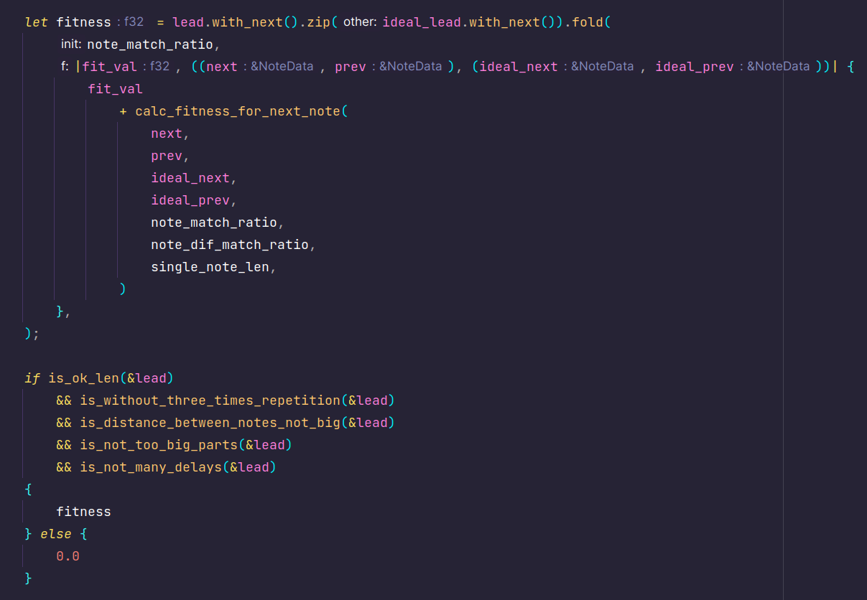
Fitness function and Selection
Algorithm uses multiple tests to check if generated lead is acceptable. First of all, all notes are compared with the ideal lead: algorithm compares both distances between pitches from the generated lead and the ideal one and tempo (delays) between notes. Partial coincidence is counted for distances in pitch, but tempo match is more strict. For pitch match it gives 1/4 of the amount that can be achieved by the single note, for tempo match it gives 3/4. Every note weights 1 / lead size. Other restrictions are also chosen: 1) legnth should be less than 11 2) same note cannot repeat 3 times one after another 3) distances between neighbour notes cannot be greater than 7 semitones 4) number of the delays between parts is less than 4 (not greater than 4 parts in the melody)
Selection is done with the roulette method described in the lecture. No additional upgrades were implemented.

Slide 7
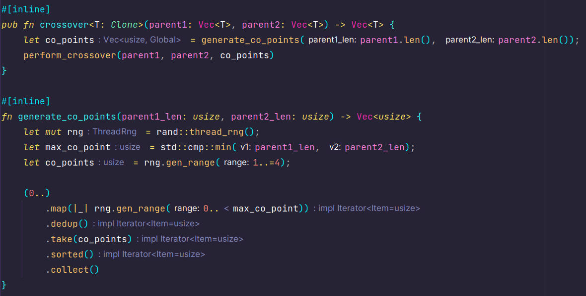
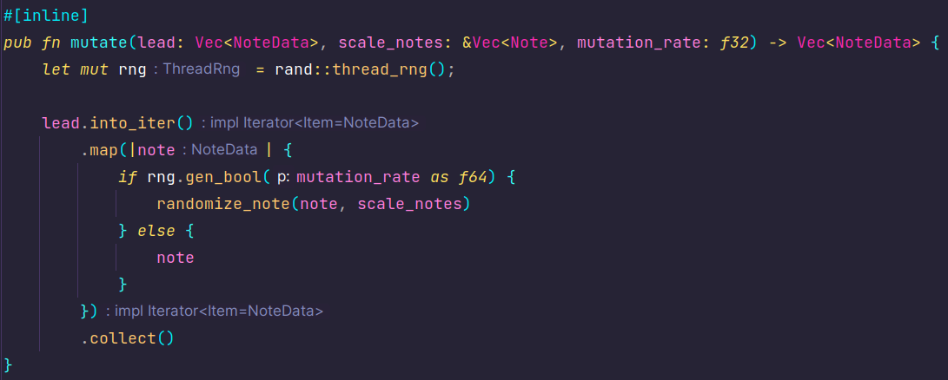
Crossover and Mutation
In the crossover method, multiple points are randomly chosen. Number of points is also randomly generated in range [1;4]. Then, two parents form the child for the next generation. Additionally, parent can still appear in the next population.
Mutation algorithm traverses through the lead, randomly picks some notes and randomizes their pitch. Obtained notes still lie on the scale.

Slide 8
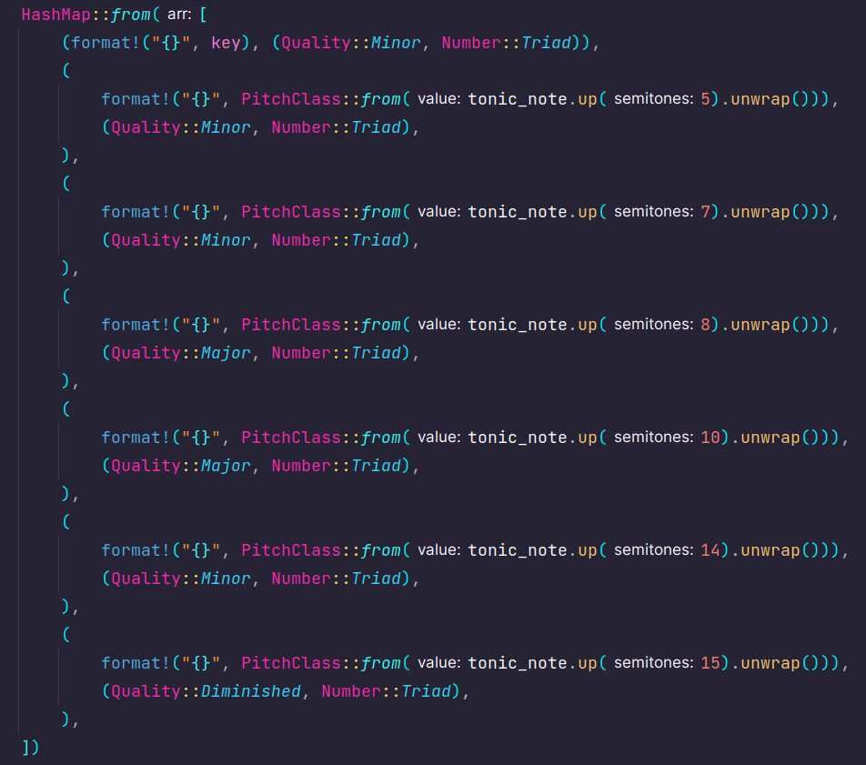
Harmony Generation
Harmony generation has not changed: it still traverses through the combination of two generated leads and either puts new note or extends previous one with the length and the delay of the current note from the lead. All chords are generated on octave 3 with Aeolian mode map. As can be noticed on the third slide, generation is buggy: some notes’ delta time is incorrect, besides, delays between parts are also wrong, however, it gives a groove to the melody, so, let’s consider it as a featuere :)

Slide 9
Analisys of the Results. Future work
Even though algorithm produces listenable results (and sometimes even funky ones), they are limited with the rhythm. For instance, notes with other lengths can be included. To improve the result and extend it with other ideas, first of all, other scales and modes can be chosen. Currently, project is limited with Melodic Minor and Aeolian mode.
Algorithm to create chord progressions can be fixed, improved and extended, as it is very limited right now, because main focus was on melody generation, so I was running out of time to come up with more progressive algorithms for harmony creation. Additioanlly, other elements of the accompaniment can be used: drums, bells and filler notes, melodies for bridges and others can be added to the current implementation. However, I am satisfied with the result as it gives some ideas that can be further improved for the next time.

