Slide 1
IMG Team project
Amir Bikineyev, Arseny Savchenko, Louay Farah, Timur Zheksimbaev

Slide 2
Introduction
Resulting music contains 4 batches: lead melody, arpeggio, harmony and drums. Every batch generation is assigned to a specific person (lead melody - Savchenko, Harmony - Bikineyev, arpeggio - Farah, drums - Zheksimbaev). User is free to manually choose any key, scale or mode with an input in the beginning of the program. On every step, the resulting .mid file is passed further and combined with the next batch. Finally, 8 bar song is generated as the single .mid file

Slide 3
Technical stuff
Lead Melody: Rust, ghakuf crate, additional utility crates
Harmony: Python, mido, music21
Arpeggio: Python, music21 Drums: Java, JFugue

Slide 4
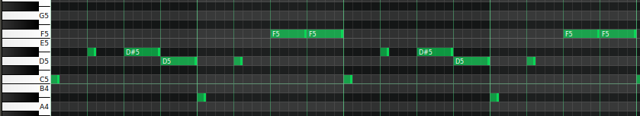
Lead Melody Generation
Traverses through all 16 parts of the bar
Position 1 - lengths are 1, 2 or 4
Position 2 or 4 - length is 1
Position 3 - lengths are 1 or 3
Some positions may be skipped (delay)
Multiple melody types are used (ABAB, AAAB, ABAC)

Slide 5
Pros and cons
Pros:
Universal for all scales, keys and modes
Produces unique results on every generation
Cons:
Requires multiple tries to generate something catchy
Some scales and modes may not work together completely

Slide 6
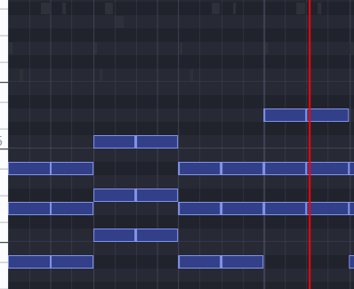
Accompaniment
To generate batch evolutionary strategy was used. Initially we have population consists of 100 members and this number stays constantly. As mutation changing the chord type among the possible in the key of melody was prefered. Fitness function contains the pleasant parameter, which checks whether note from melody and chords are matched, the chord progression parameter, which checks whether chords lies in some progression and the repetitions of the same chord in a row parameter to avoid the same chord 3+ time in a row.

Slide 7
Pros and cons
Pros:
Every time pleasant accompaniment was created
No need to specify manually, just start the program
Cons:
Result is highly dependent on fitness function and coefficient of every variable
The time in which accompaniment was created

Slide 8
Arpeggio
The code generates arpeggios for an input melody by first analyzing the key of the melody using the analyze() method of the music21 library, and then looping through the measures in the melody. For each measure, it creates a Chord object from the notes in the measure and transposes it down by 2 octaves. It then applies a custom arpeggiate function to the Chord object to generate an arpeggio, where the style and direction of the arpeggio are chosen randomly from a set of predefined options ("up" and "down", "ascending" and "descending"). The arpeggio is added to an arpeggio stream, which is then combined with the original melody to create a new score.

Slide 9
Pros and cons
Pros:
It is a systematic and repeatable approach that can be used to generate arpeggios for any input melody.
Analyzing the key of the melody helps ensure that the generated arpeggios are musically appropriate.
Cons:
The generated arpeggios may not always fit well with the overall style or mood of the original melody or composition.
The arpeggio generation process may not take into account the specific nuances or characteristics of the input melody, resulting in arpeggios that don't quite fit or feel out of place.

Slide 10
Drums
Drums were written manually with usage of jfugue library, and external midi files.
Each drum and bass patterns were chosen randomly each time drum part of a song was generated.
Instruments which were used are: hi-hat, snare, kick and bass. Several combinations of snare rolls and kick rolls were written.

Slide 11
Pros and cons
Pros:
Drums created using this approach are aesthetically pleasing.
You can combine many different drum and bass patterns.
Cons:
Drums can be always the same.
Using algorithms you can find out more about combinations of drum instruments.

Slide 12
Demo
(❁´◡`❁)

Slide 13
Future work
Despite being universal and unique on every try, melody generation requires multiple tries to generate something catchy. As for the chords, additional mutations and crossover can be used. To improve the arpeggios, More variation to the arpeggio patterns can be considered by introducing additional patterns and by allowing for more randomness in the pattern selection. As for the drums, more complex drum and bass patterns, with usage of many other instruments (cymbals, toms, crashes, etc.).

Slide 14
Thanks for attention

