Slide 1
How to Build Digital Visibility?
Disclaimer: I am not such an expert. This is just to give an idea.
Presentation Preparation
Dr. Fatma Betul DINCASLAN

Slide 2
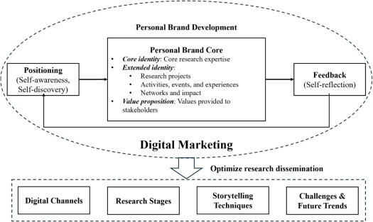
What Is Digital Visibility?
It is NOT simply self-promotion
It is about strategic narration of your professional contributions online
Also, about how easily your contribution to research, community and expertise can be found
Enhancing academic impact through digital marketing strategies might help (welcome to 21st century!)
https://www.tandfonline.com/doi/full/10.1080/08911762.2025.2554430#abstract
Notes:
In case of self promotion, you ignore the contributions of others and collaborations, while in case of strategic narration you appreciate everyone s contribution and highlight yours as independent identity and as part of team (never underestimate the people you work, these relationships/trust will be one of the outputs of whatever you are building itself, idk perhaps we can highlight this in networking as well)
On the other hand, we might accept that not everyone might be happy with online presence as themselves (foe example I rather my work to be present than me all the time. But sometimes you need to be there to show the link with work and the worker itself to get the recognition). Understand that not everyone might be comfortable as some sort of celebrity online (it is better not to confuse this with that).

Slide 3



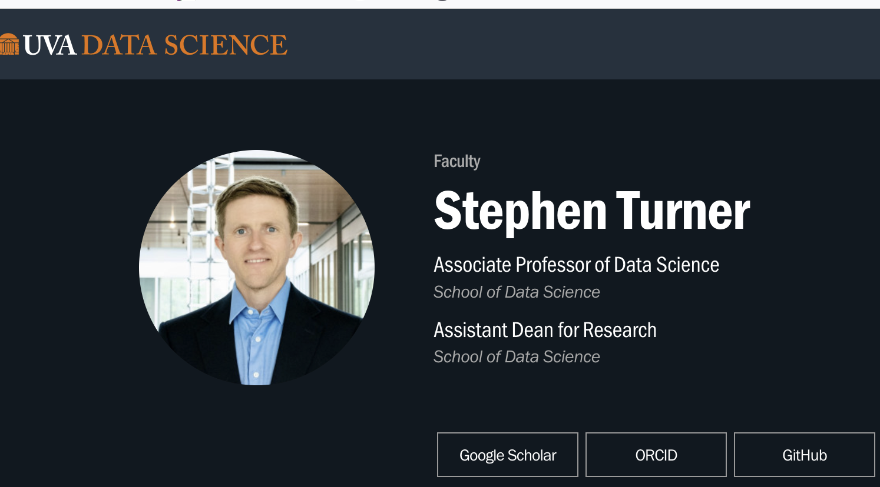
How to Build Professional Presence Online?
As an academic, the must-haves:
ORCID
  Research contributions and work experience
Google Scholar
  From posters, thesis and books to articles
GitHub
  Zenodo or other alternatives
  For codes/scripts and data analysis
Institutional pages (if available)
Example school associated webpage
Notes:
We know for academic but how about other career trajectories including the academic

Slide 4
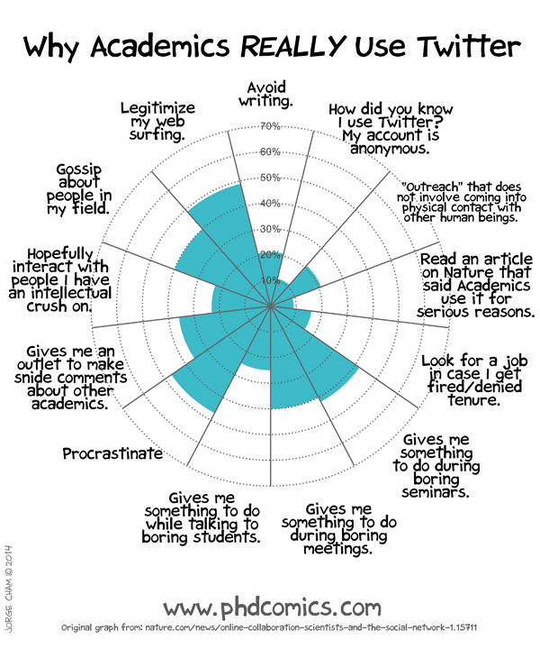
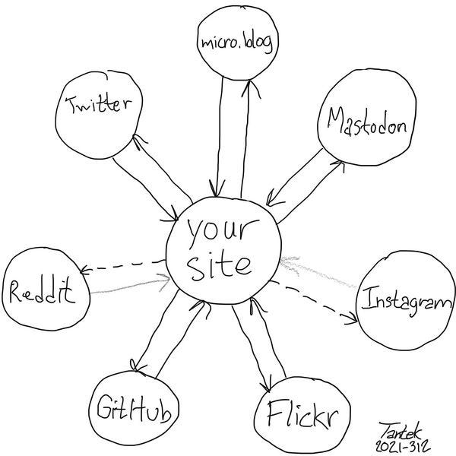
How to Build Professional Presence Online?
Twitter is not the only way, there are alternatives
Some alternatives:
Substack for personal blogging
Medium for partner blogging programs
YouTube for long videos
Tiktok or Instagram for short videos
Bluesky, Twitter or Mastodon for connecting and short discussions
LinkedIn for professional connections and queries
Discord for stream coding
Reddit or StackOverflow for technical discussions
Spotify for podcasts
https://blog.stephenturner.us/p/technical-blogging
Notes:
Twitter is dead but luckily, we have other ways of showing up.
Here you will emphasize what Stephen turner emphasized in the blogpost referring to him. Personal website is first (for example starting with substack and the other platforms to go, not just for technical blogging).

Slide 5
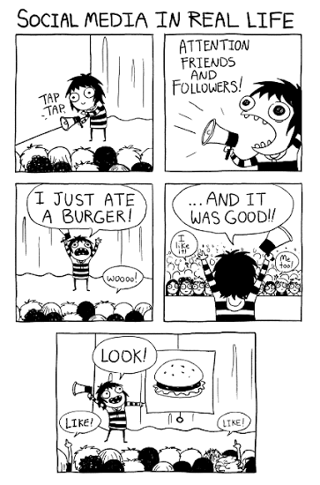
How to Build Digital Visibility
Set a goal
  Is it technical blogging, leveraging professional connections or finding a date?
  Then find the right platform and use accordingly (not adjust your position based on the platform).
Invest time
  Understand the platform basics and rules
  Know your target audience
  Perhaps use some hashtags (#) whenever it is required
Have consistent profile aligning with your goal
  For example, if it is professional, no need to promote your pictures from daily life all the time
Keep the balance
  Not to shy to promote your work vs. being arrogant ignoring the value of others
Be proactive
  To get the attention in the websites, keep sharing your expertise insights or relevant experiences
  Keep update and engage to be present
  Learn storytelling and follow some trends to be relatable
Be authentic
  Remember it will be your brand
  Show how your perspective differs and contribute while respecting others (and be careful AI infusion to everything)
Keep in mind about being accountable, transparent and verifiable profile
  Do not exaggerate or lie
courtesy: Sarah Andersen comics
Notes:
Some resources: https://www.essex.ac.uk/blog/posts/2023/12/08/building-your-visibility-profile-and-networks-as-a-researcher-on-social-media
Also some examples here might help to enhage the community in the session.

Slide 6
Helpful Resources
Technical blogging and visibility: https://blog.stephenturner.us/p/technical-blogging
Online visibility might simply increase the impact, https://www.degruyterbrill.com/publishing/for-authors/tools-resources/how-to-promote-your-work-on-social-media
Online visibility basics: https://www.essex.ac.uk/blog/posts/2023/12/08/building-your-visibility-profile-and-networks-as-a-researcher-on-social-media
THE on Linkedin: https://www.timeshighereducation.com/campus/building-your-research-profile-social-media-focus-linkedin

Slide 7



Acknowledgements
I prepared these ppts to give a detailed idea based on the discussions we had during the meetings with the incredible organizing committee of ECSC2026:
Dr. Pradeep Eranti
Paula Camargo Romero
Victor Grentzinger
Ankita Murmu
Haseeb Manzoor
Estefania Torrejón
Elisabeth Hellec

