Slide 1
Med&Omix
Second Meeting Query-ing

Slide 2
Previously Discussed in Med&Omix Meeting
How to use cBioPortal
How to apply on our hypothesis
So, I basically will do simple dry-testing of an hypothesis

Slide 3
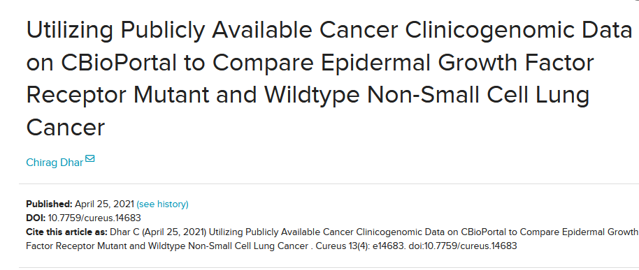
Let’s Decide A Simple Hypothesis
I found this article on «Utilizing Publicly Available Cancer Clinicogenomic Data on CBioPortal to Compare Epidermal Growth Factor Receptor Mutant and Wildtype Non-Small Cell Lung Cancer»
https://www.cureus.com/articles/57441-utilizing-publicly-available-cancer-clinicogenomic-data-on-cbioportal-to-compare-epidermal-growth-factor-receptor-mutant-and-wildtype-non-small-cell-lung-cancer#reference s

Slide 4
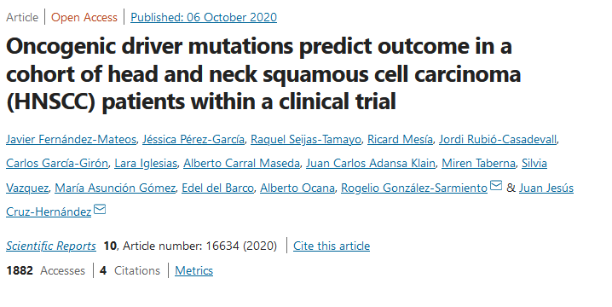
Let’s Decide A Simple Hypothesis
Then looked for an alternative disease with alternative mutation... Later, found this «Oncogenic driver mutations predict outcome in a cohort of head and neck squamous cell carcinoma (HNSCC) patients within a clinical trial»
HPV status
https://www-nature-com.libproxy1.nus.edu.sg/articles/s41598-020-72927-2

Slide 5
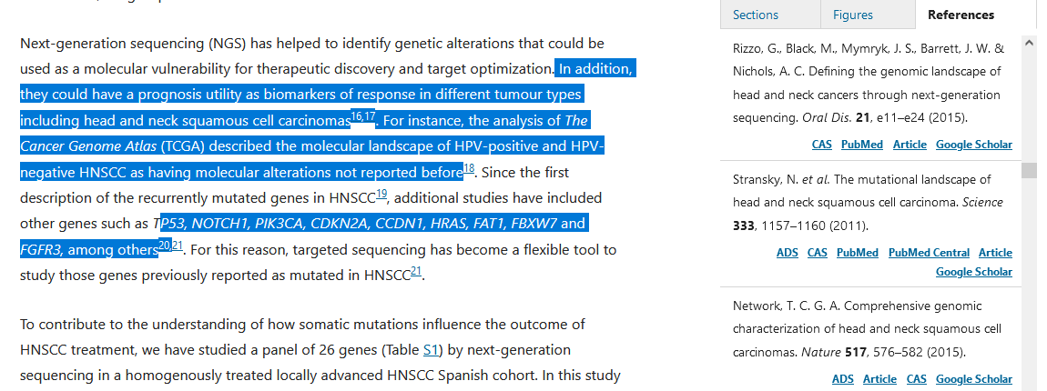
Let’s Decide A Simple Hypothesis
They are the ones referred in the article, so I will test how much consistent across all these datasets

Slide 6
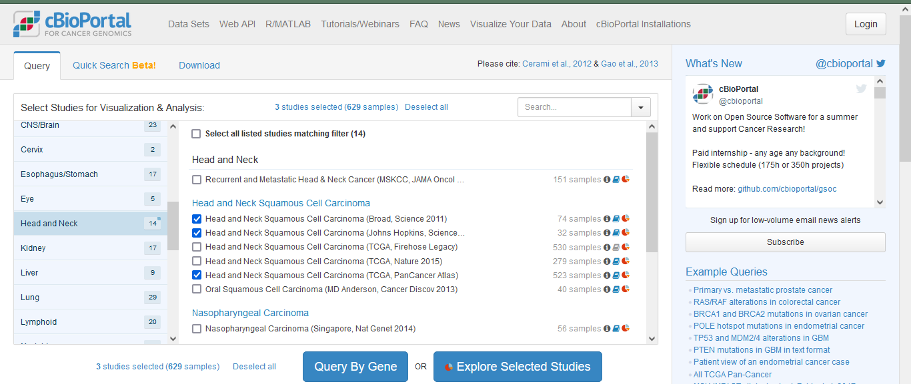
How to apply on
Selected these datasets available

Slide 7
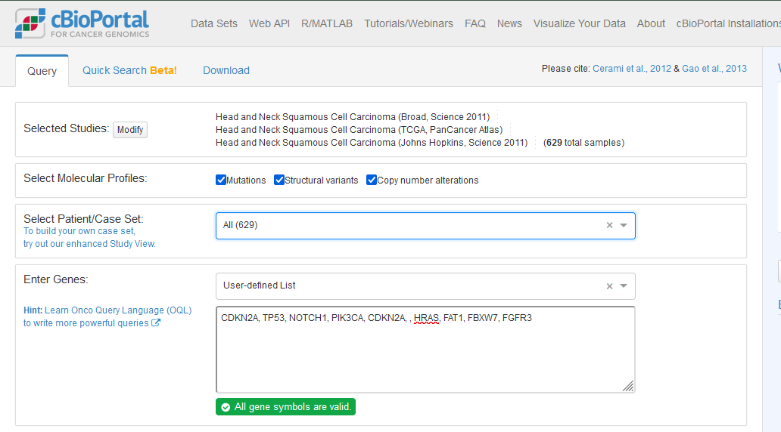
How to apply on

Slide 8
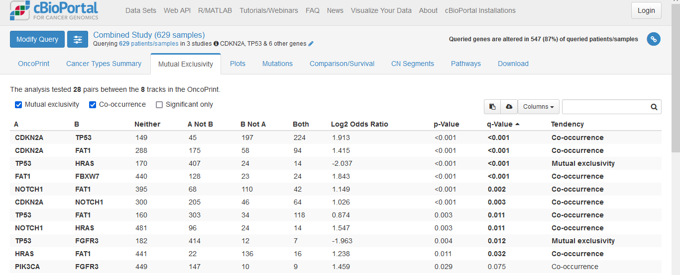
How to apply on
Interesting relationships... For example, TP53 and HRAS are mutually exclusive, and TP53 and FAT1 co-occurs. However, FAT1 and HRAS co-occurs, too. (Need to check pathway details for this)

Slide 9
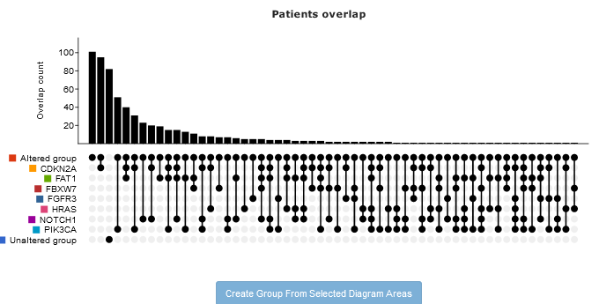
How altered group is selected

Slide 10
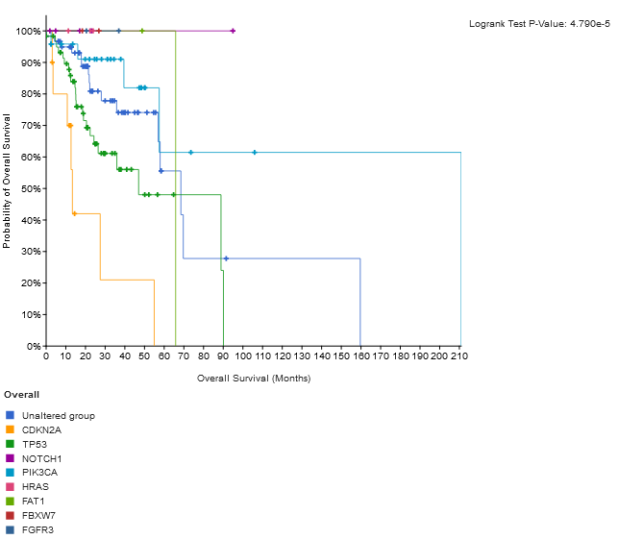
If I look the survival data for all the genes
It seems CDKN2A (correlated to HPV stats) alteration might be related to poor outcome in 0-50months period of survival, whereas HRA& NOTCH1 alteration has minimal or no direct effect on the survival.

