Slide 1

One Minute Digital Diary

Slide 2
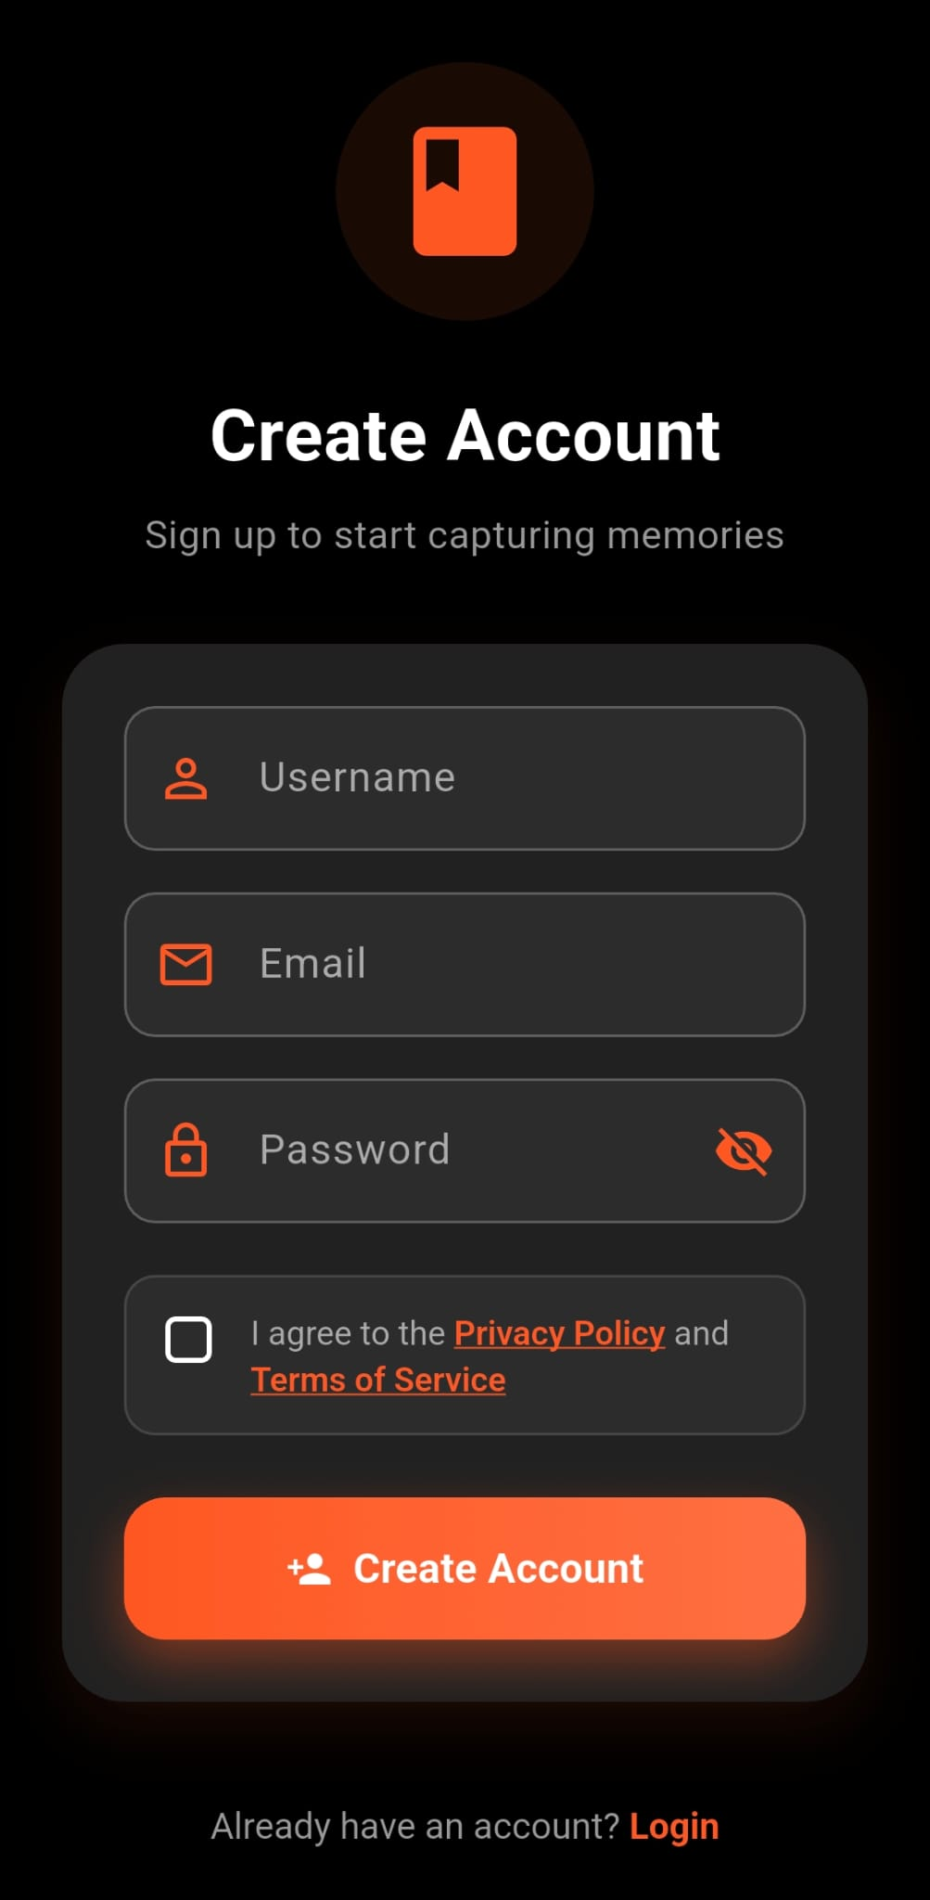
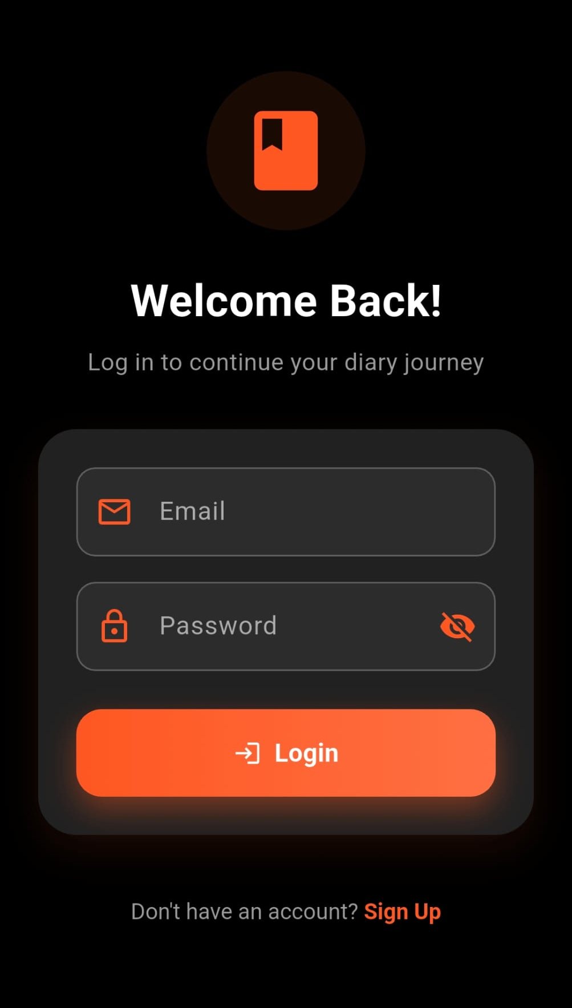
Login page:
Login page is the welcoming interface for the user. User comes across this page only once (unless they log out). After the first login their account stays open. Users without an account can create one via Sign Up.

Slide 3
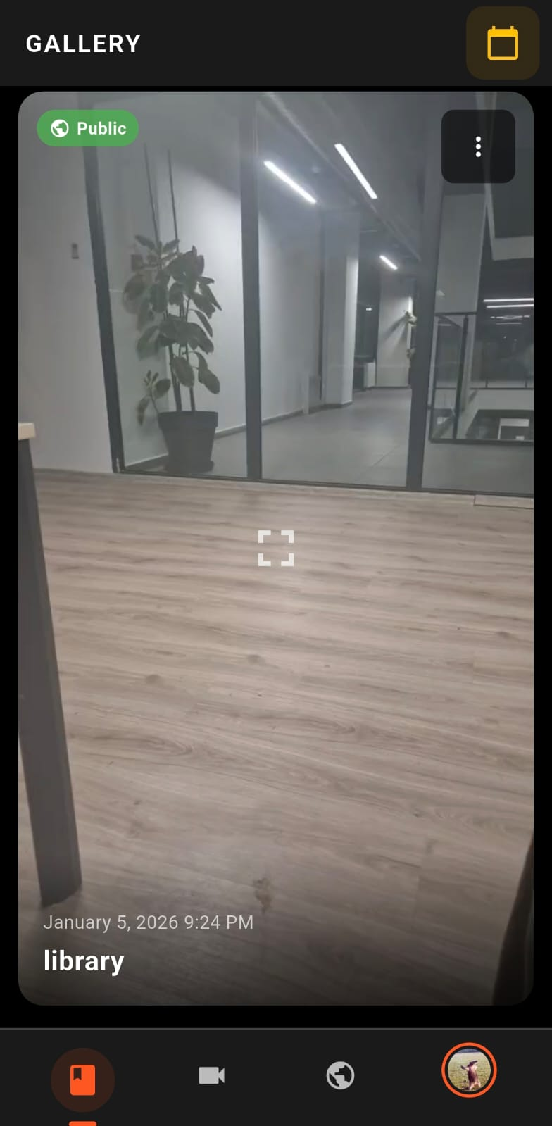
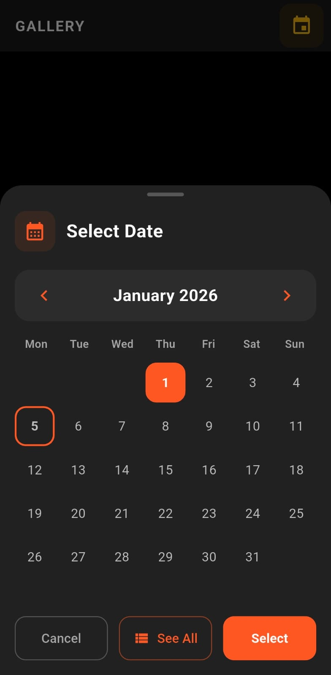
Gallery:
Gallery page is where you can see all of your videos that you have recorded. They are labelled and sorted by date that you can search via calendar menu.

Slide 4
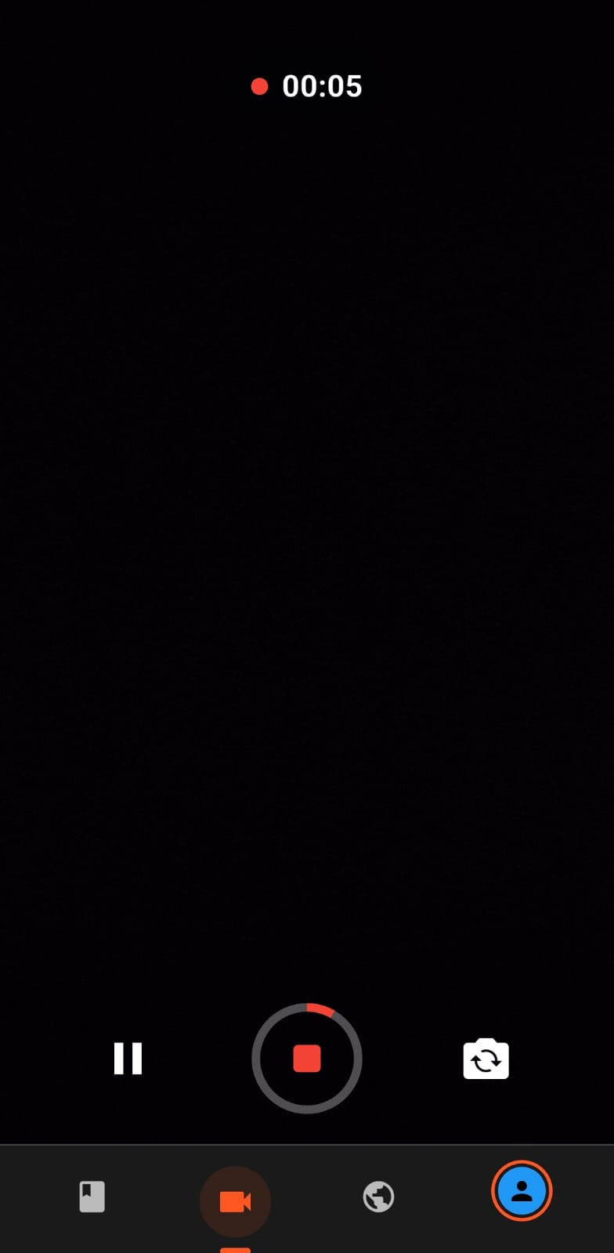
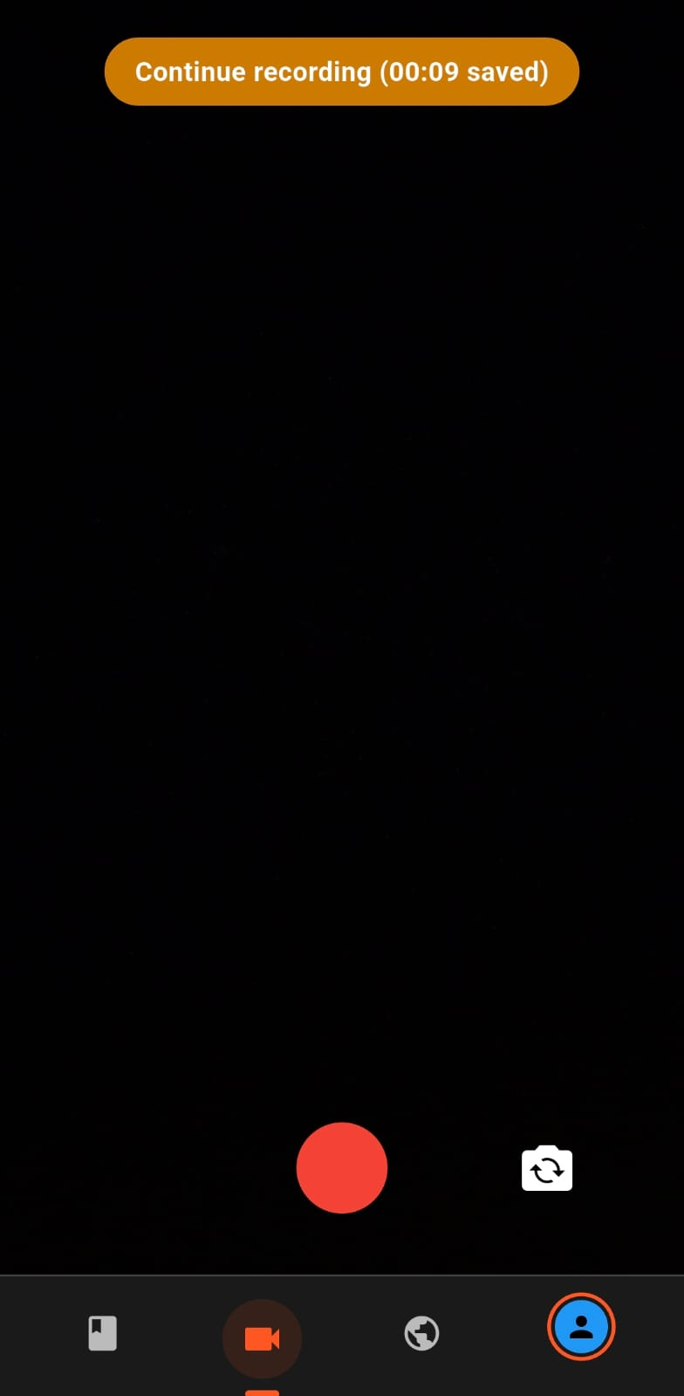
Video Recording:
This page allows you to take multiple videos throughout your day. you can record more than one clip, merge them in to one video which is maximum of 1 minute (5 for premium users).

Slide 5
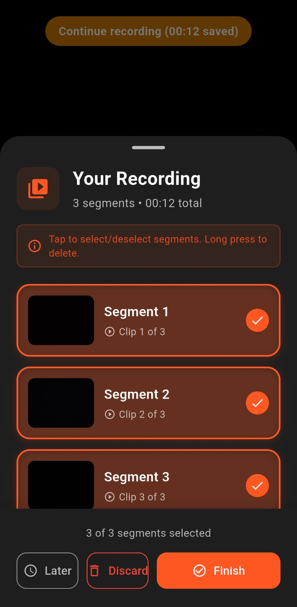
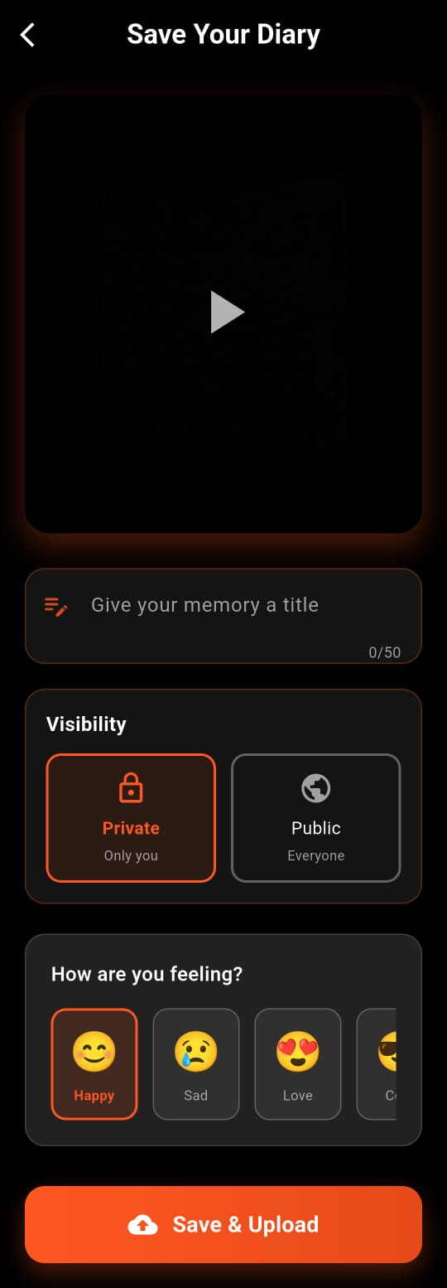
Edit/Share Page:
This is where you finalise your video. You can merge or delete your clip(s). Set the video’s visibility and add a feeling to your video.

Slide 6
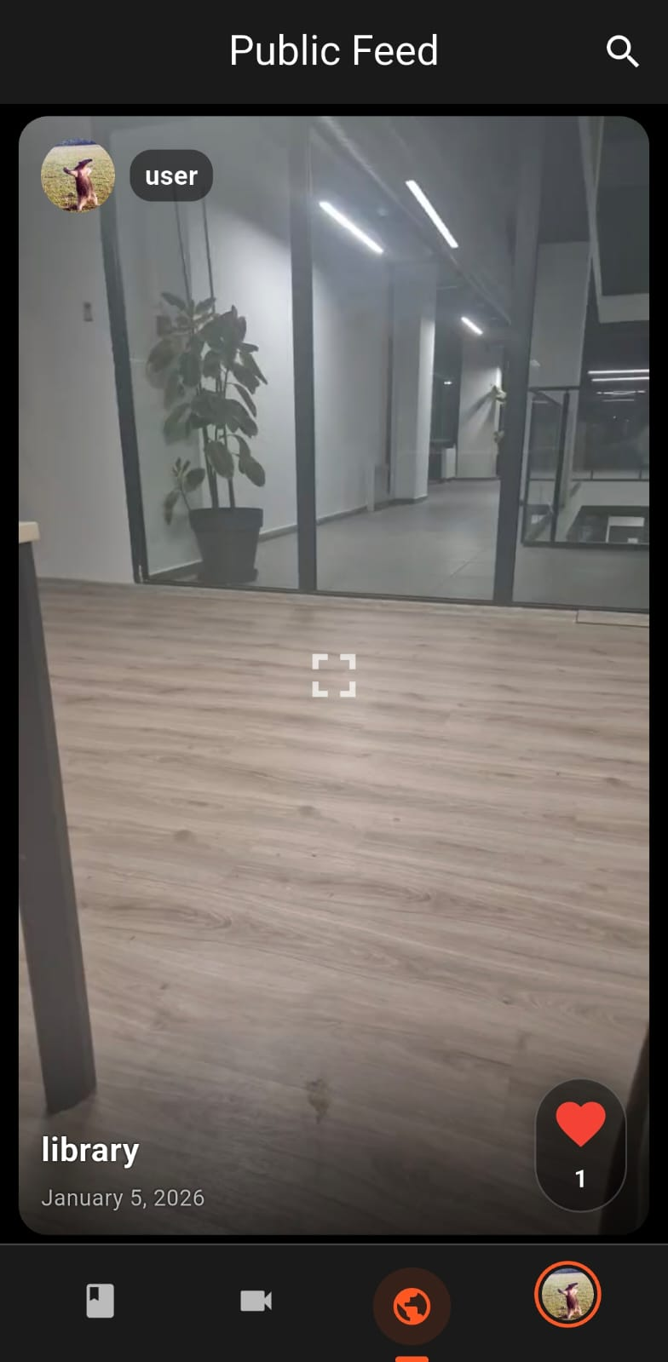
Public Feed:
This is where you can see what other users are sharing. every video stays in the feed for 24 hours once they are posted. You can watch and like other’s videos.

Slide 7
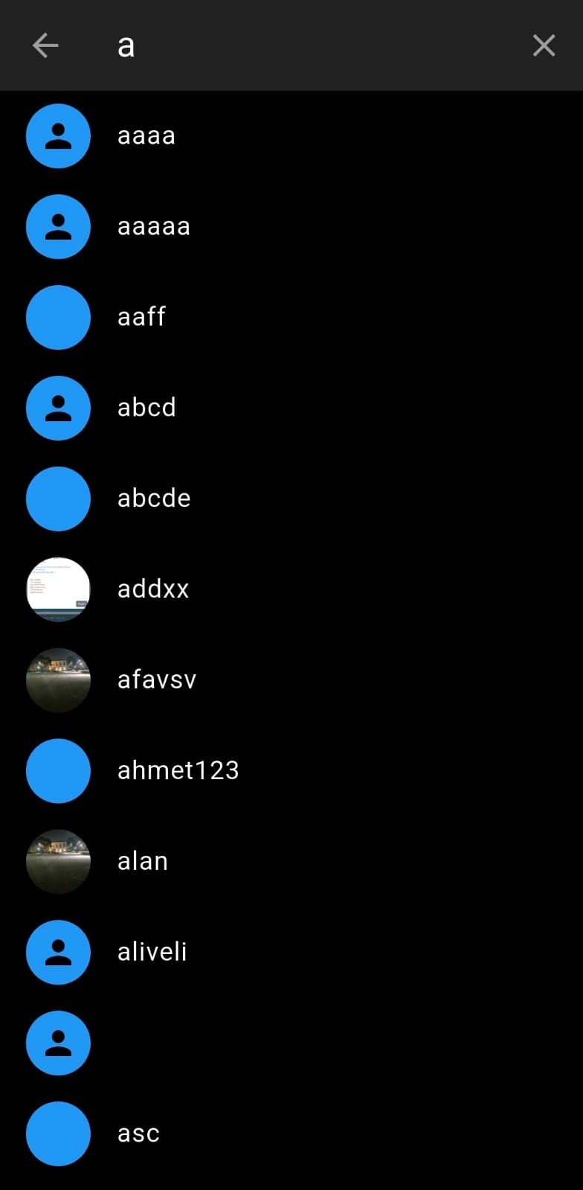
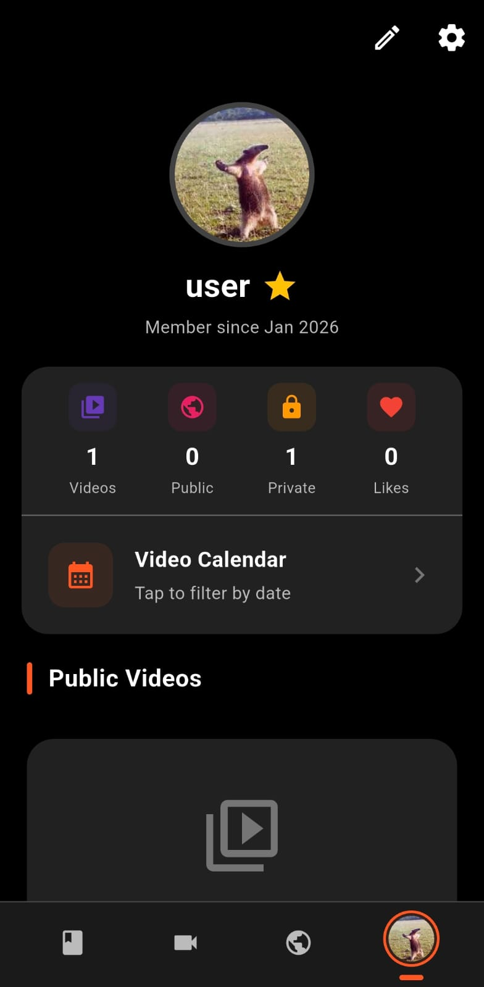
Searching/Profiles:
From the public page you can search you can search other users by typing their username. When you click the user you can see their public videos and stats (total likes etc.).

Slide 8
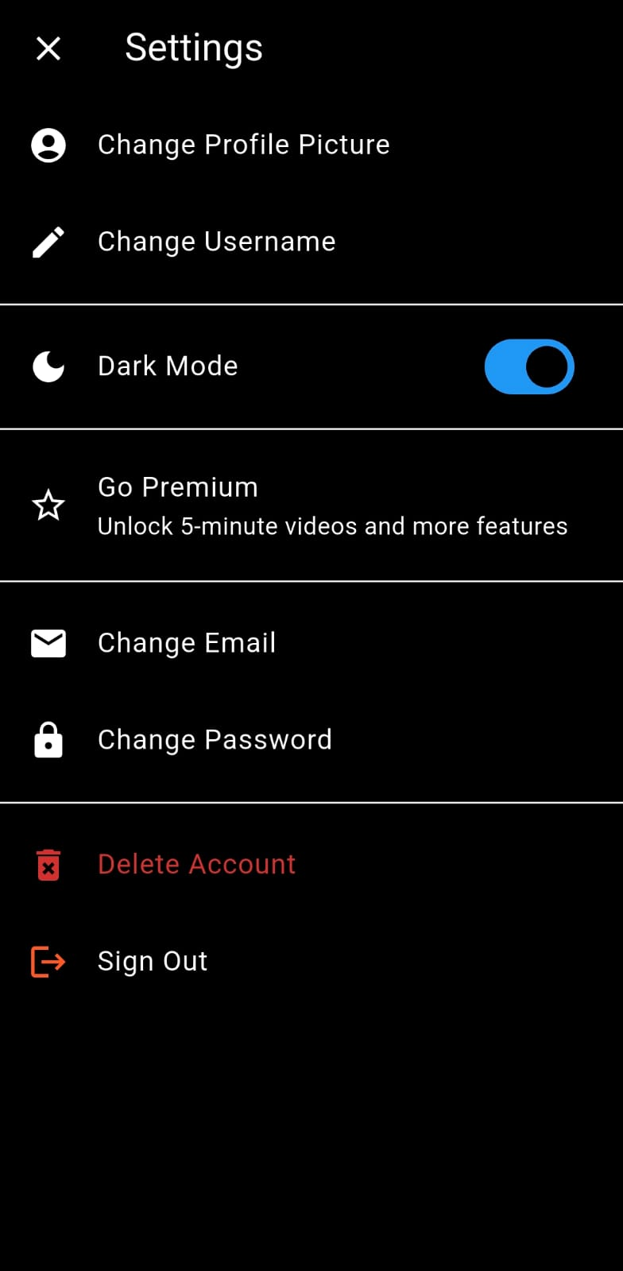
Settings:
This is where you can manage your app experience and your account information.

Slide 9
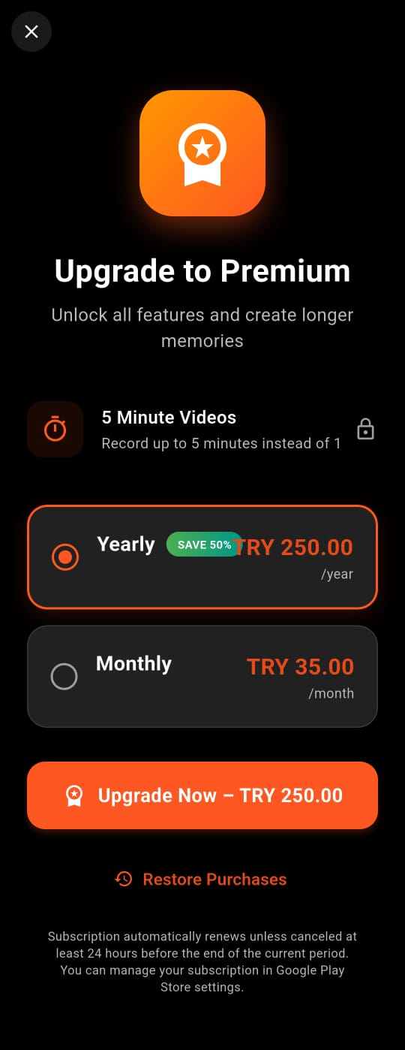
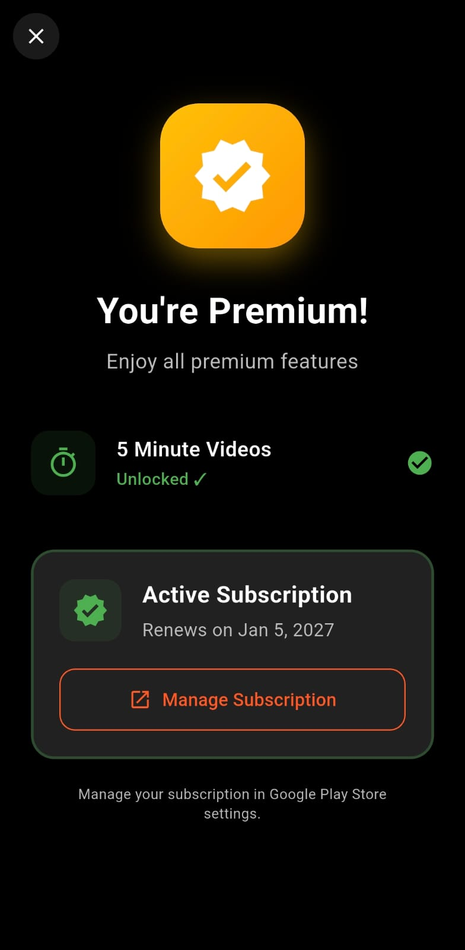
Premium Page:
For the better usage of the app you can pay region based price for monthly or yearly subscription. Premium users can record 5 minute videos .
User can cancel the subscription from their google account.

Slide 10
thanks

