Slide 1
Decision modeling with R: lessons learned from the development of hesim
Devin Incerti | Genentech
July 1, 2021 | R for HTA Showcase

Slide 2
Background
Decision models are complex mathematical models that often contain large numbers of parameters and complex relationships between inputs and outputs
Complexity often result in models that are not transparent, efficient, or flexible
While it has argued that this is caused, in part, by choice of software (e.g., Excel vs R), software is not the only culprit
Good code is just as important---if not more so--- than the choice of software
Following software engineering best practices can improve the quality of models and enhance their credibility

Slide 3




Attributes of good code*
Transparency
Transparent code is easily understood and reproducible
Reliability
Reliable code produces expected output without errors
Efficient code runs fast enough and is programmed quickly enough to achieve its intended purpose
Efficiency
Extensible code is easily adapted to allow for new capabilities or functionality
Extensibility
*Attributes listed here are non-exhaustive

Slide 4
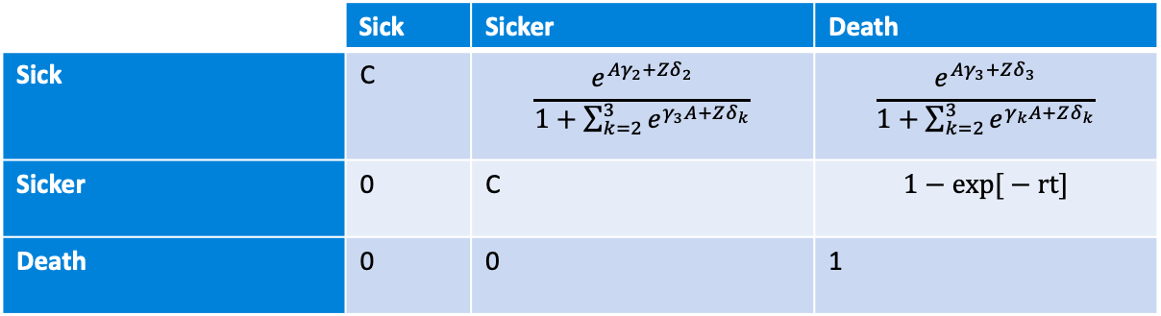
Example
Decision problem
Decision model
5 competing treatment strategies
10 representative patients (vary by age and sex)
Decision framework: CEA
Markov cohort model
Probabilistic sensitivity analysis
3 health states (sick, sicker, death)
Yearly model cycles
20 year time horizon
Treatment effects for treatment strategies are (log) odds ratios
Additional covariates Z (age, sex)
Complement = 1 – Pr(sick) – Pr(death)
Multinomial logistic regression
Rate modeled as function of age and sex

Slide 5
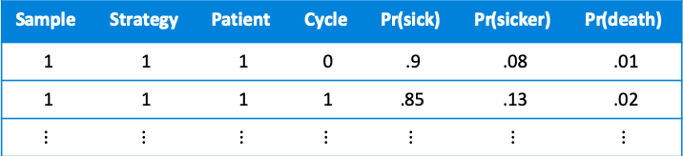
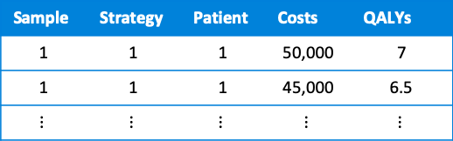
Lesson 1: plan ahead
Start by thinking about the output you will need/want to answer your decision problem
State probabilities
Expected values (costs and QALYs)
We can then think about the steps/functions needed to produce that output
Markov modeling steps
Modeling pipeline
Set treatment strategies and patients (input data)
Sample parameters for PSA
Simulate state probabilities
Simulate costs & QALYs
Perform CEA
  ICER
  PSA
input_data <- make_input_data()
params <- get_params()
stprobs <- sim_stateprobs(input_data, params)
ev <- sim_ev(stprobs, input_data, params)
icer_out <- icer(ev)
psa_out <- psa(ev)

Slide 6
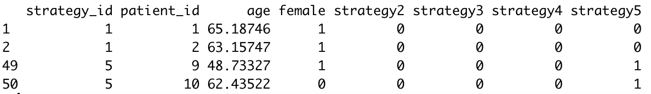

Lesson 1 cont’d: convenient model inputs
A convenient way to model multiple treatment strategies (n = 5) and patients (n = 10) is to create a single data frame (the “input data”)
In a PSA, the parameters are drawn from suitable probability distributions:
Multinomial logit coefficients for sick→ sicker transition (same for sick -> death)
Coefficients for rate parameter of sicker→ death transition
Recall that we need simulation results for every strategy, patient, and PSA sample. An important consideration is whether to draw the parameters once at each iteration (as shown here) or to draw all at once (i.e., to vectorize)

Slide 7
Lesson 2: choose a style guide and stick to it
Let’s start with some ”bad” code:
A ”dot” is confusing because its unclear if the function is an S3 method
Usually better for functions to be verbs
state_probs <- sim.StateProbs()
expectedValues <- expected_values_sim()
ICER <- icer()
psa_out <- psa()
Inconsistent naming conventions for objects
Inconsistent naming conventions for functions
But don’t need a verb if function computes well known noun
Some better code:
stateprobs <- sim_stateprobs()
expected_values <- sim_expected_values()
icer_out <- icer()
psa_out <- psa()
Notes:
There are many good coding frameworks (I like tidyverse); what’s important is to have a consistent style
A consistent style makes code more readable
Readable code is more transparent, maintainable, and reliable (less error prone)

Slide 8
Lesson 3: write modular code
sim_stateprobs <- function(input_data, params,
n_samples, n_cycles, x0) {
for (s in 1:n_samples) {
for (i in 1:nrow(input_data)) {
# A bunch of code to sample the parameters here
params_sample <- list()
for (j in 1:n_params) {
k <- ncol(params[[j]]$mean[j])
params_sample[[j]] <- rnorm(k, params[[j]]$mean,
params[[j]]$sd)}
}
# A lot of code to get transition probability matrix
# Predict probabilities with multinomial logit
# Predict probabilities with exponential model
# More code to simulate the Markov chain
for (t in 1:n_cycles) {
x[t + 1, ] <- x[t, ] %*% p
}
} # End loop of input data
} # End loop over treatment strategies
sim_stateprobs1 <- function(input_data, params,
n_cycles, x0) {
params_sample <- sample_params(n = 1, params)
tpmat <- tpmatrix(input_data, params_sample)
sim_markov_chain(x0, p = tpmat, n_cycles
}
vs
sim_stateprobs <- function(input_data, params,
n_samples, n_cycles, x0) {
for (s in 1:n_samples) {
for (i in 1:nrow(input_data)) {
sim_stateprobs1(input_data, params, n_cycles, x0)
}
}
}
Why?
  Can read the code almost like reading the English language (transparency)
  Easier to test functions and identify source of bugs (reliability)
  Easier to refactor when adding new features (extensibility)
Notes:
Each function should do only 1 thing
Modular code is more transparent, reliable, and extensible
Enhances transparency
Should be able to read the code almost like reading English language
Documentation can make each function even more clear (pkgdown can create clickable links to documentation for each function, which in turn, link to source code)
Much easier to test modular functions and find sources of errors when they occur
Easier to refactor when adding new features

Slide 9
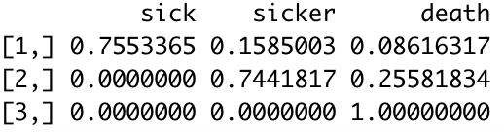
Lesson 3 cont’d: modularizing the construction of the transition probability matrices
tpmatrix <- function(input_data, params)
rbind(
tp_sick(input_data, params),
tp_sicker(input_data, params),
c(0, 0, 1) # Death is an absorbing state
)
)
Transition probabilities from sick state
Transition probabilities from sicker state
tp_sick <- function(input_data, params) {
beta <- params[c("sick_sicker", "sick_death")]
x <- make_x(input_data, beta[[1]])
mlogit_probs(x, beta)
}
tp_sicker <- function(input_data, params) {
beta <- params[["sicker_death"]]
x <- make_x(input_data, beta)
rate <- exp(x %*% t(beta))
prob_death <- 1 - exp(-rate)
c(sick = 0, sicker = 1 - prob_death, death = prob_death)
}
Transition probabilities from sick state predicted from multinomial logit model
Create “input matrix” by selecting columns of input data corresponding to parameters
mlogit_probs <- function(x, beta) {
# General code to predict probabilities given
# coefficients from a multinomial regression
}
make_x <- function(input_data, params) {
input_data[, "intercept"] <- 1 # Add intercept
as.matrix(input_data[, colnames(params)])
}

Slide 10
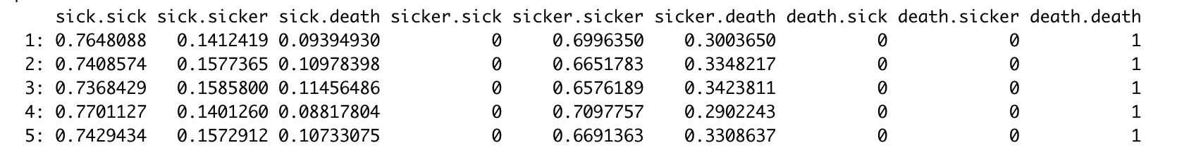
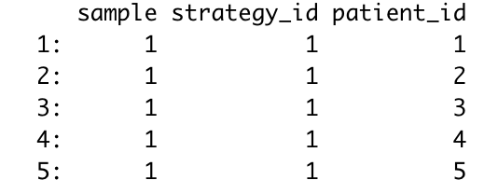
Lesson 4: vectorize R code when feasible
In our toy model with 5 treatment strategies, 10 patients, 20 (annual) model cycles, and 1,000 PSA samples, there are 5 * 10 * 20 * 1,000 = 1,000,000 iterations
Looping many times in pure R can be slow; the prior code runs in ~45 seconds
We can speed up the code considerably (~2 seconds) by vectorizing (looping with compiled code) with hesim
Using hesim::tpmatrix()to precompute transition probabilities for every combination of ID variables
The GitHub repo for this presentation shows how the non-vectorized code can be slightly tweaked to create transition matrices in a vectorized manner. hesim will then implement a Markov chain (written in C++) for each row in the table above

Slide 11
Concluding thoughts
R is a good software tool for decision modeling but its important to following good software practices
If done carefully, it can result in very transparent modeling; however, writing transparent code is a lot of extra effort and neither academia, industry, or consulting provide strong incentives for doing this
There is a lot of potential to leverage open-source packages to make work more efficient and less error prone; we should work together more
We aren’t software engineers, but we should try to write code a little more like them

