Slide 1



X-ray Cluster 1 & 2 Training
FACTS X-ray Scientist
http://research.ntu.edu.sg/facts
Version 2020.001

Slide 2
Contents
Background on X-rays
X-ray diffraction analysis of polycrystalline materials
Diffraction geometry: BBG vs GIXRD
Hands-on training
Other matters

Slide 3
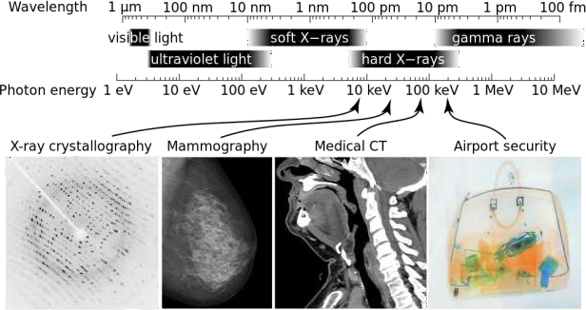
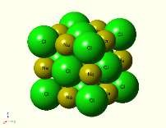

X-ray radiation
Electromagnetic radiation spectrum
rays are EM waves with:
λ = 0.01 – 10 nm
E = 0.125 – 125 keV
X-rays have wavelength in the same order as the interatomic distances in a crystalline material
http://commons.wikimedia.org/wiki/File:X-ray_applications.svg
NaCl
Space group 225, Fm-3m a = 0.562 nm

Slide 4
X-ray safety
Dangers
ionising radiation (λ<100nm), includes X-rays and gamma rays
Biological effects (somatic & genetic), Carcinogen
Precautions
Exposure limits (radiation worker @ 20 mSv/yr, Public 1 mSv/yr)
Protection (distance, shielding, interlock, reduce time)
Monitoring
Radiation survey meter, Area radiation monitors
Personal dosimeters (TLD, electronic dosimeters)
Background radiation (~0.1-0.3 μSv/hr)

Slide 5
X-ray safety in FACTS
ray instruments
IEC 61010-1:2010 compliance for newer machines
Safety interlocks, enclosure
L3 license issued by NEA
Room with card controlled access
Instrument manager
L5 license issued by NEA
Familiar with instrument set-up, proper operation and application
Basic instrument trouble-shooting
User
3 ionising radiation e-learning modules
Personal X-ray dosimeter and dosage log

Slide 6
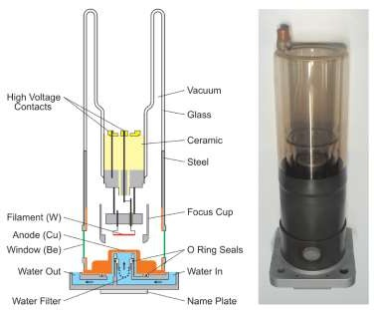
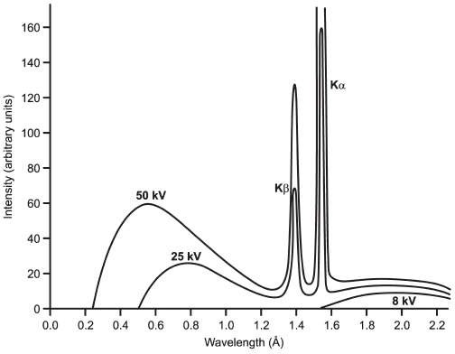
Generation of X-rays
Sealed Laboratory X-ray Tube Source
Characteristic X-ray radiation
Continuous or White radiation
Source: “Ch.2 Experimental Setups” in Powder Diffraction Theory
and Practice

Slide 7
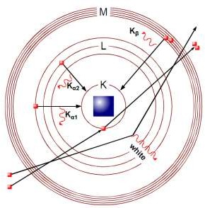
Generation of X-rays
Characteristic X-ray radiation
Continuous or White radiation
 | Anode | Energy (keV for Kα) | Wavelength (nm)
 |  |  | Kα | Kα1 | Kα2 | Kβ
 | Ag | 22.11 | 0.0560868 | 0.05594075 | 0.0563789 | 0.0497069
 | Mo | 17.44 | 0.0710730 | 0.0709300 | 0.0713590 | 0.0632288
 | Cu | 8.04 | 0.1541838 | 0.1540562 | 0.1544390 | 0.1392218
 | Co | 6.93 | 0.1790260 | 0.1788965 | 0.179285 | 0.162079
 | Cr | 5.41 | 0.2291 | 0.228970 | 0.2293606 | 0.208487
Kβ → removed using metal filters or monochromator
Kα₂ → removed as well for HRXRD

Slide 8
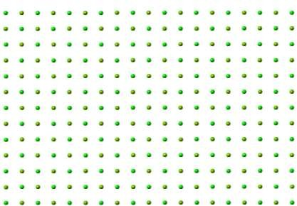
X-ray diffraction analysis
Crystal
periodic arrangement of atoms in space
Crystallographic planes
hkl index, d-spacing,
NaCl
Space group 225, Fm-3m
a = 0.562 nm
Unit cell
a = 0.562 nm
(001)
(002)
z
x
y
(011)
(021)
(111)
z
x
y

Slide 9
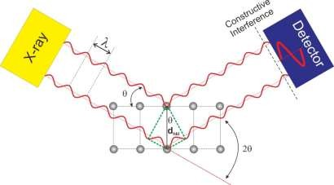
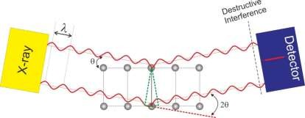
X-ray diffraction analysis
Bragg’s law:
nλ = 2dsinθ
Crystallographic planes
hkl index, d-spacing (hkl),
a = 0.562 nm
(002)
(001)
(011)
(021)
(111)
z
x
y

Slide 10



X-ray diffraction analysis
Bragg’s law: nλ = 2dsinθ | Diffraction vector
X-ray diffraction pattern
2θ-vs-Intensity plot, peaks (hkl)
(hkl)
2θ
Intensity
^{d}hkl
(hkl)
(hkl)
^{d}hkl
2θ
Peaks appear when hkl normal and diffraction vector are aligned parallel
^{d}hkl

Slide 11
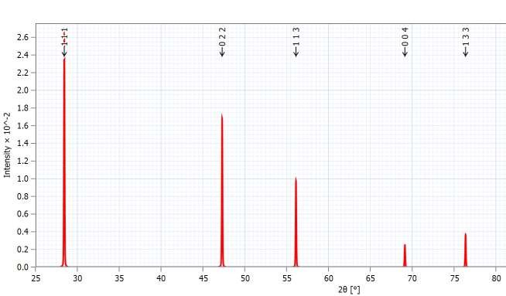
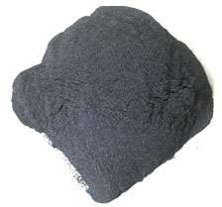
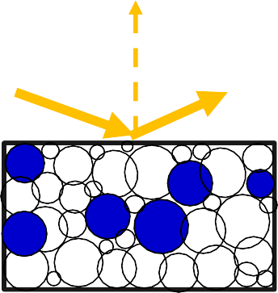
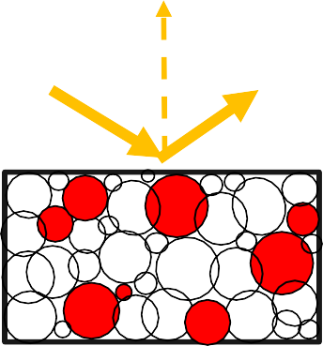
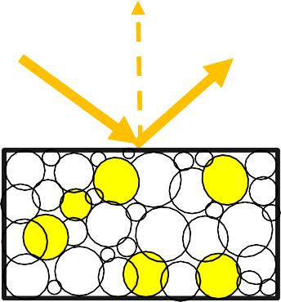
XRD analysis: polycrystalline
Silicon powder
X-ray
Det.
Powder sample have randomly oriented crystals exposed to the incident X-rays. Some of them are perfectly aligned parallel with the diffraction vector.
2θ = 29.86
2θ = 47.3
2θ = 69.13
111
022
004

Slide 12
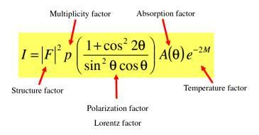
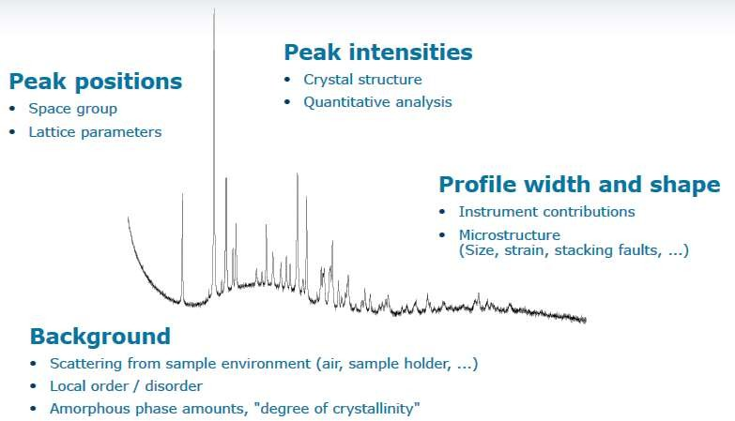
X-ray diffraction analysis
nλ = 2dsinθ
Peak Position
Depends on | Main info
Periodic arrangement of atoms/molecules λ of X-ray Sample preparation | Qualitative phase analysis Lattice parameters Space group Residual stress
Peak Intensity
Depends on | Main info
Crystal structure λ of X-ray | Quantitative phase analysis Crystal structure Preferred orientations/texture
Peak Profile (Width & Shape)
Depends on | Main info
Instrument Lattice distortion Microstructure | Crystallite sizes Micro-strain
Background
Depends on | Main info
Sample environment i.e. air, holder Amorphous phase | Amount of amorphous phase

Slide 13
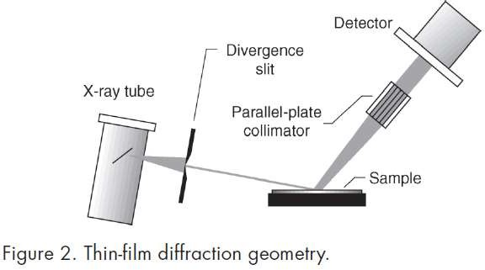
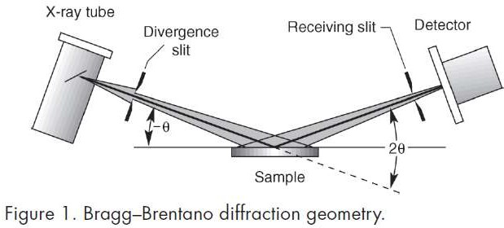
Diffraction geometry
Bragg-Brentanno: θ/2θ scan
GIXRD: 2θ scan at fixed θ or α
Powder sample
Bulk sample
Thin film (with substrate)
Surface
Thin film (without substrate)
Depth profiling

Slide 14
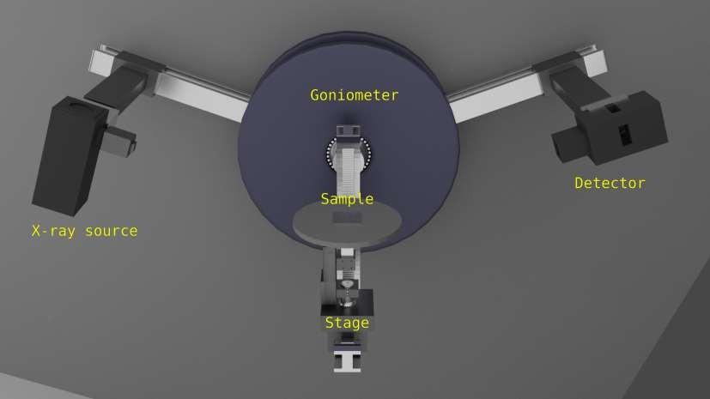
XRD scan modes
https://youtu.be/HrWT2M63DbU?list=PLzN0KRQO_AyrEWBW54KFP-RRNdYF2MBoR

Slide 15
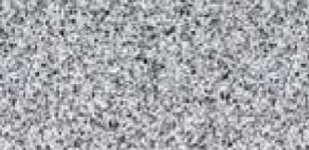



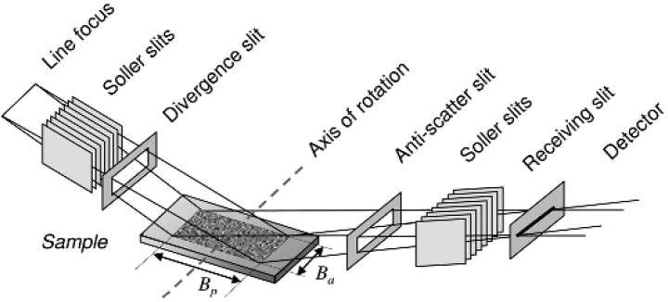

θ/2θ : Bragg-Brentanno geometry
X
Diffraction vector
D
Powder XRD:
Bragg-Brentanno (parafocusing) geometry
Divergent beam optics:
- Including crystals with tilted hkl normal
Angular resolution can be improved with narrow
slits
Div. slit
θ
hkl
2θ
Bragg-Brentanno geometry with optics
Focus length
5/March/2019
FACTS short course, Buenconsejo
15

Slide 16
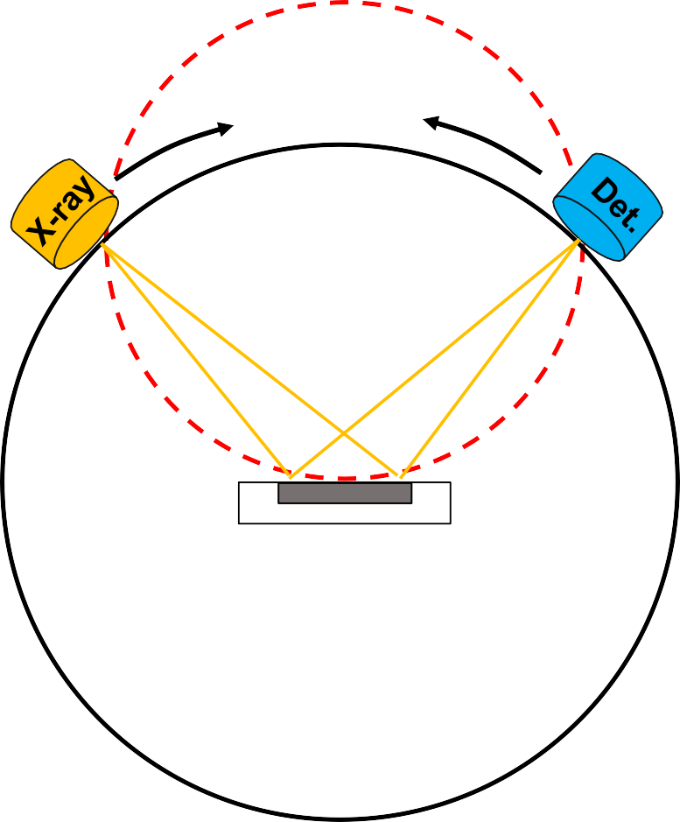
Bragg-Brentano Geometry
Focusing Circle
Geometry has to be very precise
Sample should be on the focusing circle
Randomly oriented crystals/grains (1 – 10 microns) to prevent preferred orientation
Goniometer provides the precision and accuracy required to keep the diffraction experiment in the correct geometry
sample
X-ray optics (Incident/diffracted) conditions the beam for optimum data collection.
Goniometer Circle

Slide 17
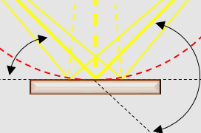
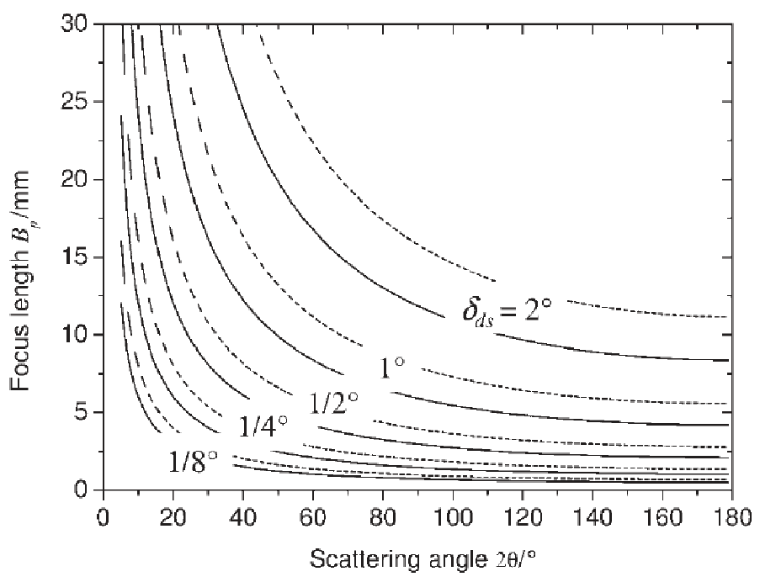
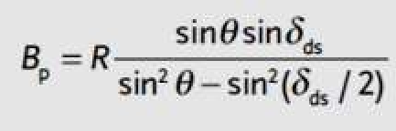

θ/2θ: Bragg-Brentanno geometry
Focusing circle
X
D
out-of-focus
in-focus
out-of-focus
θ
2θ
R= 320 mm (dashed curves)
= 240 mm (solid curves)
Goniometer circle
5/March/2019
FACTS short course, Buenconsejo
17

Slide 18
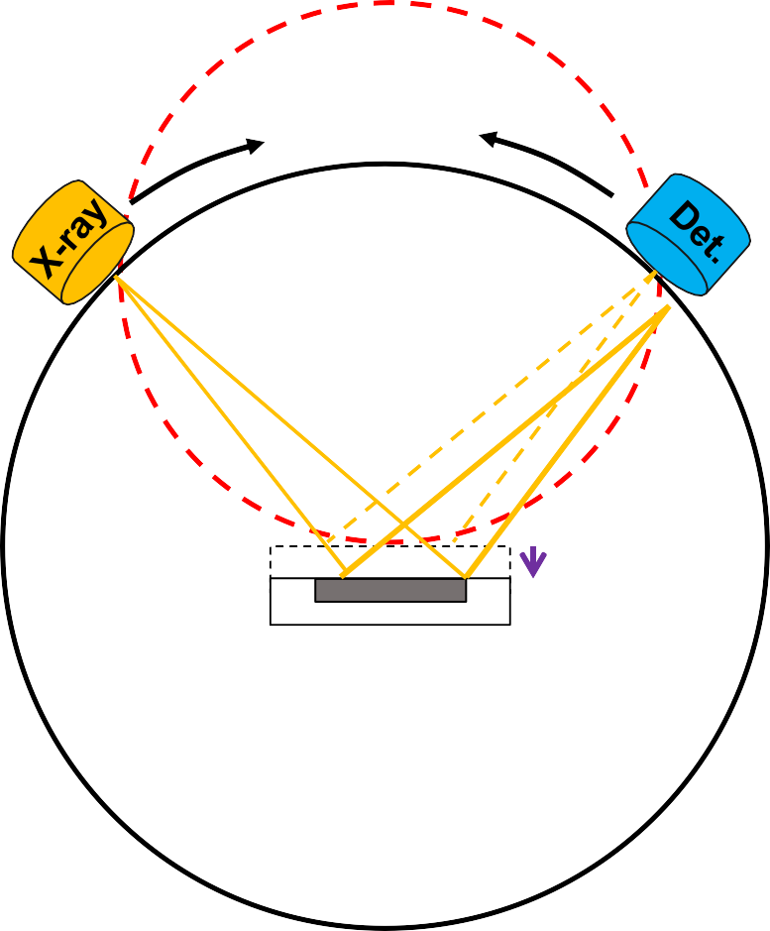
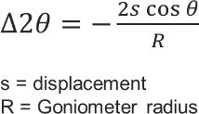
Common errors in Powder XRD experiment: Sample displacement error
Focusing Circle
Displacement
sample
Peaks shift to lower angle
Peaks shift to higher angle
Goniometer Circle

Slide 19
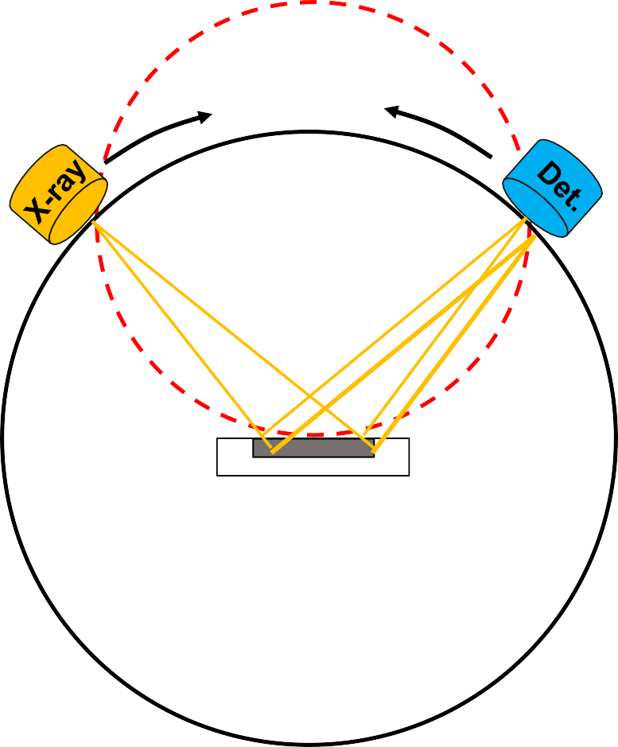
Common errors in Powder XRD experiment: Transparency error
Focusing Circle
Incident X-rays penetrate too
much into the sample
Peak asymmetry towards low angle
Typical for organic samples.
Can be avoided by using parallel beam and grazing incident set-up.
sample
Goniometer Circle

Slide 20
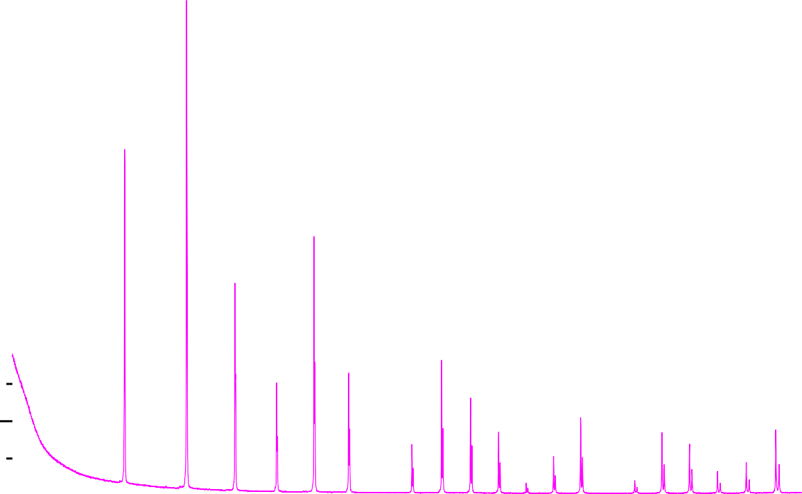
Scan parameters
80000
Scan range:
Crystal structure
Information to collect
Phase ID
Structure determination
Stress-Strain analysis
Micro-structure
70000
60000
Intensity (a.u.)
50000
40000
30000
20000
10000
0
10 20 30 40 50 60 70 80 90 100 110 120
2Theta (deg)
X-ray Cluster 1 & 2 Training
2020
20

Slide 21
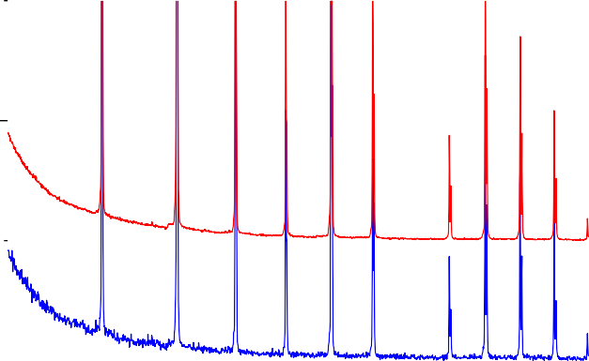
Scan parameters: Scan time
70000
7000
Time/Step = 1s
Time/Step = 0.1s
60000
6000
50000
1s time/step
5000
0.1s time/step
Intensity (a.u.)
Intensity (a.u.)
40000
4000
30000
3000
20000
2000
10000
1000
0
40 50
2Theta (deg)
0
40 50
2Theta (deg)
10
20
30
60
70
80
10
20
30
60
70
80
Normalized Intensity (a. u.)
1s time/step
0.1s time/step
2020
10
2X0 -ray C30luster 410 & 2 T5r0aining60
70
80
21
2Theta (deg)

Slide 22
Scan Parameters: Step size
^{K}α1
^{K}α2
Intensity (a. u.)
0.02 deg 0.05deg 0.1deg
0.02 deg
0.05 deg
Intensity (a. u.)
0.1 deg
62.6
62.8
63.0
63.2 63.4
2Theta (deg)
63.6
63.8
64.0
Intensity (a. u.)
10
20
30
40 50
2Theta (deg)
60
70
80
0.02 deg
0.05 deg
0.1 deg
 | 30.0 | 30.1 | 30.2 | 30.3 | 30.4 | 30.5 | 30.6 | 30.7 | 30.8
2020 | X-ray Cluster 1 & 2 Training |  |  | 2Th | eta (deg | ) |  | 22

Slide 23
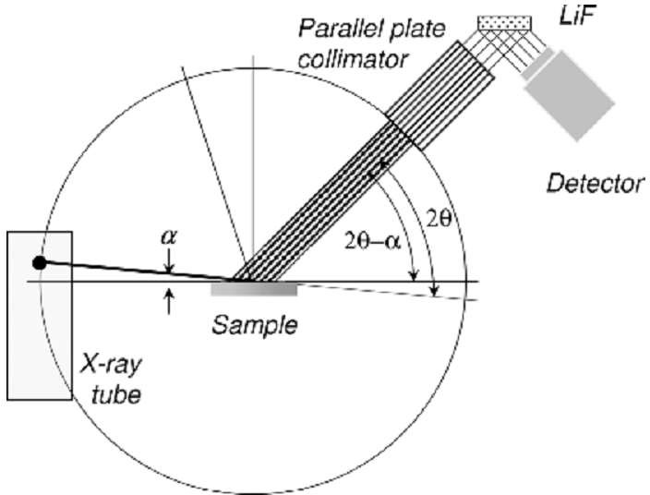
Grazing Incident XRD (GIXRD)
Why Grazing Incidence? Low α shallow penetration To avoid the substrate!
Source: “Ch. 4 Grazing Incidence Configuration” in Thin Film Analysis by X-ray Scattering. M. Birkholz
2020 X-ray Cluster 1 & 2 Training
23

Slide 24
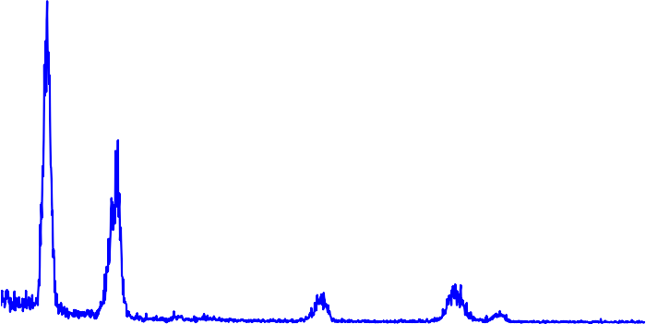
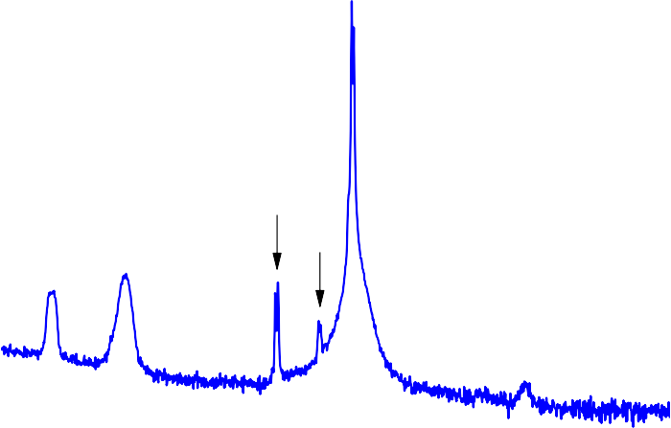
Examples: GIXRD versus BBG scan
100000
GIXRD α =1º
80000
63Au-35Cu-2Al thin film
fcc-phase t = 681 nm
Substrate: SiO /Si-001
2
GIXRD:
Probes the thin film region only
Relative Intensity is lower
(111)_{fcc}
Intensity
60000
(200)
fcc
40000
Bragg-Brentanno (θ/2θ scan):
Additional contribution from the
substrate
Very high intensity
20000
(220)
(311)_{fcc}
0
1E13
1E12
1E11
1E10
1E9
1E8
1E7
1000000
100000
10000
1000
fcc
(222)
fcc
θ-2θ scan
substrate
Log Intensity
How much difference in the absorption and penetration depth?
40
5/March/2019
60
80
100
FACTS short course, Buenconsejo
2θ (º)
24

Slide 25


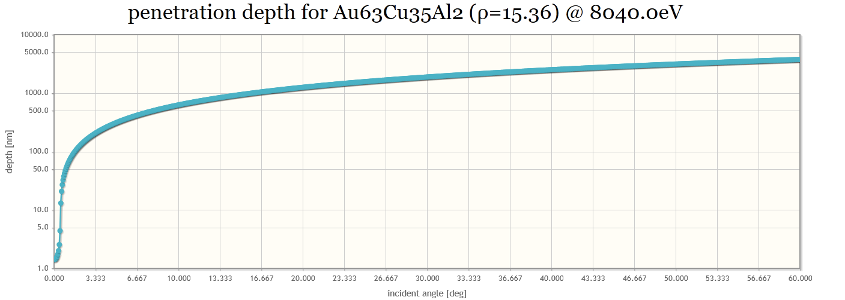

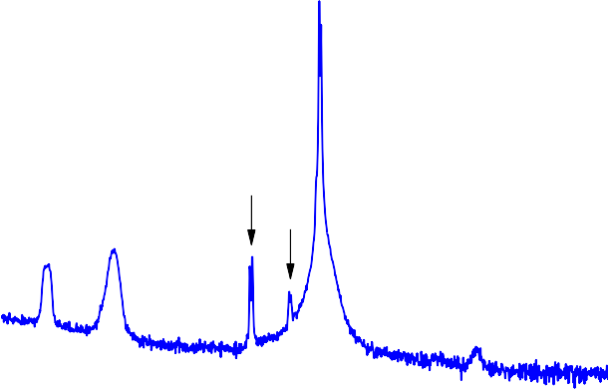
GIXRD: X-ray penetration depth
α=1º
depth =55 nm
θ > 15º
depth > 900 nm
100000
GIXRD α =1
o
80000
63Au-35Cu-2Al thin film
fcc-phase t = 681 nm
(111)_{fcc}
Intensity
60000
Substrate: SiO /Si-001
(200)
fcc
2
40000
20000
(220)
fcc
(311)_{fcc}
(222)
0
1E13
1E12
1E11
1E10
1E9
1E8
1E7
1000000
100000
10000
1000
fcc
θ-2θ scan
substrate
Log Intensity
---Note-----
Porosity, columnar grains, voids, defects in the material could reduce the effective density of the film and therefore the penetration depth could be deeper.
Thin film density could be measured using XRR.
5/March/2019 FACTS short course, Buenconsejo
40
60
80
25
100
2θ (º)

Slide 26
Hands-on training
X-ray safety measures in FACTS
Dosimeter usage and e-logging
XRD room access
Sample preparation
Shimadzu (Cluster 1)
Bruker & Panalytical (Cluster 2)
Standard operating procedure
Shimadzu (Cluster 1)
Bruker & Panalytical (Cluster 2)
Post data collection analysis
Match software for Phase ID, Quantitative analysis

Slide 27
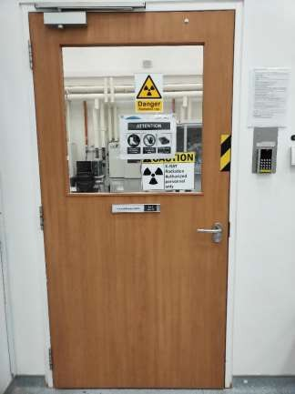
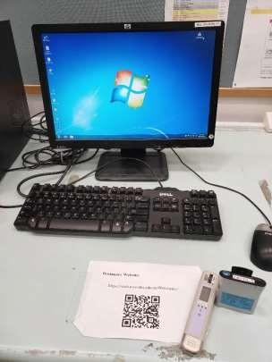
X-ray safety in FACTS
Access only for XRD users
Personal Dosimeter

Slide 28
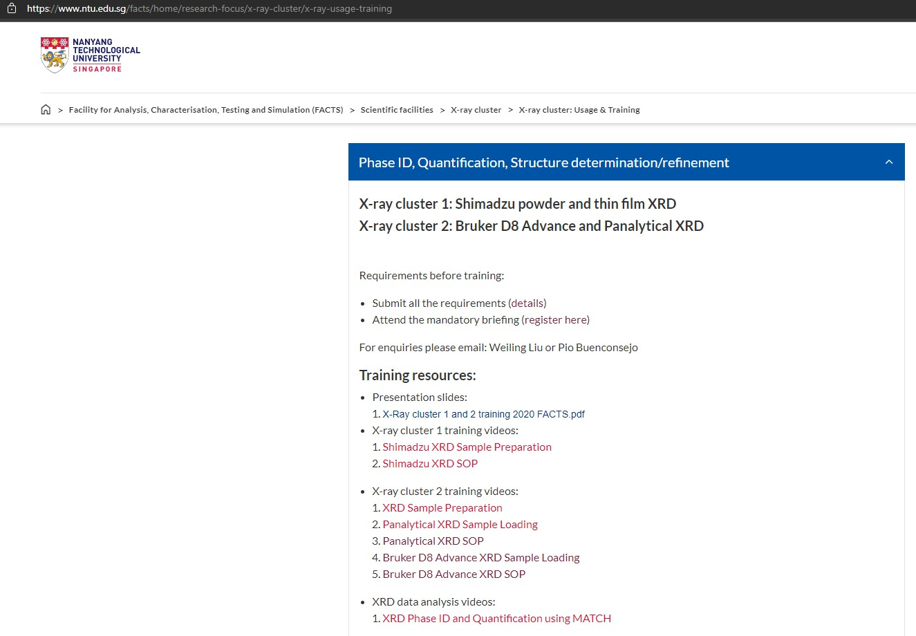
Resources

Slide 29
X-ray cluster
Cluster 1:
Shimadzu Powder XRD & Thin Film XRD
Cluster 2:
Bruker D8 Advance & Panalytical Xpert Pro
Cluster 3: Training is by appointment only
Bruker Apex II Single Crystal XRD
Bruker D8 Discover HRXRD (multipurpose)
Rigaku Smartlab High-flux (9kW X-ray source) XRD
Xenocs Nanoinxder SAXS/WAXS, GISAXS/GIWAXS
Anton Paar SAXSess SAXS/WAXS

Slide 30
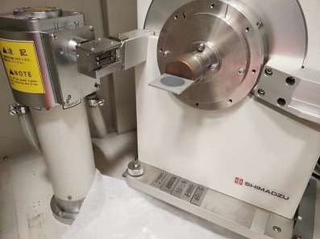
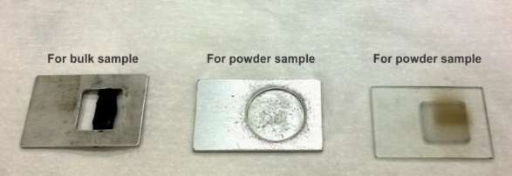
Sample Loading
Shimadzu Powder XRD
Bulk sample holder is shorter in length by about 5mm. Need to consider this as offset when loading the sample.

Slide 31
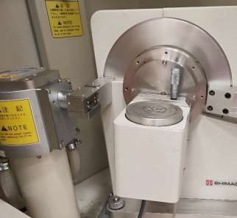
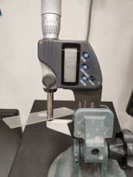
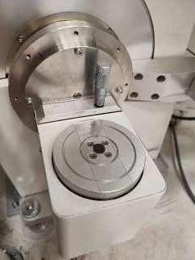

Sample Loading
Shimadzu Thin Film XRD
Set stage height to
8.3 – 0.966 = 7.334 mm
Turn on the pump to fix the sample on the stage

Slide 32
X-ray cluster
Cluster 1:
Shimadzu Powder XRD & Thin Film XRD
Cluster 2:
Bruker D8 Advance & Panalytical Xpert Pro
Cluster 3: Training is by appointment only
Bruker Apex II Single Crystal XRD
Bruker D8 Discover HRXRD (multipurpose)
Rigaku Smartlab High-flux (9kW X-ray source) XRD
Xenocs Nanoinxder SAXS/WAXS, GISAXS/GIWAXS
Anton Paar SAXSess SAXS/WAXS

Slide 33
Data analysis
MATCH for Phase ID, quantification
PDF 4+, ICSD database: for checking structure and Cif files
TOPAS, EVA

Slide 34
Important things to remember after training
Only official NTU staff with NTU staff card; students and exchange students
with NTU matriculation card are allowed to use FACTS facilities.
After training, XRD users must use > 3 hours within the first 30 days of training, or their access will be automatically deactivated. To regain access, user must wait for at least the following month for retraining. There will be charges for retraining.
If there is no usage of instrument within 365 days from the last usage, access will be automatically removed by the FOM server. Retraining with charges is applicable in this case.
For booking of instruments, users are encouraged to cancel the booking early if they do not need the slots. Charges will still apply if users cancel booking within 24 hours or fail to turn up for usage thereafter.
If a user uses an instrument booked under the name by a different user, this constitutes as unauthorized usage. Penalties including access removal to ALL FACTS equipment will apply. Users are advised to request FACTS staff to change the booking to the correct user, instead of simply allowing access to someone who needs the access.
Users will bear the cost of any equipment damage and instrument access will be revoked for any misuse.

Slide 35
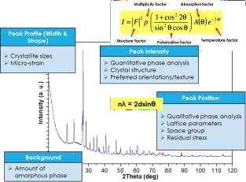
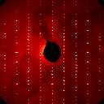
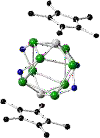
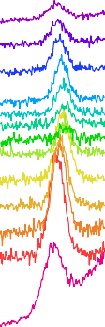
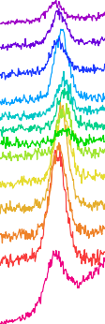
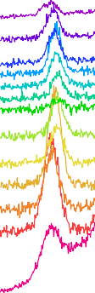
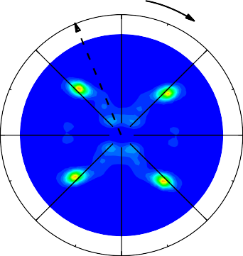
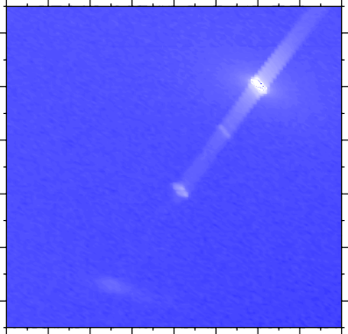
X-ray Scattering Analysis @FACTS
Powder XRD Grazing Incident XRD
Single Crystal XRD
100000
GIXRD scan of Au alloy film
α = grazing incident angle
111
10000
200
Intensity
220
311
222
400
331
420
1000
α = 20
100
Precession image of a diffraction pattern
Solved crystal structure:
C (black), Al (blue), Ti (grey) and F (green)
α = 0.5
10
40
60
80
2θ
100
120
High-Resolution XRD
Reciprocal space map of an epitaxial thin film
Residual Stress
Triaxial residual stress analysis of Au alloy film
Texture
(111) PF of a Cu foil
2000
φ= 0 φ= 45 φ= 90
ψ=0-90
o
0
φ
35
1.2E+05
1800
27
4.2
1600
315
45
204 substrate
1.1E+03
1400
-ψ
18
4.0
1200
8.8
3.8
1.1E+01
1000
270
90
0.0
l
3.6
800
+ψ
1.1E-01
600
3.4
400
1.0E-03
200
225
135
3.2
204 film
0
112 114 116 118 120
2θ
112 114 116 118 120
2θ
112 114 116 118 120
2θ
1.4 1.5 1.6 1.7 1.8 1.9 2.0 2.1 2.2
h
1.0E-05
180

Slide 36




X-ray Scattering Analysis @FACTS
SAXS GISAXS
X-Ray Reflectivity
Nanostructured material
Nano-particle size analysis
q
z
1000000
in-plane scattering
SiN film
Experimental Simulated
q = 0.012
10
5
100000
1
d = 52.36 nm
10000
1000
100
10
Intenstiy
1
10³
0.00
0.02
0.04
0.06
Particle size distribution
q (A⁻¹)
^{0.0004} SiO spheres
xy
0.0003
2
fitting results
thickness = 200.1(1.1) nm roughness = 2.05 (0.11) nm
density = 2.23 (0.02) g/cm³
N(R)
0.0002
10¹
0.0001
q
xy
0.0000
0
5 10 15
r (nm)
₁₀-1
0.0
0.5
1.0
1.5
2θ
We also have:
We can always discuss on:
In-situ heating/cooling stage •
High-power X-ray source (Rigaku Smartlab)
XRF for composition analysis
Wide range of software for XRD data analysis
Ad-hoc in-situ experiments with supervision
Design of experiment
Data treatment and analysis

