Slide 1


INTELLIGENT AYURVEDIC HERBAL PLANT IDENTIFICATION
AND
ECONOMIC ANALYSIS IN SRI LANKA
R-26-IT-021
SLIIT
FACULTY OF COMPUTING
1
R-26-IT-021
2026/05/11

Slide 2
Comments for the Proposal and Actions Taken
Student ID | Comment | Action Taken
IT22640598 | Maintain conversation context across multiple turns to enable natural follow‑up questions (e.g., reusing the previously mentioned plant without repeating its name). | Implemented session‑aware conversation memorywith session_id and conversation_store to retain chat history enabling future personalization and context‑aware recommendations.
IT22132796 | The panel suggested incorporating more key parameters to improve prediction accuracy and better reflect real-world conditions. | I improved our model by adding more important factors, which helped increase the accuracy and real-world reliability of the system
IT22168986 | Further refinement of the components is necessary to clearly establish their research value. Consider Leaf shape , Leaf texture, Color patterns, Leaf vein structure , Plant morphology features etc. | This research proposes a multi-modal intelligent plant identification framework that integrates leaf morphology, texture analysis, vein structure extraction, and color-pattern recognition to improve classification accuracy and disease-aware plant recognition under real-world environmental conditions.
IT22112132 | Consider how to measure leaf health, maturity, chemical indicators, defects | For maturity detection, I will train a separate model using images captured under different lighting conditions such as good lighting, low lighting, and natural outdoor lighting. This will help the model identify maturity based on real visual features like color, texture, size, dryness, and overmaturity signs, instead of depending only on brightness.
SLIIT
FACULTY OF COMPUTING
2
R-26-IT-021
2026/05/11

Slide 3
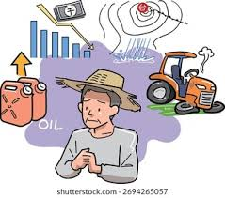
Intelligent Ayurvedic Herbal Plant Identification and Economic Analysis in sri lanka
Problem Definition
Challenges Faced in Sri Lankan Ayurvedic Herbal Sector
  Sri Lanka has -1,400 medicinal plant species used in Ayurveda for over 3,000 years.
  Indigenous knowledge is rapidly disappearing (most practitioners aged 55+).
  Less than 30% of population can identify common medicinal plants.
  Farmers face crop failures and income loss due to poor selection and market timing.
  Quality assessment of plants is manual, subjective, and inconsistent.
  Information is scattered, mostly in English, and not easily accessible.
SLIIT
FACULTY OF COMPUTING
3
R-26-IT-021
2026/05/11

Slide 4


Intelligent Ayurvedic Herbal Plant Identification and Economic Analysis in sri lanka
Impact of the Problem on Users and Society
On Farmers:
  Income loss of 30-60%
  High crop failure rates (15-25%)
  Vulnerability to middlemen exploitation
On Manufacturers & Industry:
  LKR 2.3 Billion spent annually on imports
  Inconsistent raw material supply and quality issues
On Society:
  Loss of indigenous Ayurvedic knowledge
  Public health risks from misidentified or low-quality plants
  Educational gap among younger generation
  Environmental pressure from unsustainable harvesting
SLIIT
FACULTY OF COMPUTING
4
R-26-IT-021
2026/05/11

Slide 5

Intelligent Ayurvedic Herbal Plant Identification and Economic Analysis in sri lanka
Existing Solutions and Their Limitations
  Generic plant ID apps not trained for Sri Lankan species
  Pattern-matching chatbots cannot handle novel questions
  No integration between identification, knowledge, cultivation, and quality
  Lack of explainability in AI decisions
  Limited or no Sinhala language support
  No economic/profit analysis for farmers
SLIIT
FACULTY OF COMPUTING
5
R-26-IT-021
2026/05/11

Slide 6
Intelligent Ayurvedic Herbal Plant Identification and Economic Analysis in sri lanka
Design Excellence of the Overall Solution
  CNN-based intelligent plant recognition.
  Fast Ai-based Medicinal Plant Quality Assessment.
  Explainable Prediction Using Grad-cam Heatmaps.
  Scalable design that allows adding more herbal plants and features in the future.
  Integration of AI/ML with real-world agricultural problem-solving.
  RAG-based Herbal AI Assistant -No prior solution combines deep plant knowledge with conversational AI and multilingual support for Sinhala.
  Dynamic Knowledge Updates - New plants added to ChromaDB vector store instantly without retraining or manual pattern creation.
SLIIT
FACULTY OF COMPUTING
6
R-26-IT-021
2026/05/11

Slide 7


HERBAL KNOWLEDGE INTELLIGENCE SYSTEM - AI ASSISTANT FOR SRI LANKAN MEDICINAL PLANTS
MUNASINGHE M P
IT22640598
SLIIT
FACULTY OF COMPUTING
8
IT22640598 | M P MUNASINGHE | R-26-IT-021
2026/05/11

Slide 8

j
Herbal Knowledge Intelligence System - AI Assistant for Sri Lankan Medicinal Plants
How the Solution will Address the Sub-Problem
User Requirements Addressed by the Solution​
  Traditional Ayurvedic knowledge is declining due to poor accessibility and lack of interactive tools.
  Existing chatbots suffer from loss of conversation context, topic drifting, and frequent hallucinations.
  Users find it difficult to ask follow-up questions about the same medicinal plant.
  Our solution provides a context-aware conversational assistant that remembers the plant being discussed and maintains meaningful dialogue.
  Users can ask free-form questions in English or Sinhala about medicinal plants.
  System maintains conversation context for follow-up questions (e.g., “What are its benefits?” after mentioning a plant).
  Provides accurate, grounded answers.
  Supports mobile access through Flutter frontend.
SLIIT
FACULTY OF COMPUTING
9
IT22640598 | M P MUNASINGHE | R-26-IT-021
2026/05/11

Slide 9

Herbal Knowledge Intelligence System - AI Assistant for Sri Lankan Medicinal Plants
Design Excellence / Contribution
  Used optimized chunking strategy (700 characters with 150 overlap) and text-embedding-3-large for high retrieval accuracy.
  Implemented Contextual Query Rewriting + Strict Plant Topic Anchoring - that solves context loss in domain-specific conversations.
  Chose RAG over Fine-tuning for better maintainability and updatability of traditional knowledge.
  Strong session management and conversation memory.
User Feedback on Prototype
  Successfully maintains conversation context during multi-turn dialogues.
  Users appreciate natural follow-up questioning about the same plant.
  Fast and relevant responses with good grounding.
  Positive feedback on multilingual support .
SLIIT
FACULTY OF COMPUTING
10
IT22640598 | M P MUNASINGHE | R-26-IT-021
2026/05/11

Slide 10

AI-DRIVEN CULTIVATION RECOMMENDATION SYSTEM FOR SMALL-SCALE HERBAL FARMERS
IT22132796
Wickramasinghe D G T K
SLIIT
FACULTY OF COMPUTING
IT22132796 | D G T K WICKRAMASINGHE | R-26-IT-021
2026/05/11
11

Slide 11


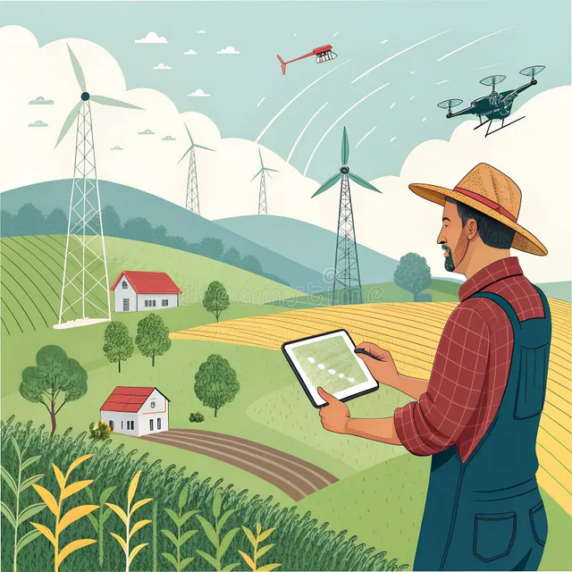
AI-Driven Cultivation Recommendation System For Small-Scale Herbal Farmers
How the Solution Addresses the Sub-Problem
  The system solves the difficulty of identifying medicinal herbal plants accurately using manual methods.
  It uses a machine learning model to analyze plant data and predict the correct herbal species.
  Farmers and users can input environmental and soil parameters to get accurate recommendations.
  Reduces dependency on expert knowledge, which is often limited or unavailable in rural areas.
  Improves decision-making speed in herbal cultivation and selection.
User Requirements Addressed by the Solution
  Simple and user-friendly interface for farmers and non-technical users.
  Fast prediction results through an automated backend model.
  Ability to input basic agricultural parameters (soil type, rainfall, land size, etc.).
  Reliable and accurate crop/plant recommendations.
  Mobile/web accessibility for easy usage in field conditions.
  Minimal manual effort required from the user.
SLIIT
FACULTY OF COMPUTING
IT22132796 | D G T K WICKRAMASINGHE | R-26-IT-021
2026/05/11
12

Slide 12

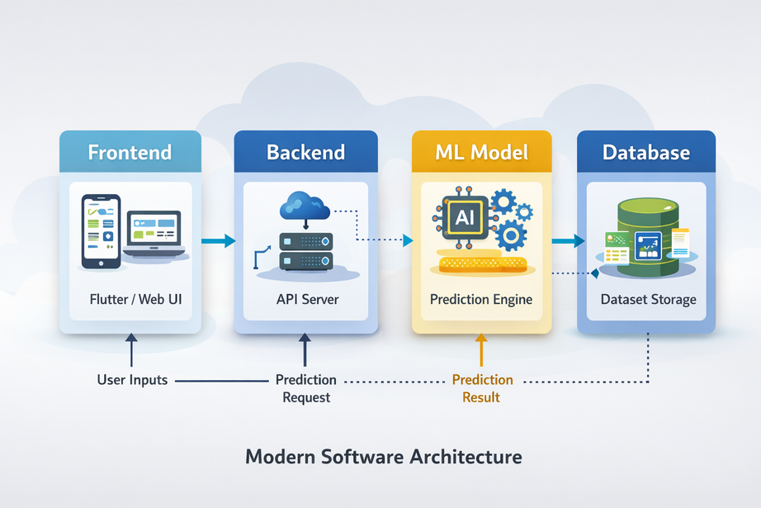

AI-Driven Cultivation Recommendation System For Small-Scale Herbal Farmers
Design Excellence / Contribution
  Clean and modern UI designed for easy understanding and usability.
  Modular system architecture (frontend + backend + ML model separation).
  Efficient data processing pipeline for quick predictions.
  Scalable design that allows adding more herbal plants and features in the future.
  Integration of AI/ML with real-world agricultural problem-solving.
  Focus on performance optimization and reduced response time.
User Feedback on Prototype
  Users found the interface simple and easy to navigate.
  Positive feedback on the quick response time of predictions.
  Users appreciated the automated recommendation system compared to manual methods.
  Some users suggested adding more plant categories and detailed explanations.
  Farmers expressed interest in using it as a daily agricultural support tool.
  Prototype considered useful for improving herbal cultivation decisions.
SLIIT
FACULTY OF COMPUTING
IT22132796 | D G T K WICKRAMASINGHE | R-26-IT-021
2026/05/11
13

Slide 13

MOBILE-BASED DETECTION OF SRI LANKAN AYURVEDIC PLANTS
USING IMAGE RECOGNITION
H D SACHINTHA
IT22168986
SLIIT
FACULTY OF COMPUTING
IT22168986 | H D SACHINTHA | R-26-IT-021
14
2026/03/16

Slide 14



MOBILE-BASED DETECTION OF SRI LANKAN AYURVEDIC PLANTS
USING IMAGE RECOGNITION
How the Solution Addresses the Sub-Problem
  Users can scan plant leaves or seeds using a smartphone camera
  AI model identifies Sri Lankan Ayurvedic medicinal plants
  System displays medicinal uses and plant details instantly
  Reduces difficulty in identifying similar-looking medicinal plants
User Requirements Addressed
  Image capture using mobile camera
  Fast plant recognition
  Display medicinal information
  User-friendly mobile interface
  Accurate identification results
Design Excellence / Contribution
  CNN-based intelligent plant recognition
  Mobile-first design for easy public access
  Integration of AI with Ayurvedic knowledge
  Supports preservation of traditional medicinal knowledge
SLIIT
FACULTY OF COMPUTING
IT22168986 | H D SACHINTHA | R-26-IT-021
2026/05/11
15

Slide 15
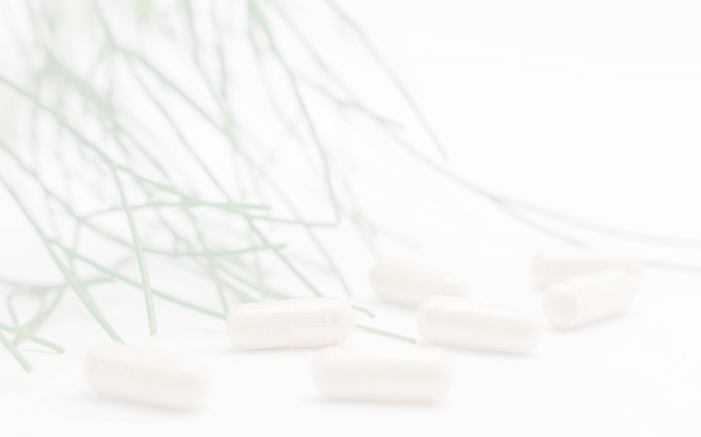
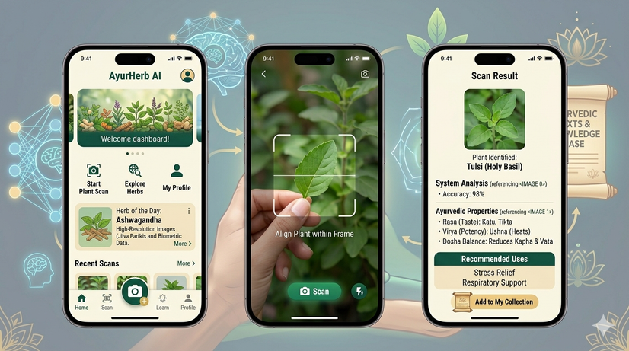

MOBILE-BASED DETECTION OF SRI LANKAN AYURVEDIC PLANTS
USING IMAGE RECOGNITION
Prototype Features
  Plant image scanning
  Image preprocessing module
  AI recognition model
  Medicinal plant database integration
  Result display with plant details
Future Improvements
  Real-time disease detection
  AI chatbot for herbal recommendations
  Cloud database expansion
  Multi-language support
User Feedback on Prototype
Positive Feedback
  Easy to use mobile application
  Helpful medicinal information
  Quick plant identification
  Attractive and simple interface
Suggested Improvements
  Add more Sri Lankan medicinal plants
  Sinhala/Tamil voice support
  Offline mode support
  Better camera optimization
SLIIT
FACULTY OF COMPUTING
IT22168986 | H D SACHINTHA | R-26-IT-021
16
2026/03/16

Slide 16

EXPLAINABLE AI SYSTEM FOR AYURVEDIC MEDICINAL PLANT QUALITY ASSESSMENT
PATTIYA ARACHCHI P A H K
IT22112132
SLIIT
FACULTY OF COMPUTING
IT22112132 | PATTIYA ARACHCHI P A H K | R-26-IT-021
2026/05/11
17

Slide 17

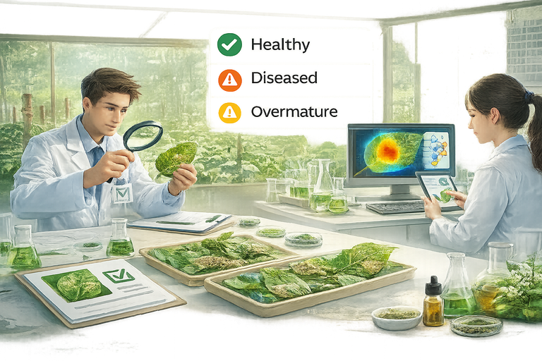
EXPLAINABLE AI SYSTEM FOR AYURVEDIC MEDICINAL PLANT QUALITY ASSESSMENT
Problem Identification
  Ayurvedic Medicinal Plant Quality Is Usually Checked Manually.
  Manual Inspection Depends On Expert Knowledge.
  Plant Diseases, Pest Damage, And Over-maturity Can Reduce Medicinal Suitability.
  Non-expert Users May Struggle To Identify Unsuitable Plant Materials.
  Incorrect Quality Assessment Can Affect The Reliability Of Ayurvedic Preparations.
Existing System Gap
  Most Existing Systems Focus Only On Plant Identification Or Disease Detection.
  Limited Focus On Medicinal Suitability Assessment.
  Many Systems Do Not Explain Why A Prediction Was Made.
  Lack Of Explainable Ai Support Reduces User Trust.
  Limited Support For Local Ayurvedic Medicinal Plant Quality Evaluation.
Proposed Solution
  Develop An Ai-based Image Analysis System To Assess Medicinal Plant Quality.
  Classify Plant Samples As Suitable Or Not Suitable For Medicinal Use.
  Detect Visible Quality Issues Such As Disease, Damage, Or Over-maturity.
  Use Resnet50 Transfer Learning For Image Classification.
  Use Grad-cam Heatmaps To Visually Explain Model Decisions.
SLIIT
FACULTY OF COMPUTING
IT22112132 | PATTIYA ARACHCHI P A H K | R-26-IT-021
18
2026/05/11
Notes:
In traditional medicine, plant leaves or fruits must meet certain quality conditions before they can be used in treatments. However, quality inspection is currently performed manually by experts.
This approach has several limitations. It is time-consuming, requires specialized knowledge, and may not be accessible in rural or agricultural environments. As a result, diseased or over-mature plant materials may sometimes be used, which can reduce the effectiveness of herbal medicine.
Therefore, the objective of my research component is to develop an AI-based system that can automatically evaluate the quality of medicinal plant materials using image analysis.
To achieve this, the system will train a deep learning model capable of identifying plant conditions such as healthy, diseased, or overmature.
Additionally, transfer learning will be used to improve model performance with limited datasets, and Explainable AI techniques will be applied to help users understand how the model makes decisions.
This system aims to support farmers, herbal suppliers, Ayurvedic practitioners, and even individuals who are still learning about medicinal herbs.

Slide 18

EXPLAINABLE AI SYSTEM FOR AYURVEDIC MEDICINAL PLANT QUALITY ASSESSMENT
User Requirements
Future Enhancements
  Upload Or Capture Medicinal Plant Leaf/Fruit Images.
  Get Quality Prediction Result Quickly.
  Display Result As:
    Suitable For Medicinal Use
    Not Suitable For Medicinal Use
  Show Prediction Confidence Percentage.
  Display Grad-cam Heatmap For Explanation.
  Provide A Simple Interface
  Implement Image Capture Option For Real-time Prediction.
  Increase Dataset Size Using More Real-world Medicinal Plant Images.
  Improve Model Performance
  11Deploy The System As A Mobile Application.
  Test The Mobile App With Real Users
Design Excellence
Current Progress
  Simple Image Upload And Prediction Interface.
  Fast Ai-based Medicinal Plant Quality Assessment.
  Explainable Prediction Using Grad-cam Heatmaps.
  Confidence Score To Support User Decision-making.
  Scalable System Design For Future Mobile App Deployment.
  Studied Related Works On Medicinal Plant Identification, Plant Disease Detection, And Grad-cam.
  Collected Datasets From Kegalle Field Collection And Mendeley.
  Trained And Tested Two Models:
    Mobilenetv2 (Test Accuracy: 0.7015)
    Resnet50 (Test Accuracy: 0.7415)
  Selected Resnet50 Due To Better Performance.
  Implemented Image File Upload For Prediction.
  Added Grad-cam For Visual Explanation.
  Current System Shows:
    Prediction Result
    Confidence Percentage
    Grad-cam Heatmap
SLIIT
FACULTY OF COMPUTING
IT22112132 | PATTIYA ARACHCHI P A H K | R-26-IT-021
2026/05/11
19
Notes:
To implement the proposed solution, a computer vision and deep learning based methodology is used.
First, the system collects images of medicinal plant leaves or fruits.
These images then go through preprocessing steps, such as resizing and normalization, to ensure consistent image quality.
After preprocessing, the system performs feature extraction using a pretrained deep learning model called ResNet50.
ResNet50 is a convolutional neural network architecture that has been trained on large image datasets and is capable of extracting important visual features such as edges, shapes, and textures.
Using transfer learning, the pretrained model is adapted to classify medicinal plant conditions into three categories:
Healthy, Diseased, and Overmature.
In addition to classification, the system also integrates Explainable AI using Grad-CAM.
Grad-CAM generates heatmaps that highlight the regions of the plant image that influenced the model’s decision.
The main technologies used in this component include Python, PyTorch, OpenCV, ResNet50, and Grad-CAM, and the model training will be performed using GPU platforms such as Google Colab.

Slide 19

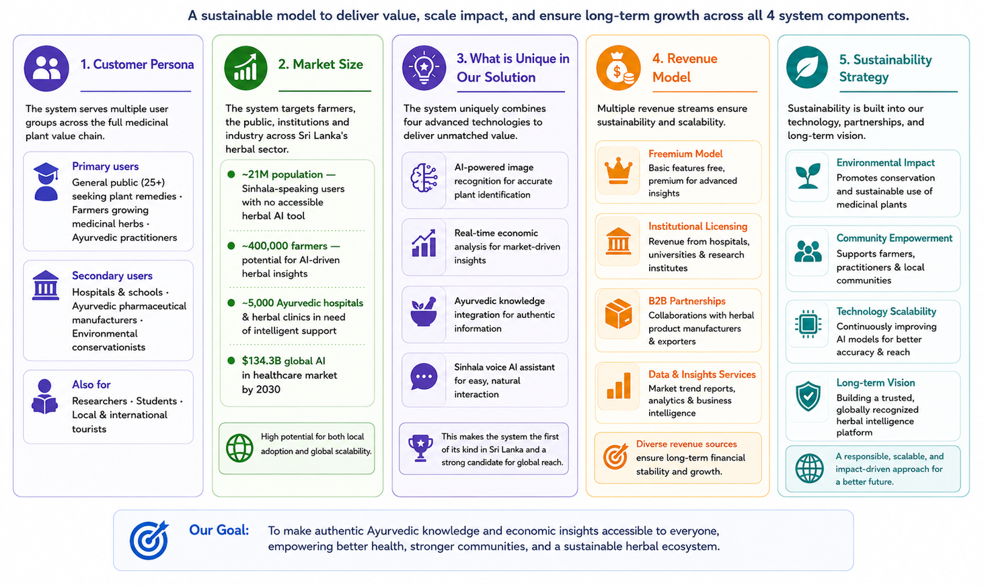
Ability of commercialization
SLIIT
FACULTY OF COMPUTING
20
R-26-IT-021
2026/05/11

Slide 20

SLIIT
FACULTY OF COMPUTING
21
R-26-IT-021
2026/03/16

