Slide 1


INTELLIGENT AYURVEDIC HERBAL PLANT IDENTIFICATION
AND
ECONOMIC ANALYSIS IN SRI LANKA
R-26-IT-021
SLIIT
FACULTY OF COMPUTING
1
R-26-IT-021
2026/08/30

Slide 2

2

Slide 3







OUR RESEARCH
TEAM
Supervisor
Mr. Nelum Amarasena
Co-supervisor
Ms. Kaushika kahatapitiya
Team Leader
M.P. Munasinghhe
Team Member
D.G.T.K.Wickramsinghe
Team Member
H.D. Sachintha
Team Member
P.A.H.K. Pattiyarachchi
3

Slide 4
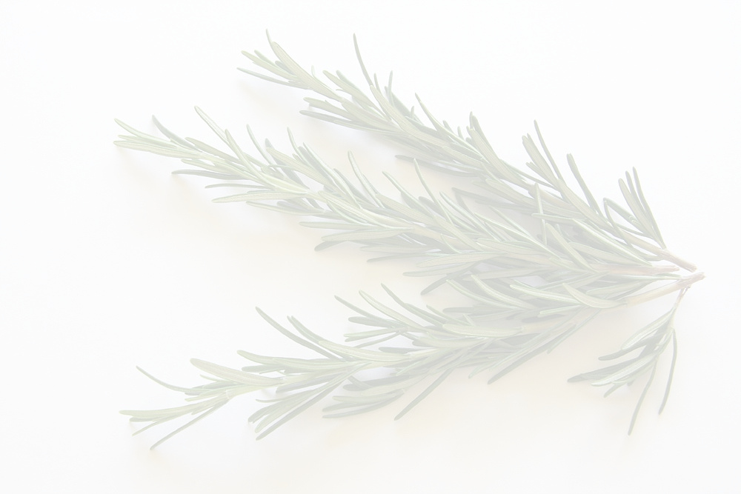






Problem and Motivation
Sri Lanka has a rich tradition of Ayurvedic medicine and medicinal plants, but traditional herbal knowledge is becoming difficult to access and apply effectively.
Observed Problems
KNOWLEDGE ACCESSIBILITY
Existing medicinal plant knowledge is scattered and difficult to access through simple natural-language interaction.
CULTIVATION DECISIONS
Small-scale farmers lack data-driven support for selecting profitable and suitable medicinal plants.
PLANT IDENTIFICATION
Non-experts often struggle to correctly identify medicinal plants.
QUALITY ASSESSMENT
ASSESSMENTS of plant quality can be subjective and inconsistent.
SLIIT
FACULTY OF COMPUTING
4
R-26-IT-021
2026/08/30

Slide 5





Intelligent Ayurvedic Herbal Plant Identification and Economic Analysis in sri lanka
Solution Overview
An Integrated AI Ecosystem for Sri Lankan Ayurvedic Plants
Herbal Knowledge Assistant
Provide Ayurvedic plant information through a Sinhala + English conversational AI assistant.
Cultivation Recommendation
Recommend suitable medicinal plants by considering soil, climate, land, market demand, cost, profit and risk.
Plant Detection
Identify Sri Lankan Ayurvedic plants from leaf, flower or fruit images.
Quality Assessment
Classify plant materials as Healthy, Diseased or Overmature and explain the prediction using Grad-CAM.
SLIIT
FACULTY OF COMPUTING
5
R-26-IT-021
2026/08/30

Slide 6

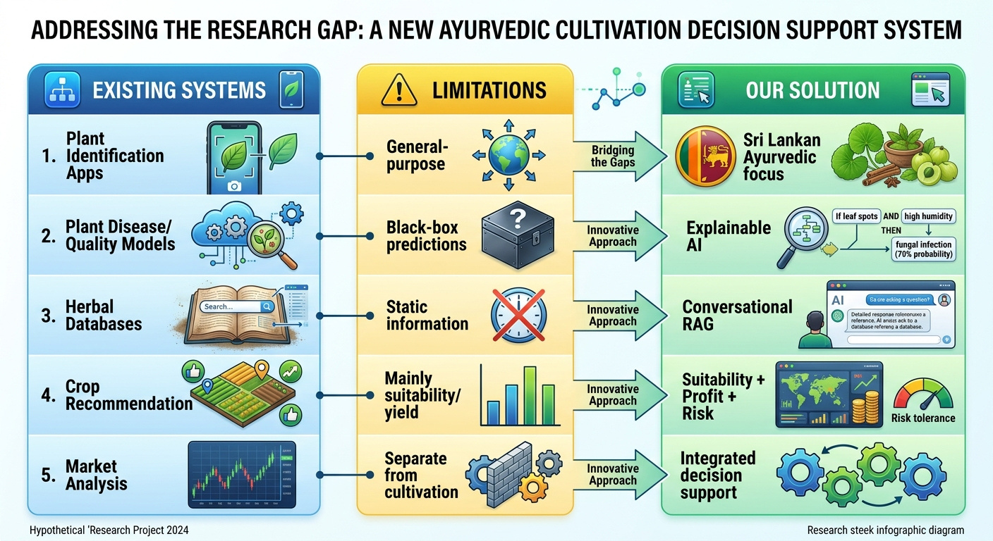

Intelligent Ayurvedic Herbal Plant Identification and Economic Analysis in sri lanka
OVERALL RESEARCH GAP
Research Gap
There is no integrated Sri Lankan platform combining plant identification, explainable quality assessment, Ayurvedic knowledge and economic-environmental cultivation recommendations.
SLIIT
FACULTY OF COMPUTING
6
R-26-IT-021
2026/08/30

Slide 7
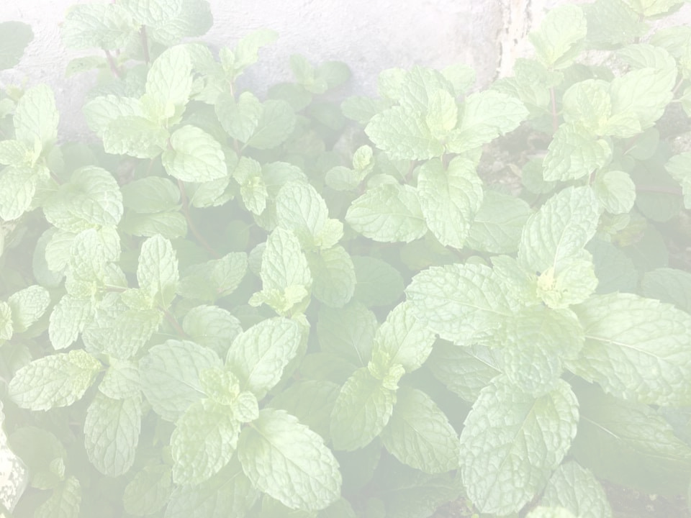
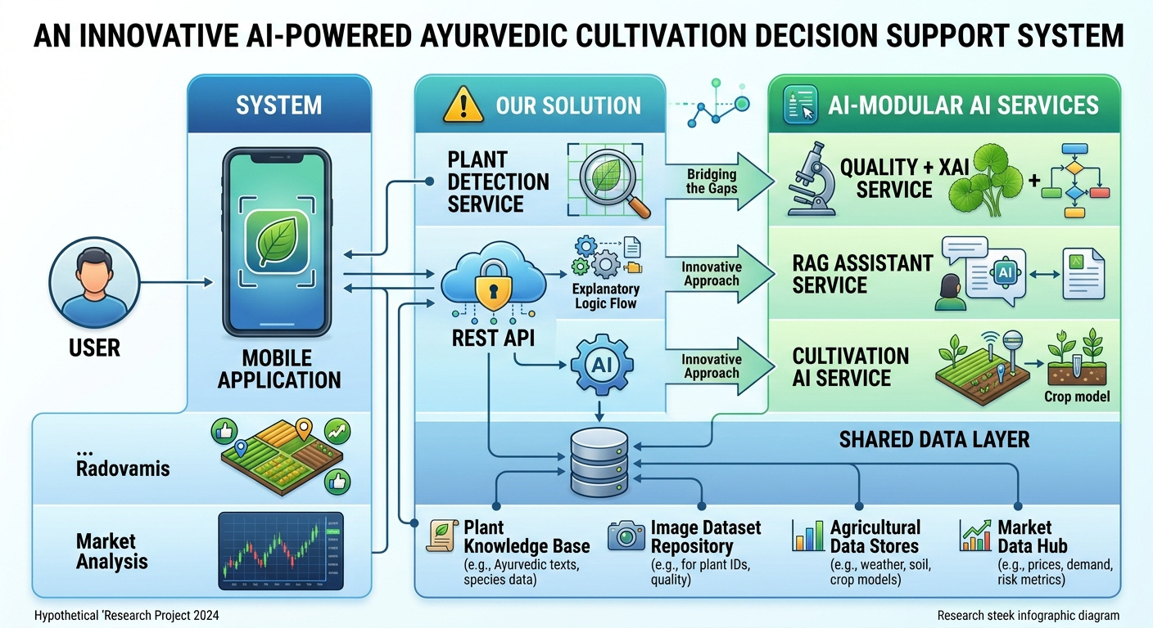
Intelligent Ayurvedic Herbal Plant Identification and Economic Analysis in sri lanka
SYSTEM ARCHITECTURE & INTEGRATION
SLIIT
FACULTY OF COMPUTING
7
R-26-IT-021
2026/08/30

Slide 8



Intelligent Ayurvedic Herbal Plant Identification and Economic Analysis in sri lanka
Herbal Knowledge
RAG + Sinhala/English
  Natural-language interaction
  Sri Lankan medicinal plant knowledge
Plant Detection
Deep Learning / CNN
  Image-based identification
  Sri Lankan Ayurvedic plants
OUR RESEARCH COMPONENTS
Cultivation Recommendation
ML + Economic Optimization
  Soil & climate
  Market demand
  Yield & profit
  Risk & sustainability
Quality Assessment
Efficientnetv2 + Grad-CAM
  Healthy / Diseased / Overmature
  Visual explanation
SLIIT
FACULTY OF COMPUTING
8
R-26-IT-021
2026/08/30

Slide 9



COMMERCIALIZATION & IMPACT
🎯 Target Users
  Beginner Farmers
  Students
💡 Value Proposition
One intelligent platform connecting Ayurvedic knowledge with practical agricultural and economic decision-making.
💰 Business Model
  Freemium access
  Premium AI analysis
  Institutional licensing
  B2B/API services
🌍 Expected Impact
Better farming decisions → Higher economic potential → Sustainable cultivation → Preservation of Ayurvedic knowledge
SLIIT
FACULTY OF COMPUTING
9
IT22640598 | M P MUNASINGHE | R-26-IT-021
2026/08/30

Slide 10

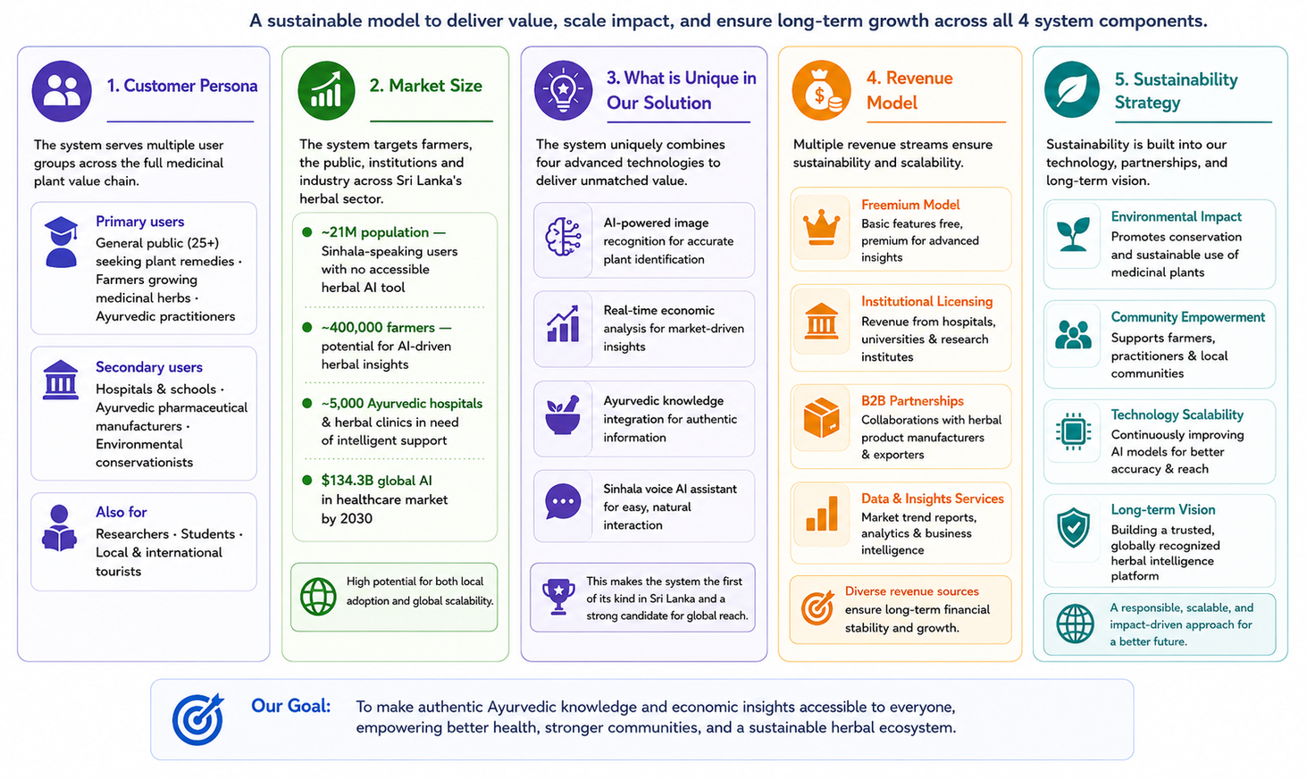
Ability of commercialization
SLIIT
FACULTY OF COMPUTING
10
R-26-IT-021
2026/08/30

Slide 11


11

Slide 12

SLIIT
FACULTY OF COMPUTING
12
R-26-IT-021
2026/03/16

