Slide 1

INTELLIGENT AYURVEDIC HERBAL PLANT IDENTIFICATION
AND
ECONOMIC ANALYSIS IN SRI LANKA
R-26-IT-021
SLIIT
FACULTY OF COMPUTING
1
R-26-IT-021
2026/03/16

Slide 2

2

Slide 3


Users and Stakeholders
  Primary Users:
    New Farmers
    Ayurvedic Doctors (Heveralas) and Students
  Secondary Users/Stakeholders:
    Ayurvedic Manufacturers
    Consumers/End-Users
    Environmental Conservationists
SLIIT
FACULTY OF COMPUTING
3
R-26-IT-021
2026/03/16

Slide 4
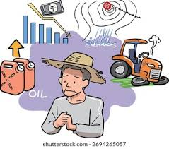
Impact of the Problem on Users and Society
Impact on Farmers
  Income loss of 30-60% due to poor crop selection and market timing
  Crop failures affecting 15-25% of cultivation attempts
  40% of farmers reported inappropriate species selection as cause of crop failures
  Vulnerability to middlemen exploitation without market intelligence
  Trapped in low-income cycles despite high market demand for medicinal plants
Impact on Manufacturers and Industry
  73% of herbal manufacturers face inconsistent raw material availability as their biggest operational difficulty
  LKR 2.3 billion spent annually on importing herbs that could be grown locally
  Local production meets only 40-50% of industrial demand
  Quality adulteration undermines product efficacy and consumer trust
  Reduced export potential damages Sri Lanka's global reputation
SLIIT
FACULTY OF COMPUTING
4
R-26-IT-021
2026/03/16

Slide 5


Impact of the Problem on Users and Society
Impact on Society
Loss of Indigenous Knowledge:
  Traditional knowledge concentrated among practitioners aged 55+
  Oral transmission failing as elders pass away without documentation
  Irreplaceable loss of preparation methods and healing practices
Public Health Risks:
  30% of medicinal plants in classical literature have nomenclature disputes
  Adulterated or misidentified plants cause ineffective treatment or toxicity
  Undermines trust in traditional medicine systems
Educational Gap:
  Less than 30% of population can identify common medicinal plants
  Students lack accessible learning resources in Sinhala
  Younger generation disconnected from cultural heritage
Environmental Impact:
  Unsustainable wild harvesting when cultivation fails
  Pressure on biodiversity from collection of rare species
  Loss of traditional conservation practices
SLIIT
FACULTY OF COMPUTING
5
R-26-IT-021
2026/03/16

Slide 6

The Proposed Solution
An integrated AI-powered ecosystem that connects the complete medicinal plant value chain:
  Mobile-Based Plant Detection – Instantly identifies Sri Lankan medicinal plants from leaf/flower/seeds images using deep learning
  Herbal Knowledge AI Assistant – Answers questions about plant uses, preparation, and properties in Sinhala/English using RAG technology
  Cultivation Recommendation System – Advises farmers on optimal crops based on soil, climate, and market prices using ML algorithms
  Explainable Quality Assessment – Evaluates plant quality with visual heatmaps showing which features influenced the decision (Grad-CAM)
SLIIT
FACULTY OF COMPUTING
7
R-26-IT-021
2026/03/16

Slide 7

HERBAL KNOWLEDGE INTELLIGENCE SYSTEM - AI ASSISTANT FOR SRI LANKAN MEDICINAL PLANTS
MUNASINGHE M P
IT22640598
SLIIT
FACULTY OF COMPUTING
10
IT22640598 | M P MUNASINGHE | R-26-IT-021
2026/03/16

Slide 8

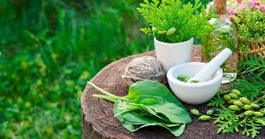
Herbal Knowledge Intelligence System - AI Assistant for Sri Lankan Medicinal Plants
The Problem:
  Sri Lanka has 1,400 medicinal plant species used in Ayurveda for over 3,000 years
  Indigenous knowledge is rapidly disappearing: elderly practitioners (55+) passing away, little transmission to youth
  Less than 30% of population can name common garden medicinal plants
  Existing information is scattered, expensive books, unreliable websites, mostly English-only
The Gap:
  Existing systems require technical queries.
  Current chatbots rely on pattern matching and cannot answer new questions.
  No true semantic understanding of Sinhala medical queries.
  Static knowledge bases → hard & manual to update.
  No natural-language conversational depth + factual grounding.
SLIIT
FACULTY OF COMPUTING
11
IT22640598 | M P MUNASINGHE | R-26-IT-021
2026/03/16

Slide 9

Herbal Knowledge Intelligence System - AI Assistant for Sri Lankan Medicinal Plants
Our Solution:
A Conversational AI Assistant
  An intelligent system that makes this knowledge accessible to everyone.
  Retrieval-Augmented Generation (RAG): Combines a deep, curated knowledge base with the power of Large Language Models (LLMs) for accurate, context-aware answers.
  Multilingual Support: Users can ask questions in English and Sinhala using natural, everyday language.
Main Objective: Develop an optimized RAG pipeline for multilingual herbal knowledge retrieval.
Sub-objectives:
  Implement semantic search for English & Sinhala queries using OpenAI embeddings
  Optimize chunking strategies for maximum retrieval accuracy
  Design context-aware prompt engineering for GPT-3.5-turbo response generation
SLIIT
FACULTY OF COMPUTING
12
IT22640598 | M P MUNASINGHE | R-26-IT-021
2026/03/16

Slide 10

Herbal Knowledge Intelligence System - AI Assistant for Sri Lankan Medicinal Plants
Key Domains of Knowledge:
  Retrieval-Augmented Generation (RAG): retrieval module + generation module
  Vector databases: how ChromaDB performs similarity search
Data Availability & Ethics:
  Plant data sourced from publicly available research and validated books.
  Security: No personal data stored; HTTPS for API communication.
Technologies Used:
  Embedding Model
  Large Language Model
  Vector Database
  Development Tools
  Python
  Flask (backend)
  React Native (frontend)
•Validation Strategy:
  Technical: Retrieval accuracy, answer faithfulness
  Domain: Ayurvedic doctor/expert validation of 50–100 sample Q&A pairs.
  User: Usability testing with general public & students (qualitative feedback)
SLIIT
FACULTY OF COMPUTING
13
IT22640598 | M P MUNASINGHE | R-26-IT-021
2026/03/16

Slide 11
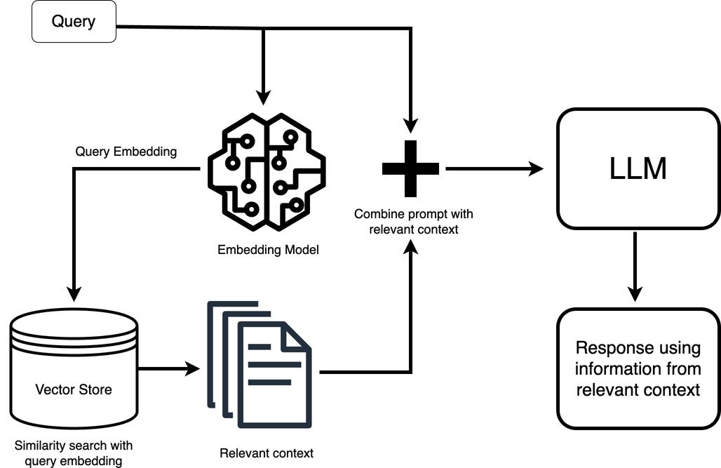
Herbal Knowledge Intelligence System - AI Assistant for Sri Lankan Medicinal Plants
System Overview
  User asks a question about a medicinal plant
  Mobile app sends the query to the backend API
  System converts the query into embeddings
  Vector database searches for relevant knowledge
  LLM generates a contextual answer
Dependencies and common components
  Deep Learning Models (CNN) – plant species
identification from leaf and flower images
  Machine Learning Algorithms – cultivation
recommendation based on soil, climate, and market data
  Knowledge Retrieval System (RAG) – answering herbal medicine questions using plant knowledge database
  Data Visualization Tools – displaying suitability score, profit prediction, and Grad-CAM heatmaps
Output
  Accurate medicinal plant information
  Uses, preparation methods, and plant parts
  Response in Sinhala or English
SLIIT
FACULTY OF COMPUTING
IT22640598 | M P MUNASINGHE | R-26-IT-021
2026/03/16
14

Slide 12

AI-DRIVEN CULTIVATION RECOMMENDATION SYSTEM FOR SMALL-SCALE HERBAL FARMERS
IT22132796
Wickramasinghe D G T K
SLIIT
FACULTY OF COMPUTING
IT22132796 | D G T K WICKRAMASINGHE | R-26-IT-021
2026/03/16
15

Slide 13
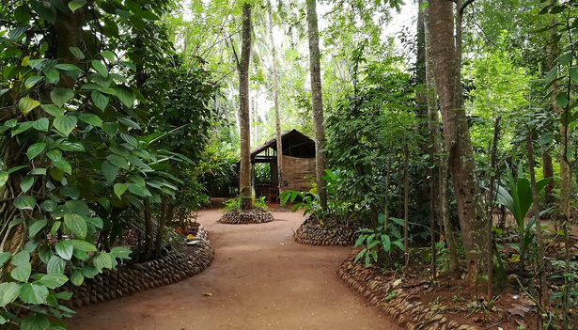
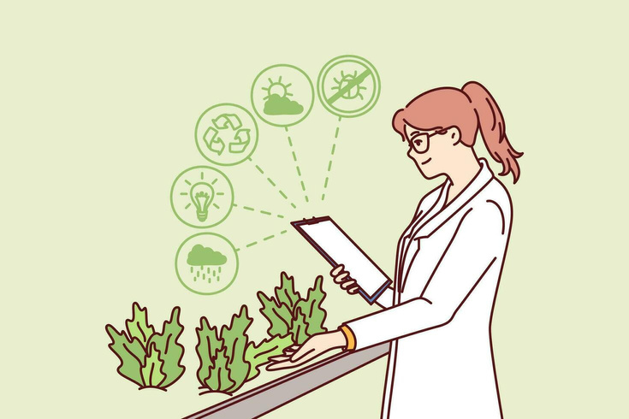
AI-Driven Cultivation Recommendation System For Small-Scale Herbal Farmers
Problem Definition
  Small-scale farmers in Sri Lanka cultivate Ayurvedic medicinal plants, but they often lack knowledge about suitable crops for their soil and climate.
  Farmers also lack market demand information and profit predictions.
  This leads to low yield, crop failures, and reduced farmer income.
Research Objective
Develop an AI-based cultivation recommendation system that suggests the most suitable and profitable medicinal plants for farmers.
Sub-Objectives
  Analyze soil and climate data
  Predict plant suitability
  Estimate profit and risk
  Provide recommendations through a mobile platform
SLIIT
FACULTY OF COMPUTING
IT22132796 | D G T K WICKRAMASINGHE | R-26-IT-021
2026/03/16
16

Slide 14

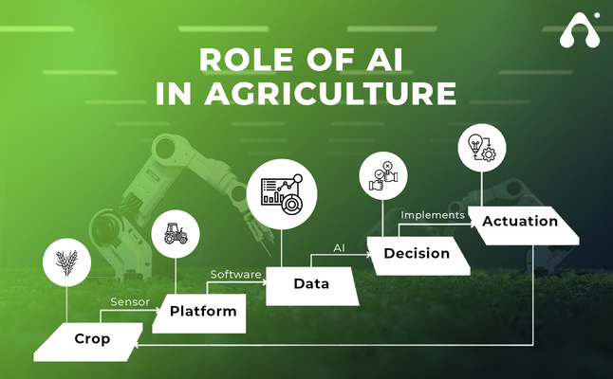
AI-Driven Cultivation Recommendation System For Small-Scale Herbal Farmers
Research Methodology
The system analyzes multiple datasets to generate intelligent cultivation recommendations.
Domain Knowledge
  Agriculture and Ayurvedic herbal cultivation
  Machine Learning for prediction
  Market analysis for economic evaluatiron
Technologies Used
  Machine Learning Algorithms
    Random Forest
    Gradient Boosting
  Data Sources
    Soil data
    Climate data
    Market price datasets
  Development Tools
    Python
    Flask
    Mobile application interface
Validation & Evaluation
  Model accuracy testing
  Comparison with real farming data
  Performance evaluation metrics
SLIIT
FACULTY OF COMPUTING
IT22132796 | D G T K WICKRAMASINGHE | R-26-IT-021
2026/03/16
17

Slide 15
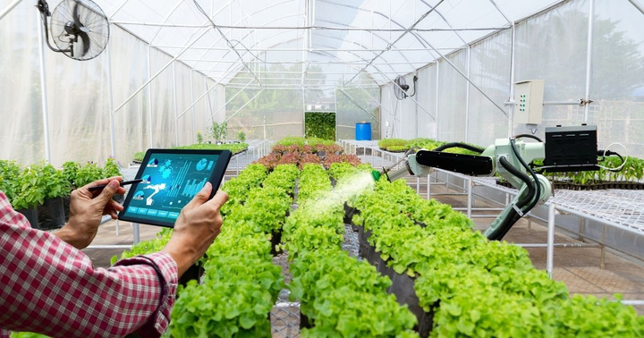
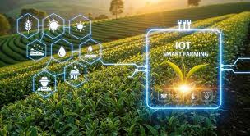
AI-Driven Cultivation Recommendation System For Small-Scale Herbal Farmers
System Overview
  Farmer inputs farm details
  System collects soil, climate, and market data
  Machine learning model analyzes suitability
  System generates crop recommendations
Output
  Best medicinal plants to cultivate
  Suitability score
  Estimated profit and risk level
Dependencies
  Herbal plant dataset
  Climate and soil datasets
  Integration with other project components
SLIIT
FACULTY OF COMPUTING
IT22132796 | D G T K WICKRAMASINGHE | R-26-IT-021
2026/03/16
18

Slide 16
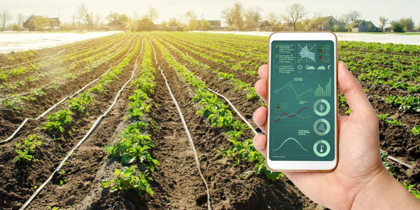
AI-Driven Cultivation Recommendation System For Small-Scale Herbal Farmers
COMMERCIALIZATION
Target Market
• Small-scale herbal farmers
• Ayurvedic cultivation farms
• Agricultural advisory organizations
Value Proposition
• Helps farmers select profitable crops
• Reduces cultivation risk
• Improves herbal supply chain
Investment / Cost
• System development
• Dataset collection
• Mobile application deployment
Revenue Model
• Farmer subscription plans
• Agricultural advisory services
• Government / NGO partnerships
19
SLIIT
FACULTY OF COMPUTING
IT22132796 | D G T K WICKRAMASINGHE | R-26-IT-021
2026/03/16

Slide 17

MOBILE-BASED DETECTION OF SRI LANKAN AYURVEDIC PLANTS
USING IMAGE RECOGNITION
H D SACHINTHA
IT22168986
SLIIT
FACULTY OF COMPUTING
IT22168986 | H D SACHINTHA | R-26-IT-021
20
2026/03/16

Slide 18

MOBILE-BASED DETECTION OF SRI LANKAN AYURVEDIC PLANTS
USING IMAGE RECOGNITION
Problem Definition
  Develop an image recognition model using machine learning techniques to identify medicinal plants from scanned images..
  Traditional knowledge about medicinal plants is gradually disappearing and not easily accessible.
Research Objective
Traditional knowledge about medicinal plants is gradually disappearing and not easily accessible.
Sub-Objectives
  Collect and build a medicinal plant information database
  Develop an image-based plant detection model
  Provide plant identification and medicinal details through a mobile application
SLIIT
FACULTY OF COMPUTING
IT22168986 | H D SACHINTHA | R-26-IT-021
2026/03/16
21

Slide 19
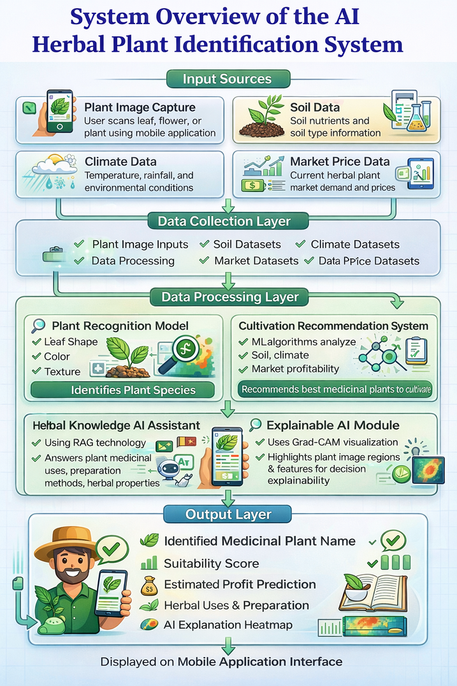
Mobile-Based Detection of Sri Lankan Ayurvedic Plants
Using Image Recognition
System Overview
  User scans a plant leaf , Feed , flowers using
the mobile application.
  The system captures and processes the plant image
  The image recognition model analyzes plant
features such as shape, and texture
  The system identifies the plant species using
the trained AI model
references
Lee, S. H., Chan, C. S., Mayo, S. J., & Remagnino, P. (2015). Deep-Plant: Plant Identification with Convolutional Neural Networks. Proceedings of the IEEE International Conference on Image Processing (ICIP). https://doi.org/10.1109/ICIP.2015.7350987
SLIIT
FACULTY OF COMPUTING
IT22168986 | H D SACHINTHA | R-26-IT-021
2026/03/16

Slide 20
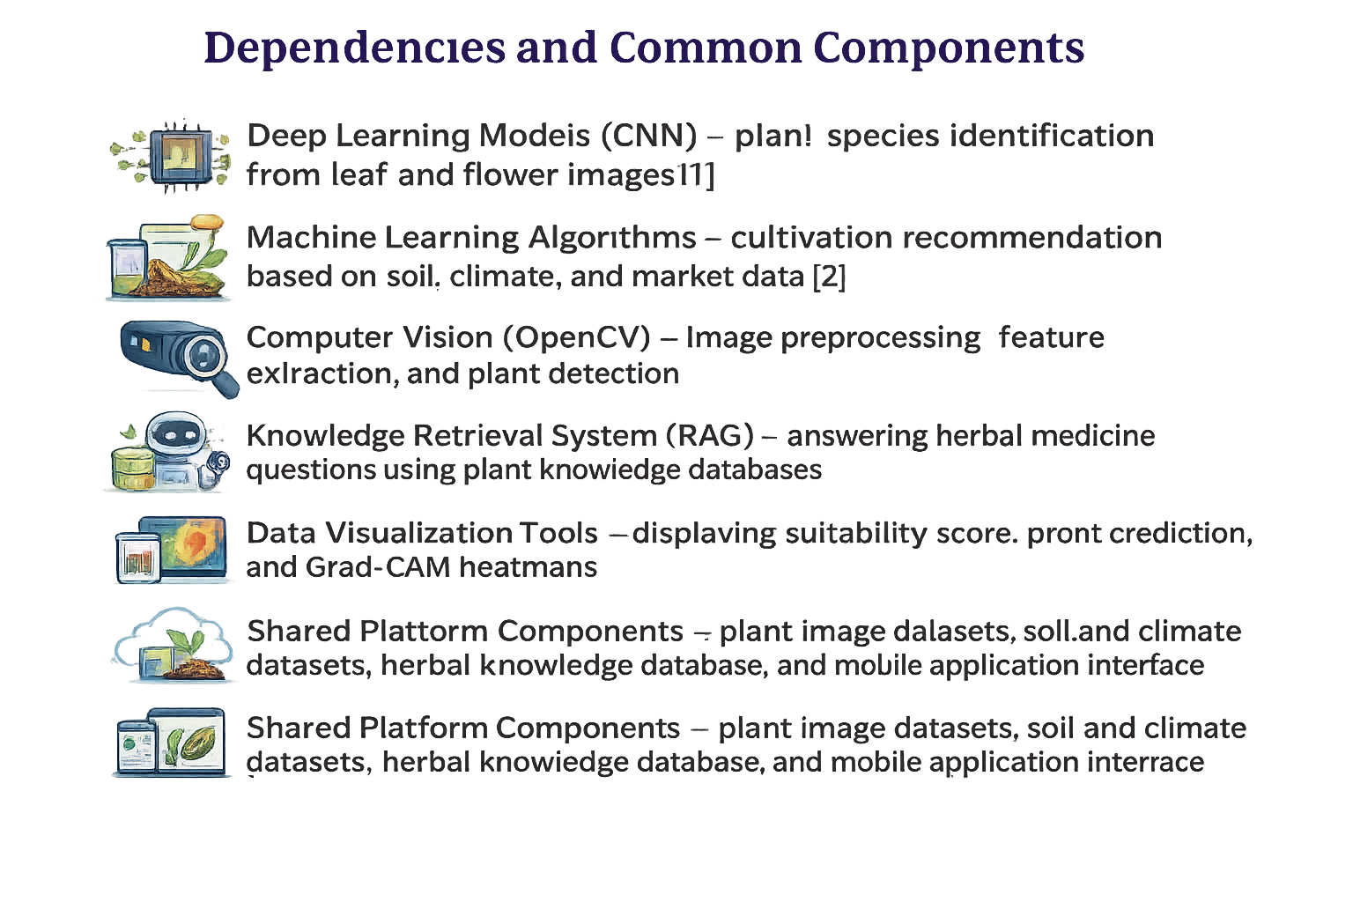
Mobile-Based Detection of Sri Lankan Ayurvedic Plants
Using Image Recognition
Output
  Plant name (Sinhala and English)
  Ayurvedic medicinal benefits of the plant
  Parts of the plant used for medicine
  Traditional uses and health applications
Dependencies and common components
  Deep Learning Models (CNN) – plant species
identification from leaf and flower images [1]
  Machine Learning Algorithms – cultivation
recommendation based on soil, climate, and market data [2]
  Knowledge Retrieval System (RAG) – answering herbal medicine questions using plant knowledge database
  Data Visualization Tools – displaying suitability score, profit prediction, and Grad-CAM heatmaps
RESEARCH METHODOLOGY
PROBLEM IDENTIFICATION
DATA COLLECTION
PLANT DETECTION MODEL
SYSTEM DEVELOPMENT
EVALUATION
SLIIT
FACULTY OF COMPUTING
IT22168986 | H D SACHINTHA | R-26-IT-021
2026/03/16
23

Slide 21


MOBILE-BASED DETECTION OF SRI LANKAN AYURVEDIC PLANTS
USING IMAGE RECOGNITION
Research Methodology
The system analyzes multiple datasets to generate intelligent cultivation recommendations.
Domain Knowledge
  Ayurvedic Medicinal Plants
  Image Processing and Computer Vision
  Mobile Application Development
Technologies Used
  Machine Learning /AI Techniques
    Convolutional Neural Networks (CNN)
    Image Recognition Algorithms
  Data Sources
    Plant Leaf and Flower Image Datasets
    Sri Lankan Ayurvedic Medicinal Plant Information
  Development Tools
    Python
    TensorFlow
    OpenCV
Validation & Evaluation
  Model accuracy testing
  Validation and Testing of the Ayurvedic
Plant Detection System
  System Performance Evaluation
and Accuracy Assessment
SLIIT
FACULTY OF COMPUTING
IT22168986 | H D SACHINTHA | R-26-IT-021
24
2026/03/16

Slide 22

EXPLAINABLE AI SYSTEM FOR AYURVEDIC MEDICINAL PLANT QUALITY ASSESSMENT
PATTIYA ARACHCHI P A H K
IT22112132
SLIIT
FACULTY OF COMPUTING
IT22112132 | PATTIYA ARACHCHI P A H K | R-26-IT-021
2026/03/16
25

Slide 23
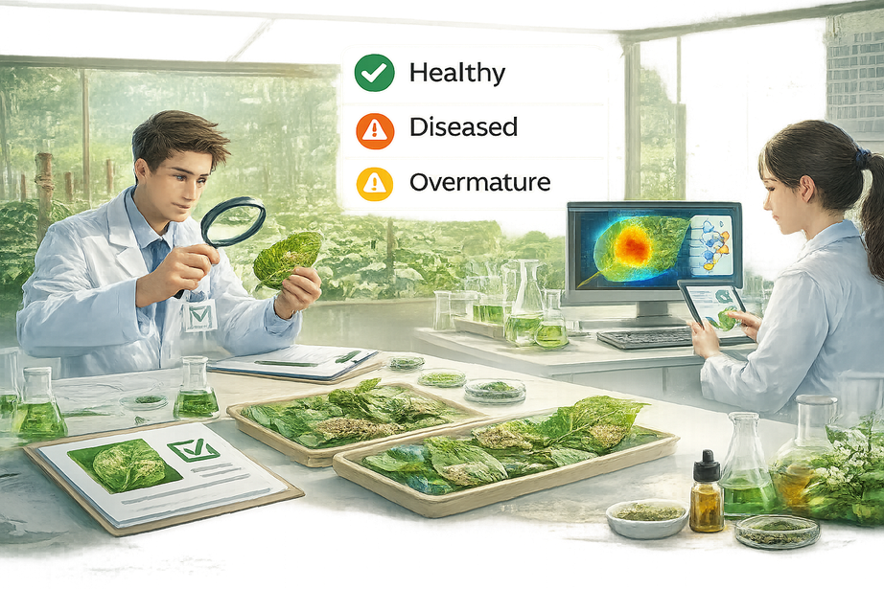
EXPLAINABLE AI SYSTEM FOR AYURVEDIC MEDICINAL PLANT QUALITY ASSESSMENT
Problem Definition
  Quality assessment of Ayurvedic medicinal plants is mainly done manually by experts.
  Manual inspection is time-consuming, subjective, and not always available, especially in rural areas.
  Diseased or over-mature plant materials can reduce the effectiveness of herbal medicine.
Objective
  Develop an AI-based system that evaluates the quality of medicinal plant leaves or fruits using images.
Sub-Objectives
  Train a deep learning model to classify plant condition.
  Use transfer learning to work with limited datasets.
  Apply Explainable AI (Grad-CAM) to visualize model decisions.
  Assist farmers, herbal suppliers, Ayurvedic practitioners, and beginners in identifying plant quality.
SLIIT
FACULTY OF COMPUTING
IT22112132 | PATTIYA ARACHCHI P A H K | R-26-IT-021
26
2026/03/16

Slide 24
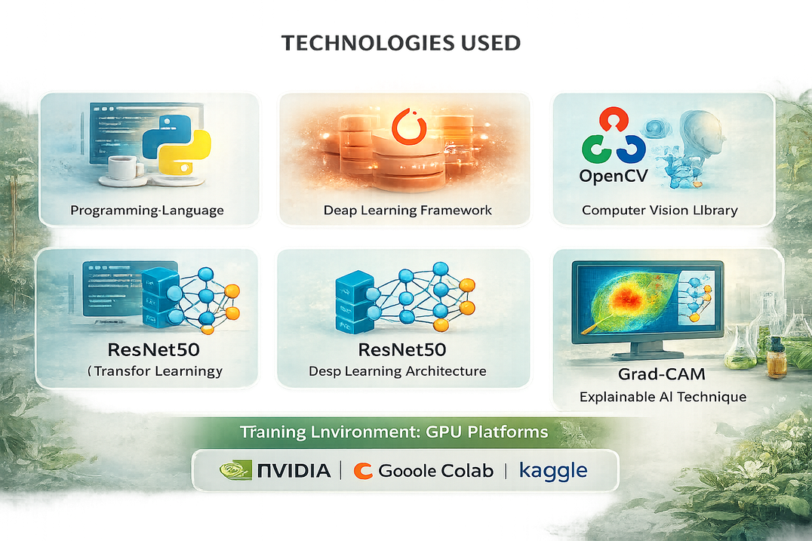
EXPLAINABLE AI SYSTEM FOR AYURVEDIC MEDICINAL PLANT QUALITY ASSESSMENT
Research Methodology
  Image collection of medicinal plant leaves or fruits
  Image preprocessing and normalization
  Feature extraction using a pretrained CNN model
  Classification into:
    Healthy
    Diseased
    Overmature
  Explainable AI visualization using Grad-CAM
Technologies Used
  Python
  PyTorch
  OpenCV
  ResNet50 (Transfer Learning)
  Grad-CAM (Explainable AI)
SLIIT
FACULTY OF COMPUTING
IT22112132 | PATTIYA ARACHCHI P A H K | R-26-IT-021
2026/03/16
27

Slide 25

EXPLAINABLE AI SYSTEM FOR AYURVEDIC MEDICINAL PLANT QUALITY ASSESSMENT
Evaluation Metrics
  Accuracy
  Precision
  Recall
  F1 Score
  Visual evaluation of Grad-CAM explanations
Data Availability
Plant images collected from:
  Herbal Gardens
  Field photography
  Public plant image datasets (kaggle, plant village)
Security & Ethics
  No personal or sensitive data collected
  Images used only for research purposes
  Dataset handled according to academic research guidelines
SLIIT
FACULTY OF COMPUTING
IT22112132 | PATTIYA ARACHCHI P A H K | R-26-IT-021
2026/03/16
28

Slide 26
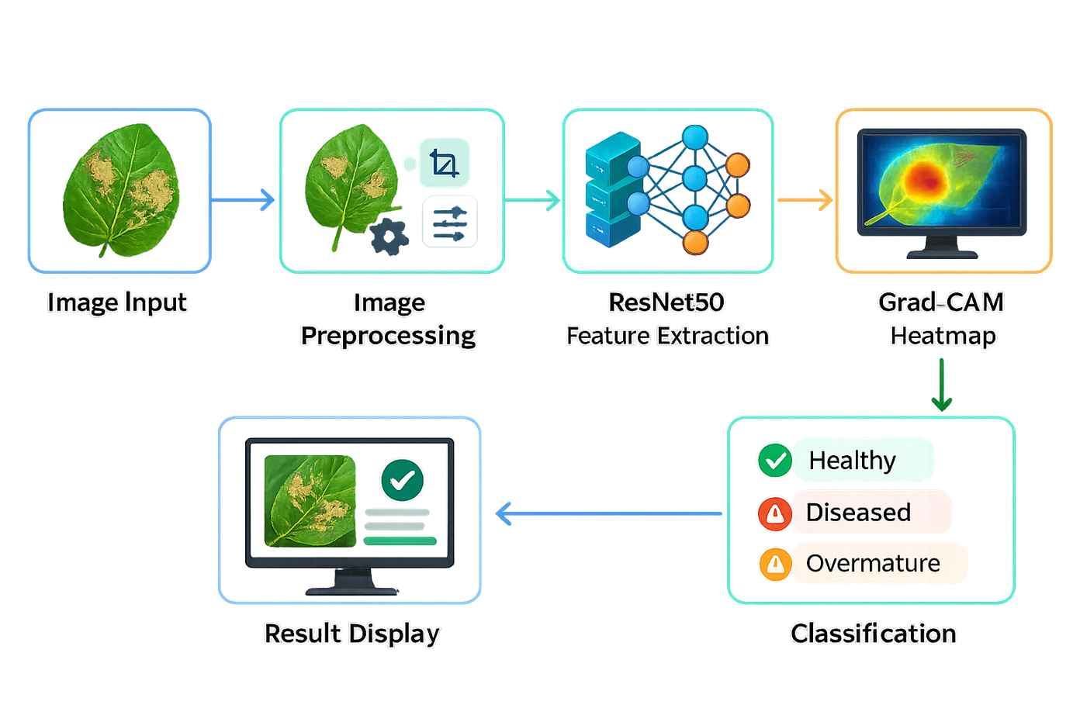
EXPLAINABLE AI SYSTEM FOR AYURVEDIC MEDICINAL PLANT QUALITY ASSESSMENT
SYSTEM WORKFLOW
SLIIT
FACULTY OF COMPUTING
IT22112132 | PATTIYA ARACHCHI P A H K | R-26-IT-021
2026/03/16
29

Slide 27


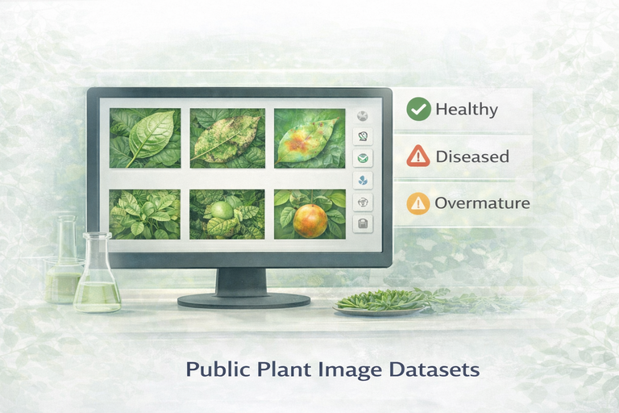
EXPLAINABLE AI SYSTEM FOR AYURVEDIC MEDICINAL PLANT QUALITY ASSESSMENT
Dependencies
  PyTorch Deep Learning Framework
  OpenCV Image Processing
  Pretrained ResNet50 Model
  GPU Environment (Google Colab)
Expected Output
  Plant quality prediction
  Visual explanation highlighting affected areas
SLIIT
FACULTY OF COMPUTING
IT22112132 | PATTIYA ARACHCHI P A H K | R-26-IT-021
2026/03/16
30

Slide 28
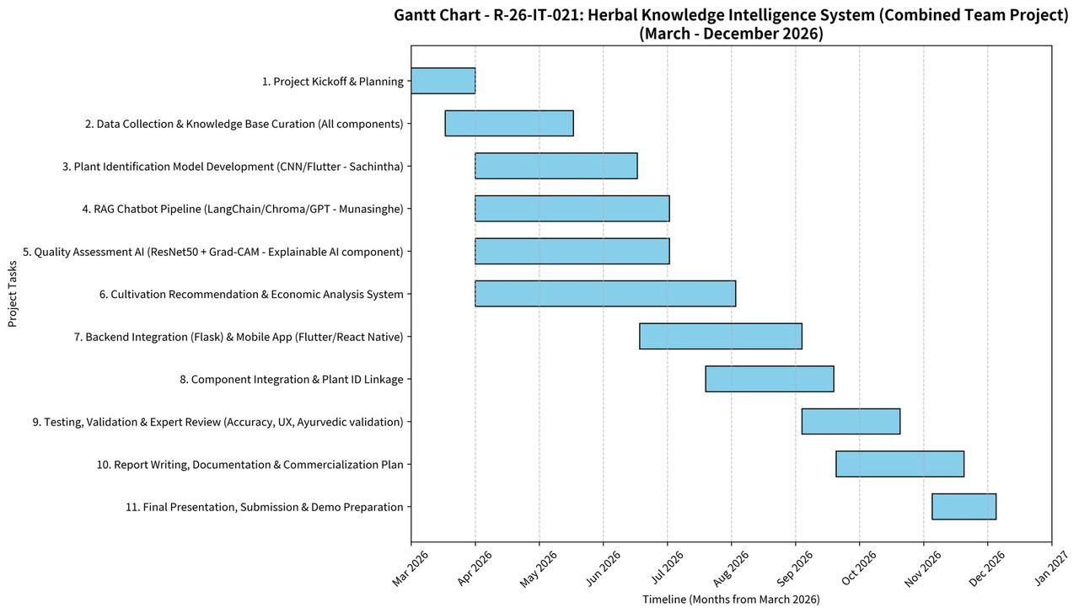
Gantt Chart
SLIIT
FACULTY OF COMPUTING
31
R-26-IT-021
2026/03/16

Slide 29
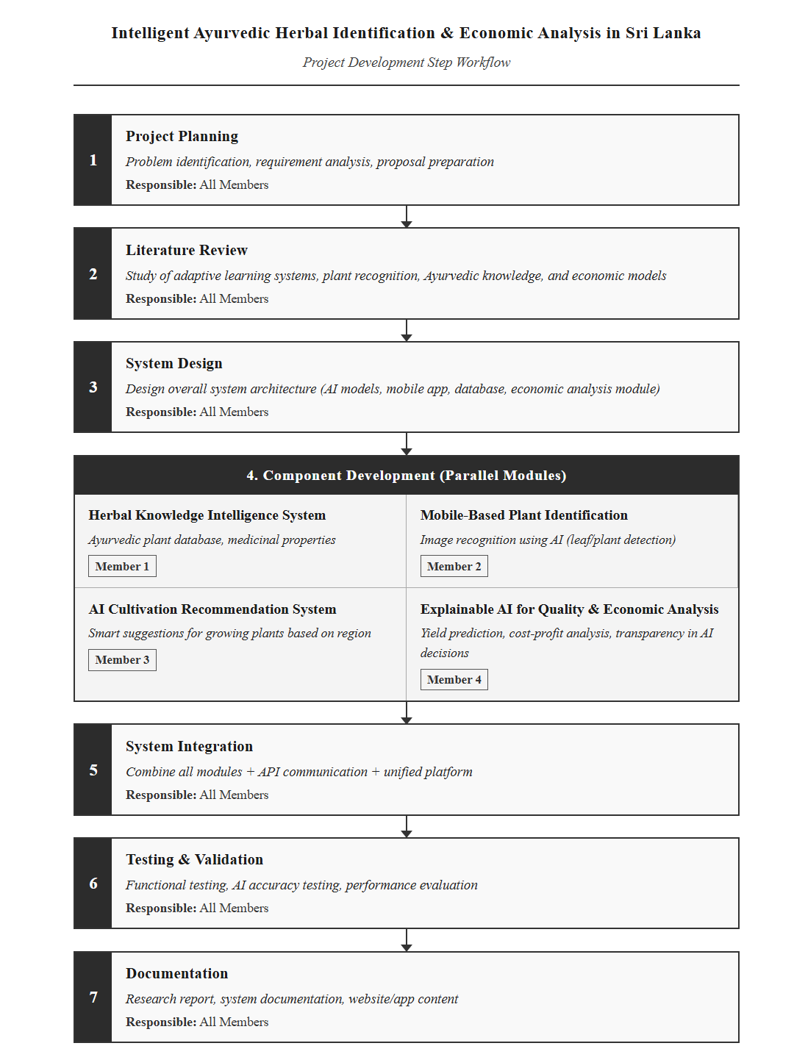

WORK BREAKDOWN STRUCTURE
SLIIT
FACULTY OF COMPUTING
32
R-26-IT-021
2026/03/16

Slide 30

SLIIT
FACULTY OF COMPUTING
33
R-26-IT-021
2026/03/16

