Slide 1
Lecture 1
Review of Logic Fundamentals
Khaza Anuarul Hoque ECE 4250/7250 Fall 2018

Slide 2
Learning Objectives
Combinational Logic
Boolean Algebra and Algebraic Simplification
Karnaugh Maps
Designing with NAND and NOR Gates
Hazards in Combinational Circuits
Flip-Flops and Latches
Mealy Sequential Circuit Design
Design of a Moore Sequential Circuit
Equivalent States and Reduction of State Tables
Sequential Circuit Timing
Tristate Logic and Busses

Slide 3



Combination Logic: Basic Gates
AND Gate: C = A AND B = A ▪ B = AB
OR Gate: C = A OR B = A + B
NOT Gate or Inverter: C = NOT A = A’

Slide 4


Combination Logic: Basic Gates (cont’d)
XOR Gate: C = A XOR B = AB’ + A’B = A B

Slide 5
Combination Logic: Canonical Forms
Generally not the simplest form (can be minimized)
Derive directly from a Boolean function’s truth table
Two canonical forms:
Sum of Products (minterm)
Product of Sums (maxterm)

Slide 6
Combination Logic: Canonical Forms (cont’d)
Sum of Products (minterm)
Example:
C_{out} = X’YC_{in} + XY’C_{in} + XYC’_{in} + XYC_{in}
Minterm expansions can be written in m-notation or decimal notation:
Sum = m₁ + m₂ + m₄ + m₇ = ∑m(1,2,4,7)
C_{out} = m₃ + m₅ + m₆ + m₇ = ∑m(3,5,6,7)

Slide 7
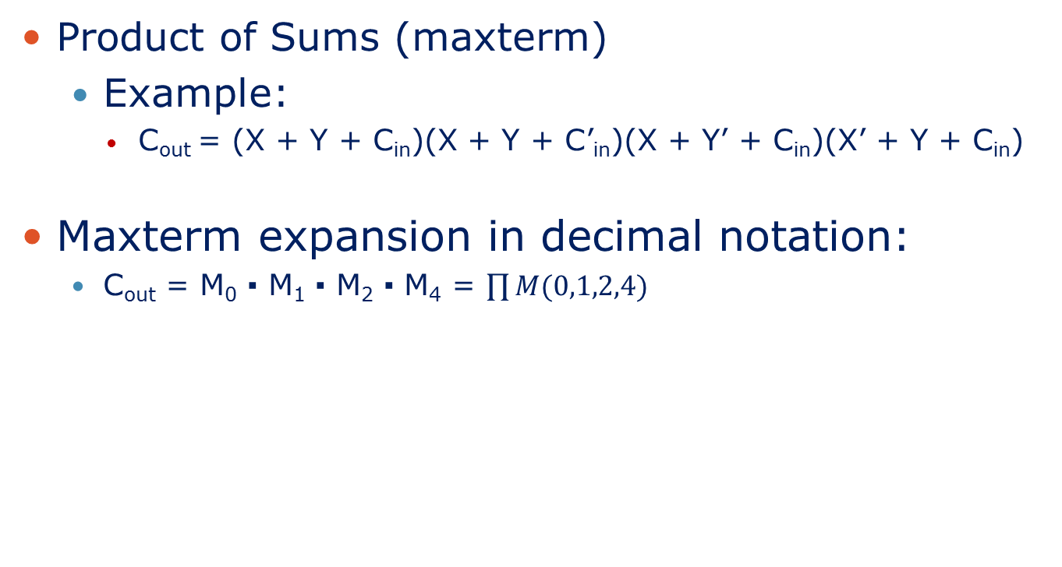
Combination Logic: Canonical Forms (cont’d)
Product of Sums (maxterm)
Example:
C_{out} = (X + Y + C_{in})(X + Y + C’_{in})(X + Y’ + C_{in})(X’ + Y + C_{in})
Maxterm expansion in decimal notation:
C_{out} = M₀ ▪ M₁ ▪ M₂ ▪ M₄ = $\prod{M(0,1,2,4)}$

Slide 8
Boolean Algebra and Algebraic Simplification
DeMorgan’s Law:
Complement all the terms in the expression:
Replace each variable by its complement.
Switch 1 with 0 and 0 with 1.
Change all ANDs to ORs and all ORs to ANDs.
Add parentheses to ensure proper order of operations.
If AND is performed before OR in F, then parentheses may be required to ensure that OR is performed before AND in F’.

Slide 9
Boolean Algebra and Algebraic Simplification (cont’d)
Operations with 0 and 1:
X + 0 = X X • 1 = X
X + 1 = 1 X • 0 = 0
Idempotent laws
X + X = X X • X = X
Involution law:
(X')' = X
Laws of complementarity:
X + X' = 1 X • X' = 0

Slide 10
Boolean Algebra and Algebraic Simplification (cont’d)
Commutative laws:
X + Y = Y + X XY = YX
Associative laws:
(X + Y) + Z = X + (Y + Z) = X + Y + Z
(XY)Z = X(YZ) = XYZ
Distributive laws:
X(Y + Z) = XY + XZ
X + YZ = (X + Y)(X + Z)

Slide 11
Boolean Algebra and Algebraic Simplification (cont’d)
Simplification theorems:
XY + XY' = X (X + Y) (X + Y') = X
X + XY = X X(X + Y) = X
(X + Y')Y = XY XY' + Y = X + Y
DeMorgan’s laws:
(X + Y + Z + … )' = X'Y'Z'… (XYZ …)' = X' + Y' + Z' + …
[f(X₁, X₂, … X_{N}, 0, 1, +, •)]' = f(X₁', X₂', … X_{N}', 1, 0, •, +)

Slide 12
Boolean Algebra and Algebraic Simplification (cont’d)
Duality:
(X + Y + Z + …)^{D} = XYZ … (XYZ…)^{D} = X + Y + Z + …
[f(X₁, X₂, … X_{N}, 0, 1, +, •)]^{D} = f(X₁, X₂, … X_{N}, 1, 0, •, +)
Theorem for multiplying out and factoring:
(X + Y)(X' + Z) = XZ + X'Y
XY + X'Z = (X + Z) (X' + Y)
Consensus theorem:
XY + YZ + X'Z = XY + X'Z
(X + Y)(Y + Z)(X' + Z) = (X + Y)(X' + Z)

Slide 13
Boolean Algebra and Algebraic Simplification (cont’d)
Four ways of simplifying a logic expression are:
Combining terms: use theorem XY + XY’ = X to combine two terms.
Eliminating terms: use theorem X + XY = X to eliminate redundant terms. Then try to apply consensus theorem
(XY + X’Z + YZ = XY +X’Z).
Eliminating literals: use theorem X + X’Y = X + Y to eliminate redundant literals. Simple factoring might be required prior to using the theorem.
Adding redundant terms: can be introduced in several ways such as adding XX’, multiplying by (X + X’), and so on.

Slide 14
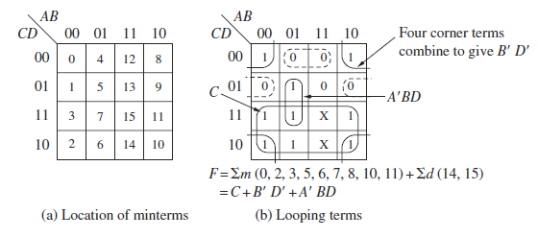
Karnaugh Maps
K‑maps provide a convenient way to simplify logic functions of three to five variables.
4 variable K-maps:

Slide 15
Karnaugh Maps (cont’d)
Procedure to obtain a minimum sum of products from a Karnaugh map:
1. Choose a minterm (a 1) that has not yet been covered.
2. Find all 1’s and X’s adjacent to that minterm.
3. If a single term covers the minterm and all the adjacent 1’s and X’s, then that term is an essential prime implicant, so select that term.
4. Repeat steps 1, 2, and 3 until all essential prime implicants have been chosen.
5. Find a minimum set of prime implicants that cover the remaining 1’s on the map.

Slide 16
Designing with NAND and NOR Gates
To design a circuit of NOR gates:
Get a product-of-sums representation of the function.
Find a circuit of OR and AND gates that has an AND gate at the output.
If an AND gate output doesn’t drive an AND gate input and an OR Gate output doesn’t connect to an OR gate input, conversion is done by replacing all gates with NOR gates and complementing inputs if needed.
Conversion to a circuit of NAND gates is similar except:
The starting point is a sum-of-products.
The output gate of the AND-OR circuit should be an OR gate.

Slide 17
Hazards in Combinational Circuits
Transients occur when different paths from input to output have different propagation delays:
Static 1-hazard: in response to an input change and for some combination of propagation delays, a circuit output may momentarily go to 0 when it should remain a constant 1.
Static 0-hazard: if the output may momentarily go to 1 when it should remain a 0.
Dynamic hazard: when the output is supposed to change from 0 to 1 (or 1 to 0), the output may change three or more times.

Slide 18
Hazards in Combinational Circuits (cont’d)
To design a circuit that is free of static and dynamic hazards, use this procedure:
Find a sum‑of‑products expression (F^{t}) for the output in which every pair of adjacent 1’s is covered by a 1‑term.
If a different form of circuit is desired, manipulate F^{t} to the desired form by using simple factoring, DeMorgan’s laws, and so on. Treat each x_{i} and x’_{i} as independent variables to prevent introduction of hazards.

Slide 19
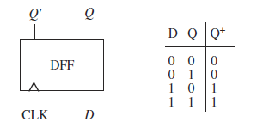
Flip-Flops and Latches
Sequential circuits commonly use flip‑flops as storage devices. Some types include:
Delay (D) flip‑flops, J‑K flip‑flops, Toggle (T) flip‑flops
Clocked D Flip-Flop:

Slide 20
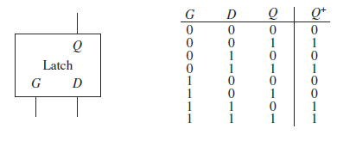
Flip-Flops and Latches (cont’d)
Some types of latches include:
S-R latch, Transparent D Latch.
Transparent D Latch:

Slide 21
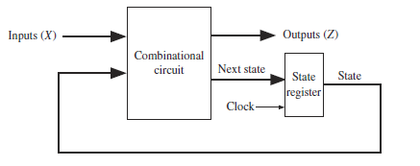
Mealy Sequential Circuit Design
Two types of sequential circuits:
Moore: the outputs depend only on the present state.
Mealy: the outputs depend on both the present state and the present inputs.
Consists of a combinational circuit, which generates the outputs and the next state, and a state register, which holds the present state. The state register is usually comprised of D flip-flops.

Slide 22
Mealy Sequential Circuit Design (cont’d)
Steps required to design a sequential circuit:
1. Determine the required relationship between the input and output sequences. Find a state graph and state table.
2. Reduce the table to a minimum number of states.
3. If the reduced table has m states , n flip-flops are needed. Use either the encoded state assignment technique or the one‑hot assignment technique.
4. Form the transition table.
5. Plot next‑state maps and input maps for each flip‑flop and derive the flip‑flop input equations. Derive the output functions.
6. Realize the flip‑flop input equations and the output equations using the available logic gates.
7. Check your design.

Slide 23
Moore Sequential Circuit Design
Outputs depend only on the present state.
Easier to design and debug than Mealy machines, but often contain more states than equivalent Mealy machines.
No outputs occur during the transition.
Cannot respond to an input until the active edge of the clock occurs; this is in contrast to a Mealy circuit.

Slide 24
Equivalent States and Reduction of State Tables
This concept is important for design and testing as it helps to reduce the hardware consumed by circuits.
Two states in a sequential circuit are said to be equivalent if we cannot tell them apart by observing input and output sequences.
To determine equivalence, use the state equivalent theorem: if and only if for every single input X, the outputs are the same and the next states are equivalent.

Slide 25
Equivalent States and Reduction of State Tables (cont’d)
Summary of the implication table method of determining state equivalence:
1. Construct a chart that contains a square for each pair of states.
2. Compare each pair of rows in the state table. If the outputs associated with states i and j are different, place an X in square i–j. If the outputs are the same, place the implied pairs in square i–j. If the outputs and next states are the same place a check (√) in square i–j.
3. Go through the table square by square. If square i–j contains the implied pair m–n, and square m–n contains an X, then , and an X should be placed in square i–j.
4. If any X’s were added in step 3, repeat step 3 until no more X’s are added.
5. For each square i–j that does not contain an X, .

Slide 26
Sequential Circuit Timing
The correct functioning of sequential circuits involves several timing issues:
Propagation Delay or Clock-to-Q delay: small amount of time that elapses from the time the clock changes to the time the Q output changes.
Setup Time (t_{su}): the amount of time the D input is stable before the active edge of the clock.
Hold time (t_{h}): the amount of time the D input is stable after the active edge of the clock.

Slide 27
Tristate Logic and Busses
Tristate buffers: gates with a high impedance state (hi‑Z) in addition to high and low logic states. The high impedance state is equivalent to an open circuit.
Use tristate buffers when connecting multiple gate outputs to the same wire or channel.
Can be used to aid in data transfers between registers.
Tristate buffers are either inverting or non-inverting.

Slide 28
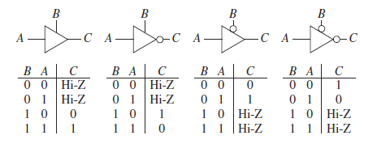
Tristate Logic and Busses (cont’d)
4 kinds of tristate buffers:

Slide 29
Summary
This chapter serves as a review of important logic design topics such as:
Combinational logic
Sequential logic
Sequential circuit timing
Synchronous design

