Slide 1
Big Data
One on One

Slide 2
Agenda
Introduction
What is Big Data?
What is Hadoop?
Data warehouse vs Hadoop
Importance of Azure in Big Data
And next
Hadoop Architecture
When do I need Big Data?
Major improvements over Hadoop releases

Slide 3
What is Big Data?
Large data that is complex to handle.
Increasing scale. (E.g. Smart phone)
Source?
Both
Internal
&
External
Industry oriented data – IOT, Sensors, Meters …
Web / Cloud – Wikipedia, GIT, Dropbox, Google drive…
Media – FB, Twitter…
Unstructured data like Videos, Images..
Web sites – Shopping sites, Click stream analysis & Event-driven programming (User behavior)…

Slide 4
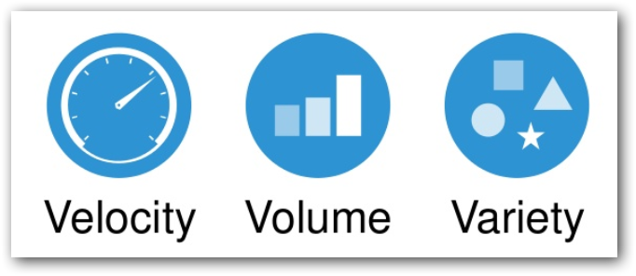
4th V –> Veracity

Slide 5
When do I need Big Data?
Not in all the case!!!
Big Data plays better only if it is Bigger Data. (4 V’s)
Every enterprise started to understand big data and the potential of data-driven marketing.
What data is to them?
What data does for them?
Hybrid - RDBMS + Hadoop environment.

Slide 6
So what is Hadoop?
PROCESS and STORE in a distributed computing environment (commodity hardware).
Open source – Apache License.
Fault tolerant (Data & Processing)

Slide 7
Which path to choose?
Big Data Developer
Big Data Admin
Data Scientist

Slide 8
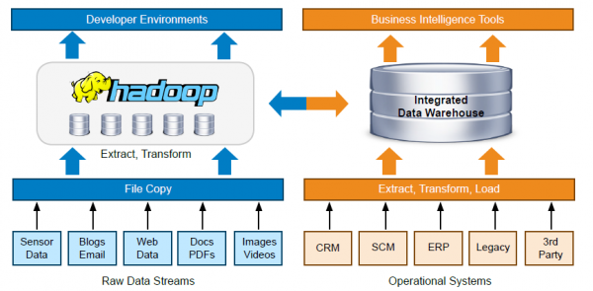
Data warehouse vs Big Data

Slide 9
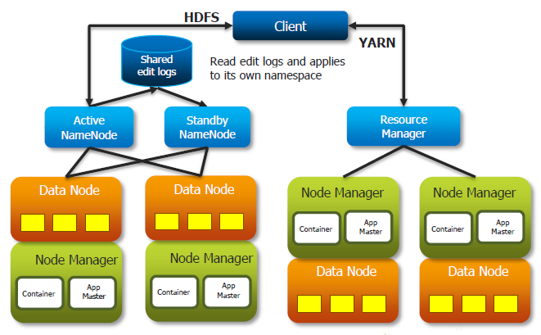
Hadoop Architecture
HDFS - Master/Slave architecture. (Not Client/Server)

Slide 10
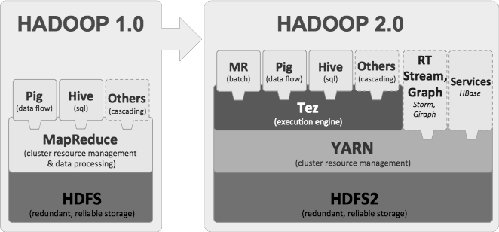
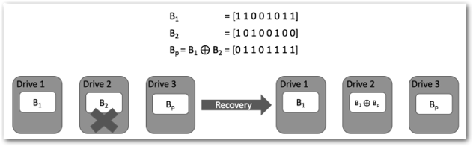
Major improvements over Hadoop releases
2. Introduction of YARN - 2
1. Fault Tolerance
- Replication (200%) - 2
- Erasure coding (50%) - 3

Slide 11
Major improvements over Hadoop releases
3. Data Balancing
HDFS Load Balancer - 2
HDFS Disk Balancer - 3
4. High Availability
2 Name nodes (1 Active & 1 Standby) - 2
More than 2 Name nodes (1 Active & multiple Standbys) - 3
5. Default port numbers
Changed due to Linux ephemeral port range (32768-61000) (E.g. 50070 -> 4870) - 3

Slide 12
Importance of Azure in Big Data
Dynamic scalability.
Go with perfectly sized cluster when needed, while not inducing any costs when not needed.
Clusters can be spun up on vendors like,
Microsoft Azure,
Amazon Web Services,
Google Cloud Platform
Supported Cloud file systems,
Azure Blob
Azure Data Lake (3+)
Amazon S3
OpenStack

