Slide 1

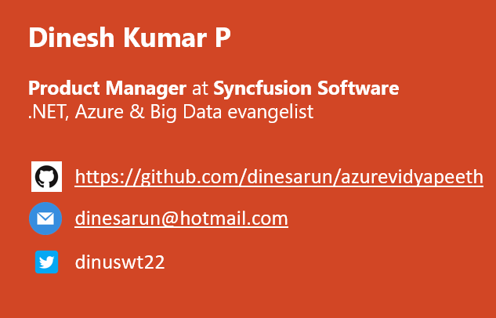
Azure Data Lake Storage Gen1 for BigData
Notes:
Happy morning guys. Ya. I am Dinesh Kumar. Product Manager at Syncfusion Software. I manage ‘Data sources’ division of Data Platform team. And I am pretty happy to present this Webinar in Azure Vidyapeeth to you all. Here we go!

Slide 2
Agensss
Database options in Azure
Why should I choose Data Lake?
Control v Business value
Agenda
Notes:
In this webinar, you will learn to decide which database service can be used for your situation and when it can be used.
Microsoft Azure comes as huge and changing fast. Hence the name change too. “Azure Data Lake Store” has been renamed to “Azure Data Lake Storage Gen1”

Slide 3
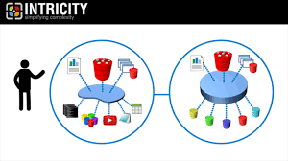
BigData – Apache Hadoop – Data Lake
Data Lake – Store any kind of data. Like water from different sources pool into a Lake and get stored.
Hadoop was the first major data lake with “HDFS” accepting videos, files, logs,…
Hadoop’s disadvantage – Slow processing that was overcome by tools like Spark, etc.
From: https://www.intricity.com/data-warehousing/what-is-a-data-lake/

Slide 4
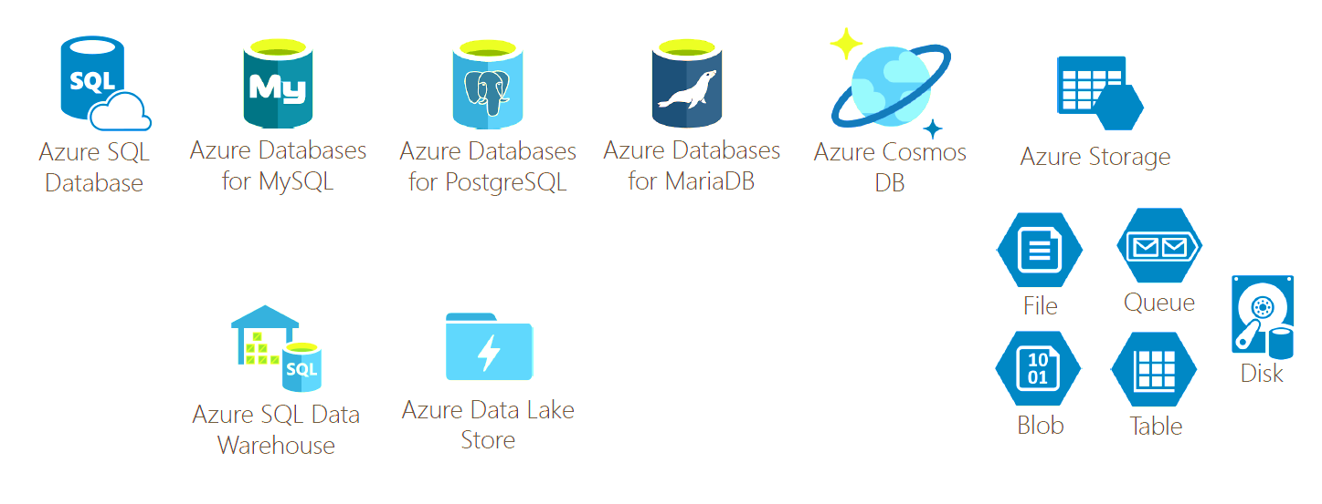
Database options in Azure

Slide 5
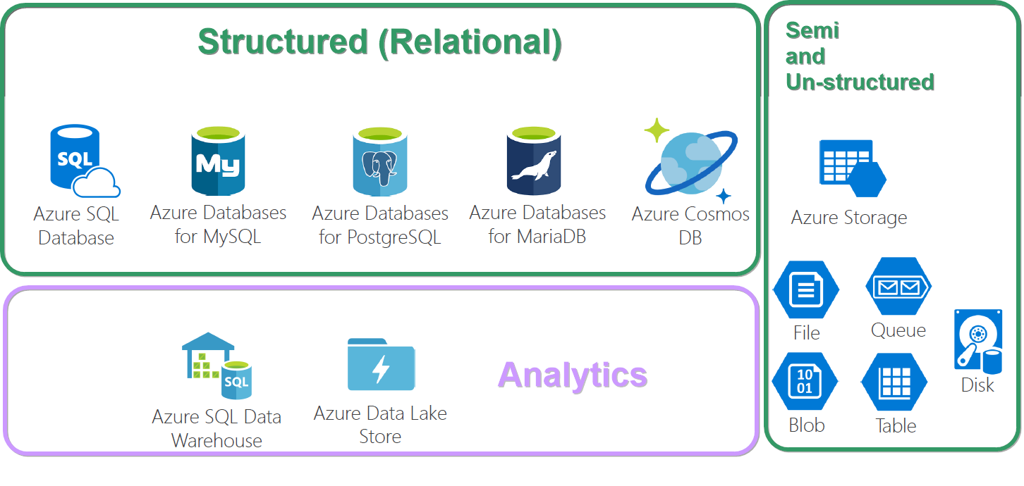
OLAP, OLTP

Slide 6

Building a Data Lake
Notes:
Realizing value of investing, depends on how best to use it.
Choose Data Lake, based on the problem you’re trying to solve. i.e. does the problem is around Analytics, Machine Learning,...
Data projects should really be treated as products and not merely as infrastructure

Slide 7

Use case
An insurance firm.
Grown over the years through acquisition of many small insurance companies - hence, it doesn’t have a single, consolidated view of their customer base.
Also details are fragmented among many subsystems, product lines -
Health insurance,
Vehicle insurance,
Pet insurance, etc.
So plans to build a data lake.
Data scientists or BI analysts to generate insights.
From: https://www.thoughtworks.com/insights/blog/curse-data-lake-monster
Notes:
Different file formats.
Different reporting tools.
Different data types – Phone calls, Logs, Feedbacks.

Slide 8

Simple analogy, Build a car? Buy a car? Rent a car?

Slide 9

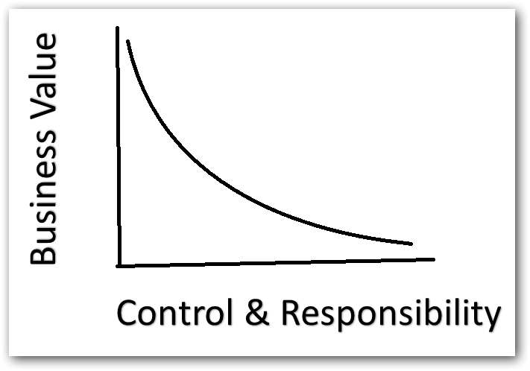
Control vs Business value
Lesser the control, more business value.
More the control, less business value.

Slide 10

Features
Optimized storage for Big Data analytics workloads.
Hierarchical file system
Security
Authentication – Azure AD
Authorization – POSIX ACLs
No limits on account sizes, file sizes or no of files.

Slide 11

So, What can I store? => Semi-structured (CSV, XML, other files...) => Un-structured (Image, Video, PDF, Document, Key/Value, Graph,..)

Slide 12
Blob or Data Lake
Azure Blob | Azure Data Lake
For non-text files like images, videos | For text files like CSV, XML, Json
Not integrated with Azure AD | Tightly integrated with Azure AD. i.e. We can set access controls over files we store here.
Cost is based on accessing (hot & cool access tier) | Cost is based on amount of Storage we use
Meant for storage | Meant more for Analytics and tight integration with BigData environment (HdInsight, Any native tool like Hadoop, Spark…)
Find more here - https://docs.microsoft.com/en-us/azure/data-lake-store/data-lake-store-comparison-with-blob-storage

Slide 13

Play Time!
Notes:
In this demo, lets see how to setup , manage and access a data lake repository for operational and exploratory analytics.
Create Azure Data Lake in Azure Portal.
Create Data Analytics in Azure Portal.
Show web app creation in Azure AD and copy the keys and URLs from that webapp.
Fetch data via Rest API

Slide 14

Data Lake Analytics
On demand analytics job service.
Simplifying BigData via Dynamic scaling based on data size
Built on YARN for cloud scale and performance.
Works with all Azure data.
Highest performance with Azure Data Lake
Also works with Blob, SQL db and Warehouse.
Query language -> U-SQL.
IDE -> Visual Studio.
Cost -> Pay only for the processing power that you use.

Slide 15
Play Time!
Notes:
Data Analytics service in portal
Add Data sources – Data Lake, Storage accounts for Blob
Show the code in Visual Studio – Read.usql, Script.usql
Submit locally and show the output in AppData
Connecting Azure account in ‘Data Lake Analytics Explorer’
Submit in Azure and Show the output in Azure Data Lake.
Finally create a “U-SQL” Sample Application and show different use cases.

Slide 16
Azure Data Lake Storage Gen 2
GA at Feb 7, 2019
Data Lake architecture built on top of Blob storage,
Same low cost as Blob
Azure Data Ecosystem

Slide 17
Pricing and Upgrade
Gen 1 - https://azure.microsoft.com/en-us/pricing/details/data-lake-storage-gen1/
Gen 2 - https://azure.microsoft.com/en-us/pricing/details/storage/data-lake/
Lesser than Gen 1
Bit more than Azure Blob
Upgrade from Gen1 to Gen2 – When and Why?
https://docs.microsoft.com/en-us/azure/storage/blobs/data-lake-storage-upgrade

Slide 18

References
Enter Text
https://blogs.msdn.microsoft.com/azuredatalake/
https://azure.microsoft.com/en-in/resources/videos/data-lake-developer-tools/

Slide 19



Enter Text
Questions ?
https://github.com/dinesarun/azurevidyapeeth
dinesarun@hotmail.com
dinuswt22

