Slide 1

Big Data – Hadoop cluster with Azure Blob
Dinesh Kumar P
dinesarun@hotmail.com

Slide 2

Enter Text
What is Big Data?
4 V’s.
Importance of Azure in Big Data.
So what is Hadoop?
Hadoop Architecture.
Demo - Deploy a single node cluster in Windows with file system in Azure Blob.
Demo - Deploy a VM in Azure that is preconfigured with Hadoop and ecosystem.
Agenda

Slide 3
Large data that is complex to handle.
Unstructured data like Videos, Images..
Data Source
IOT, Sensors …
Web / Cloud – Wikipedia, GIT, Dropbox, Google drive…
Media – FB, Twitter…
Web sites – Shopping sites, Click stream analysis, Event-driven programming (User behavior)…
Enter Text
What is Big Data?

Slide 4
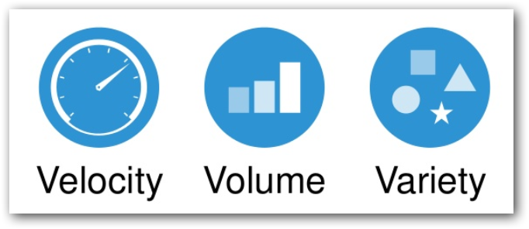
Enter Text
4th V –> Veracity
4 V’s

Slide 5
PROCESS and STORE in a distributed computing environment that is easily scalable.
Open source – Apache License.
Fault tolerant (Data & Processing)
Master/Slave architecture.
Datawarehouse ⬄ Hadoop.
Hybrid - RDBMS + Hadoop environment.
Enter Text
So what is Hadoop?

Slide 6
Storage - Dynamic scalability of cluster / storage medium.
Processing - Have perfectly sized cluster when needed and don’t incur cost when you don’t need the environment.
Hadoop Clusters can be spun up with various options in Microsoft Azure,
Microsoft – HDInsight
Syncfusion – Cluster Manager
Cloudera – Altus
Hortonworks – Cloudbreak
Supported Azure file systems,
Azure Blob
Azure Data Lake (3+)
Enter Text
Importance of Azure in Big Data

Slide 7
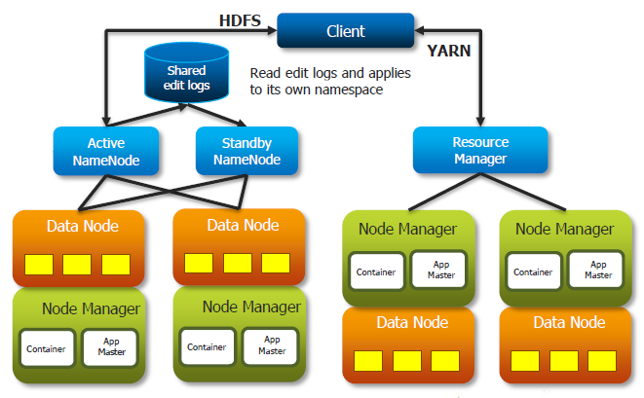
Enter Text
Hadoop Architecture

Slide 8
Enter Text
DEMO!

