Slide 1

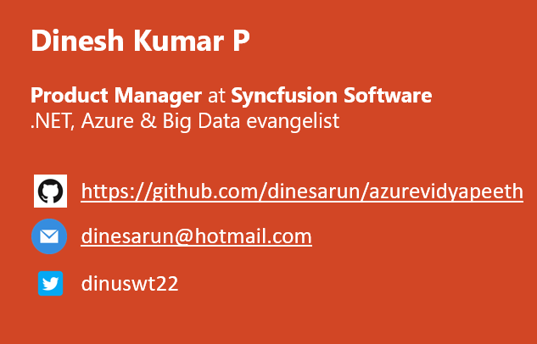
Azure Data Lake Storage Gen1 for BigData
Notes:
Happy morning guys. Ya. I am Dinesh Kumar. Product Manager at Syncfusion Software. I manage ‘Data sources’ division of Data Platform team. And I am pretty happy to present this Webinar in Azure Vidyapeeth to this wonderful audience. Here we go!

Slide 2
Agensss
Database options in Azure
Why should I choose Data Lake?
Control v Business value
Agenda
Notes:
In this webinar, you will learn to decide which database service can be used for your situation and when it can be used.
Microsoft Azure comes as huge and changing fast. Hence the name change too. “Azure Data Lake Store” has been renamed to “Azure Data Lake Storage Gen1”

Slide 3
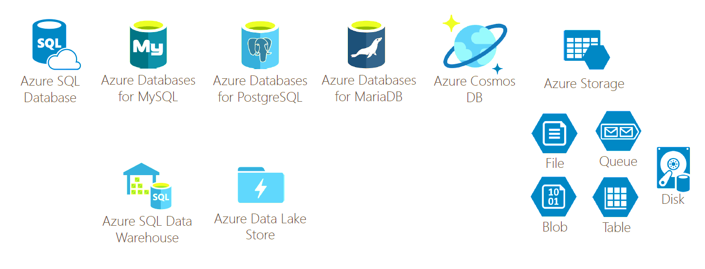
Database options in Azure

Slide 4
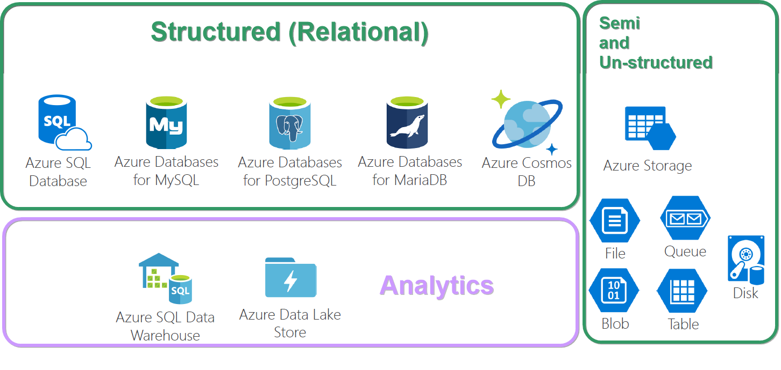
OLAP, OLTP

Slide 5

Why should I choose Azure Data Lake?...

Slide 6

What can I store? Semi-structured (CSV, XML,) Structured (Relational like SQL) Un-structured (Image, Video, PDF, Document, Key/Value, Graph,..)

Slide 7

Simple analogy, Build a car? Buy a car? Rent a car?

Slide 8

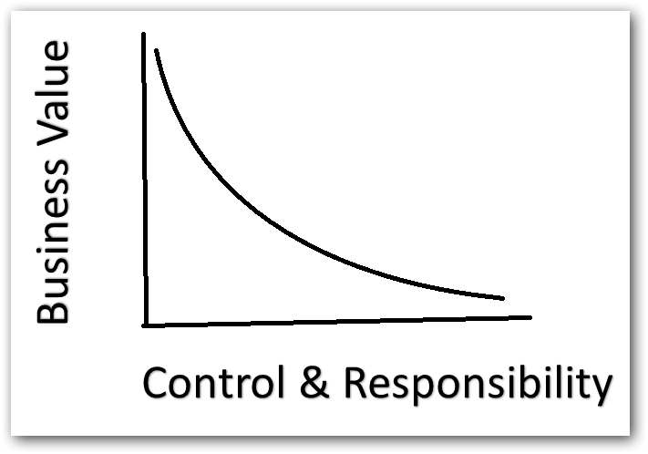
Control vs Business value
More the control, less business value.
Less the control, more business value.

Slide 9

Features
Automatic Backups
Data Recovery
High availability
Replica count
Geographic location – CosmosDB

Slide 10

Play Time!

Slide 11

References
Enter Text
.

Slide 12



Enter Text
Questions ?
https://github.com/dinesarun/azurevidyapeeth
dinesarun@hotmail.com
dinuswt22

