Slide 1

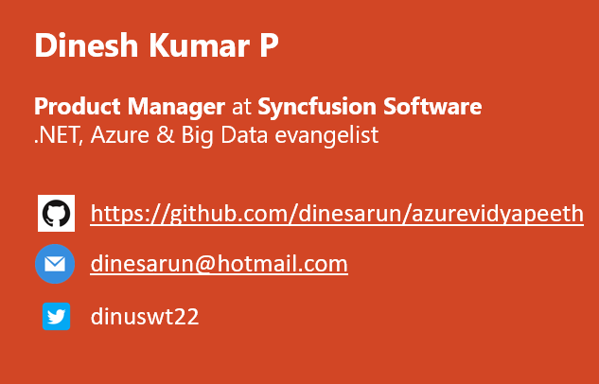
Azure Data Lake Storage Gen1 for BigData
Notes:
Happy morning guys. Ya. I am Dinesh Kumar. Product Manager at Syncfusion Software. I manage ‘Data sources’ division of Data Platform team. And I am pretty happy to present this Webinar in Azure Vidyapeeth to this wonderful audience. Here we go!

Slide 2
Agensss
Database options in Azure
Why should I choose Data Lake?
Control v Business value
Agenda
Notes:
In this webinar, you will learn to decide which database service can be used for your situation and when it can be used.
Microsoft Azure comes as huge and changing fast. Hence the name change too. “Azure Data Lake Store” has been renamed to “Azure Data Lake Storage Gen1”

Slide 3
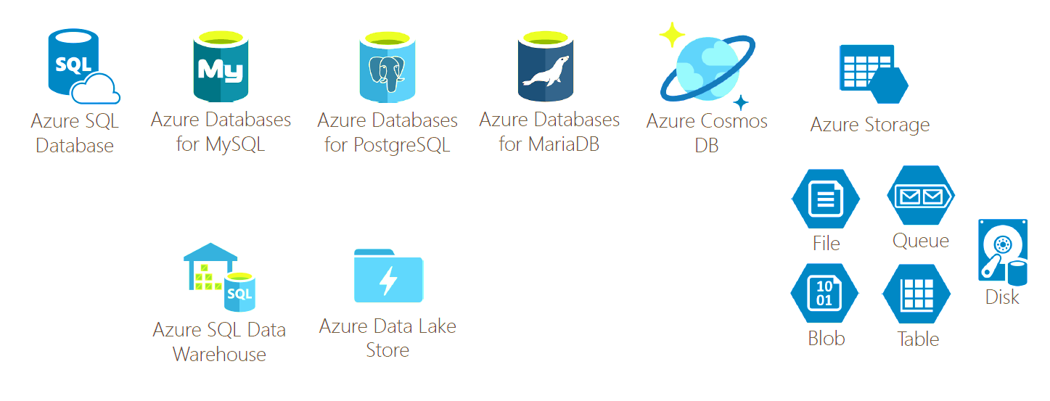
Database options in Azure

Slide 4
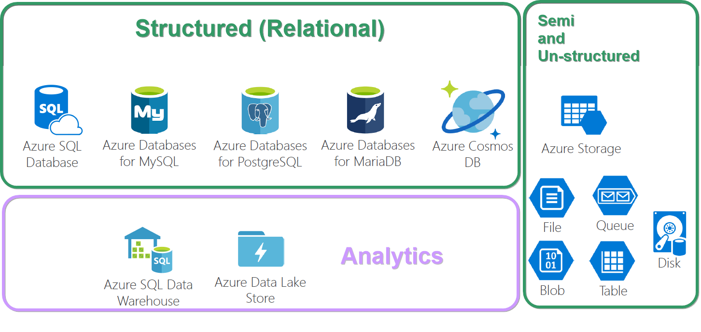
OLAP, OLTP

Slide 5

Why should I choose Azure Data Lake?...

Slide 6

What can I store? Semi-structured (CSV, XML, other files...) Structured (Relational like SQL) Un-structured (Image, Video, PDF, Document, Key/Value, Graph,..)

Slide 7

Simple analogy, Build a car? Buy a car? Rent a car?

Slide 8

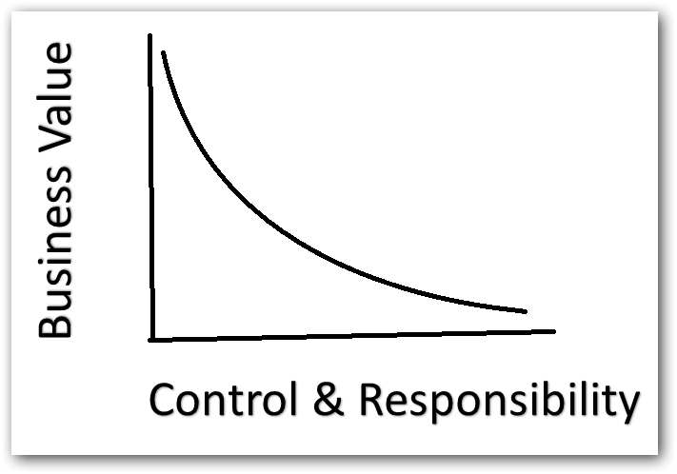
Control vs Business value
More the control, less business value.
Less the control, more business value.

Slide 9

Features
Automatic Backups
Data Recovery
High availability
Replica count
Geographic location – CosmosDB

Slide 10
Choosing Blob or Data Lake
Azure Blob | Azure Data Lake
Preferred for non-text files like images, videos | Preferred for text files like CSV, XML, Json
Not integrated with Azure AD | Tightly integrated with Azure AD. i.e. We can set access controls over files we store here.
Cost is based on accessing (hot & cool access tier) | Cost is based on amount of Storage we use
Meant for storage | Meant more for Analytics and tight integration with HdInsight and even native tools like Hadoop, Spark…

Slide 11

Play Time!

Slide 12

Data Lake Analytics
Run Big Data analysis jobs that scale to massive data sets.
Create and manage batch, real-time and interactive analytics jobs.
Query using the U-SQL language.
Work with Visual Studio.

Slide 13
Play Time!

Slide 14
Why BigData
Cost reduction.
Hybrid storage options,
Mostly used – SQL Server
Rarely used like logs – Azure Blob
AI , Analytics, Cloud are also in picture of Big Data.
Empowers management to make better decisions analyzing more about their work.
Notes:
Cost reduction - Big data technologies such as Hadoop and cloud-based analytics bring significant cost advantages when it comes to storing large amounts of data.

Slide 15

References
Enter Text
https://blogs.msdn.microsoft.com/azuredatalake/

Slide 16



Enter Text
Questions ?
https://github.com/dinesarun/azurevidyapeeth
dinesarun@hotmail.com
dinuswt22

