Slide 1


Sentiment analysis
Big Data – Apache Spark
Azure – Cognitive service
Dinesh Kumar Prabakaran
@dinuswt22
dinesarun@hotmail.com

Slide 2

Enter Text
Apache Spark
Stanford NLP
Azure Cognitive Service – Text analytics API
Sentiment analysis Demo using ‘Stanford NLP’ with Apache Spark
Sentiment analysis Demo using Azure Text analytics API
Agenda

Slide 3
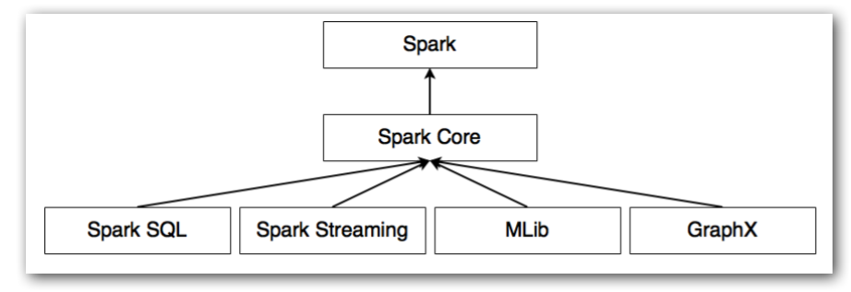
Unified analytics engine.
Spark runs on Hadoop, Apache Mesos, Kubernetes, standalone, or in the cloud (Azure Databricks).
Enter Text
Apache Spark

Slide 4
Has a document processing pipeline in terms of annotators, which extract the words, phrases and perform different linguistic analysis based on the input parameters.
Stanford core NLP wrapper for Apache Spark, wraps Stanford CoreNLP annotators as Spark DataFrame functions.
Reads a string column representing documents, and applies CoreNLP annotators to each document. The output column contains annotations from CoreNLP.
Enter Text
Stanford core NLP wrapper for Spark

Slide 5
Annotator | Functionality | Example
tokenize | Divides text into a sequence of words
ssplit | Split the text into sentence. Identify full stop, exclamation etc. and split sentences | Wow! You look great! This is a simple sentence.
pos | Reads the text and assigns parts of speech to each word such as noun, verb, adjective, etc. | "This is a simple sentence" will be tagged as "This/DT is/VBZ a/DT sample/NN sentence/NN"
lemma | Forms of a word are grouped together so that they can be analyzed as a single item. | Wow! You look great!
parse | Provides syntactic analysis. Relationship among words. | “The school goes to boy” is rejected.
sentiment | Provides model for sentiment analysis
Enter Text
Stanford core NLP Annotators

Slide 6
Uses classification techniques that include features generated from part-of-speech tags and word embeddings.
The API does everything and returns a numeric score between 0 and 1.
Scores close to 1 indicate positive sentiment and scores close to 0 indicate negative sentiment.
Online demo - https://azure.microsoft.com/en-in/services/cognitive-services/text-analytics/
Enter Text
Azure Cognitive Service – Text analytics API

Slide 7
https://spark-packages.org/package/databricks/spark-corenlp
https://stanfordnlp.github.io/CoreNLP/
https://spark.apache.org/streaming/
Enter Text
References

Slide 8
Enter Text
DEMO!

