Slide 1
Notes:
Hi Folks. A very good afternoon to one and all connected to this Vidyapeeth webinar.
Ya. I am Dinesh Kumar. Product Manager for Data Platform team at Syncfusion Software. Am pretty happy to present this Webinar. Here we go!

Slide 2

Enter Text
Data science project & Spark in it.
Install Spark – local mode in Windows machine.
Spark in a distributed environment using Syncfusion Cluster Manager.
Deploy “Azure Databricks” service.
Execute some workloads.
Visualize using PowerBI.
Agenda

Slide 3
Apache Spark in a Big Data or Data science projects,
Storage & Access – Initial / Processing / Final.
Processing – ETL, Analytics.
Visualization – BI tools for business decisions.
Enter Text
Data Science / Big Data projects

Slide 4
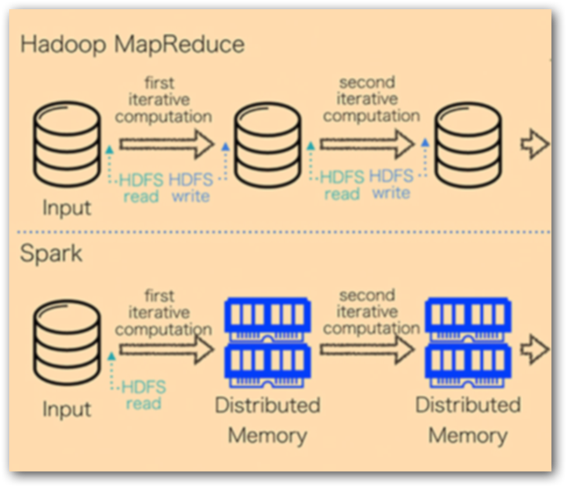
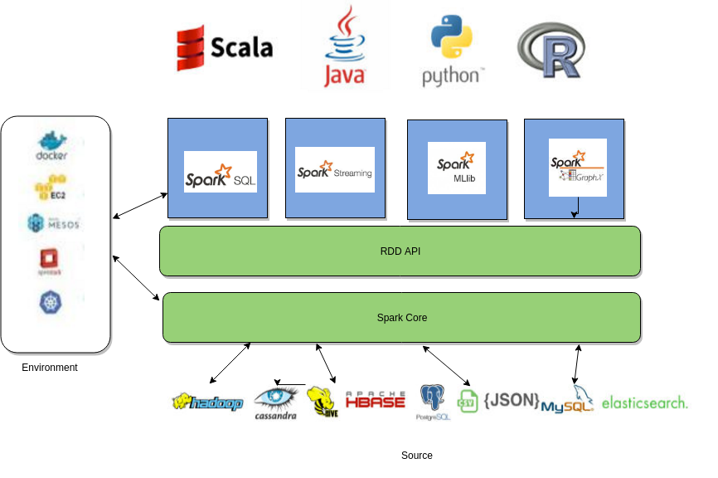
Enter Text
In-memory data analytics engine
Lazy execution (Only when Action triggered)
Apache Spark - Goodness
Notes:
* Local mode Spark uses CPU – Respective JAVA process turns higher then decreases.

Slide 5
Enter Text
Manual Cluster Optimization.
https://help.syncfusion.com/bigdata/cluster-manager/performance-improvements#spark
Expensive.
Debugging.
Apache Spark – Can get improved
Notes:
* Standalone Spark uses CPU – Respective JAVA process turns higher then decreases.

Slide 6
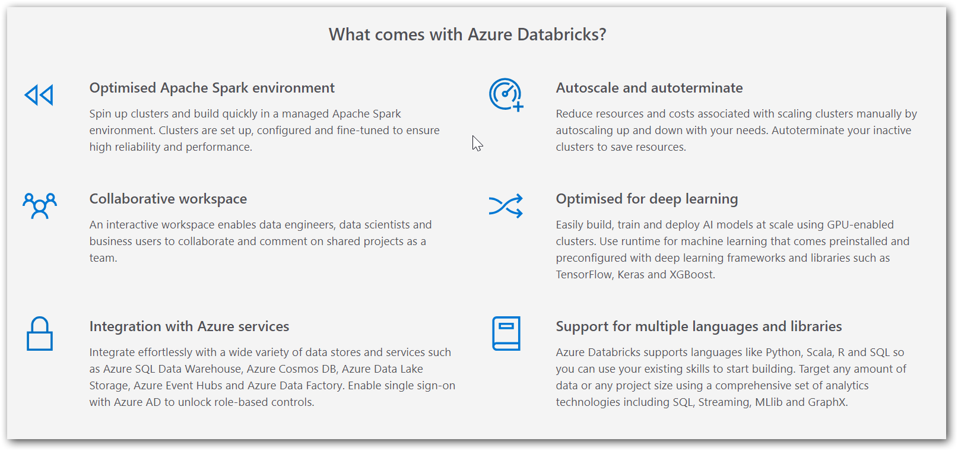
Enter Text
Azure Databricks
Notes:
Apache Spark based analytics service.
Create Spark cluster in minutes.

Slide 7
Enter Text
Play Time!

Slide 8
Apache Spark
Syncfusion Cluster Manager
Azure Blob
Azure Databricks
Microsoft PowerBI
Enter Text
What we saw today
Notes:
Syncfusion Cluster Manager
– Easily create and deploy Syncfusion Hadoop cluster in Microsoft Azure virtual machines
– Pre-requisites in https://help.syncfusion.com/bigdata/cluster-manager/azure#create-cluster-on-azure
Microsoft PowerBI
– Go from data to insights in minutes. Any data, any way, anywhere. And all in one view.
– https://powerbi.microsoft.com/en-us/

Slide 9
Enter Text
https://help.syncfusion.com/bigdata/cluster-manager/azure#create-cluster-on-azure
https://docs.databricks.com/spark/latest/data-sources/azure/azure-storage.html
https://docs.microsoft.com/en-us/azure/azure-databricks/databricks-extract-load-sql-data-warehouse
https://docs.azuredatabricks.net/user-guide/bi/power-bi.html
https://docs.azuredatabricks.net/api/latest/authentication.html
https://towardsdatascience.com/visualizing-data-with-azure-databricks-and-power-bi-desktop-845b0e317dc6
References

Slide 10



Enter Text
Questions
https://github.com/dinesarun/azurevidyapeeth
dinesarun@hotmail.com
dinuswt22

