Slide 1



Store in ‘Hadoop-Blob cluster’
Process using ‘Spark‘
Visualize using ‘PowerBI’
Dinesh Kumar P
.Net, Azure & BigData evangelist
dinesarun@hotmail.com
dinuswt22
Notes:
Ya. I am Dinesh Kumar. One of the Product Manager at Syncfusion Data Platform team. And I am pretty happy to present this Webinar in Azure Vidyapeeth to this wonderful audience. Here we go!

Slide 2

Enter Text
Background of Big Data, Data science projects.
Demo,
Deploy Hadoop cluster in Azure backed with Azure Blob.
Workout Blob data using Apache Spark.
Store the result back to Azure Blob.
Connect PowerBI with Azure Blob and create a Dashboard.
About Azure Blob, Microsoft Power BI, Apache Spark.
Agenda

Slide 3
The background of most Data science / Big Data based use case will have the following,
Storage – Initial / Processed / Final data.
Processing – ETL, ELT, Analytics,…
Visualization – Show the data for business decisions.
Enter Text
Data Science / Big Data use cases

Slide 4
Yes. We are going to deploy a Hadoop-Spark cluster in Azure VMs.
And for data storage we are going to use Azure Blob. So the part of replication, data being fault tolerant will be taken care by Blob itself.
Using Azure Blob has any advantage? Yes indeed.
You need cluster only at time of processing.
Any time data will be available and accessible in various means like Rest API.
Enter Text
Hadoop cluster in Azure backed with Azure Blob?

Slide 5
Enter Text
Play Time!

Slide 6
Name Node 1
Name Node 2
Enter Text
Azure Blob
Data Node 1
Data Node 2
Data Node 3
Hadoop-Blob cluster Architecture

Slide 7
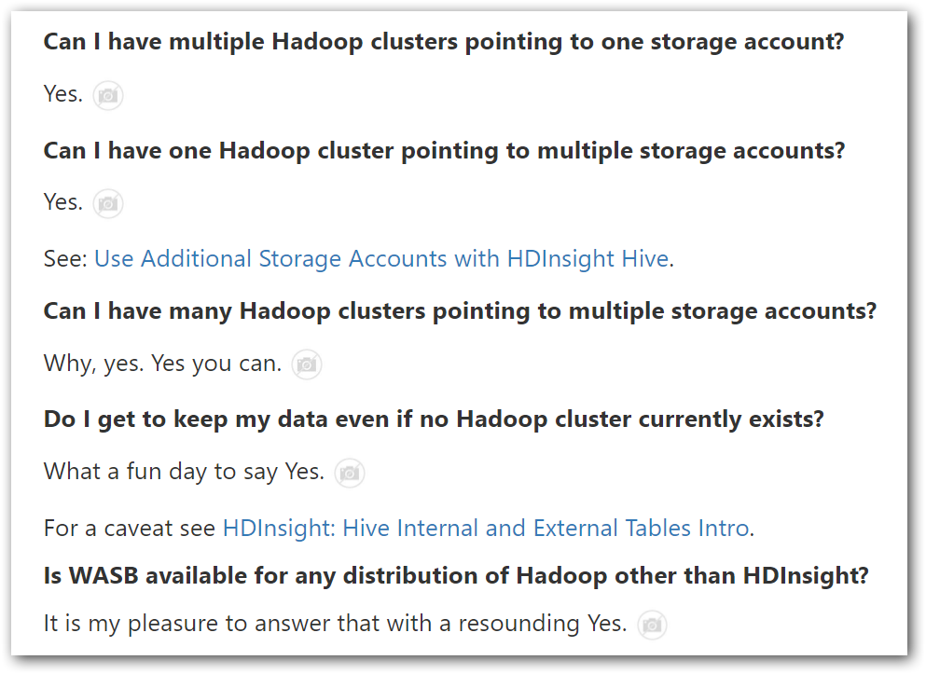
Enter Text
From the blog - https://blogs.msdn.microsoft.com/cindygross/2015/02/04/understanding-wasb-and-hadoop-storage-in-azure/
Hadoop + Azure

Slide 8
Azure Blob
Syncfusion Cluster Manager
Apache Spark, Apache Hadoop
Microsoft PowerBI
Enter Text
Notes:
Azure Blob
– Binary large object - https://docs.microsoft.com/en-us/azure/storage/blobs/storage-blobs-introduction#blob-service-concepts
– Accessible in URL form - https://sandbox202153diag421.blob.core.windows.net/dinesh-test
Syncfusion Cluster Manager
– Easily create and deploy Syncfusion Hadoop cluster in Microsoft Azure virtual machines
– https://help.syncfusion.com/bigdata/cluster-manager/azure#create-cluster-on-azure
– Pre-requisites
Apache Spark + Apache Hadoop
– http://spark.apache.org/
Microsoft PowerBI
– Go from data to insights in minutes. Any data, any way, anywhere. And all in one view.
– https://powerbi.microsoft.com/en-us/

Slide 9
Enter Text
https://blogs.msdn.microsoft.com/arsen/2016/07/13/accessing-azure-storage-blobs-from-spark-1-6-that-is-running-locally/
https://hadoop.apache.org/docs/current/hadoop-azure/index.html
https://blogs.msdn.microsoft.com/cindygross/2015/02/04/understanding-wasb-and-hadoop-storage-in-azure/
https://docs.microsoft.com/en-us/power-bi/service-azure-and-power-bi#transform-shape-and-merge-your-cloud-data
References

Slide 10

Enter Text
Questions ??
https://github.com/dinesarun/azurevidyapeeth
dinesarun@hotmail.com
dinuswt22

