Slide 1


Python in Big Data & About Azure Notebooks
Dinesh Kumar Prabakaran,
Product Manager at Syncfusion Software Inc.
@dinuswt22
dinesarun@hotmail.com

Slide 2

Enter Text
About Azure NoteBooks.
Industry standard samples in different streams.
Workout samples with libraries used for data science.
Samples like WordCount executed using ‘pySpark’ over a Hadoop cluster.
Agenda

Slide 3
Python is a major player in the Big Data game along with R and Scala.
Python’s success in the world of ‘data-science’ makes it a great ‘second language’ for any .Net developer.
Lot of learning options
Enter Text
Python in Big Data
Notes:
Python is a general-purpose programming language and platform that provides a rich ecosystem of powerful features and libraries.
In my opinion, it is not necessary to become proficient at building good software in Python to be able to productively perform data analysis.

Slide 4
https://notebooks.azure.com/
Interactive online coding
Getting to your Data in Azure Notebooks
GitHub, Azure Blob, Azure Tables, Azure SQL Server
On-Demand – Use “Data” menu “Upload” option.
Package installation
Use ! Symbol before the command,
!pip install <packageName>
!conda install <packageName> -y
Enter Text
Azure Notebooks

Slide 5
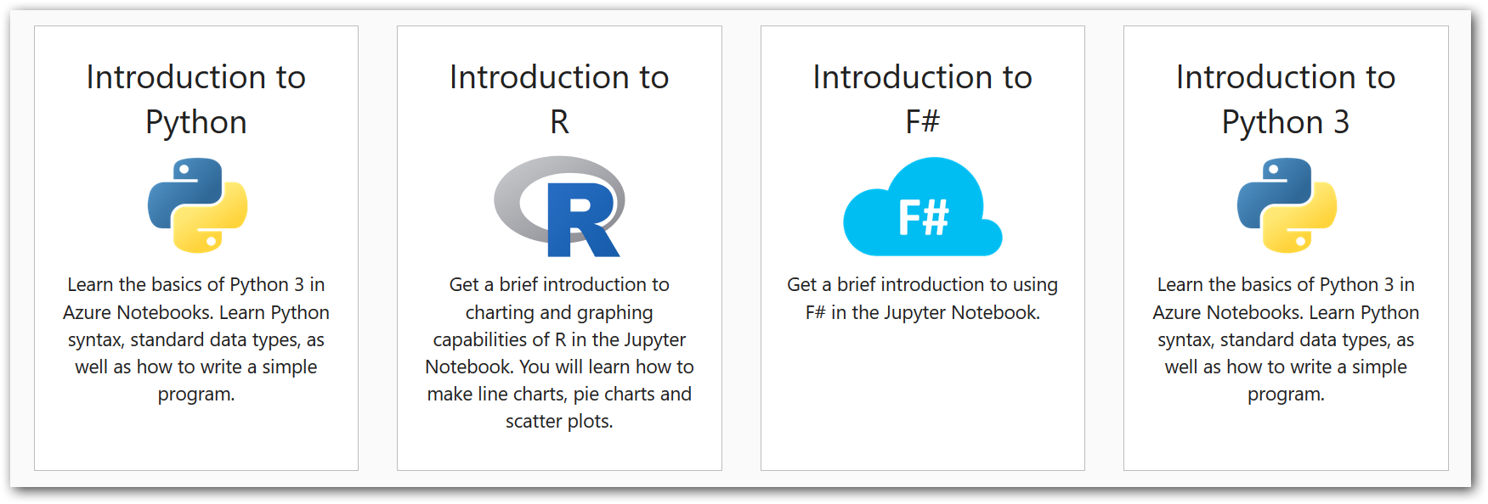
Enter Text
Featured projects in ANB (libraries)
Notes:
The R kernel is still young, so miss a lot of feature, but can still display inline graphincs in notebooks.
F# - A functional language. Immutable.

Slide 6
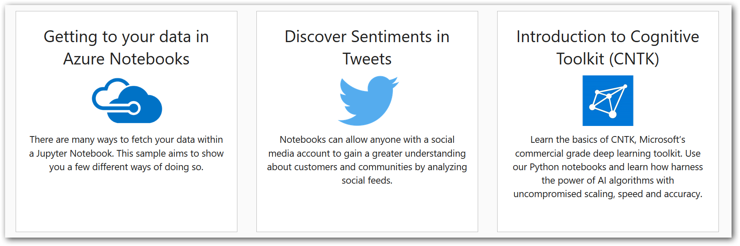
Enter Text
Featured projects in ANB (libraries)
Notes:
Sentiment analysis - on demand link - https://info.microsoft.com/IN-AZUREPLAT-WBNR-FY19-07Jul-23-Sentimentanalysisdemonstration-MCW0007805_02OnDemandRegistration-ForminBody.html
Big Data, Hadoop basics - on demand link - https://info.microsoft.com/IN-AZUREPLAT-WBNR-FY18-06Jun-08-AboutBigDataandinstallHadoop-MCW0007235_02OnDemandRegistration-ForminBody.html

Slide 7
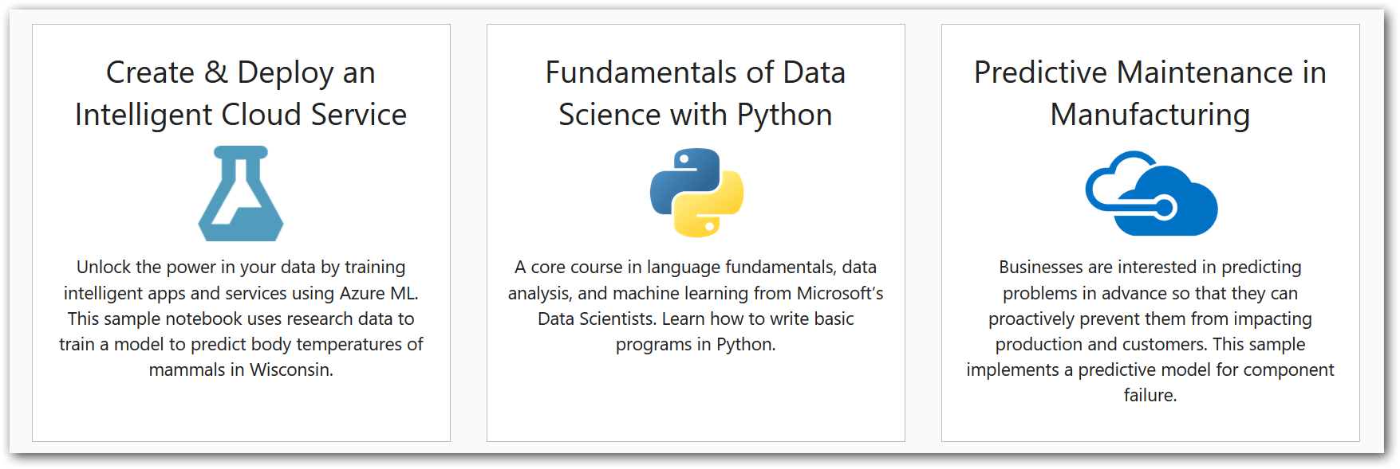
Enter Text
Featured projects in ANB (libraries)
Notes:
Projects will be use case specific. So its far better and interesting to learn. E.g. Azure ML – Body temperature use case.
1 and 3 – Both are based on Azure ML using a python package ‘azureml’ deployed to online Azure ML.

Slide 8
Numpy (Numerical data manipulation)
Pandas (Data analysis and cleansing)
matplotlib, plottly (visualization)
pyspark (Big Data Analysis)
dask, (Data Analysis for large data)
scikit-learn (Machine Learning)
seaborn (Statistical plots)
Enter Text
Libraries used in Big Data , Data Science

Slide 9
Hadoop Streaming – Canonical way of supplying any executable to Hadoop as a mapper or reducer, including standard Unix tools or Python scripts
mrjob, dumbo, hadoopy are packages that wraps Hadoop Streaming.
pydoop - Wraps ‘Hadoop Pipes’ which is a C++ API into Hadoop.
And still many others ☺
Enter Text
Python Hadoop interfaces
Notes:
Pydoop - Still it says officially that fully tested only in CentOS
In specific for MR job, can choose JAVA itself.
Python library Snakebite to access HDFS programmatically from within Python applications
For best results can check with alternate solution like pySpark, which gives better result.

Slide 10
https://notebooks.azure.com/
http://scikit-learn.org/stable/tutorial/basic/tutorial.html
Enter Text
References

Slide 11
Enter Text
DEMO!

