Slide 1

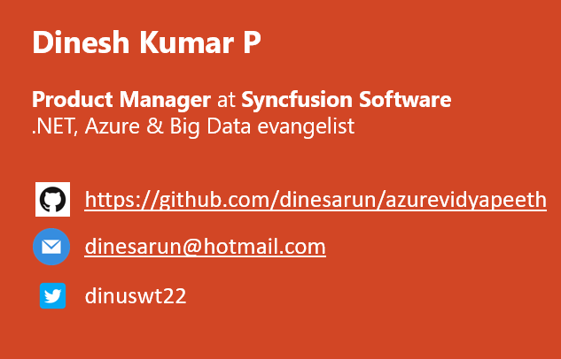
Database options in Azure and SaaS tools for visualizing those data
Notes:
Good afternoon guys. Ya. I am Dinesh Kumar. Product Manager at Syncfusion Software. I manage ‘Data sources’ division of Data Platform team. And I am pretty happy to present this Webinar in Azure Vidyapeeth to this wonderful audience. Here we go!

Slide 2
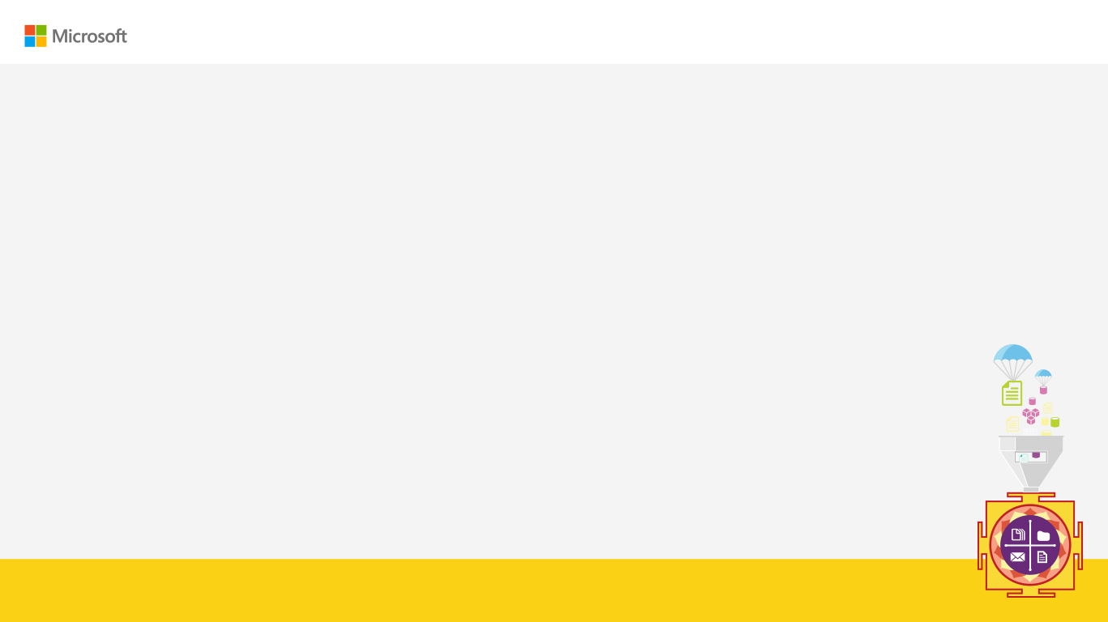
Agenda
Enter Text
Databases in Azure.
Before choosing, find out – “What to use When?”
Business Needs.
Control & Responsibility over Business Value
Demonstrate data from Azure storage in SaaS BI tool,
Files & Services using PowerBI.
Azure SQL using Syncfusion Dashboard.
Notes:
Microsoft Azure comes as huge and changing fast. It comes in handy while choosing services, deployment options, security methods etc. for a variety of situations. In this webinar, you will learn to decide which database service can be used for your situation and when it can be used.
In short we will know which services to use to store data in Azure.

Slide 3
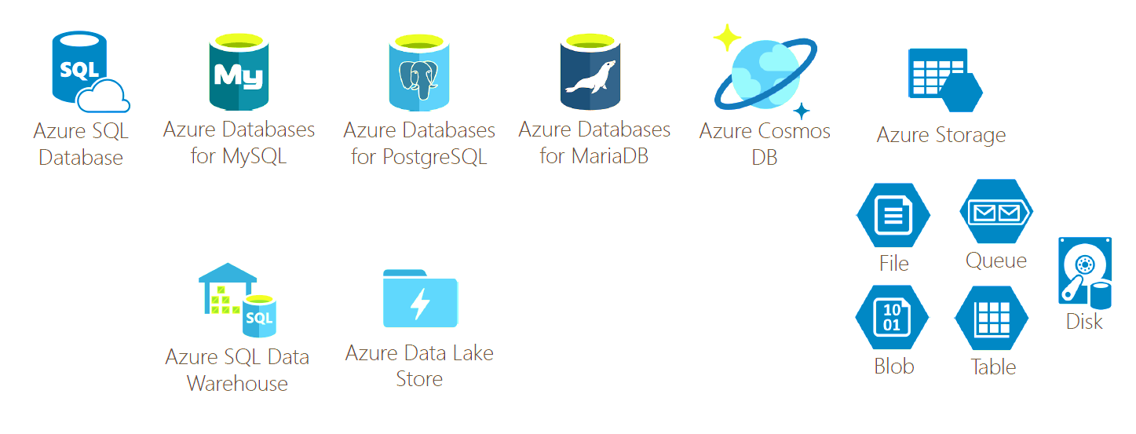
Databases in Azure
Enter Text

Slide 4
Before choosing, answer “What to use When?”
Enter Text
Data’s usage,
Application nature – OLTP
Data analytics purpose – OLAP
Type of Data,
Structured (Relational like SQL)
Semi-structured (CSV, XML,)
Un-structured (Document, Key/Value, Graph,..)

Slide 5
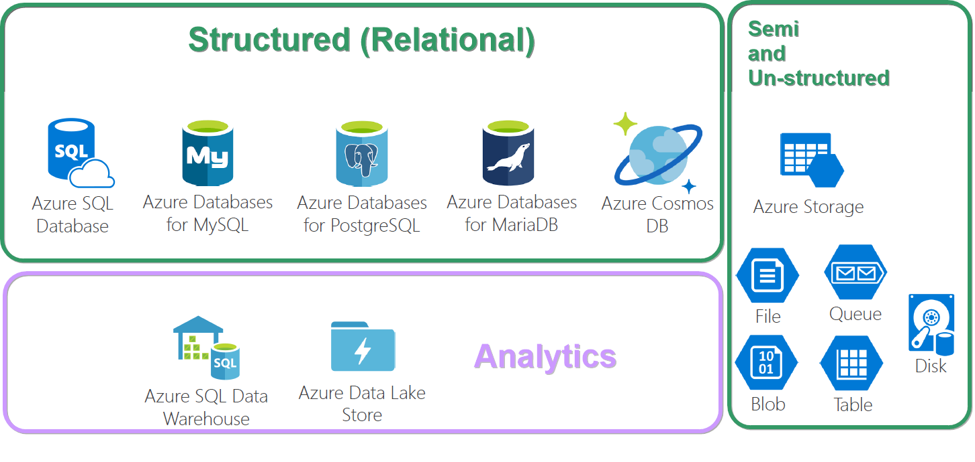
Categorize whether its OLTP or OLAP
Enter Text

Slide 6
Before choosing, answer “What to use When?”…
Enter Text
3. New or existing database?
DB Migration options – SQL, CosmosDB with best toolset
4. Where is the App running that uses data?
In Azure / other cloud / On premises?
Cloud type - Public / Private or Hybrid?

Slide 7
Before choosing, answer “What to use When?”…
Enter Text
5. Usage model - database access
All the time
Occasional (Azure Blob – Hot & Cool access tier)
6. Business continuity
Automatic Backups
Data Recovery
High availability
Replica count
Geographic location – CosmosDB

Slide 8
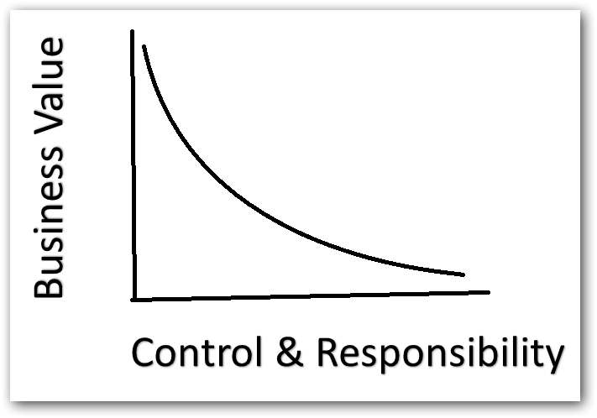
Control & Responsibility over Business Value
Enter Text
Simple analogy,
Build a car?
Buy a car?
Rent a car?

Slide 9
Control & Responsibility over Business Value,..
Enter Text
Less maintenance leads to concentrate more on business value.
For e.g. choosing from 1 of below,
Run a SQL Server in a VM
Spin-up with containers (AKS / Docker,..)
Use Azure SQL instance (Less maintenance than above 2)

Slide 10
Comparing Databases for OLTP and OLAP
Enter Text
 | Database Service | Structured data | Semi or Unstructured data | Advanced SQL query | Microsoft native libraries to manage data | Auto scaling
OLTP | SQL
 | MySQL
 | PSQL
 | MariaDB
 | CosmosDB
 | Table Storage
OLAP | Azure SQL Warehouse
 | Azure Data Lake

Slide 11
Enter Text
Play Time!

Slide 12
Azure Storage – Business needs
Enter Text
IMO, apps built in Serverless architecture i.e. SaaS, better can go with CosmosDB and others initial tryout can be done with Table storage.
If the app requirements requires real transactional kind of data, we can consider to try SQL Azure first.
Analyze in deep while choosing rather than picking service for familiarity / comfortability.

Slide 13
Azure Storage – Business needs ..
Enter Text
Need of cloud database – Easy plug & play with many tools & services with less effort.
Those more to be covered later,
Networking architecture and configuring the same,
Services to monitor the database services.

Slide 14
References
Enter Text
List of Azure services grouped by category
https://azure.microsoft.com/en-in/services
In detail about databases
https://azure.microsoft.com/en-in/product-categories/databases
E-Book to know about Cloud data challenges
https://content.microsoft.com/ads-six-data-challenges-solved

Slide 15



Enter Text
Questions ?
https://github.com/dinesarun/azurevidyapeeth
dinesarun@hotmail.com
dinuswt22

