Slide 1

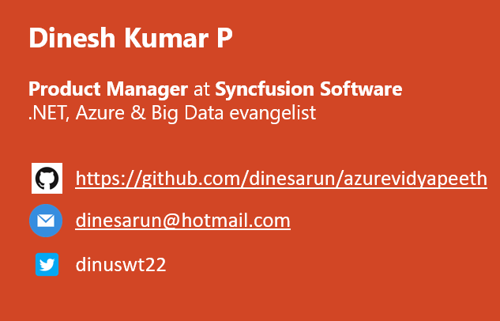
Azure Data Lake Storage Gen1 for BigData
Notes:
Happy morning guys. Ya. I am Dinesh Kumar. Product Manager at Syncfusion Software. I manage ‘Data sources’ division of Data Platform team. And I am pretty happy to present this Webinar in Azure Vidyapeeth to you all. Here we go!

Slide 2
Agensss
Big Data and Data Lake
Azure Blob / Azure Data Lake
Azure Data Lake Analytics
Demo
Quick intro about new “Gen 2”
Q & A
Agenda
Notes:
In this webinar, you will learn to decide which database service can be used for your situation and when it can be used.
Microsoft Azure comes as huge and changing fast. Hence the name change too. “Azure Data Lake Store” has been renamed to “Azure Data Lake Storage Gen1” and now in this February month, they have made “Gen 2” as generally available.

Slide 3
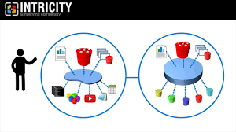
BigData – Apache Hadoop – Data Lake
Data Lake – Store data in its natural format. Like water from different sources pool into a Lake and get stored.
Hadoop was the first major data lake with “HDFS” accepting videos, files, logs,…
Hadoop’s disadvantage – Slow processing that was overcome by tools like Spark, etc.
Image from: https://www.intricity.com/data-warehousing/what-is-a-data-lake/

Slide 4
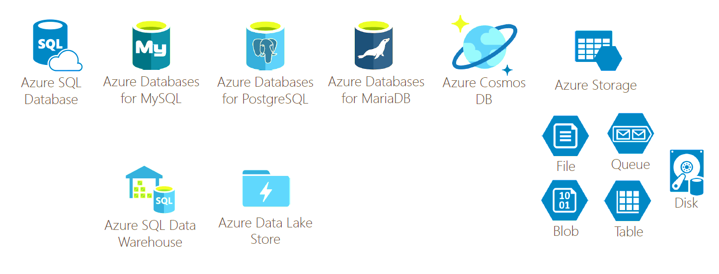
Database options in Azure

Slide 5
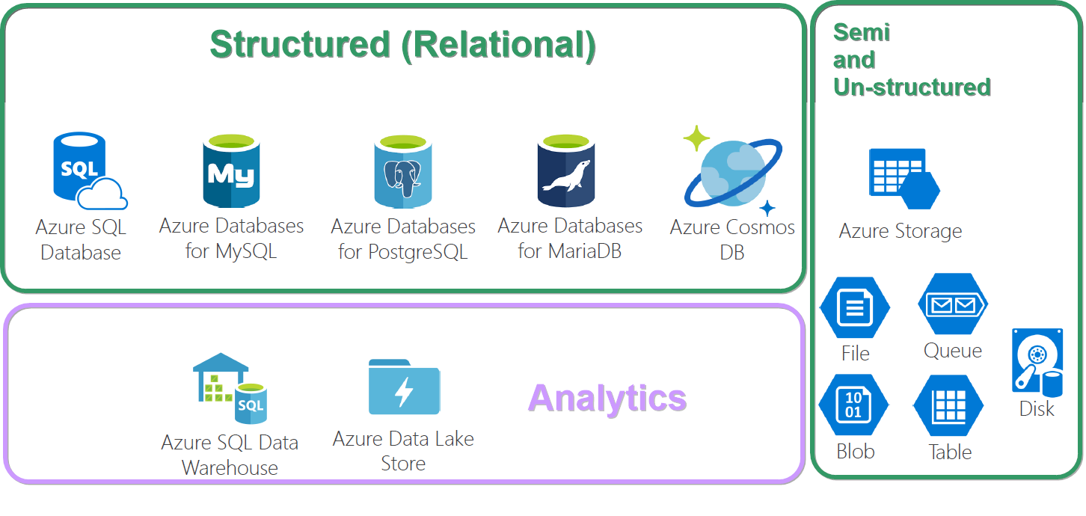
OLAP, OLTP

Slide 6

Building a Data Lake
Notes:
Value of investing can be realized only by using a service at its best.
Choose Data Lake, if the problem you’re trying to solve is around Analytics, Machine Learning,...

Slide 7
“Data projects should be treated as products and not merely as infrastructure”

Slide 8

Use case
An insurance firm.
Grown over the years through acquisition of many small insurance companies - hence, it doesn’t have a single, consolidated view of their customer base.
Also details are fragmented among many subsystems, product lines -
Health insurance,
Vehicle insurance,
Pet insurance, etc.
So plans to build a data lake.
Data scientists or BI analysts to generate insights.
From: https://www.thoughtworks.com/insights/blog/curse-data-lake-monster
Notes:
Different file formats.
Different reporting tools.
Different data types – Phone calls, Logs, Feedbacks.

Slide 9

Simple analogy, Build a car? Buy a car? Rent a car?

Slide 10

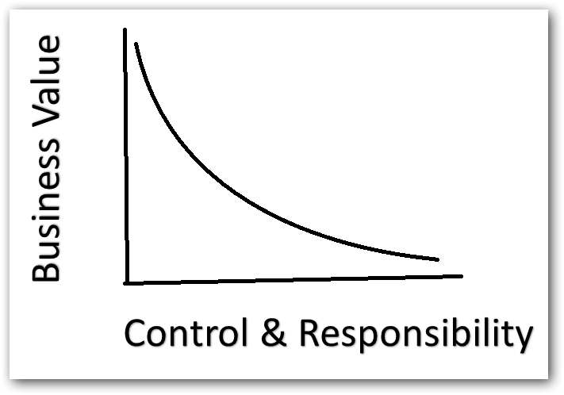
Control vs Business value
Lesser the control, more business value.
More the control, less business value.

Slide 11

Features
Optimized storage for Big Data analytics workloads.
Hierarchical file system
Security,
Authentication – Azure AD
Authorization – POSIX ACLs
No limits on account sizes, file sizes or no of files.

Slide 12

So, What can I store? => Semi-structured (CSV, XML, other files...) => Un-structured (Image, Video, PDF, Document, Key/Value, Graph,..)

Slide 13
Blob or Data Lake
Azure Blob | Azure Data Lake
For non-text files like images, videos | For text files like CSV, XML, Json
Not integrated with Azure AD | Tightly integrated with Azure AD. i.e. We can set access controls over files we store here.
Cost is based on accessing (hot & cool access tier) | Cost is based on amount of Storage we use
Meant for storage | Meant more for Analytics and tight integration around BigData (HDInsight, Native Hadoop, Spark…)
Find more here - https://docs.microsoft.com/en-us/azure/data-lake-store/data-lake-store-comparison-with-blob-storage

Slide 14

Data Lake Analytics
On demand analytics job service.
Simplifying BigData via Dynamic scaling based on data size.
Built on YARN for cloud scale and performance.
Works with all Azure data.
Highest performance with Azure Data Lake
Also works with Blob, SQL db and Warehouse.
Query language -> U-SQL.
IDE -> Visual Studio.
Cost -> Pay only for the processing power that you use.

Slide 15

Play Time!
Notes:
Data Analytics service in portal
Add Data sources – Data Lake, Storage accounts for Blob
Show the code in Visual Studio – Read.usql, Script.usql
Submit locally and show the output in AppData
Connecting Azure account in ‘Data Lake Analytics Explorer’
Submit in Azure and Show the output in Azure Data Lake.
Finally create a “U-SQL” Sample Application and show different use cases.

Slide 16
Azure Data Lake Storage Gen 2
Made GA at Feb 7, 2019
Data Lake architecture built on top of Blob storage,
Same low cost as Blob
Azure Data Ecosystem

Slide 17
Pricing and Upgrade
Gen 1 - https://azure.microsoft.com/en-us/pricing/details/data-lake-storage-gen1/
Gen 2 - https://azure.microsoft.com/en-us/pricing/details/storage/data-lake/
Lesser than Gen 1
Bit more than Azure Blob
Upgrade from Gen1 to Gen2 – When and Why?
https://docs.microsoft.com/en-us/azure/storage/blobs/data-lake-storage-upgrade

Slide 18

Other References
Enter Text
https://blogs.msdn.microsoft.com/azuredatalake/
https://azure.microsoft.com/en-in/resources/videos/data-lake-developer-tools/
https://docs.microsoft.com/en-us/azure/data-lake-analytics/

Slide 19



Enter Text
Questions ?
https://github.com/dinesarun/azurevidyapeeth
dinesarun@hotmail.com
dinuswt22

