Slide 1

Hands-on
Apache Hadoop
Azure Blob
Apache Spark
Syncfusion Dashboard

Slide 2

About data
HTTP requests to the NASA Kennedy Space Center
http://ita.ee.lbl.gov/html/contrib/NASA-HTTP.html
The logs are an ASCII file with one line per request, with the following columns:
host making the request. A hostname when possible, otherwise the Internet address if the name could not be looked up.
timestamp in the format "DAY MON DD HH:MM:SS YYYY", where DAY is the day of the week, MON is the name of the month, DD is the day of the month, HH:MM:SS is the time of day using a 24-hour clock, and YYYY is the year. The timezone is -0400.
request given in quotes.
HTTP reply code.
bytes in the reply.

Slide 3
What we are going to do?
Clean and Store the data
1
Remove unwanted characters in all rows like “-”, “[”
Store your cleaned data as text file.
Know request count did by each host.
Filter-out the requests which had resulted 404, 304 alone as a separate file.
Visualize
4
Count of different request types by hosts.
Process
3
Setting up the data
2
Set columns
Set the format (CSV)

Slide 4
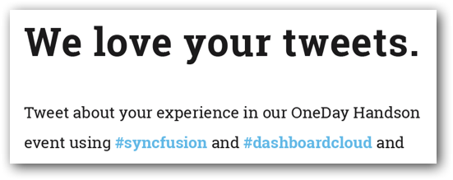

Twitter
@
https://demo.syncfusion.io/bi/en-us/dashboards/d11a9014-b252-42e4-a303-1b11fe864996/Twitter%20live%20demo/Twitter%20live%20demo?showmydashboards=1

