Slide 1
Why Snowflake and Cloud Data Warehousing?

Slide 2




About Me
Dinesh Kumar P
Product Manager,
Analytics Squad.
https://www.linkedin.com/in/dinesh-kumar-prabakaran
Notes:
Myself currently working as a product manager, for the analytics and reports squad at Kissflow. Coming through 8+ years of the journey around data space, I have involved in implementing B2B SaaS products for Big Data, ETL, and Business Intelligence.

Slide 3
Agenda
Demystify what makes a (cloud) Data warehouse different by its core architecture from Database, Data Lake.
Cloud data warehouse.
Why Snowflake?
Snowpipe: Overview
Demo –
Auto inject Twitter data into Snowflake using Snowpipe.
Real-time analysis in Power BI.

Slide 4
Database Data warehouse Data Lake
- Demystify.
- Best fit scenarios to choose one.
Notes:
This is a crazy and slightly confusing time in the data architecture space. More and more companies are shifting towards data lakes, yet the traditional data warehouse and database continues to provide value, as it has for decades. Now to add that, we have this increasingly popular lakehouse and delta lake concept. The concepts I discuss here will be common that would fit for deciding over data services in Azure as well.

Slide 5
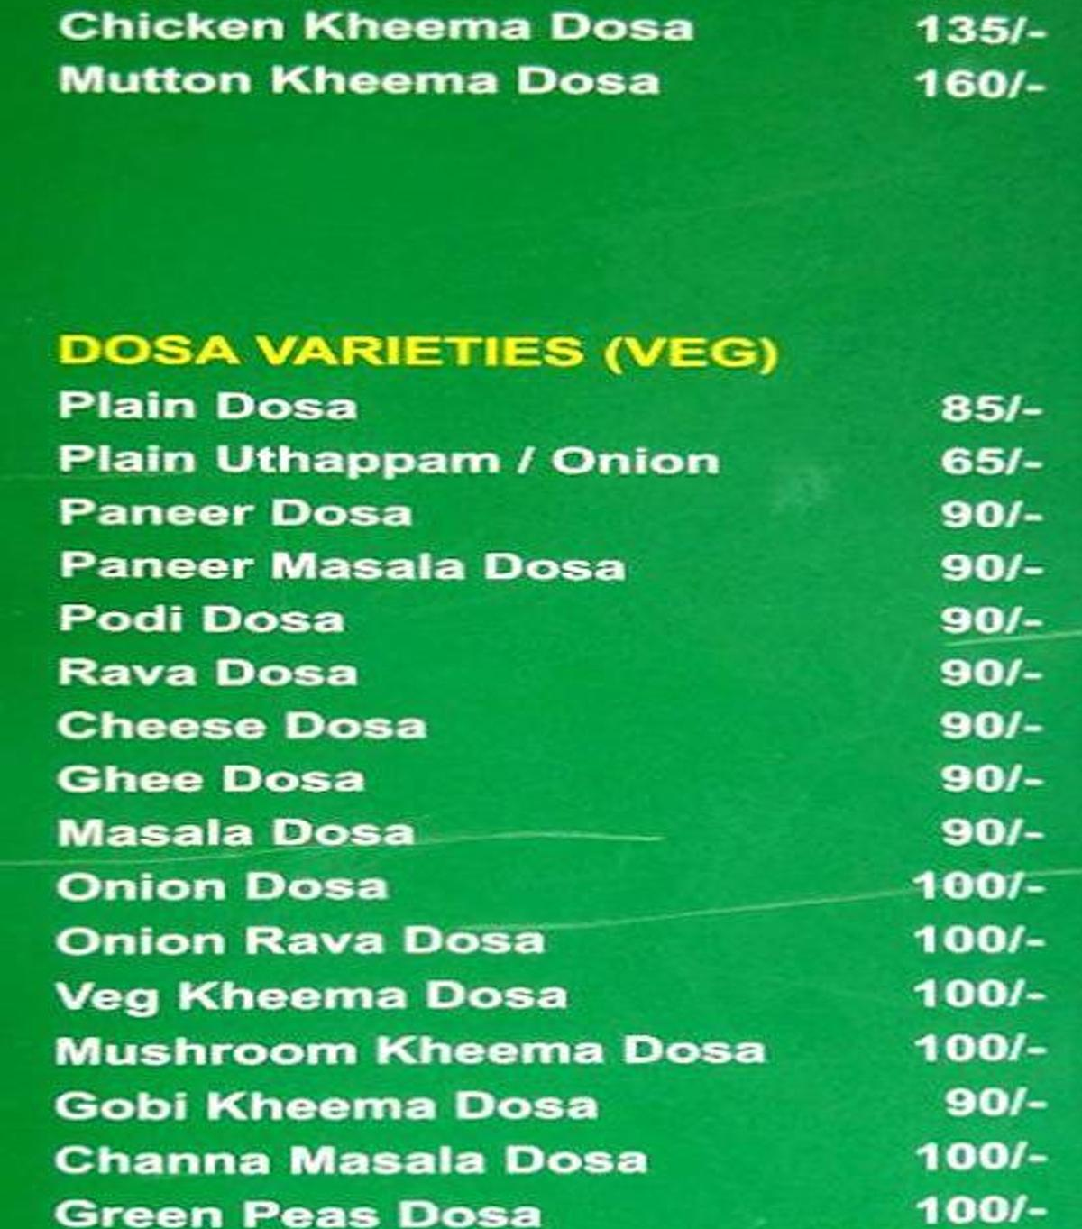
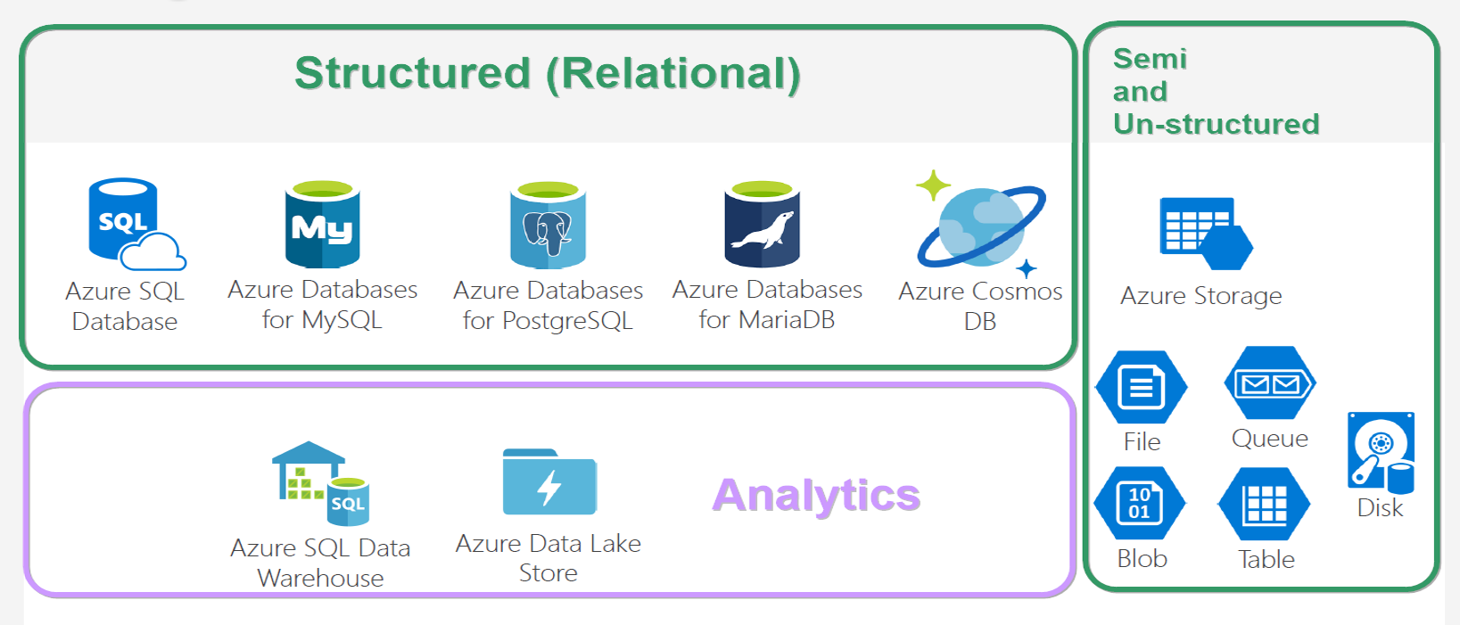
Database Varieties
Notes:
And looking at this, does both give same feeling? ☺

Slide 6
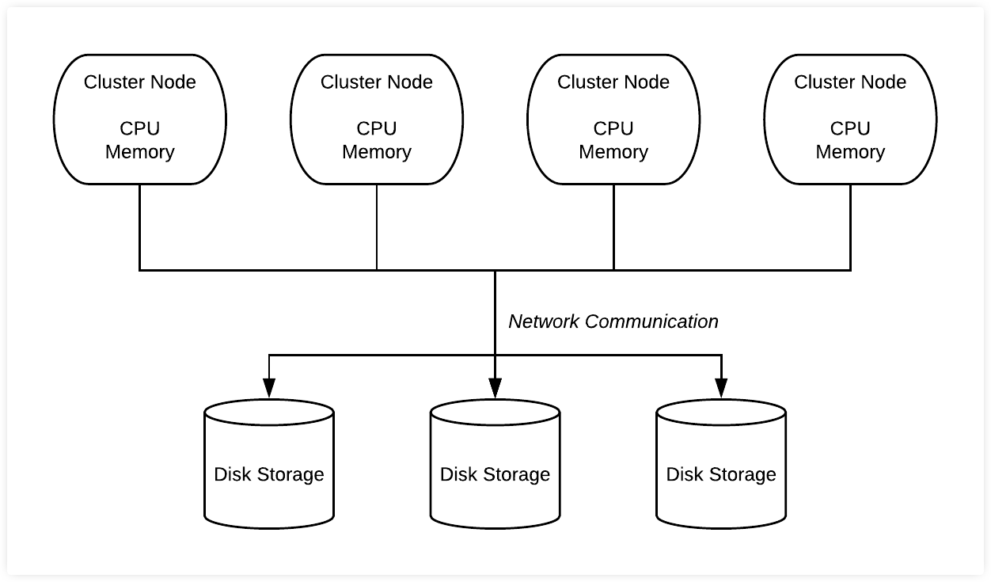
Database
* Co-location of Compute & Storage.
* Schema on Write.
* Recommended,
- Structured data of less than a TB,
- OLTP Purpose.
* Not recommended,
- Ad-hoc analytics
- More dependency in sharding.
Notes:
Size is not an issue as per a database’s doc. But generally not used for big data.
OLAP cubes are possible in RDBMS, but it need to be prepared before analytics. Which is what I mean for ad-hoc.

Slide 7
DBMS storage models
Notes:
NoSQL db – data storage model types –
* Document - Frequent schema changes with sub-tables need. (Mongo DB)
* Graph – Neo4j.
* Key-value - Redis.
* Column-oriented – Hbase, Cassandra.

Slide 8
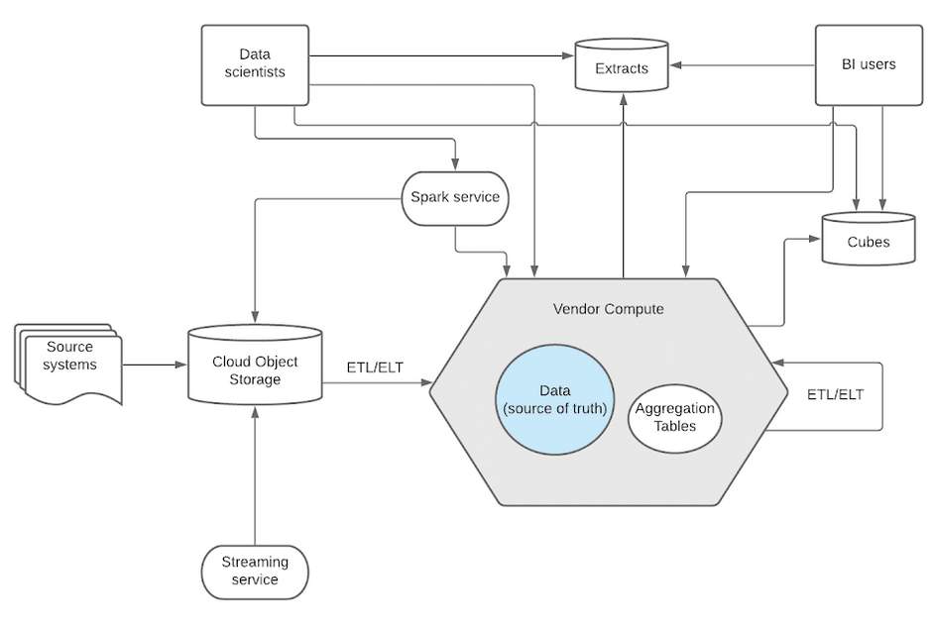
Data Warehouse
* Separation of Compute & Storage.
* Schema on Write.
* Recommended,
- If you know metadata & schema/format of analytics to be done.
- Decided that ML/AI not needed;
- Expose out, allowing customers to analyse.
* Not recommended,
- Unstructured data like image and video.
Notes:
* Data will be converted to proprietary software’s format. While leaving out, the vendor will export it to a common format like parquet or ORC.
* Snowflake has a data type called ‘BINARY’. Still not recommended. Rather you can decide to store the URL that points to that image/video stored in data lakes like S3.

Slide 9
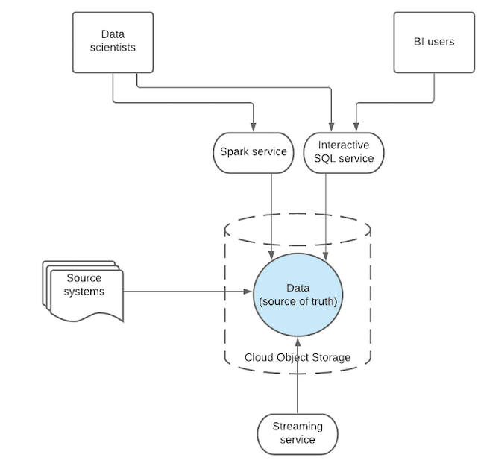
Data Lake
* Separation of Compute & Data.
* Schema on Read.
* Recommended when,
- Have all types of data of any size.
- Store now but have no plan about type of analysis to be run on it.
- Internal analytics – dump all, play as and when you need.
Not recommended when,
- Data stored should be readily available for analysis upon which users would create reports on it.
Notes:
* There wont be any conversion or copying to another system. Data relies in 1 single place and all external systems access over same data. So data democratization is good while using data lake.

Slide 10
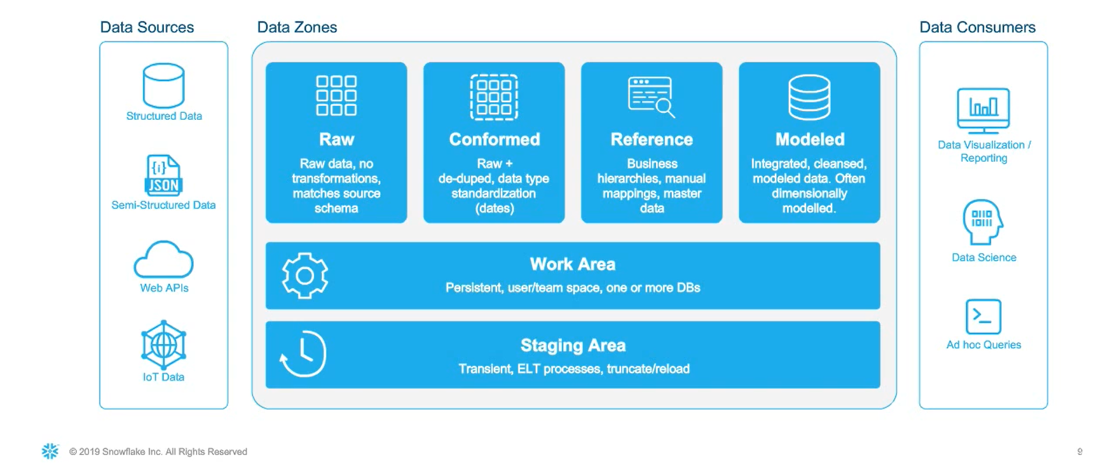
HYBRID Data architecture

Slide 11
Cloud data warehouse
* Amazon Redshift
* Azure Synapse Analytics (Azure SQL Data warehouse)
* Snowflake
* Google BigQuery

Slide 12
SNOWFLAKE cloud data warehouse PLATFORM

Slide 13
Why SnowflakE

Slide 14
SnowPIPE
* Continuous data ingestion.
* Designed for micro-batching.
*

Slide 15
DEMO – Twitter Data Snowflake. Analyse in Power BI

Slide 16
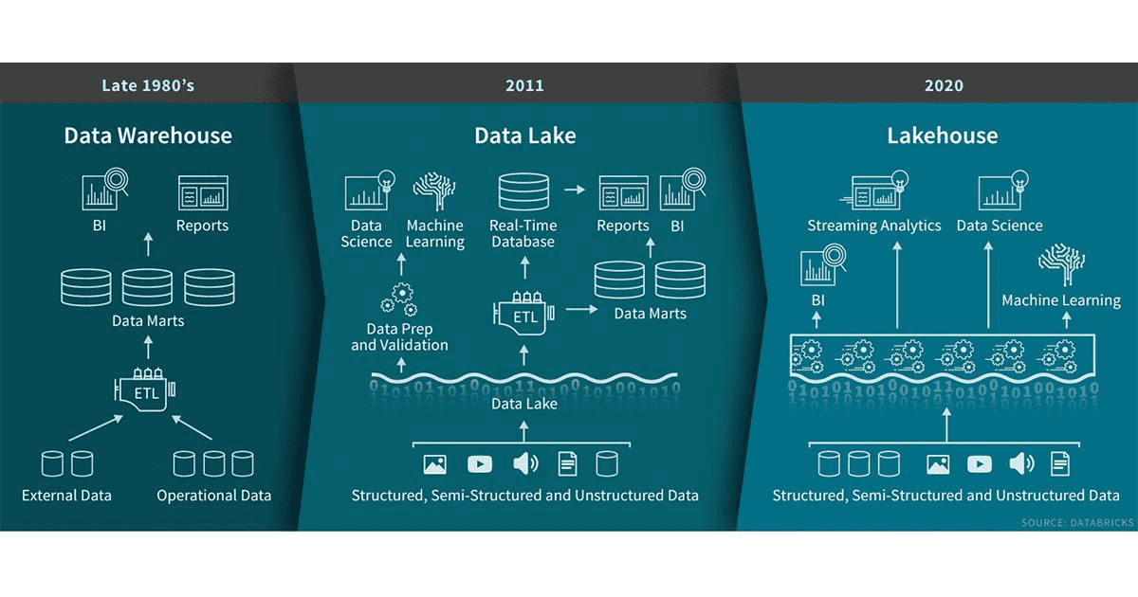

Slide 17
DATA LAKEHOUSE
* Sting together the best of both worlds – Data warehouse and Data lake.
* Implement data warehouse’ data structures & management features of data lakes.
* Single Data lakehouse for structured, semi-structured and unstructured acts as a
=> Multi-solution system,
=> Simplified data governance,
=> Cost-effective too.

Slide 18
https://www.linkedin.com/in/dinesh-kumar-prabakaran
Thank you
Questions?

