Slide 1

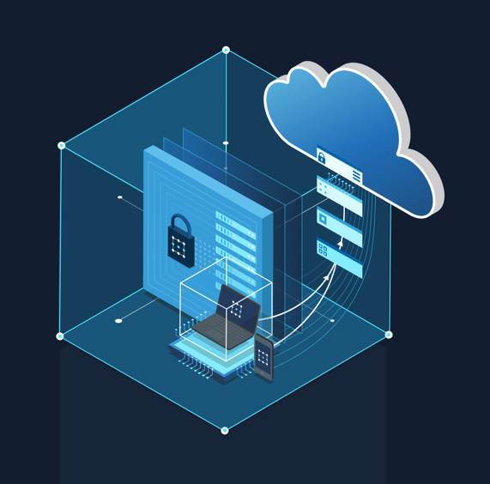
IOT Analytics using Azure Infra & analytics services
Azure Databricks
Delta Lake
Aug 26, 2021

Slide 2
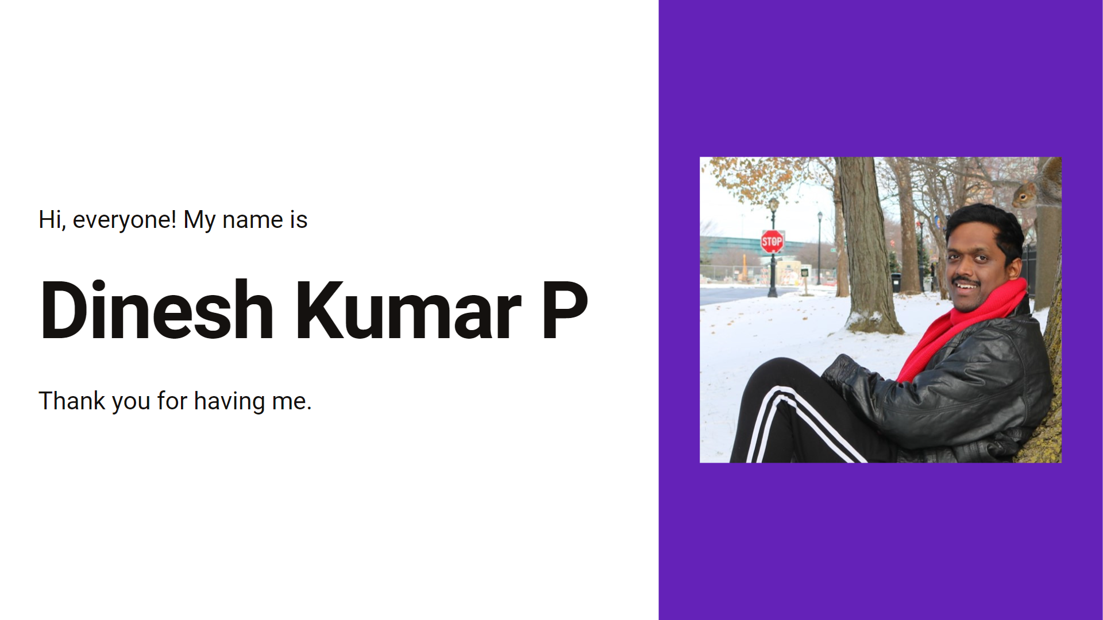

Slide 3
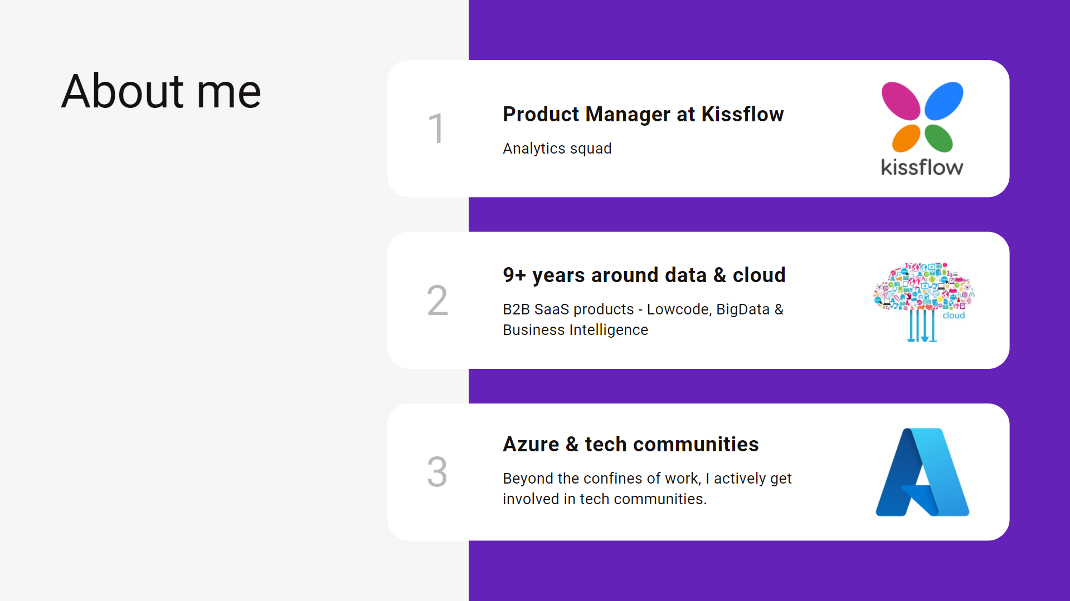

Slide 4
Agenda
IOT analytics.
Purpose – Monitoring, Analytics.
4 types of IOT analytics.
Roles – Data Engineer, Data Analyst, Data Scientist.
Where IOT analytics is done? (Data infrastructure)
Challenges in IOT analytics.
Demo.
Notes:
My talk would not be about types of algorithm types or machine learning models. More time is about how IOT analytics is happening in industry and what skillsets are expected for the roles. And let me take ENERGY industry as base for the examples and use cases that I walk through

Slide 5
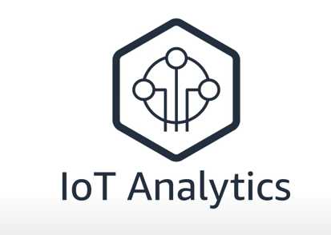
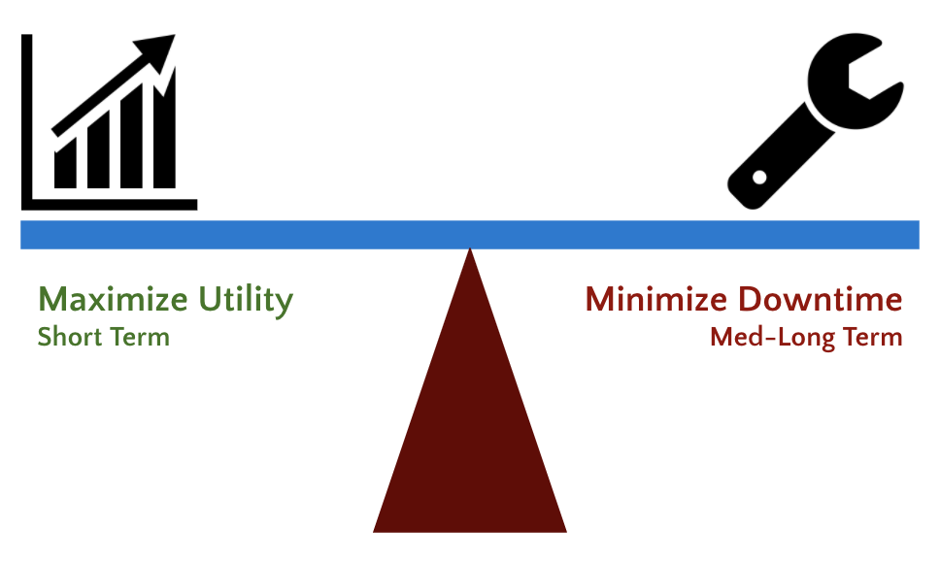
Operational insights
Data flow - Ingest, Store, Prep, Train, Serve, Visualize.
Collect => Analyze => React.
Useful for - Enterprise(users) and Device manufacturers.
Notes:
Tools we use to get things done, are generating lot more data than ever. But this data is often noisy, inconsistent and highly variable. This makes it hard or even impossible for businesses to gain value from it. This is where IOT analytics comes in.

Slide 6

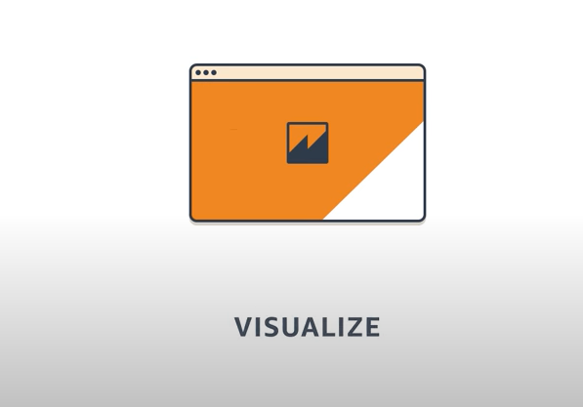
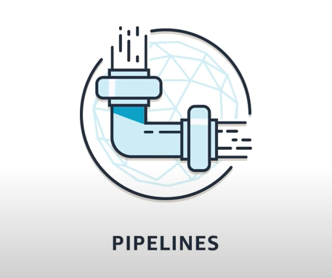
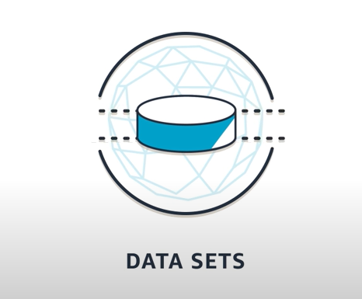
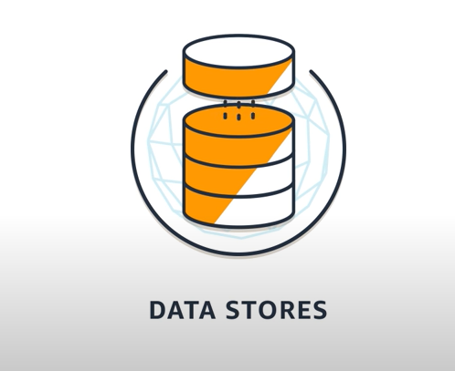
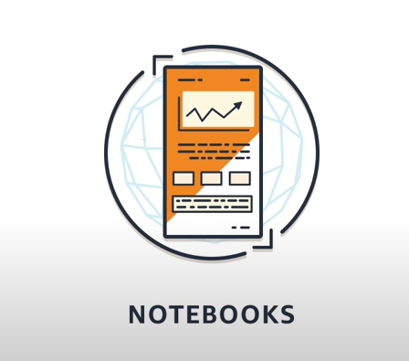
3 basic areas before analyse
Snapshots from here - https://www.youtube.com/watch?v=cYD0OU8Jdws

Slide 7
Purpose
Monitoring
Analytics

Slide 8
Use cases by department
Manufacturing - Improve production efficiency by saving costs.
Health care devices - Patient centric analytics, alerts on needy/critical times.
Energy (Solar panel / Turbine windmill) - Monitor energy captured; Load forecasting of power stored in battery to withstand based on its capacity to store.
Agriculture (Smart farming) - Monitor health metrics like soil dampness - increase crop yield; and use water effectively.
Environment (weather stations) - Monitor air quality; Predict pollution levels.

Slide 9
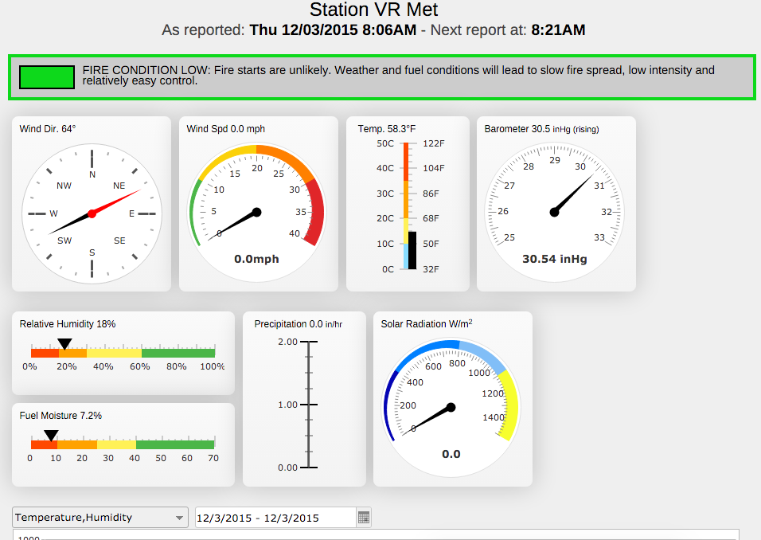
Health Monitoring dashboards
Consume from IOT devices.
Store in a database / data lake.
Visualize it in dashboard.
Alerts in case of any spikes / anomalies.

Slide 10
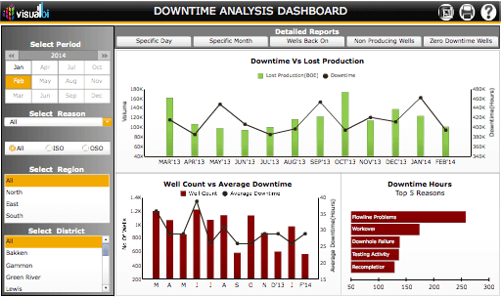
Analytics
Analyse collected data.
Allow to find answers for business questions.

Slide 11
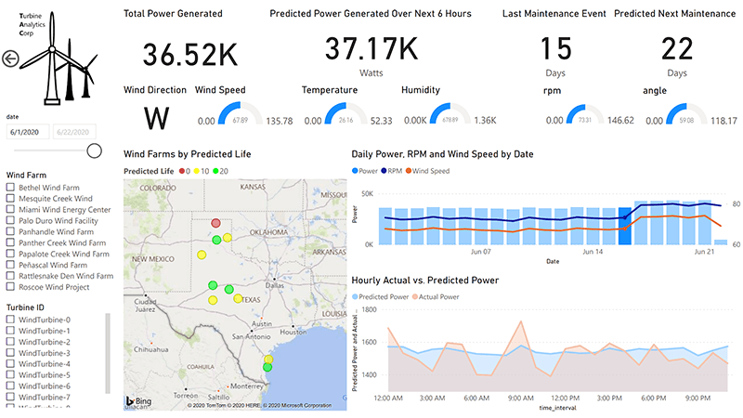
Monitoring and Analytics

Slide 12
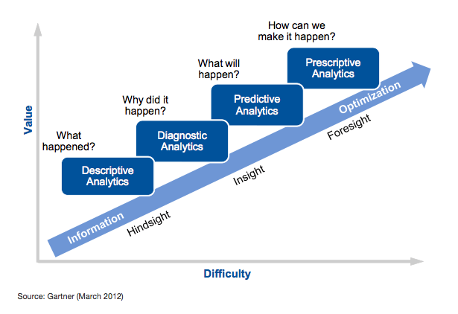
TYPES of analytics Energy (Turbine Power)

Slide 13
Descriptive analytics
What's happening?
Monitor if things are going as planned.
If any anomalies in data raise alert.
E.g. How much energy is this machine using?

Slide 14
Diagnostic analytics
Why is something happening?
Domain experts do diagnostics on data by drilling into data and improve a process / identify core problem.
E.g. Why is this machine consuming excessive energy?

Slide 15
Predictive analytics
What will happen?
End user app via ML model predict with current input about the undesired outcome.
E.g. When should I service this machine?

Slide 16
Prescriptive analytics
What action should I take?
Recommendations provided by the system to take for the prediction it did. For the undesired situation predicted, solution also system itself gives.
E.g. Answers for the question - This machine is creating too many defective components. How can I avoid this?
Used in most critical projects like Nuclear plants etc.

Slide 17
TYPES of analytics Energy (Turbine Power)
Descriptive – What quantity of power generated in last month?
Diagnostic – Why 10% decrease in power generation compared to last month?
Predictive – What is the quantity of power that would get generated in next month?
Prescriptive – How to avoid decrease in power generation in upcoming months by minimizing downtime and undergo maintenance on-time?

Slide 18

ROLES in IOT Analytics (Who builds it)
Data analyst / Data scientist
Data engineer
Notes:
The people who holds these roles are the core users and who powers up the IOT analytics.

Slide 19
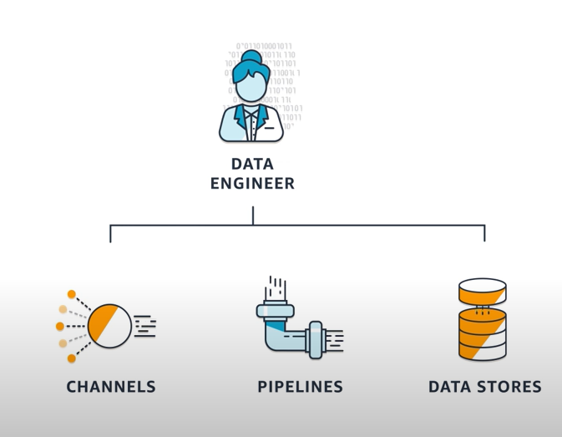
Data Engineer
Collects data from devices.
Make sure it is properly prepared and stored for analysis.
Notes:
Data Engineer holds a major important role, demanding job position but not getting prepared before he joins a company. Mostly folks train themselves for Data Analyst and Data Scientist.

Slide 20
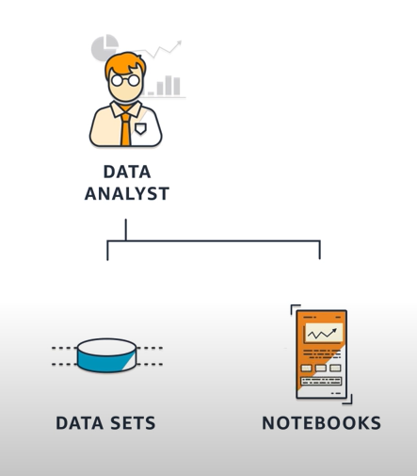
Data Analyst / Data Scientists
Produces and communicates operational insights by exploring and visualizing the data.
Notes:
Descriptive and Diagnostic Analytics – Mostly by Data Analysts.
Predictive and Prescriptive Analytics – Mostly by Data Scientists.

Slide 21
How analytics can be done? ENVIRONMENT
On-premises.
Cloud.
Hybrid.

Slide 22
On premises
CSV.
Talend.
Apache Spark – single node.
Power BI / Python Jupyter Notebooks.
Notes:
Data collected through MQTT or Kafka and saved as CSV.
Clean code via code or any ETL tool like Talend & stored into any database or data warehouse.
Analyse in Python or tools like Power BI or Excel.
Analyse via Spark for ML and model built.

Slide 23
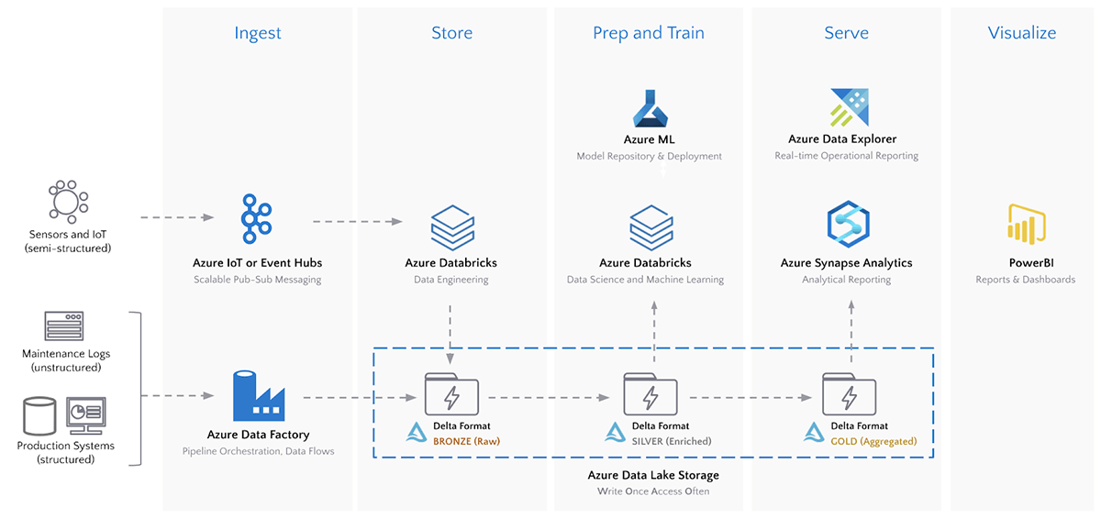
Cloud
Most difficult tasks associated with analysis of the IoT data are made easier by using such fully managed services.
Notes:
To get business value from those data - combination of tools needed - Data Lake, Stream processing frameworks, analytics tools like databricks.
Microsoft’s Azure Stream Analytics can be easily integrated with Azure IoT hub and Azure IoT suite to perform real time analytics on the IoT sensor data.
To communicate the Value i.e. insights – it need to be presented by defining it as visualizations like patterns, trends, histograms.

Slide 24
Data infrastructure for IoT
Ingest/Capture – Azure IOT / Event Hub / Kafka.
Store – Data lake.
Prep or stream processing – Azure Databricks / Stream Analytics.
Serve – Synapse Analytics.
Visualize – Power BI.

Slide 25
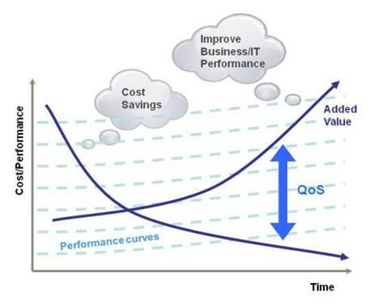
Why Cloud?
Conservative in investments.
Crawl before you walk.
Walk before you run.
Elasticity.
Both for Storage and Compute.

Slide 26
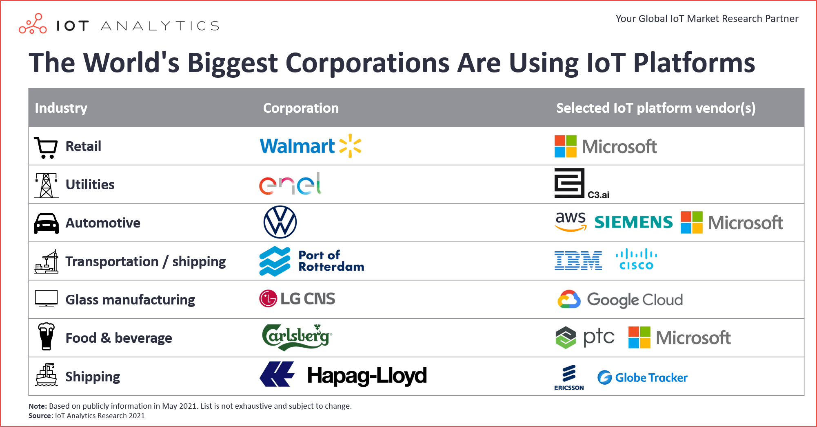
Big corporations using IOT platforms

Slide 27
Hybrid
Development – On premises.
Production and debugging environment – Cloud.
Data Storage alone in Data Lake.

Slide 28
Demo
Azure Databricks.

Slide 29
Challenges
Too much data with less business value than spending on finding that value.
Heterogenous data getting produced due to sensors used in a field of different companies.
Security breach in a sensor allows attacker to get save incorrect data / raise false alarm etc.
Misbehaving devices - Hardware failure like low battery / power down or software bug may produce incorrect or insufficient data some times.

Slide 30
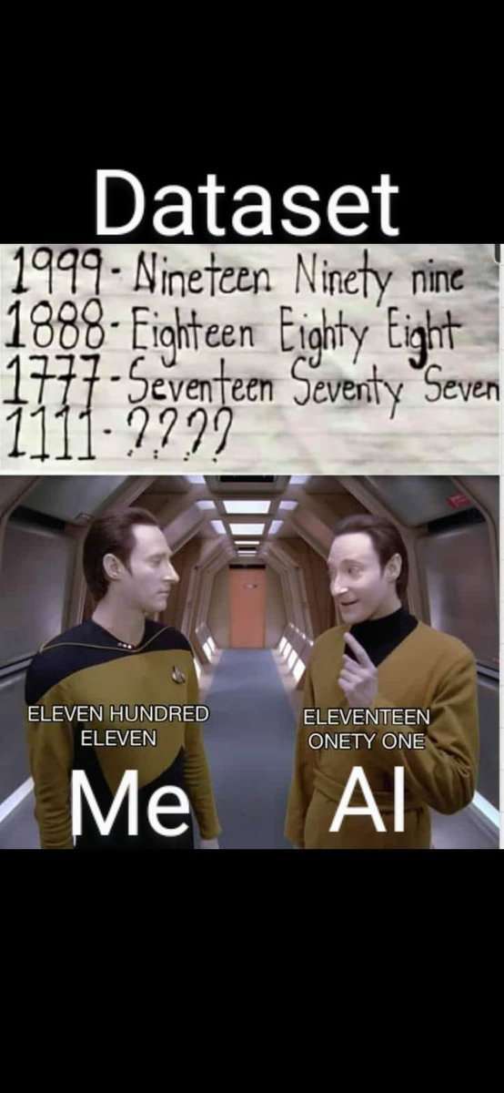
Just training alone enough? NO Correct data (Q & A) is important than more (big) data.

Slide 31
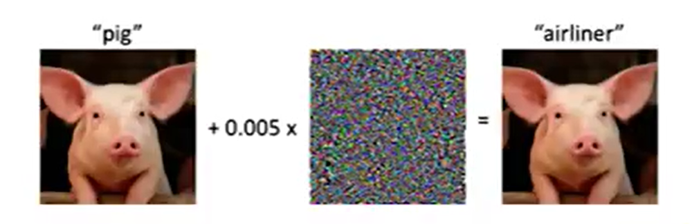
Tricking an ML model “Adversarial Attack”
Actual image and a broken image.
Looks same in human eye.
But a model will fail to recognize that both are same.

Slide 32
Other important factors in IoT analytics
Data gathering.
Data preparation.
Data Catalog.
Data Governance.
Understanding the problem
Sharing the insights.
Notes:
Data gathering -> Internal and External.
Preparation -> Cleansing the data.
Data Catalog -> Making the dataset discoverable -> from analyst to data scientist.
Data Governance -> Act according to the process and procedure of organization to manage, utilize and protect the data.
Understanding -> Problem statement, Domain knowledge, Think as a user.
Post Analyse -> Sharing the insights and Collaboration via effective communication(story telling) skills.

Slide 33


Thank you! Questions ??
https://www.linkedin.com/in/dinesh-kumar-prabakaran

