Slide 1
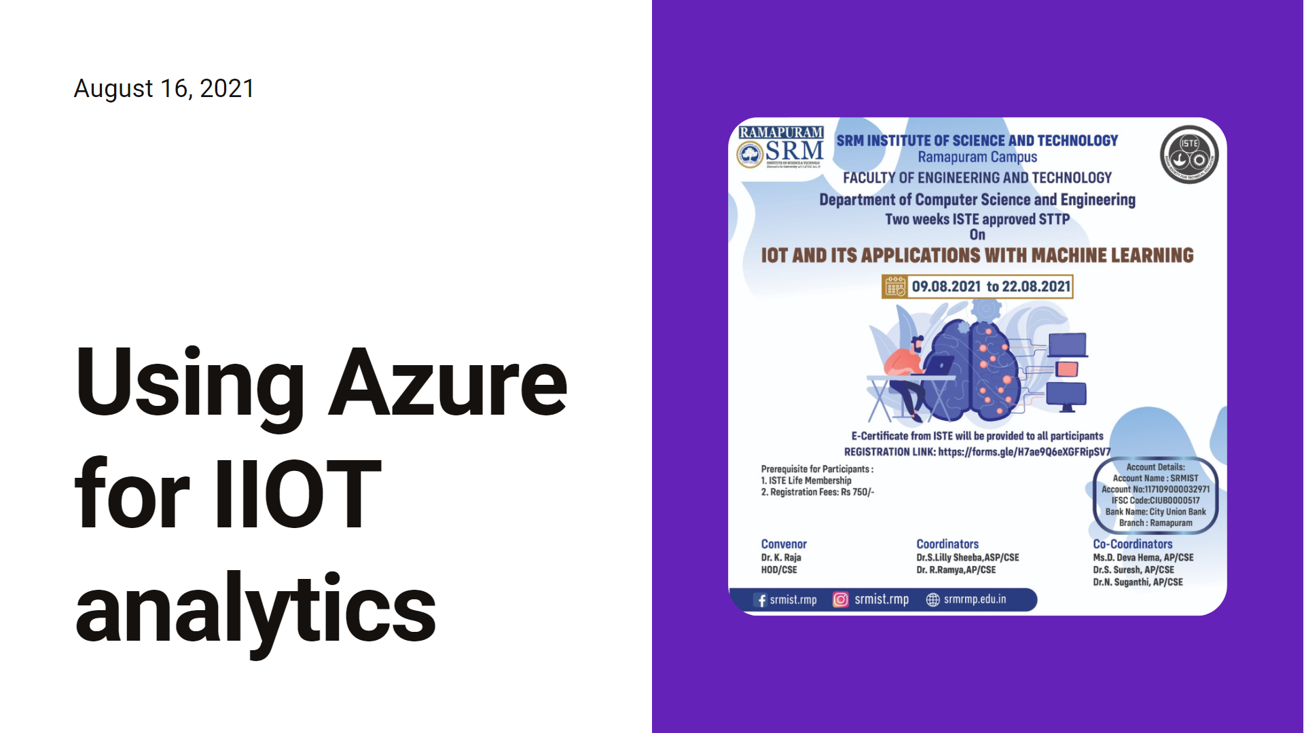

Slide 2
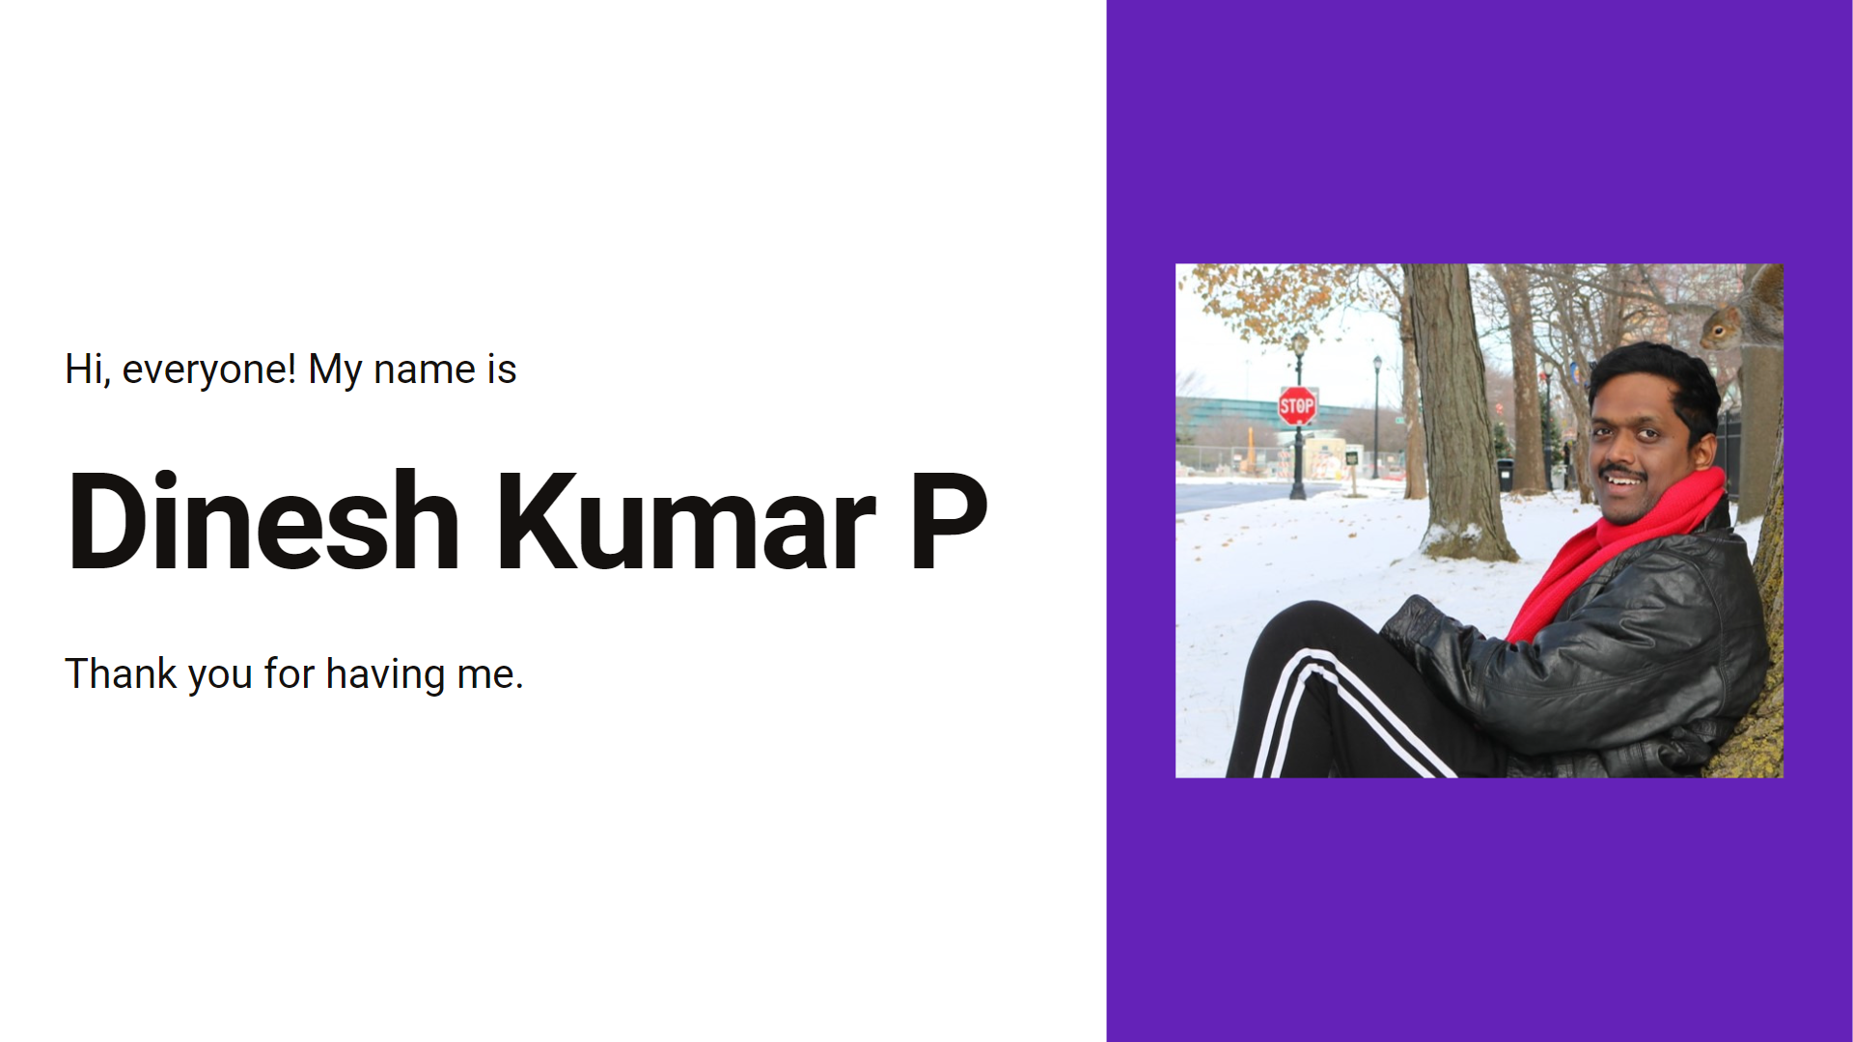

Slide 3
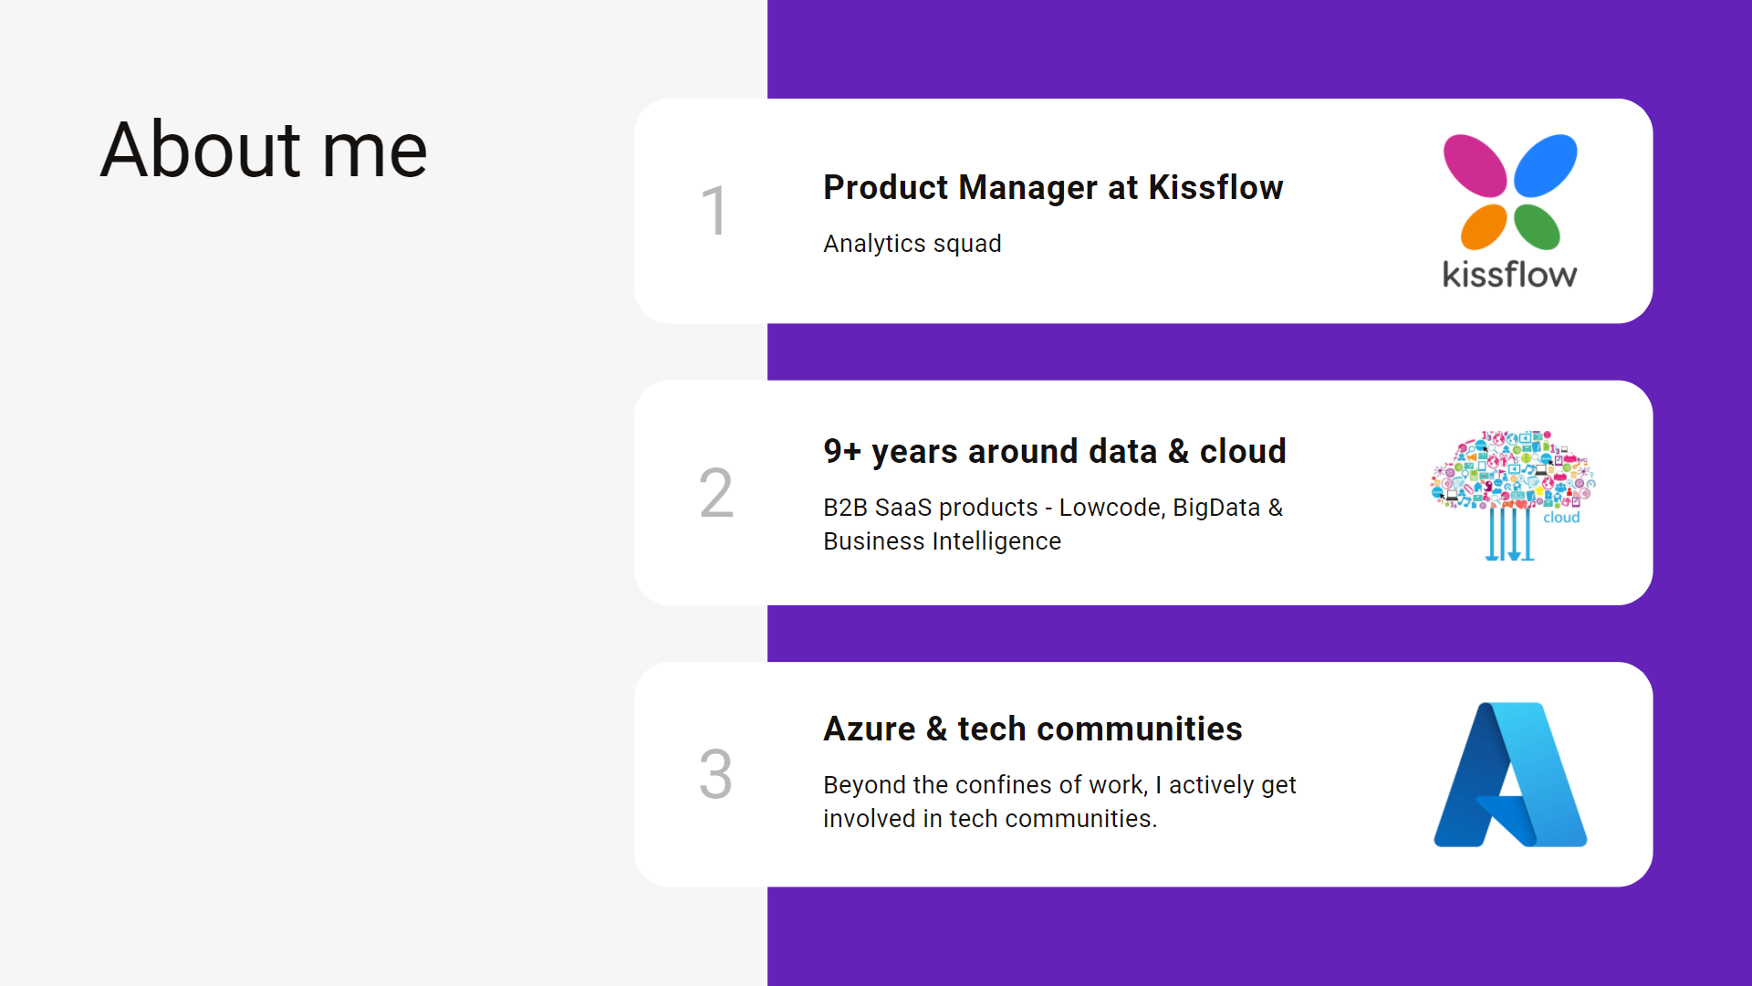

Slide 4
Agenda
IOT analytics
Purpose – Monitoring, Analytics
4 types of IOT analytics
Roles – Data Engineer, Data Analyst, Data Scientist
How, Where analytics can be done?
On-Prem architecture pattern
Cloud architecture pattern
Demo
Notes:
My talk would not be about types of algorithm types or machine learning models. More time is about how IOT analytics is happening in industry and what skillsets are expected for the roles. And let me take ENERGY industry as base for the examples and use cases that I walk through

Slide 5
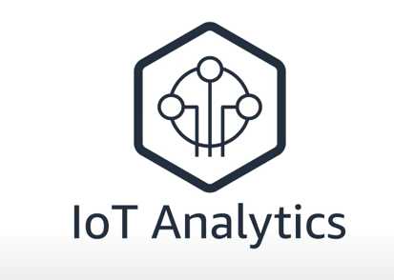
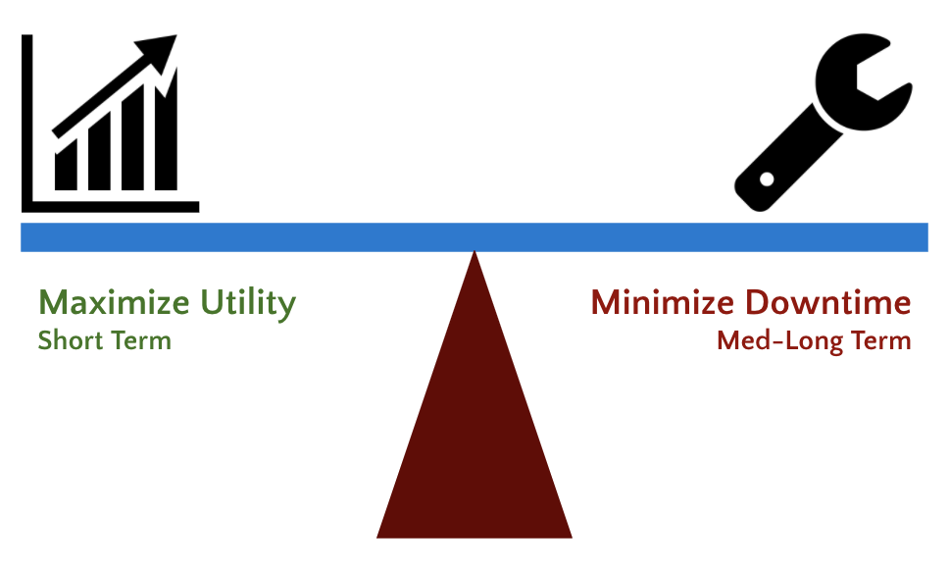
Operational insights
Data flow - Ingest, Store, Prep, Train, Serve, Visualize.
Useful for - Enterprise(users) and Device manufacturers.
Notes:
Tools we use to get things done, are generating lot more data than ever. But this data is often noisy, inconsistent and highly variable. This makes it hard or even impossible for businesses to gain value from it. This is where IOT analytics comes in.

Slide 6

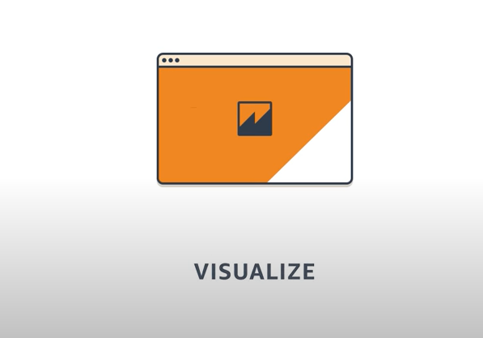
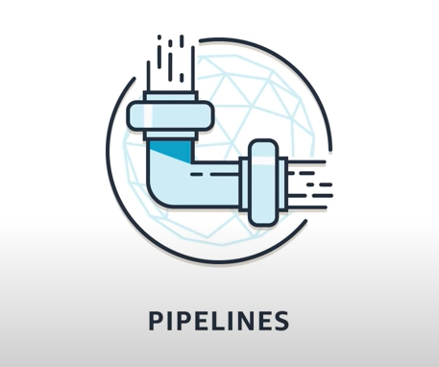
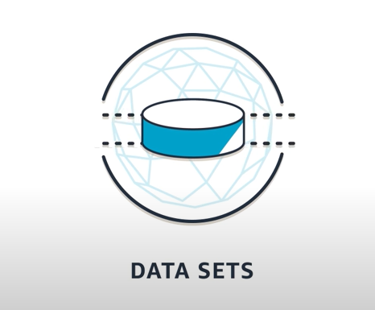
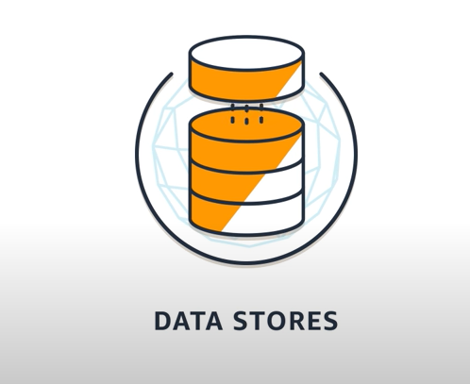
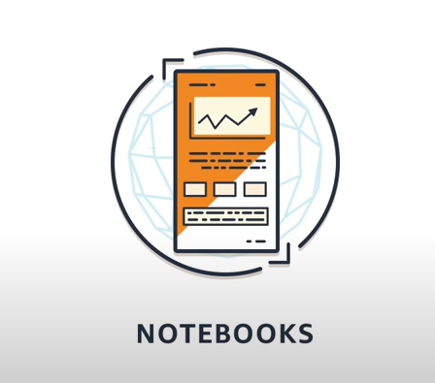
3 basic areas before analyse
Snapshots from here - https://www.youtube.com/watch?v=cYD0OU8Jdws

Slide 7
Purpose
Monitoring
Analytics

Slide 8
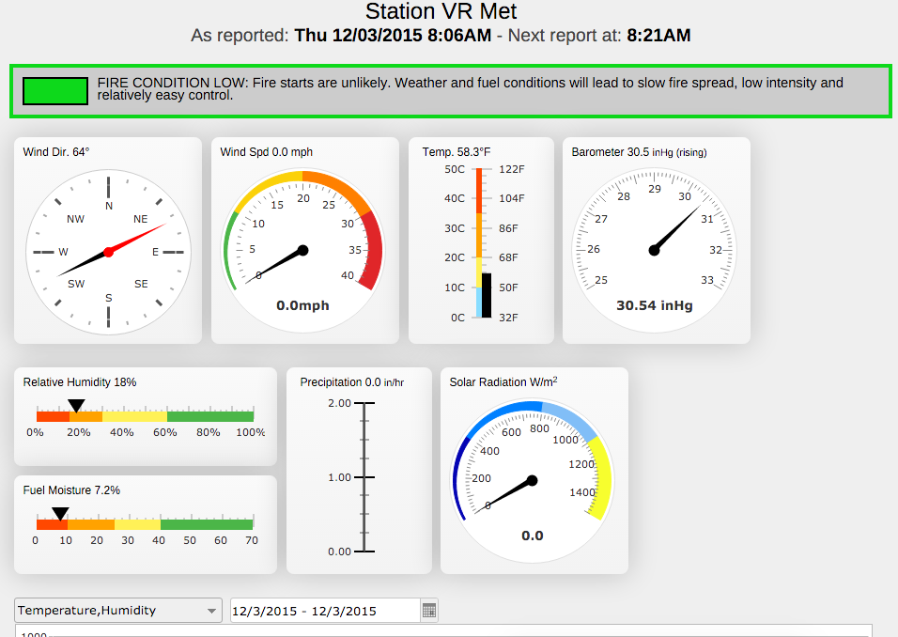
Health Monitoring dashboards
Consume from IOT devices.
Store in a database / data lake.
Visualize it in dashboard.
Alerts in case of any spikes / anomalies.

Slide 9
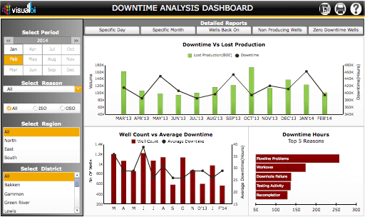
Analytics
Analyse collected data.
Allow to find answers for business questions.

Slide 10
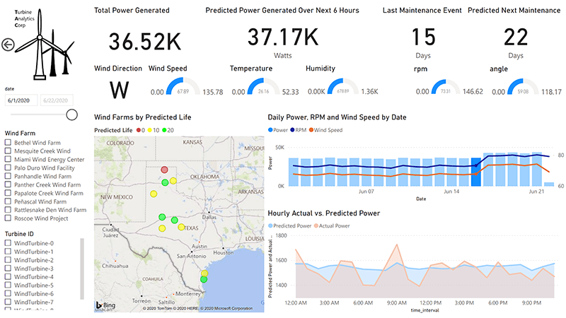
Monitoring and Analytics

Slide 11
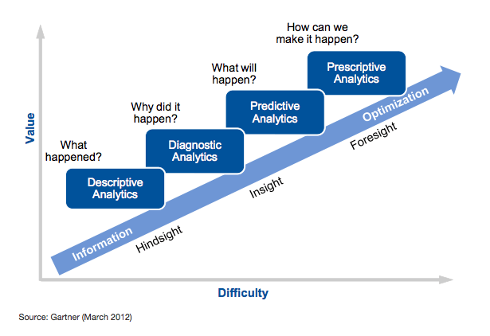
TYPES of analytics Energy (Turbine Power)
Descriptive – What quantity of power generated in last month?
Diagnostic – Why 10% decrease in power generation compared to last month?
Predictive – What is the quantity of power that would get generated in next month?
Prescriptive – How to avoid decrease in power generation in upcoming months by minimizing downtime and undergo maintenance on-time?

Slide 12

ROLES in IOT Analytics (Who builds it)
Data analyst / Data scientist
Data engineer
Notes:
The people who holds these roles are the core users and who powers up the IOT analytics.

Slide 13
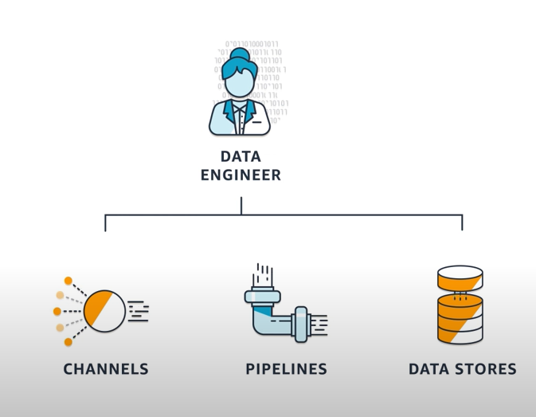
Data Engineer
Collects data from devices.
Make sure it is properly prepared and stored for analysis.
Notes:
Data Engineer holds a major important role, demanding job position but not getting prepared before he joins a company. Mostly folks train themselves for Data Analyst and Data Scientist.

Slide 14
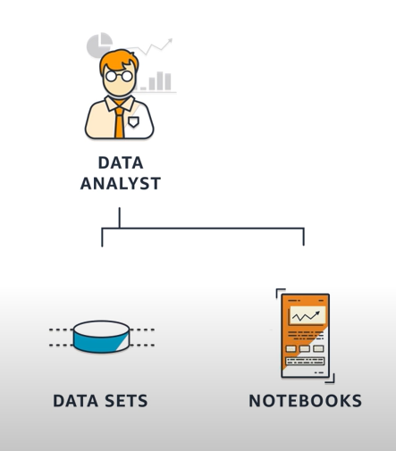
Data Analyst / Data Scientists
Produces and communicates operational insights by exploring and visualizing the data.
Notes:
Descriptive and Diagnostic Analytics – Mostly by Data Analysts.
Predictive and Prescriptive Analytics – Mostly by Data Scientists.

Slide 15
How analytics can be done? ENVIRONMENT
On-premises
Cloud
Hybrid

Slide 16
On premises
CSV
Talend
Apache Spark – single node
Power BI / Python Jupyter Notebooks
Notes:
Data collected through MQTT or Kafka and saved as CSV.
Clean code via code or any ETL tool like Talend & stored into any database or data warehouse.
Analyse in Python or tools like Power BI or Excel.
Analyse via Spark for ML and model built.

Slide 17
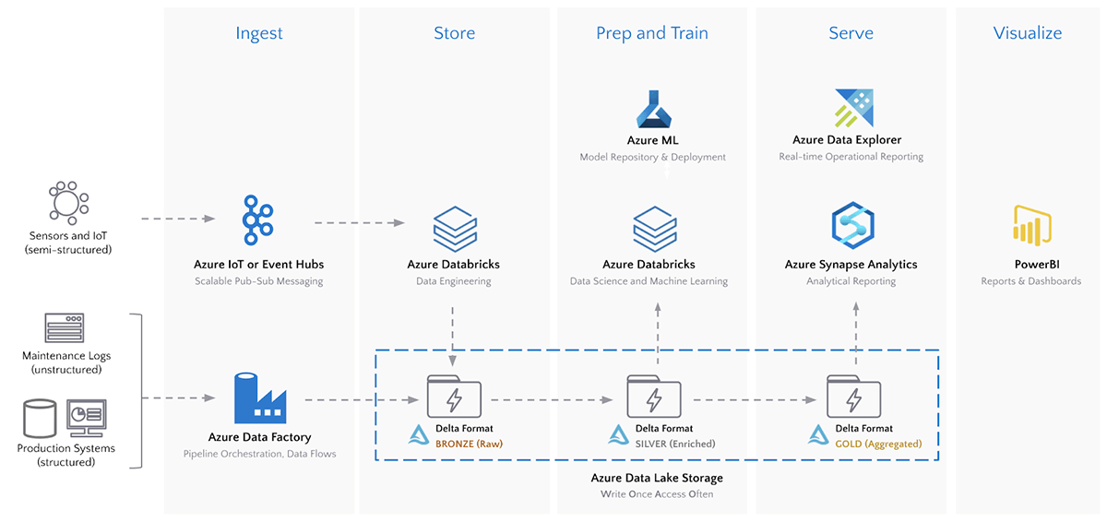
Cloud architecture
Notes:
Providers like Azure.
Ingest - Azure IOT / Event Hub / Kafka / Azure Data Factory
Store – Data lake.
Prep or stream processing – Azure Databricks / Stream Analytics.
Serve – Synapse Analytics
Visualize – Power BI

Slide 18
Why Cloud?
Conservative in investments.
Crawl before you walk.
Walk before you run.
Elasticity.
Both for Storage and Compute.

Slide 19
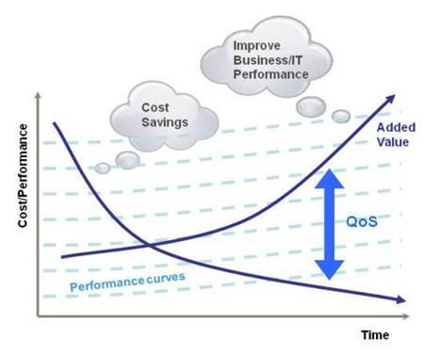
Why Cloud?

Slide 20
Hybrid
Development – On premises
Production and debugging environment – Cloud
Data Storage alone in Data Lake.

Slide 21
Demo
On Premises – Spark Standalone cluster.
Cloud – Azure Databricks multi-node cluster.

Slide 22
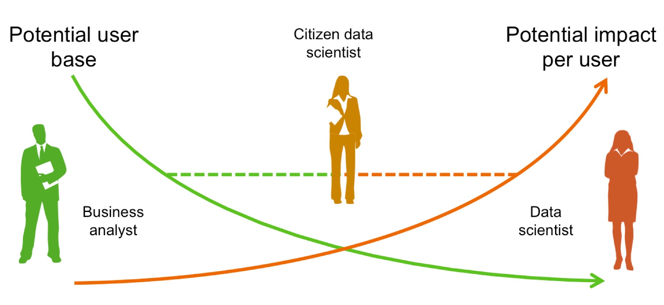
Democratization in Data Gaps are getting reduced
Notes:
Problem owners can drive the solution better and faster. The gaps will be reduced.

Slide 23
No-Code / Low-Code
Problems better solvable by industry / business people like citizen data scientist.
DIY – Do It Yourself mindset.
Adobe Photoshop vs Canva.
Notes:
I hope you know tools like Canva. Such Tools are not so famous 10 years back. Late then, if any image editing work is needed, it was Photoshop and someone who learnt it very well is needed. But now, no code tool like Canva has made it possible to create a banner so easily. That's the case of ML.Net model builder as well. Currently the adoption to production environment is mostly on enterprise level. But in a while Machine Learning will become essential for any application.

Slide 24
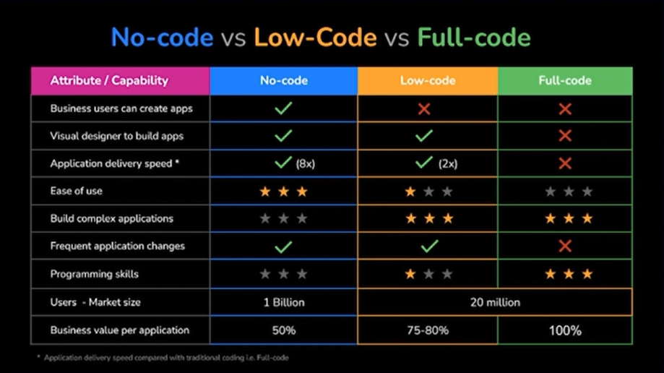
No-Code and Low-Code era

Slide 25
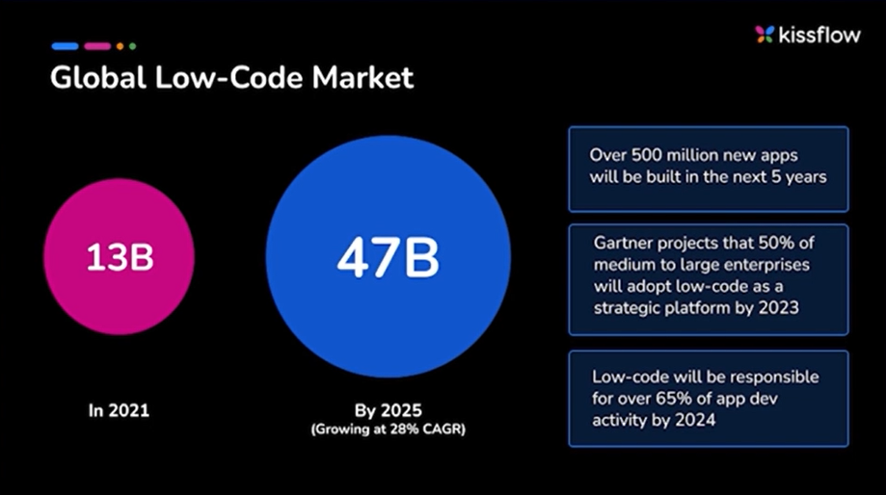
No-Code and Low-Code era
Notes:
- Attain growth faster with small, lean & remote workforce.
- Fail fast.
- By the year 2024 65% of app development and 66% of companies would use 4 low-code tools & platforms.

Slide 26
Demo
Full Code – Spark scala code
Low Code – ML.Net
No Code – Azure Cognitive Services

Slide 27
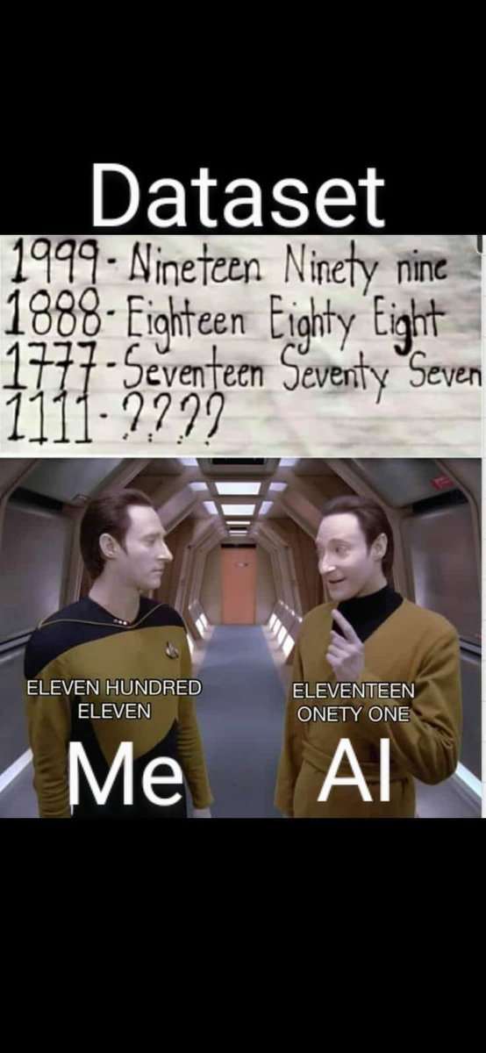
Just training alone enough? NO Correct Data is important than more(big) data.

Slide 28
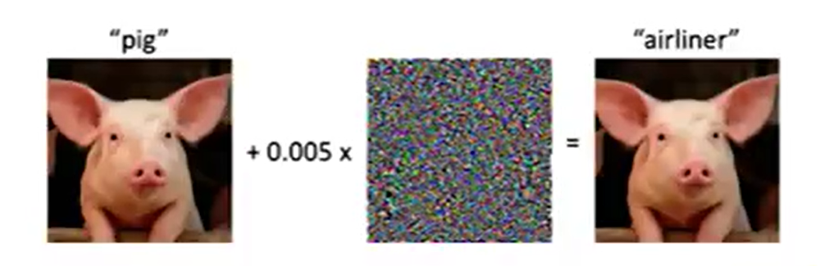
Tricking an ML model “Adversarial Attack”
Actual image and a broken image.
Looks same in human eye.
But a model will fail to recognize that both are same.

Slide 29
Other important factors
Data gathering -> Internal and External.
Preparation -> Cleansing the data.
Data Catalog -> Making the dataset discoverable -> from analyst to data scientist.
Data Governance -> Act according to the process and procedure of organization to manage, utilize and protect the data.
Understanding -> Problem statement and Domain .
Post Analyse -> Sharing the insights and Collaboration via effective communication(story telling) skills.

Slide 30


Thank you! Questions ??
https://www.linkedin.com/in/dinesh-kumar-prabakaran

