Slide 1
Introduction to DBMS
Introduction to Database Management System, Objective of Database Management System, Importance of DBMS, Merit and Demerit of DBMS, Application of DBMS

Slide 2
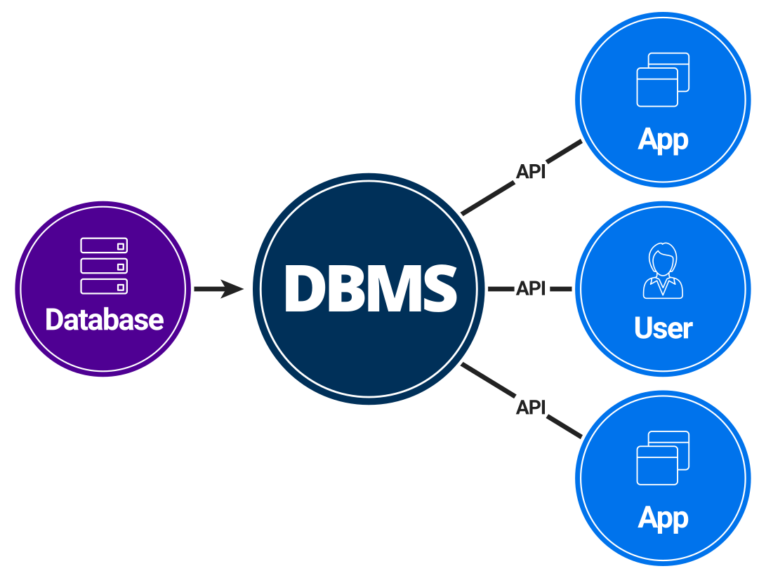
Database Management System

Slide 3
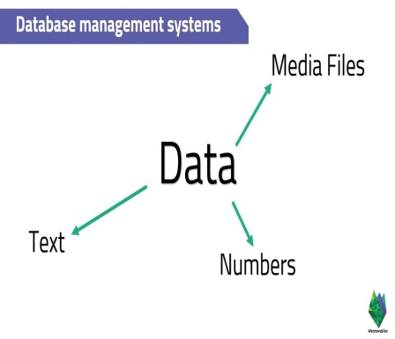
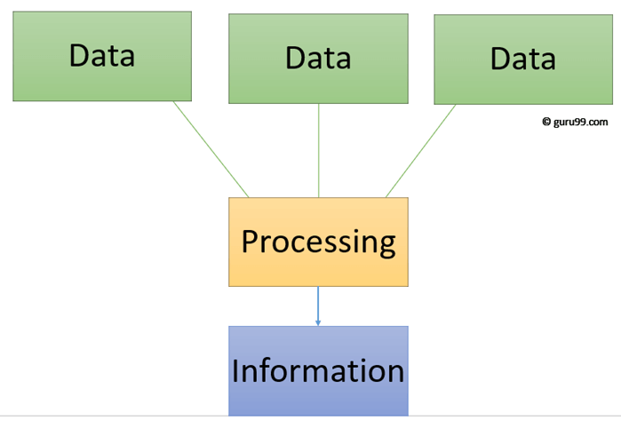
Data , Information, Database
Data is defined as facts or figures
Example : student ,Ram, BCA, fourth,
semester
Information is a processed, organized data which gives logical meaning
Ram is a student of BCA fourth semester.

Slide 4
Database
A database is a collection of related data that is organized and structured in a way that allows for efficient storage, retrieval, and management of that data. A database can be thought of as an electronic filing system, where data is stored and organized in a way that makes it easy to access and analyze.
Databases can range in size from small, personal databases to large enterprise databases that store millions or even billions of records. Some common types of databases include relational databases, NoSQL databases, object-oriented databases, and hierarchical databases.
Examples of databases could be: Database for Educational Institute or a Bank, Library, Ticket Reservation system etc.

Slide 5
Database Management System (DBMS)
A database management system (DBMS) is a software system that enables users to create, store, retrieve, update, and manage data in a database. A database is a collection of related data that is organized in a structured way so that it can be easily accessed, managed, and updated.
A DBMS provides an interface for users to interact with the database and perform various operations, such as creating tables, inserting data, querying data, updating data, and deleting data. The DBMS also provides various tools for managing the database, such as backup and recovery, security management, and performance tuning.
Some common types of DBMS include relational database management systems (RDBMS), NoSQL databases, object-oriented databases, and hierarchical databases. Each type of DBMS has its own set of features and capabilities, and is suited to different types of data and applications.
Overall, a DBMS is an essential tool for managing large amounts of data efficiently and effectively. It enables businesses and organizations to store, manage, and retrieve data in a structured way, and provides various tools for ensuring data integrity, security, and scalability.

Slide 6
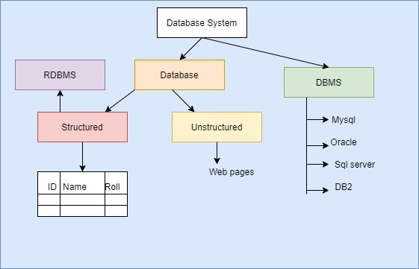

Slide 7
Objective of DBMS
The main purpose of database systems is to manage the data. some objectives of DBMS are given below
Provide for mass storage of relevant data
Making easy access to data for the authorized user.
Providing prompt response to users’ requests for data.
Eliminate redundantly (Duplicate) d data.
Allow multiple users to be active at one time.
Allow the growth of the database system
Provide data integrity.
Protect the data from physical harm and unauthorized access.
Serving different types of users. the
Provide security with a user access privilege.
Combining interrelated data to generate a report
Provide multiple views for the same data.

Slide 8
Importance of DBMS
Database management systems (DBMS) are important tools for businesses and organizations that need to store, manage, and retrieve large amounts of data. Here are some of the key reasons why DBMS are important:
Data organization: A DBMS helps to organize data in a structured manner, making it easier to access and manipulate. This can improve the efficiency of data retrieval and reduce errors that may arise from manual data handling.
Data security: DBMS can provide robust security features to protect data from unauthorized access, ensuring that sensitive data is kept confidential and secure.
Data integrity: DBMS can enforce data integrity rules to ensure that the data stored in the database is accurate and consistent. This can help to prevent errors and inconsistencies that can arise from human error or system failures.

Slide 9
Importance of DBMS
Scalability: DBMS can handle large volumes of data and can be scaled up or down as needed. This makes it possible for businesses to handle increasing amounts of data without having to worry about infrastructure constraints.
Data backup and recovery: DBMS can provide tools for backing up and recovering data in case of system failures or disasters. This can help businesses to recover their data quickly and minimize the impact of downtime.

Slide 10
Why Use a DBMS?
Data independence and efficient access.
Reduced application development time.
Data integrity and security.
Uniform data administration.
Concurrent access, recovery from crashes.

Slide 11
Merit of DBMS
There are several advantages of Database management system. Few of them are as follows:
No redundant data: Redundancy removed by data normalization. No data duplication saves storage and improves access time.
Data Consistency and Integrity: As we discussed earlier the root cause of data inconsistency is data redundancy, since data normalization takes care of the data redundancy, data inconsistency also been taken care of as part of it
Data Security: It is easier to apply access constraints in database systems so that only authorized user is able to access the data. Each user has a different set of access thus data is secured from the issues such as identity theft, data leaks and misuse of data.

Slide 12
Merit of DBMS
Privacy: Limited access means privacy of data.
Easy access to data – Database systems manages data in such a way so that the data is easily accessible with fast response times.
Easy recovery: Since database systems keeps the backup of data, it is easier to do a full recovery of data in case of a failure.
Flexible: Database systems are more flexible than file processing systems.

Slide 13
Demerit of DBMS
DBMS implementation cost is high compared to the file system
Complexity: Database systems are complex to understand
Performance: Database systems are generic, making them suitable for various applications. However this feature affect their performance for some applications

Slide 14
Applications of DBMS
Banking: all transactions
Airlines: reservations, schedules
Universities: registration, grades
Sales: customers, products, purchases
Manufacturing: production, inventory, orders, supply chain
Human resources: employee records, salaries, tax deductions
Business operations: data can be analyzed to gain insights and make informed business decisions.
E-commerce
Healthcare
Education
Government
Databases touch all aspects of our lives

Slide 15
Thank You

