Slide 1
Experience as a Web Developer Intern at Digital Dai
By: Sujal Gurung
Himalaya College of Engineering,
TU Registration Number: 6-2-378-82-2020

Slide 2
Introduction
Web Developer Intern for 3 months (Dec 2024 – Mar 2025)
Worked on multiple website projects, mainly using WordPress & Elementor
Got hands-on experience working in a team, deploying real projects

Slide 3
Objectives
Gain practical experience in building, managing websites using WordPress at professional level
Develop skills in modern web development with frameworks like Astro and Next.js
Improve understanding of web performance, scalability, & best practices

Slide 4

About the Company
Digital Dai is a digital agency established in 2024,
Providing services for:
UI / UX Design
Graphic Design,
Web Development & Maintenance,
Digital Marketing
Focused on Nepali businesses lacking dedicated digital teams

Slide 5
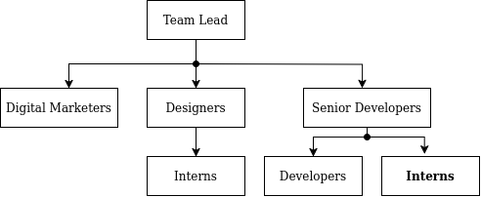
Company Structure
Mostly a small, lean team of skilled workers & few managers

Slide 6
Background Study
Low-Code Development Tools:
Allow building software primarily using GUI instead of traditional coding
Examples: WebFlow, Shopify, Wix
WordPress:
Versatile Content Management System (CMS)
Can be used for a variety of web applications: blogs, business websites, e-commerce platforms

Slide 7
Background Study
Elementor:
Low-code page builder plugin for WordPress

Slide 8
Responsibilities
Developing responsive websites using WordPress, Elementor
Collaborate with designers, developers
Configure WordPress settings, plugins to meet requirements
Perform website maintenance tasks, debug issues, and optimize website

Slide 9
Projects Involved
Worked on multiple website, web-app projects, including:
Sasto Nordic’s e-commerce store
Tarkeshwar Dental’s website
GLOHMED website maintenance & newsletter
Foreign language exam app

Slide 10
Sasto Nordic
Startup that sold Nepali products in Nordic countries (Denmark, Norway, Sweden)
Project: E-commerce site & Branding materials
Assisted with data entry, testing edge cases, and editing templates
To familiarize myself with WordPress, Elementor, WooCommerce, & the company's WordPress workflow

Slide 11
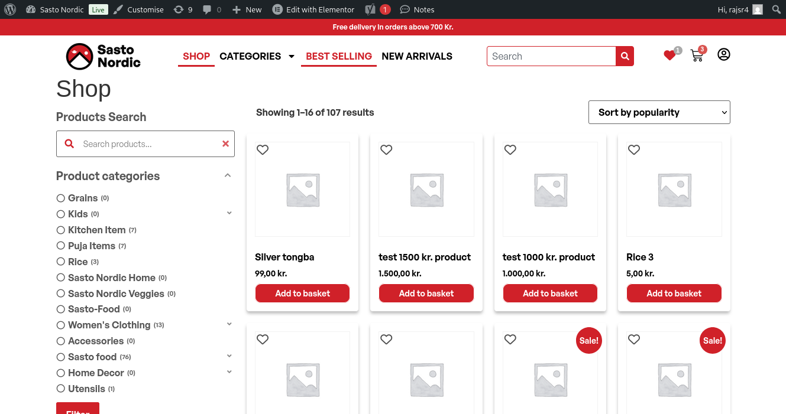
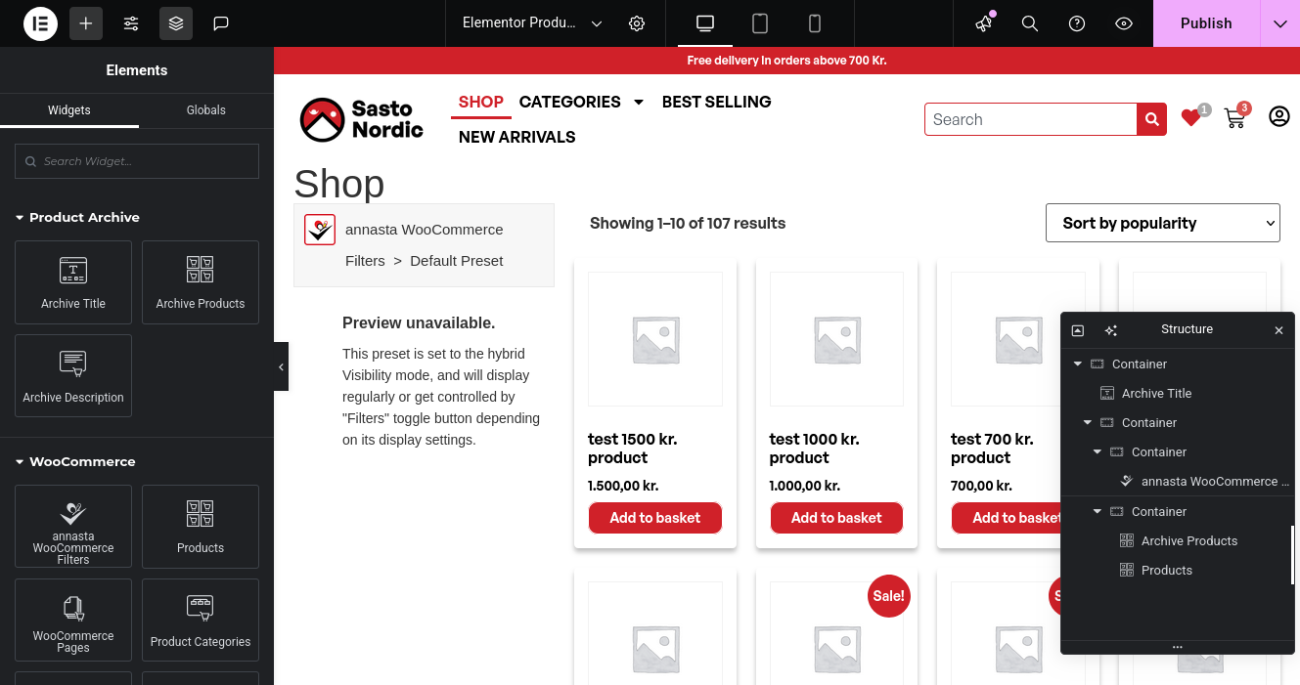
Sasto Nordic

Slide 12
Tarkeshwar Dental
Project: Informational website for a dental clinic & their services
Joined client meetings to understand project goals
Built majority of site, learning advanced WordPress features
Learned local development setup, deployment and team workflows

Slide 13
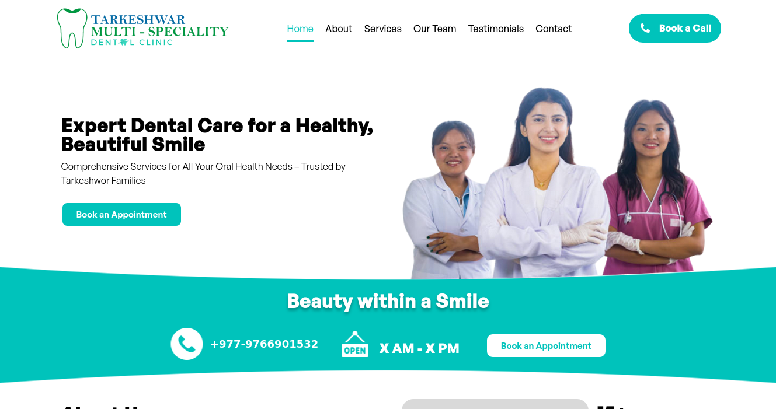
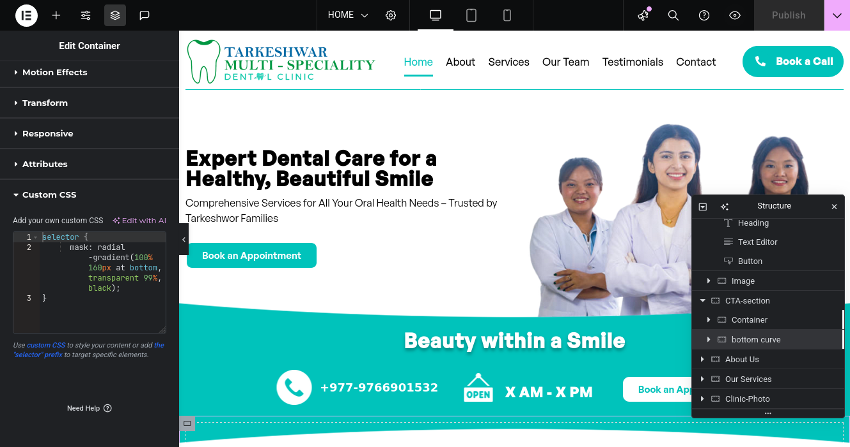
Tarkeshwar Dental

Slide 14
GLOHMED
Medical research organization in Nepal & long-term client
Handled website redesign, update requests
Optimized site by replacing heavy 3rd-party plugins
Perform maintenance, backups, verifying update safety
Designed easy-to-edit HTML email newsletter templates

Slide 15
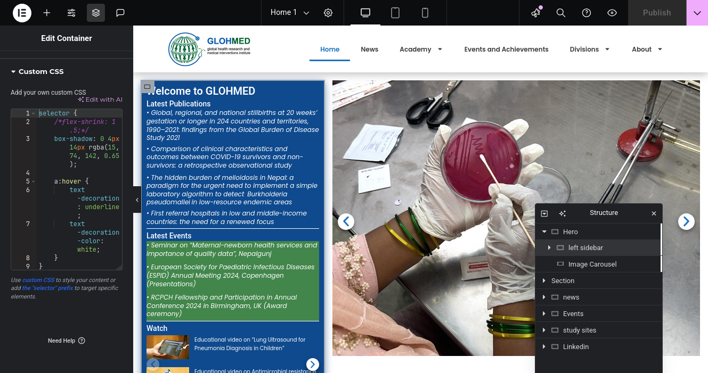
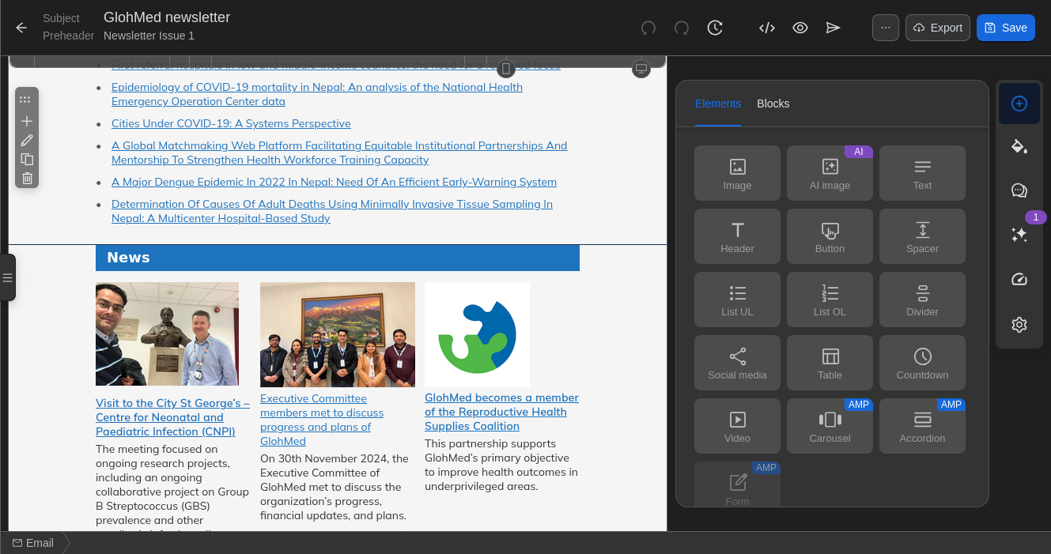
GLOHMED

Slide 16
Foreign language test web-app
Was taught to make MVPs quickly with NextJS, SQLite
Tasked to work on a unique project idea
Built foreign language exam web app prototype
Aimed at non-technical examiners for easy test editing
Created demo with Korean EPS test questions

Slide 17
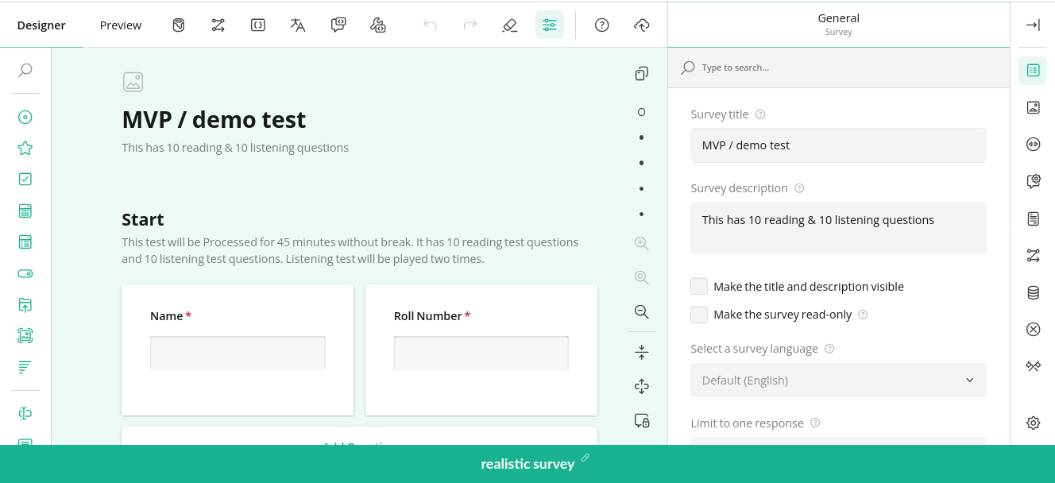
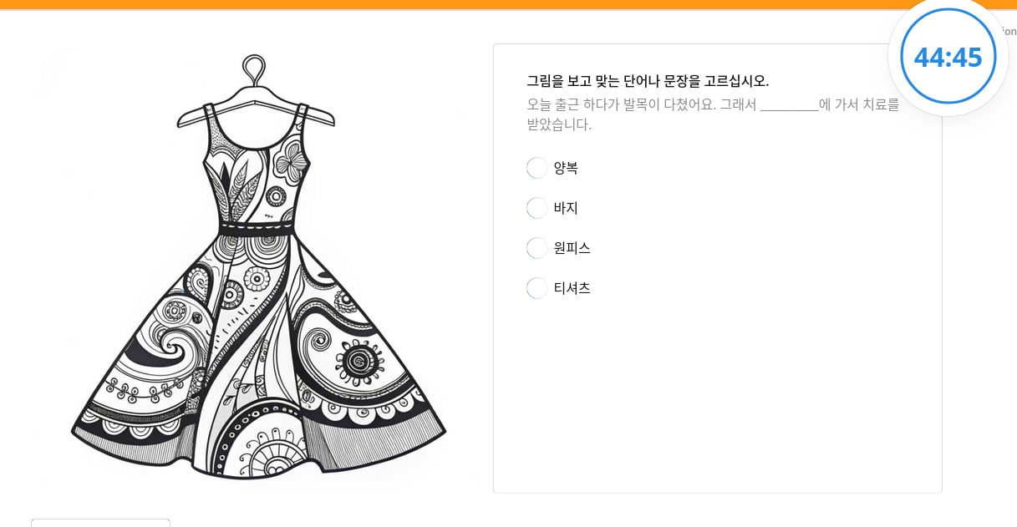
Foreign language test web-app

Slide 18
Lessons Learned
Trained in basics of professional tools (Figma, WordPress, git)
Advanced concepts in CSS, JavaScript, WordPress, web best practices
Explored Astro and Next.js for custom, complex apps

Slide 19
Conclusion
Involved in full lifecycle of real-world projects, primarily using WordPress & low-code tools
Strengthened core web development concepts
Limitation:
Focused mainly on front-end and low-code tools
Lack of technically complex projects
Overall beneficial experience

Slide 20
The End

