Slide 1
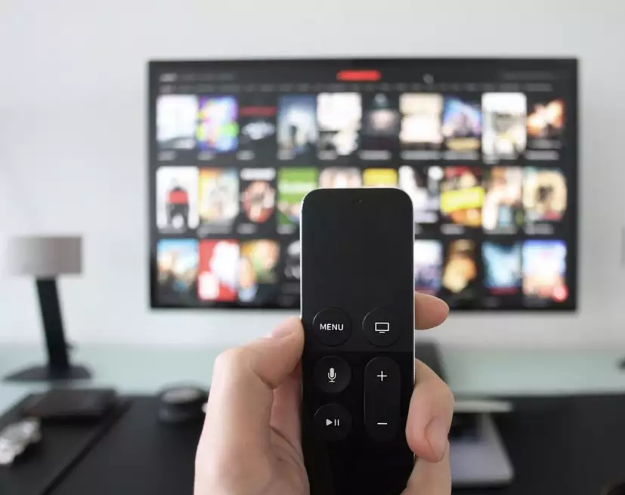
TeleviZen
A Digital Wellbeing Application for Smart Televisions
A Product Pitch from TheMinimalists

Slide 2
An Overview A look on current Scenario
Smart Televisions have been a part of our lives for more than 6 years as of now and consumption of digital content has also increased over the years.
Digital Addiction has been a major concern in every household all over the world, leading people to have messy sleep cycles, anxiety, social isolation, and aggression.
Increase in Screen time, have negative effects such as getting obese, long exposure to blue light emitted from various devices, children steering away from academics because of decrease in focus and concentration.

Slide 3
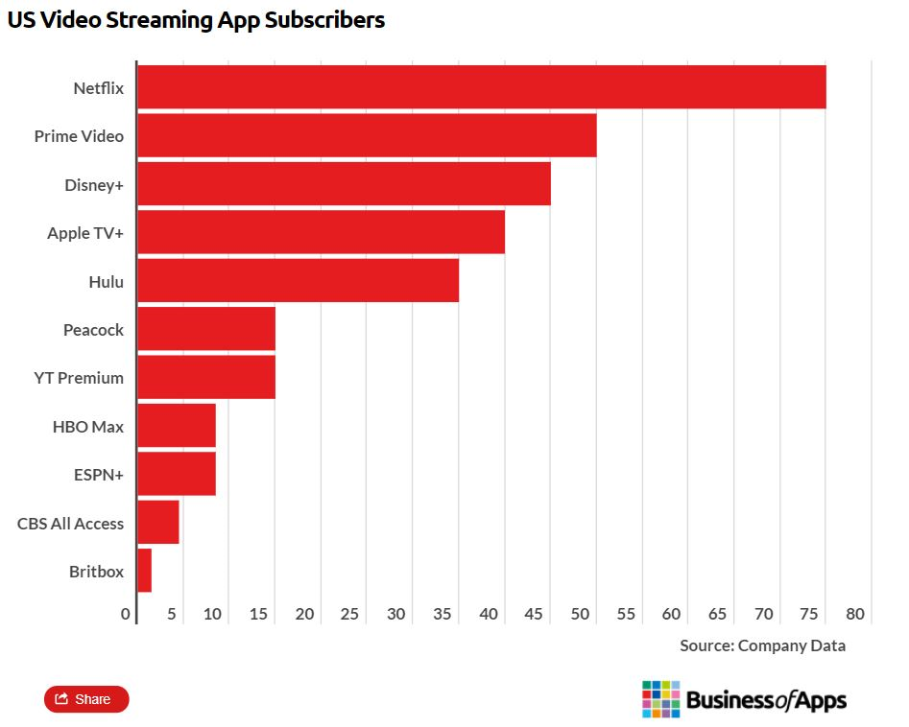
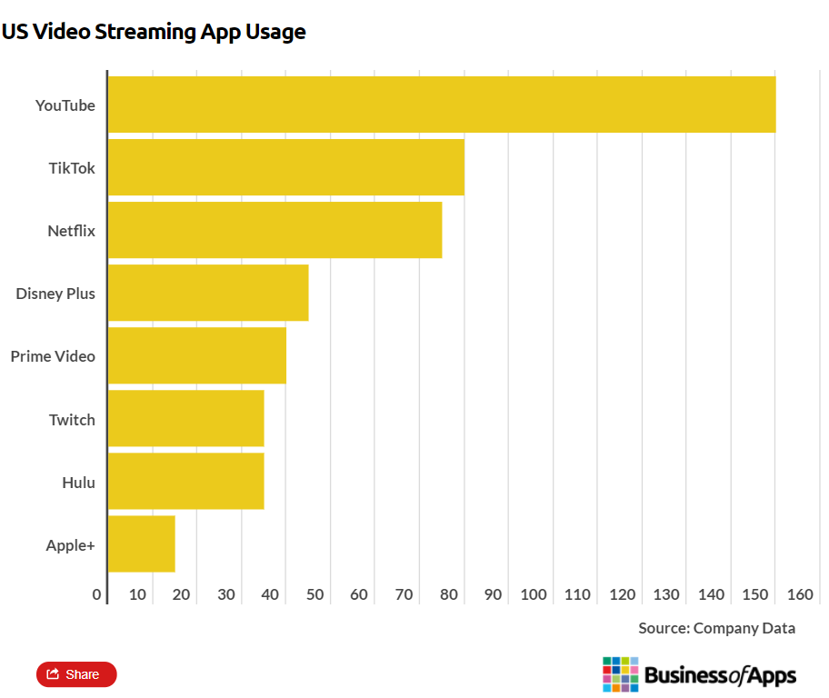
Statistics of streaming app users from US

Slide 4
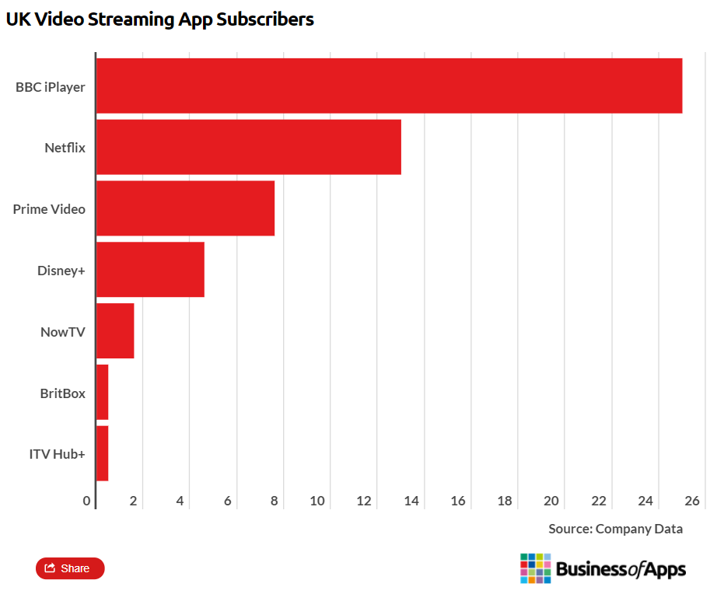
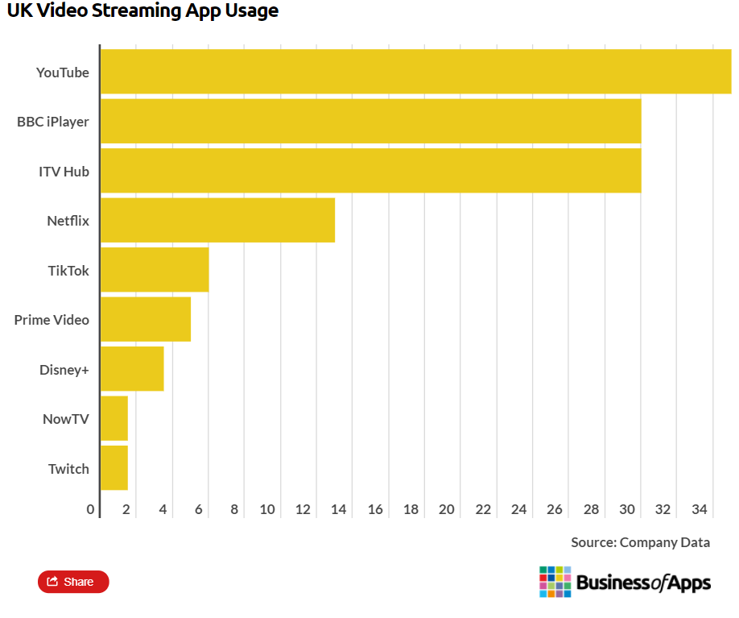
Statistics of streaming app users from UK

Slide 5
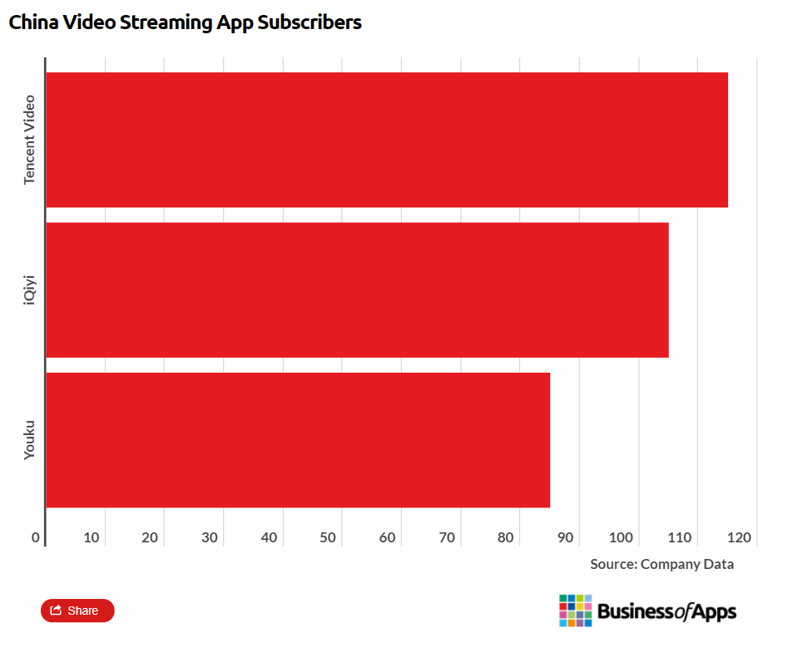
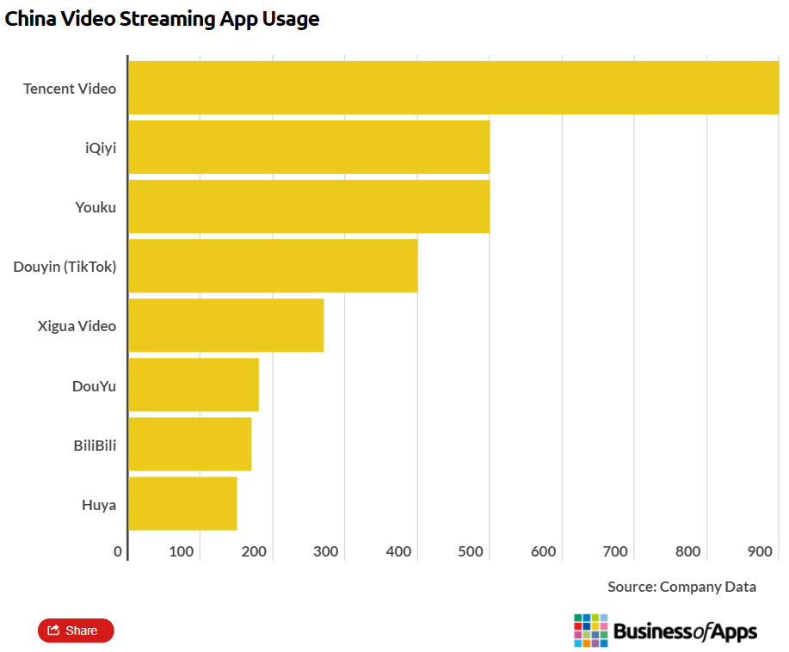
Statistics of streaming app users from China

Slide 6
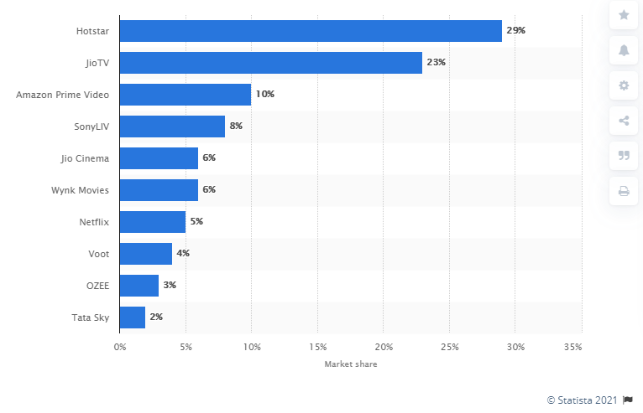
Market Share of streaming apps in India

Slide 7
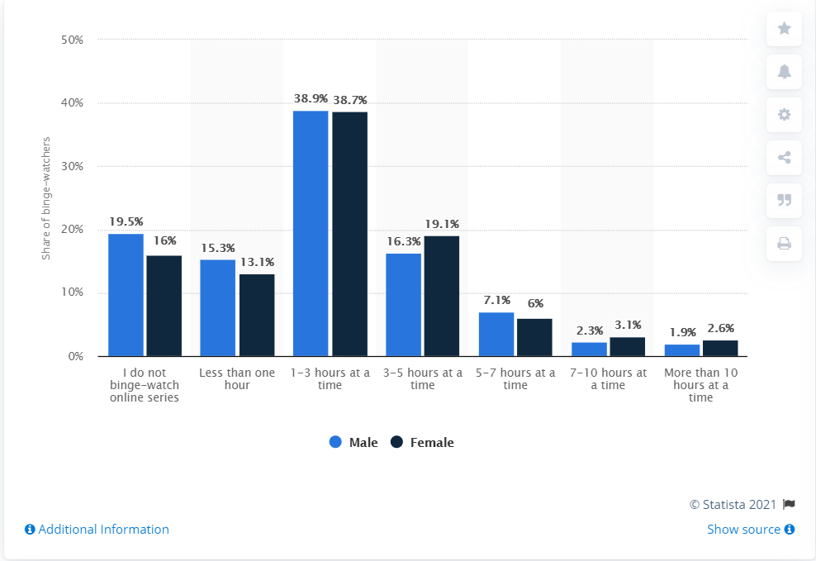
Time spent watching an online series in one sitting among binge-viewers worldwide as of August 2019, by gender

Slide 8
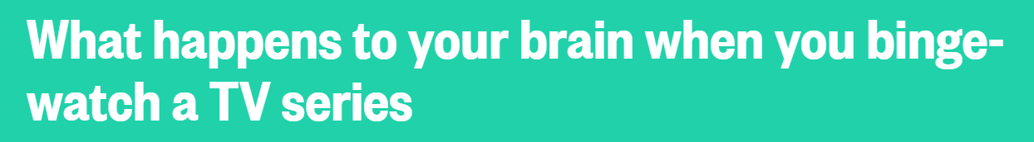
When engaged in an activity that's enjoyable such as binge watching, your brain produces dopamine. This chemical gives the body a natural, internal reward of pleasure that reinforces continued engagement in that activity. It is the brain's signal that communicates to the body, 'This feels good. You should keep doing this!' When binge watching your favorite show, your brain is continually producing dopamine, and your body experiences a drug-like high.
Mayer says that when we finish binge watching a series, we mourn the loss. "We often go into a state of depression because of the loss we are experiencing," he says. "We call this situational depression because it is stimulated by an identifiable, tangible event. Our brain stimulation is lowered (depressed) such as in other forms of depression."
"When we substitute TV for human relations we disconnect from our human nature and substitute for [the] virtual," says Dr. Judy Rosenberg, psychologist and founder of the Psychological Healing Center in Sherman Oaks, CA. "We are wired to connect, and when we disconnect from humans and over-connect to TV at the cost of human connection, eventually we will 'starve to death' emotionally. Real relationships and the work of life is more difficult, but at the end of the day more enriching, growth producing and connecting."

Slide 9
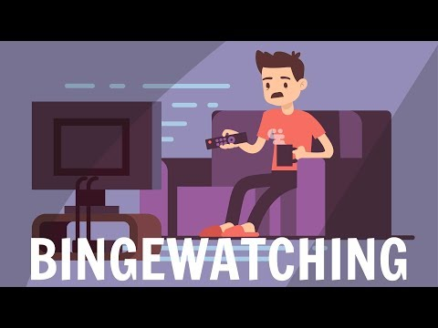

Slide 10
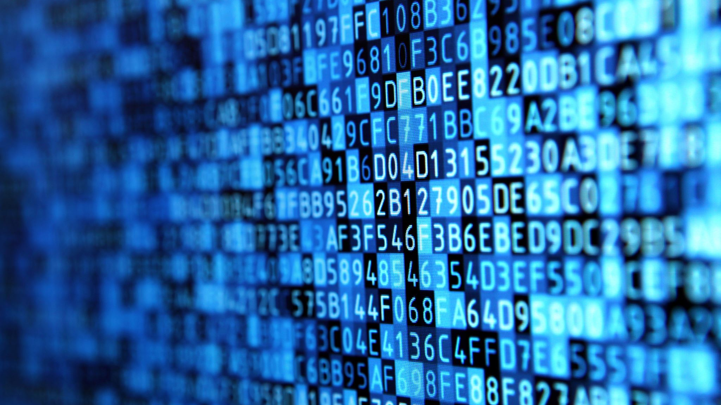
Features and Need for Digital Wellbeing App

Slide 11
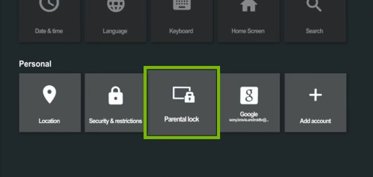
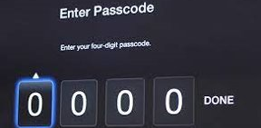
App for Television
Separate profiles for User based Restrictions
Unique 5-digit pin for profile access.
Records screen time of apps and channel watch time.
Limits screen time of apps using app lock
Gives statistical data of Tv apps usage and channel watch time
Blocks After hour tv usage.
Implements parental controls for Television Channels and Apps.

Slide 12
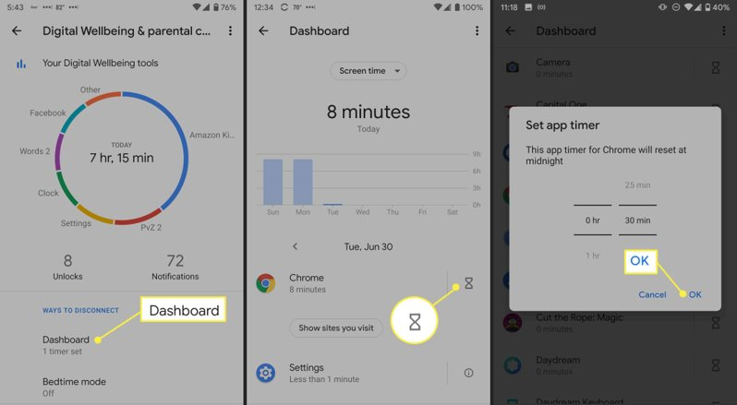
Companion App
Remote access to TV app for changing restrictions for profiles
Can remotely add or remove guest profile
Shows statistical data of tv apps usage and channel watch time in phone
Add temporary screen time for chosen app remotely

Slide 13
References
https://www.nbcnews.com/better/health/what-happens-your-brain-when-you-binge-watch-tv-series-ncna816991#anchor-ThisIsYourBrainOnBingeWatching
https://www.businessofapps.com/data/video-streaming-app-market/
https://www.statista.com/statistics/1081349/binge-watching-tv-by-gender-worldwide/
https://www.statista.com/statistics/1154174/india-video-streaming-market-share-by-app/

