Slide 1

Movie Success Prediction Social Network Analysis | Regression
Project - 2
Dinesh Kumar Padmanabhan

Slide 2
Screenplay
Domain
SMART Questions
Problem Statement
Dataset
Data Wrangling
Story Telling (Analysis)
Modelling
The End (Conclusion)

Slide 3

DOMAIN
Film Industry
Largest markets by box office revenue ?
United States (2018)

Slide 4
SMART QUESTIONS
1: Popularity Over Years
2: What kinds of properties are associated with movies that have high popularity?
3: Number of movies released year by year
4: Presence of “rich insights” in social networks

Slide 5
Existing Models Internet Movie DB (IMDB.COM) BoxOfficeMojo.COM
Problem Definition
The Hypothesis:
“A Movie Well Talked About is Well Watched”
Pre-release buzz- a success factor

Slide 6
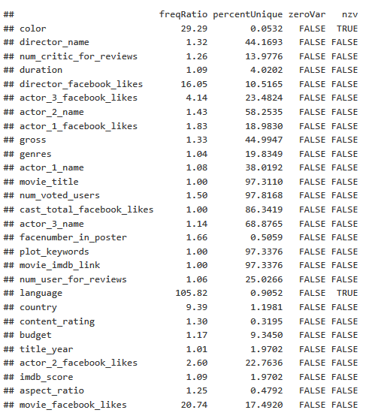
THE DATASET

Slide 7
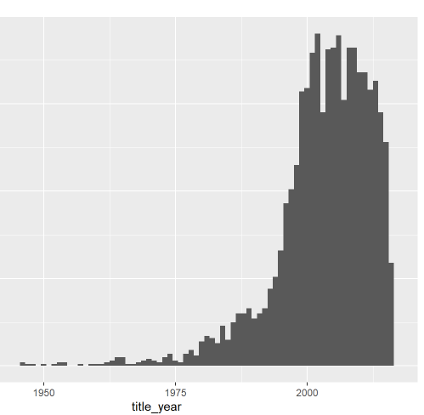
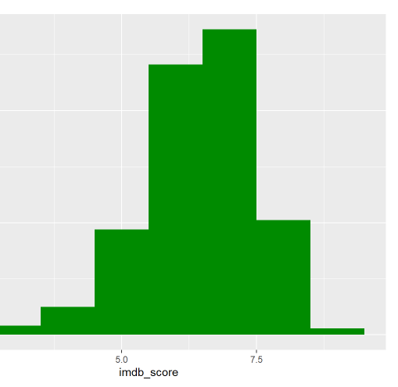
HISTOGRAMS

Slide 8
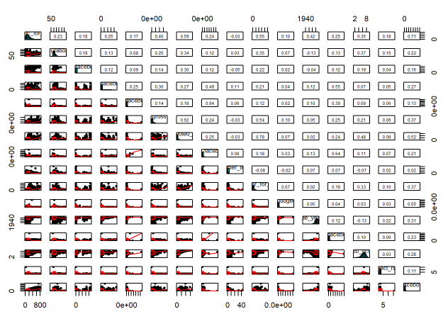
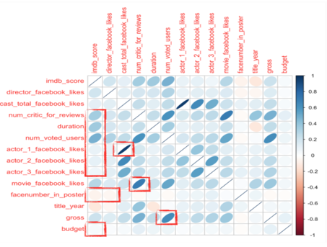
CORRELATION ANALYSIS

Slide 9
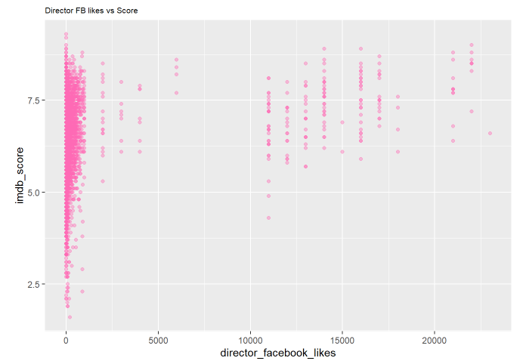
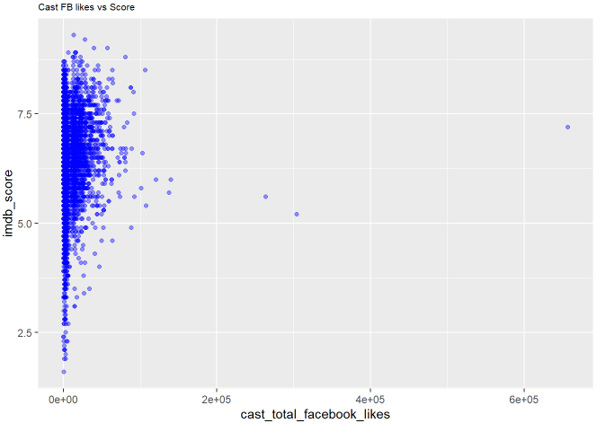
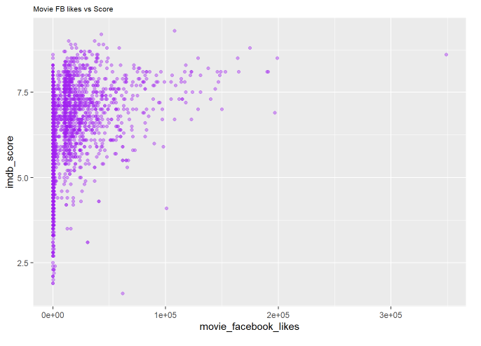
SCATTER PLOTS

Slide 10
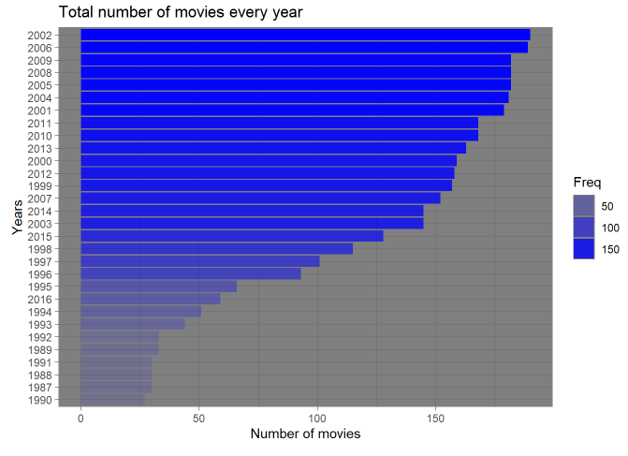
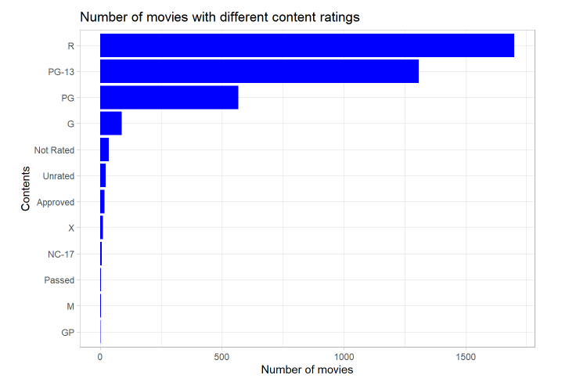
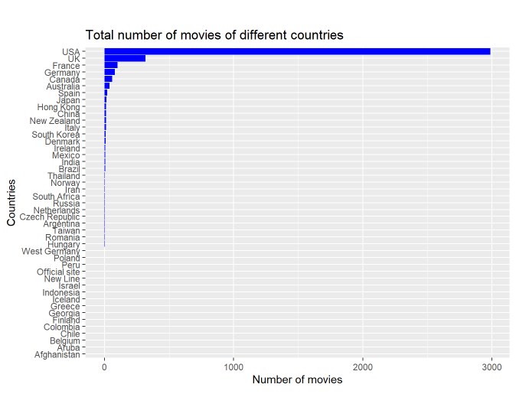
MOVIES DISTRIBUTION

Slide 11
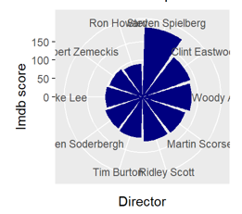
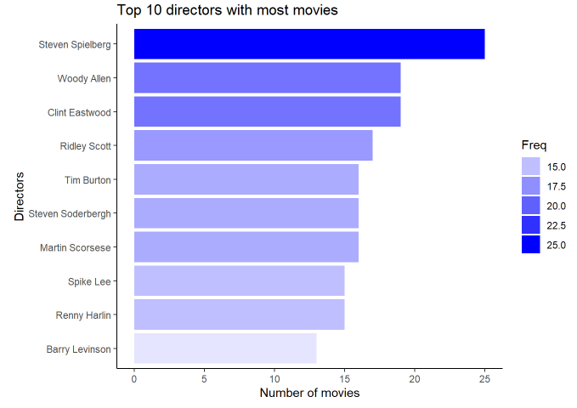
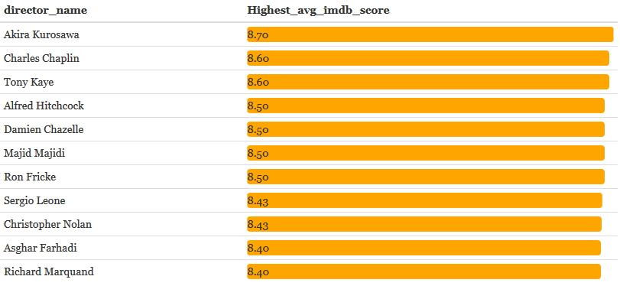
TOP 10 Directors

Slide 12
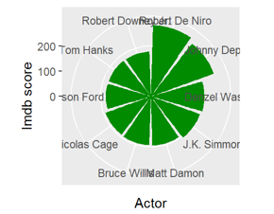
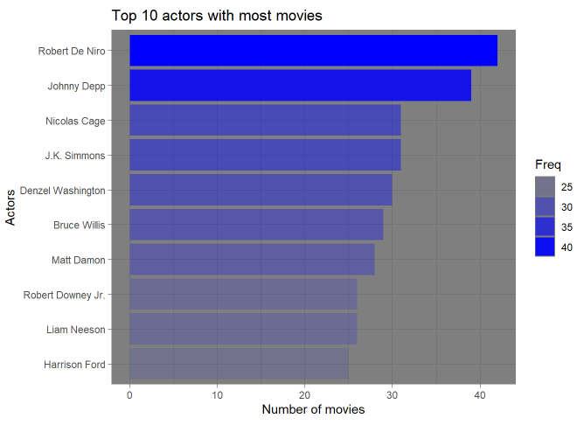
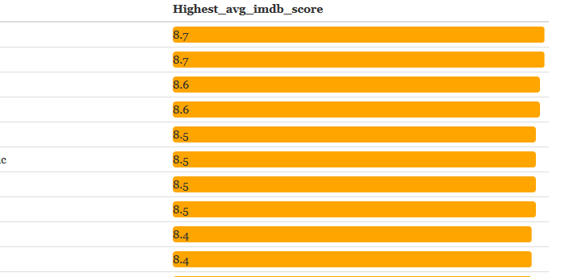
TOP 10
Actors

Slide 13
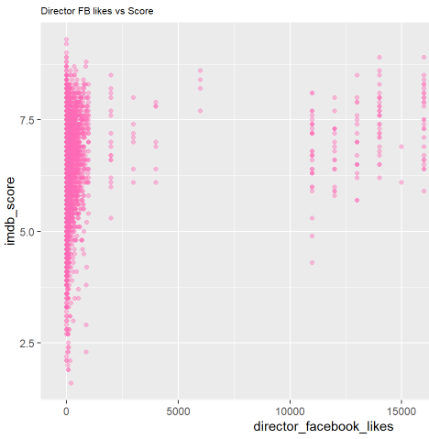
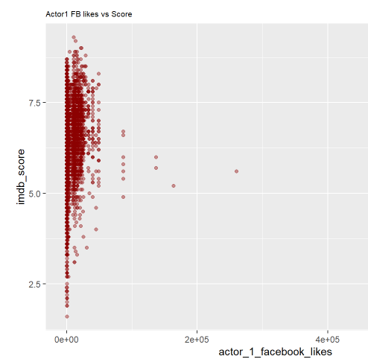
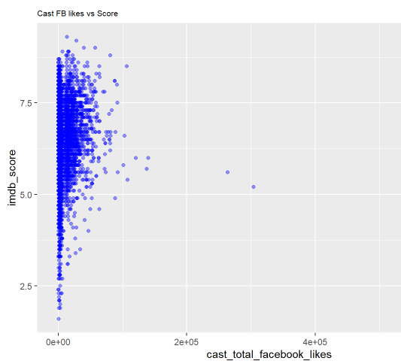

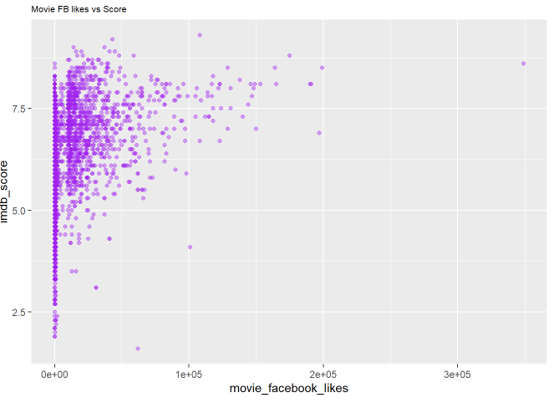
CAST & CREW FB LIKES

Slide 14
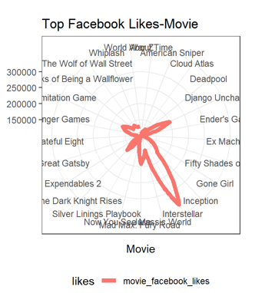
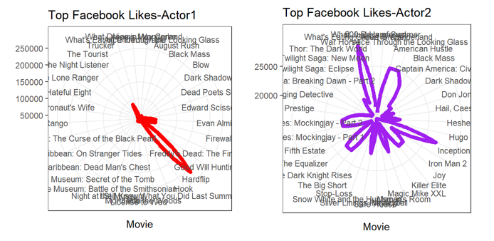
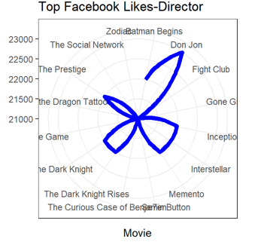
TOP FB LIKES

Slide 15
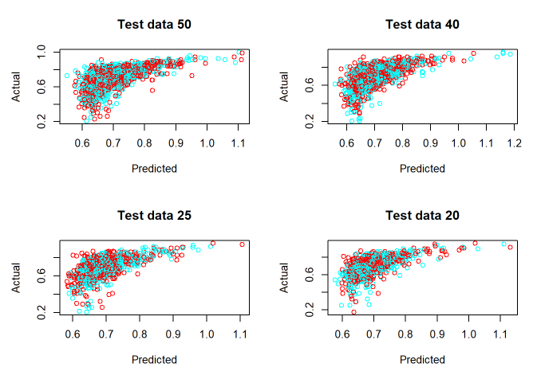
Linear Regression
Training | Testing | Mean square Error
50 | 50 | 0.008502452
60 | 40 | 0.009543997
75 | 25 | 0.008021885
80 | 20 | 0.007549562

Slide 16
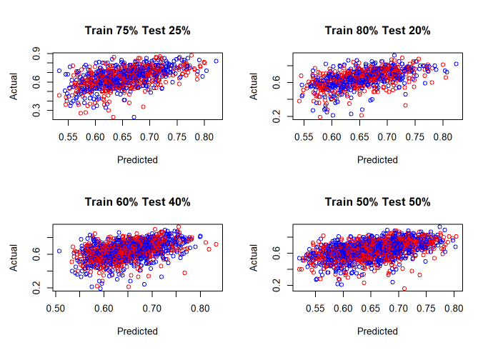
Support Vector Machine
Training | Testing | Mean square Error
50 | 50 | 0.008111651111
60 | 40 | 0.007866169099
75 | 25 | 0.008641616781
80 | 20 | 0.008390560137

Slide 17

Conclusion

