Slide 1

HAPPIEST HEALTH DIGITAL TWIN CHALLENGE 2026
GlucoSentinel: a digital twin that warns of glucose spikes 2 hours before they happen
Type 2 diabetes proof of concept fusing FHIR health records with 5-minute wearable data
0.961
95 min
85%
0.82
test AUROC
median warning lead
spikes warned 30+ min ahead
false alerts a day
DD
Dinesh D S
Team Dinesh
IIM Ahmedabad, PGP-FABM 2025-27
Notes:
Hello, I am Dinesh D S from IIM Ahmedabad. This is GlucoSentinel. A sentinel is a guard who warns before danger arrives, and that is what this digital twin does for type 2 diabetes. It fuses a patient's health record with five-minute wearable data, builds a calibrated virtual copy of that patient, and warns of a glucose spike up to two hours before it happens. On 24 unseen test patients it reaches an AUROC of 0.961, warns 85 percent of spikes at least 30 minutes ahead, gives a median warning of 95 minutes, and sends fewer than one false alert a day.

Slide 2











Executive Summary
Problem
Solution
Data
Twin Engine
AI Model
Results
Dashboard
Impact
Roadmap & Cost
A virtual copy of each patient warns of 85% of glucose spikes at least 30 minutes ahead
Built and tested end to end on synthetic FHIR and wearable data for 120 Indian patients; open source and reproducible
Problem
Solution: GlucoSentinel
Outcome on 24 unseen patients
101 M
136 M
315 M
+
=
0.961
AUROC; 0.930 without the twin
with diabetes
prediabetes
hypertension
EHR prior
FHIR record
7-day calibration
CGM + wearables
Personal twin
physiology
85%
spikes warned 30+ min ahead, vs 28% today
HbA1c hides spikes
Same 7.0% HbA1c, yet 11% vs 24% of the day above 180 mg/dL
Assimilate each 5 min
Fuse 81 features
Predict spike in 2 h
Simulate what-if
95 min
median warning lead, vs 15 min
Alarms react late
CGM trend alarm warns only 28% of spikes 30+ min ahead; median lead 15 min
0.82
false alerts a day, vs 1.62
Physics + ML
Explainable
What-if lab
Overload and silos
4,032 CGM points per patient per fortnight; EHR and phone never meet
glucose-insulin twin per patient; LightGBM on 81 features
top SHAP drivers in plain words with every alert
test a meal swap, walk, sleep or medication change first
93.5%
60-min forecasts in Clarke zone A
Indian meals
Doctor console
Standards
Indian risk
diabetes at lower BMI, younger age, on carb-heavy plates
32 regional dishes with carbs and GI split fast and slow
risk card, 2-h forecast, weekly AGP, one-click nudge
FHIR R4, ICD-10, LOINC, RxNorm; ABDM ready
-108
mg/dL peak drop from one meal swap
120 synthetic patients, 483,840 readings, 81 fused features; one command rebuilds every number in 8 minutes
Notes:
Here is the whole story on one slide. The problem: 101 million Indians have diabetes and 136 million prediabetes. Post-meal spikes do the damage between visits, but HbA1c averages them away: two of our patients share an HbA1c of 7 percent, yet one spends twice as long above 180. Today's CGM trend alarm warns only 28 percent of spikes thirty minutes ahead, and doctors face four thousand readings per patient per fortnight. Our solution starts from the EHR, calibrates a personal physiological twin over seven days, keeps it in sync with every CGM reading, and puts a LightGBM model on 81 fused features, with SHAP explanations, a what-if lab and a doctor console. The outcome on 24 unseen patients: AUROC 0.961, 85 percent of spikes warned thirty minutes ahead, a 95-minute median lead, 0.82 false alerts a day, and one meal swap lowering a predicted peak by 108 mg/dL.

Slide 3











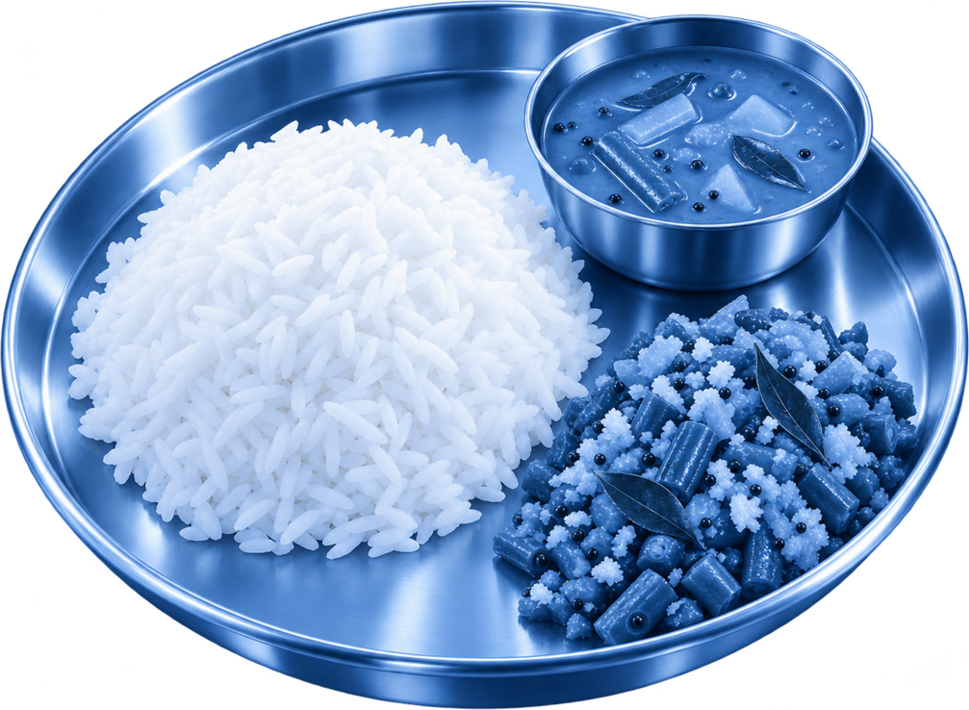


Executive Summary
Problem
Solution
Data
Twin Engine
AI Model
Results
Dashboard
Impact
Roadmap & Cost
Post-meal spikes do the damage between visits, yet today's tools react only once a spike has begun
India carries the burden, HbA1c hides the spikes, and nobody can read 4,000 CGM points per patient per fortnight
India's cardiometabolic burden
Same HbA1c, different days
% of day above 180
Alarms fire too late
% warned 30+ min ahead
136 M
315 M
101 M
with prediabetes
with hypertension
living with diabetes
National evidence
Indian risk profile
22 vs 45
2.2x
3 mo
15 min
1.62
16%
ICMR-INDIAB survey of 113,043 adults across 31 states and UTs, Lancet Diabetes and Endocrinology 2023
Diabetes at lower BMI and younger ages; rice and roti plates of 60 to 95 g carbs
glucose SD, mg/dL
more time in spikes
HbA1c review cycle
median lead, alarm
false alerts a day
spikes never warned
Anatomy of a missed spike
The gap GlucoSentinel fills
Doctor overload
4,032 CGM readings plus HR, HRV, sleep, steps per fortnight
No look-ahead
No tool says, before the meal, if it will spike
Glucose climbs
45 to 90 min after a 90 g carb lunch
Alarm at 180
already rising fast, meal absorbed
Peak 250 to 330
60+ min above 180
Repeated daily
vessel, nerve, kidney damage
Data in silos
EHR in the hospital, wearables on the phone
No what-if
Advice is generic; cannot test a swap on this patient
Usual lunch
Meal
Spike
Spike
Late alarm
Late alarm
Damage
Notes:
The ICMR-INDIAB survey of 113,043 adults found 101 million Indians with diabetes, 136 million with prediabetes and 315 million with hypertension. Indians develop diabetes at lower BMI and younger ages, on carb-heavy plates. HbA1c, reviewed every three months, is an average, so it hides spikes: Rahul and Bhavna both sit near 7 percent, but Bhavna spends 24 percent of her day above 180 versus 11 for Rahul. Current CGM alarms only see the rise once it starts: 28 percent of spikes warned thirty minutes ahead, a 15-minute median lead and 1.6 false alerts a day. The anatomy of a missed spike: a 90-gram carb lunch, glucose climbs, the alarm fires at 180 after the meal is absorbed, the peak reaches 250 to 330, and it repeats daily. The gap we fill: overload, no look-ahead, silos and no what-if.

Slide 4







Executive Summary
Problem
Solution
Data
Twin Engine
AI Model
Results
Dashboard
Impact
Roadmap & Cost
GlucoSentinel keeps a calibrated virtual copy of each patient that forecasts, explains and simulates
Physiology says how glucose works in every body; machine learning learns how this patient actually lives
The twin loop
What each user gets
Why this is different
Risk card
2-h spike risk, expected time, glucose now
Capability | CGM app | ML only | Ours
Uses EHR + genetics | No | Some | Yes
Personal physiology | No | No | Yes
Warns 2 h ahead | No | Partly | Yes
Explains each alert | No | Rarely | SHAP
What-if on this patient | No | No | Yes
Indian meals and GI | Some | No | 32 dishes
FHIR / ABDM ready | No | Rarely | R4
GlucoSentinel
Simulate
EHR prior
Approved by Dr Rao
12:30 Spike likely after lunch
risk 78%, in about 2 h
Virtual
patient
Forecast
CGM plus +30 to +120 min path
Assimilate
Calibrate
Swap curd rice for millet khichdi today
Why panel
top SHAP drivers in plain words
A. EHR prior: HbA1c, FPG, BMI, duration, TCF7L2, PRS and meds set day-one physiology
Walk 20 min, starting 20 min after eating
What-if lab
run the twin on a swap or walk
Hybrid by design. Physiology gives structure that generalises and can be simulated; ML captures habits the equations do not know.
B. Calibrate: 7-day onboarding fits insulin sensitivity, beta-cell response, basal, dawn
C. Assimilate: each 5-min CGM reading nudges the twin back on track
Predicted peak 279 to 211 mg/dL, -68
Week review
AGP, time in range, alerts
0.961 vs 0.930
95 vs 75
D. Simulate: 2 to 4 h forward under a meal, walk, sleep or medication change
AUROC with vs without twin
median lead, minutes
Notes:
GlucoSentinel is a hybrid. The twin loop: the EHR sets a day-one physiology; a seven-day onboarding week calibrates insulin sensitivity, beta-cell response, basal glucose and the dawn effect; every CGM reading nudges the twin; and the twin can be run forward under any plan. The patient receives a doctor-approved nudge before the meal, and the doctor gets a risk card, forecast, why panel, what-if lab and weekly review. Compared with a CGM app or a pure ML model, only GlucoSentinel combines EHR and genetics, personal physiology, a two-hour warning, explanations, what-if and Indian meals. The ablation proves the twin matters: without it AUROC falls from 0.961 to 0.930 and the median lead from 95 to 75 minutes.

Slide 5


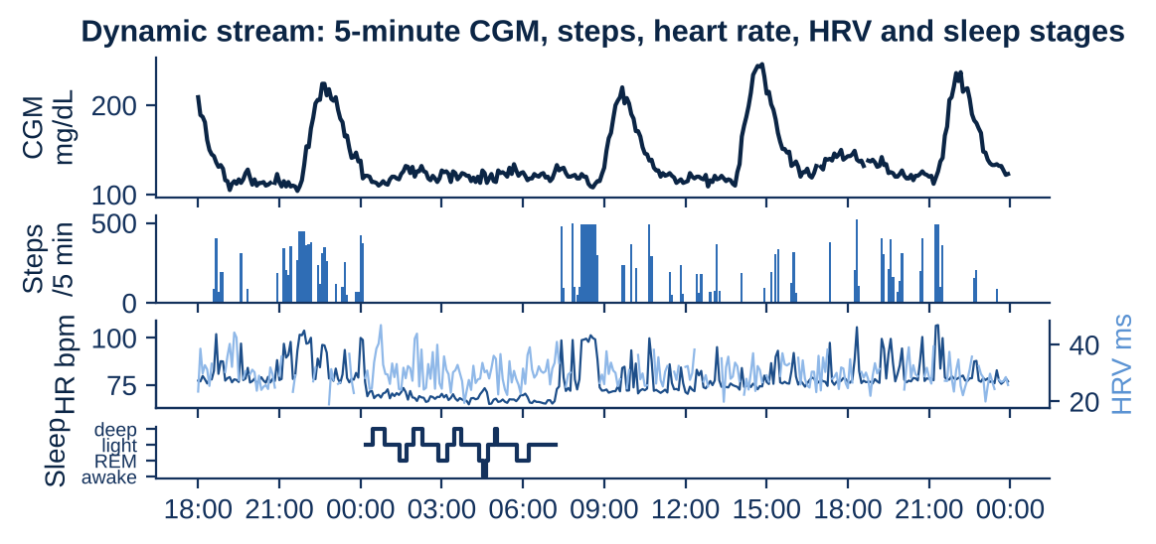
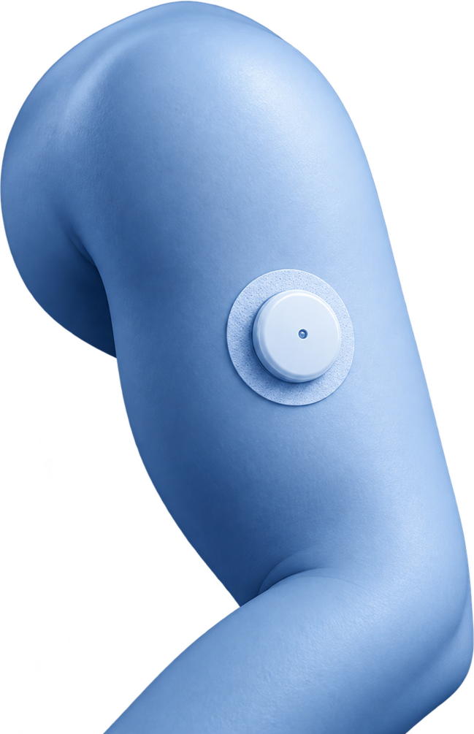
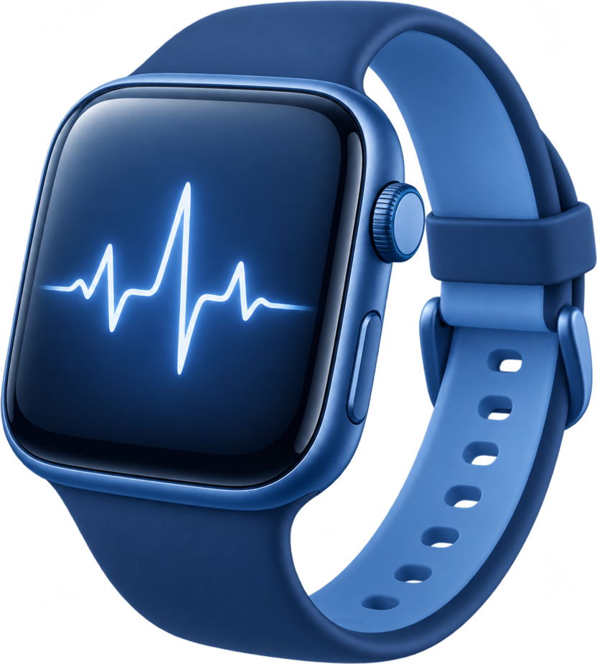
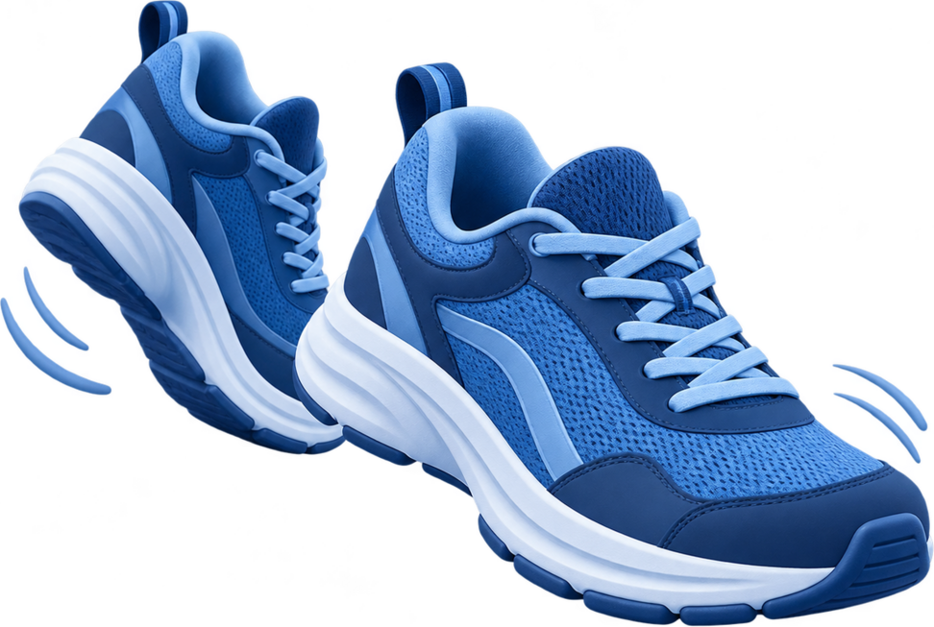








Executive Summary
Problem
Solution
Data
Twin Engine
AI Model
Results
Dashboard
Impact
Roadmap & Cost
Both required streams are fused: FHIR health records plus 14 days of 5-minute wearable data
120 synthetic Indian patients from a physiology simulator; no real patient data, as the sandbox rules require
Static stream: FHIR R4 EHR
Dynamic stream: one patient, 30 hours
FHIR resource | Content | Codes
Patient | age, sex, city | FHIR
Condition | T2D E11.9, prediabetes, HTN | ICD-10
Observation | HbA1c x3, FPG, BMI, lipids, eGFR | LOINC
Medication | metformin, glimepiride, sitagliptin | RxNorm
FamilyHistory | parental T2D | FHIR
Genetics | TCF7L2 rs7903146, PRS | LOINC
CGM
5-min glucose; 8 min lag, noise, gaps
Smartwatch
HR every 5 min, HRV at rest, sleep stages
Steps
walks, commutes, short bouts
Meal log app
~80% of meals logged, carbs +/- 22%
Cohort at a glance
How the synthetic world is made
Indian meal library (32 dishes)
120
107 / 13
Hidden physiology tied to EHR: BMI, genotype, meds
Dish | Carbs g | GI
Rice, sambar, poriyal | 90 | 75
Gujarati thali | 95 | 68
Idli (4), sambar | 60 | 70
Chapati (3), dal | 65 | 55
Bajra roti, dal | 55 | 48
Ragi dosa | 45 | 55
Gulab jamun | 45 | 85
patients
T2D / prediabetes
Daily life: regional meals, walks, sleep, stress, festivals
483,840
5,200
5-min readings
meals logged
1-minute simulation of glucose and insulin
51/30/24/15
6.3 to 7.7
S / W / N / E India
HbA1c IQR, %
Sensor model: lag, noise, dropouts, logging errors
Notes:
Both streams the brief asks for are here. The static stream is one HL7 FHIR R4 bundle per patient, the format Synthea produces and ABDM uses: ICD-10 diagnoses, LOINC labs including three HbA1c values, RxNorm medications, family history and two genetic markers, the TCF7L2 risk allele and a polygenic risk score. The dynamic stream is five-minute CGM, steps, heart rate, HRV and sleep stages plus a meal log. All of it is synthetic: hidden physiology tied to the EHR, regional Indian daily life, a one-minute glucose-insulin simulation and a realistic sensor model with lag, noise, dropouts and imperfect logging. 120 patients, 483,840 readings, 5,200 logged meals from 32 Indian dishes.

Slide 6


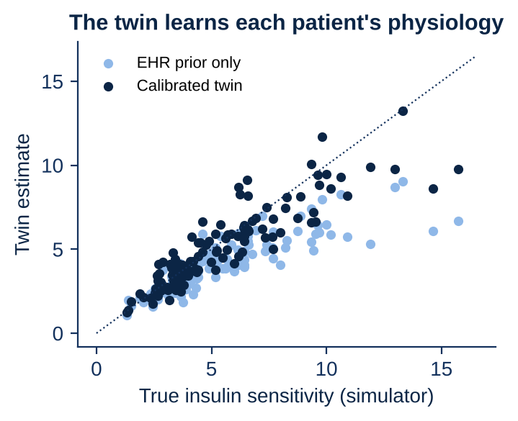






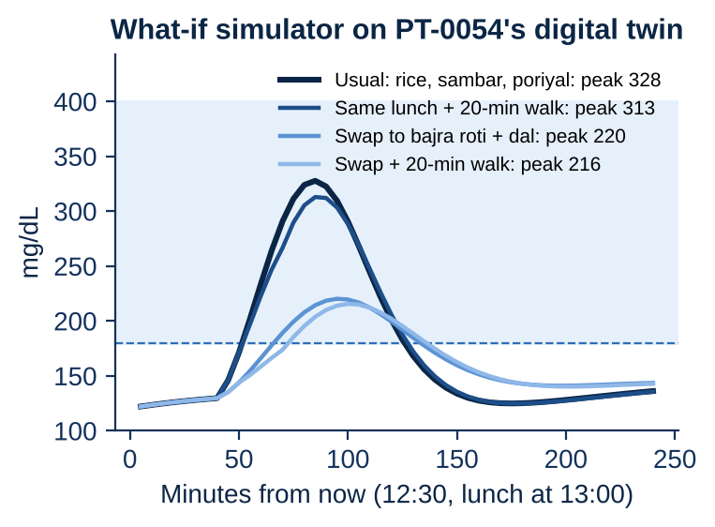
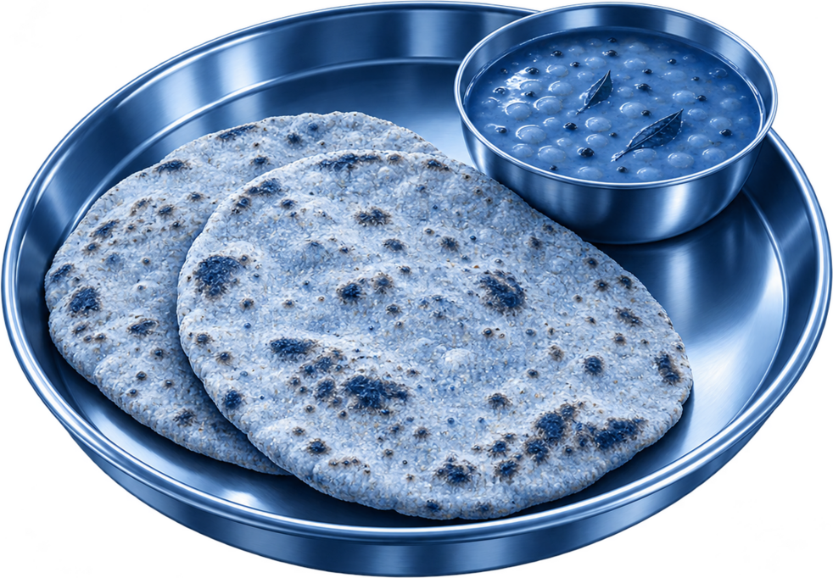
Executive Summary
Problem
Solution
Data
Twin Engine
AI Model
Results
Dashboard
Impact
Roadmap & Cost
The twin starts from the EHR, learns the patient in 7 days, then tracks every CGM reading
Personal physiology is estimated, not assumed: insulin sensitivity is recovered with r = 0.92 against the hidden truth
Physiology core (per patient)
Calibration in the onboarding week
Recovered vs true physiology
Glucose
dG/dt = -(SG + X) G + SG Gb(t) + Ra(t)/V - ex steps G
Forecast error
(fit)
Gap to EHR prior
(penalty)
Insulin action
dX/dt = -p2 X + p2 SI s(t) (I - Ib)
Best of 881 physiologies
Insulin release
dI/dt = -n (I - Ib) + gamma max(G - Gb, 0)
SI, gamma, Gb, dawn
625 + 256
1 pass
Gut
fast and slow carb pools, split by each dish's GI
candidates, 2 rounds
vectorised NumPy
Modifiers
dawn effect on Gb(t); sleep debt, stress lower s(t)
5.5 s
28 mg/dL
CPU per patient
median 2-h fit error
Live assimilation keeps the twin in sync
What the twin can simulate (patient PT-0054, 12:30)
328
usual rice lunch, peak
New CGM every 5 min
Compare with twin
Nudge 60% of gap
Project 2 h ahead
220
bajra roti + dal
Rice
-108
mg/dL, one swap
22.3
27.1
43.1
0.921
twin RMSE, 30 min
twin RMSE, 60 min
no-change, 60 min
AUROC, twin alone
313
same lunch + walk
Bajra roti
Notes:
The engine is an extended Bergman minimal model: glucose, insulin action and insulin release, a two-pool gut driven by each dish's GI, exercise uptake, the dawn effect, and sleep debt and stress lowering insulin sensitivity. In the onboarding week we simulate 625 candidate physiologies in one vectorised pass, zoom into 256 more, and score each on forecasting the patient's own CGM, with a penalty for straying from the EHR prior: about 5.5 CPU-seconds per patient. Recovered insulin sensitivity correlates 0.92 with the hidden truth. Live, each reading nudges the twin, so its 60-minute error is 27 mg/dL against 43 for no change, and the twin alone reaches AUROC 0.921. For this patient a rice lunch peaks at 328, bajra roti at 220, and a walk alone only to 313.

Slide 7








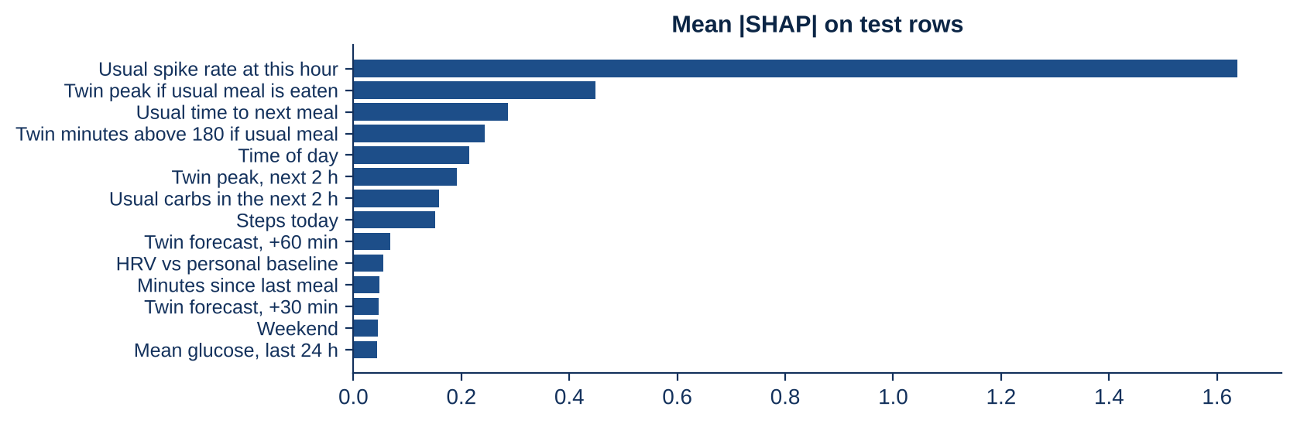
Executive Summary
Problem
Solution
Data
Twin Engine
AI Model
Results
Dashboard
Impact
Roadmap & Cost
81 fused features feed a LightGBM model, tested honestly on unseen patients and an unseen week
Target: onset of a CGM excursion above 180 mg/dL lasting 15+ minutes within the next 120 minutes
Four feature families
Evaluation protocol
Model and alert policy
E
23
EHR: HbA1c and trend, FPG, BMI, duration, meds, TCF7L2, PRS, lipids, eGFR
Activity
Week 1
Week 2
LightGBM: 31 leaves, lr 0.04, early stopping
Calibrate twin
onboard
W
40
Wearables: CGM level, slopes, variability; carbs, steps, HR, HRV, sleep
Learn routine
week 1
4 forecasters: glucose at +30 to +120 min
Train and test
week 2
R
5
Routine: usual spike rate, carbs and meal time at this hour, from week 1
84
12
24
Threshold 0.75, set on validation: <= 1 false alert a day
train
validation
test, unseen
T
13
Twin: forecasts, peak if usual meal, carbs on board, insulin action
No person and no day shared between fitting and scoring. 35,601 test rows, 30% positive.
Max 1 alert an hour; paused while above 180
Signal by data stream
What drives each prediction (mean |SHAP|, test rows)
76%
routine + twin share of SHAP
20%
raw wearables + CGM
3.5%
EHR directly; the rest flows via the twin prior
Notes:
Every five minutes we build 81 features: 23 from the EHR, 40 from wearables and CGM, 5 on the patient's routine learned in week one, and 13 from the twin. Evaluation is strict: 84 training, 12 validation and 24 unseen test patients; week one only calibrates the twin and learns routine; models train and score on week two. LightGBM with early stopping predicts the spike, four forecasters draw the glucose path, and the alert threshold of 0.75 was chosen on validation patients to keep false alerts at about one a day. Routine and twin carry 76 percent of the SHAP signal; the EHR looks small directly because its value flows through the twin's prior.

Slide 8
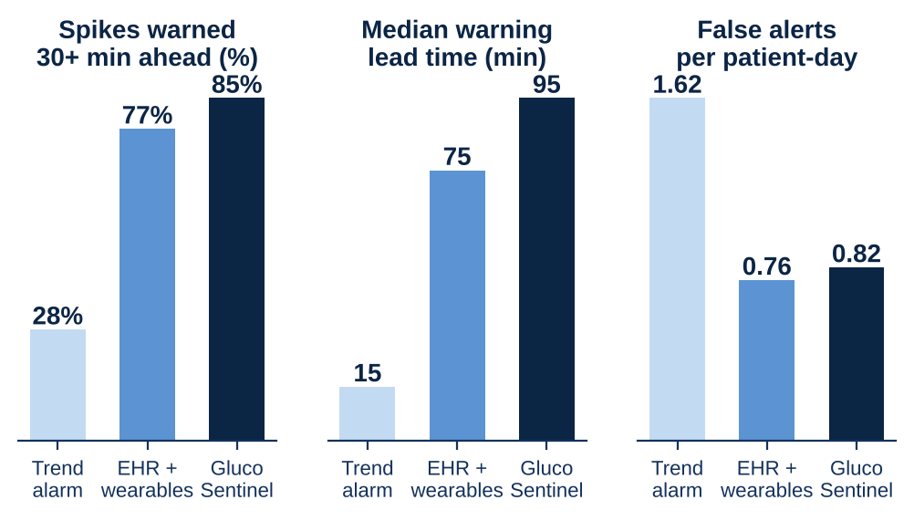
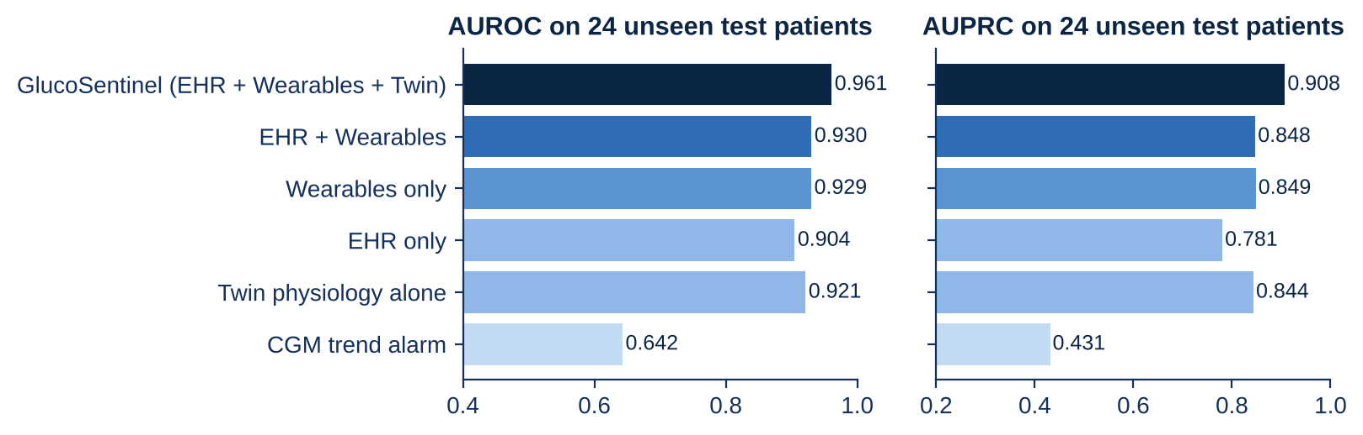


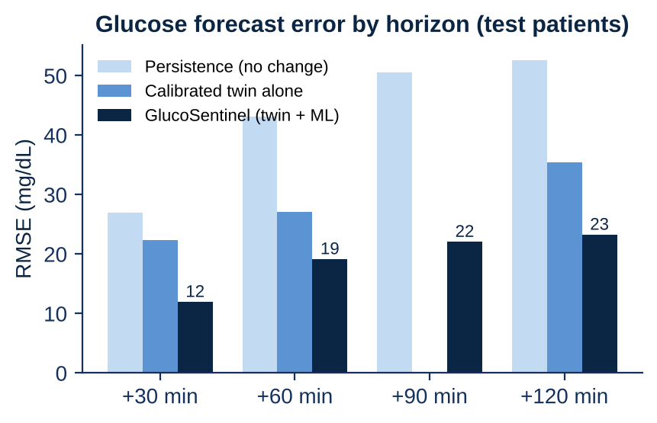
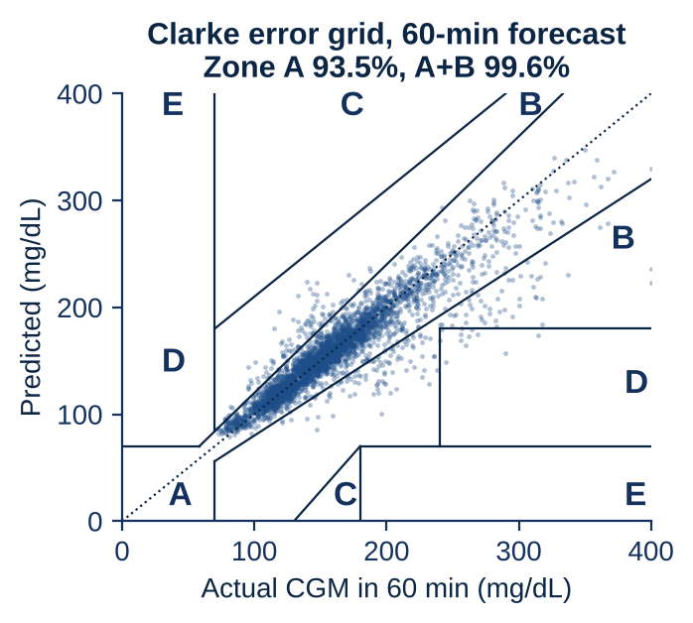
Executive Summary
Problem
Solution
Data
Twin Engine
AI Model
Results
Dashboard
Impact
Roadmap & Cost
Adding the twin lifts AUROC from 0.930 to 0.961 and gives a 95-minute median warning
All numbers on 24 unseen test patients, week 2: 35,601 five-minute rows and 582 spike episodes
Ablation: each stream and the twin add signal
Clinical view: earlier warnings, fewer false alarms
Glucose forecast error, mg/dL
Clarke error grid, 60 min
Fair across groups
Subgroup (test) | Pts | AUROC
Women | 8 | 0.967
Men | 16 | 0.957
South India | 12 | 0.961
West India | 8 | 0.957
Prediabetes | 3 | 0.965
T2D | 21 | 0.958
0.908
AUPRC
79%
alert precision
99.6%
Clarke A + B
12.0
RMSE, 30 min
Notes:
All on 24 test patients. Ablation: EHR plus time of day 0.904 AUROC, wearables alone 0.930, fused 0.930, and adding the twin and routine lifts it to 0.961, AUPRC from 0.848 to 0.908; today's CGM trend alarm reaches 0.642. Across 582 spike episodes, 85 percent are warned thirty minutes ahead versus 28, the median lead is 95 minutes versus 15, and false alerts are 0.82 a day versus 1.62. At 60 minutes the forecast error is 19 mg/dL versus 43 for no change and 27 for the twin alone; 93.5 percent of forecasts sit in Clarke zone A and 99.6 in A plus B. Performance holds across sex, region and diagnosis.

Slide 9

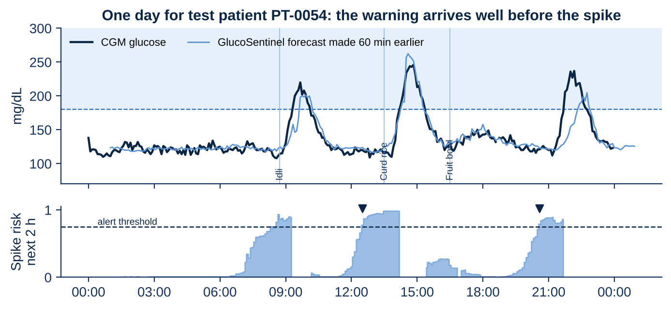


Executive Summary
Problem
Solution
Data
Twin Engine
AI Model
Results
Dashboard
Impact
Roadmap & Cost
One test patient, one day: three warnings, each 60 to 105 minutes before the spike
Gurpreet K. (PT-0054), 47, type 2 diabetes for 12.5 years, HbA1c 6.7%: never seen during training
CGM (dark), forecast made 60 min earlier (light), risk and alerts (triangles)
08:20 alert: 60 min ahead
Idli breakfast logged 08:44, 40 g carbs
Spike began 09:20, peak 220 at 09:40
50 min above 180
12:30 alert: 105 min ahead
Curd rice lunch logged 13:30, 85 g carbs
Spike began 14:15, peak 246 at 14:50
70 min above 180
20:35 alert: 70 min ahead
Dinner not logged; routine and twin still fired
Spike began 21:45, peak 237 at 22:10
60 min above 180
Why the 12:30 alert fired (SHAP share)
What the doctor does next
Where it still struggles
42%
Usual spike hour (5 of 7 days)
1
Opens the risk card: 78%, spike in about 2 h
8%
7%
15%
Twin peak if usual meal: 262
spikes never warned
warned < 30 min
2
Runs the twin: usual curd rice peaks 279
8%
Time of day
Off-routine meals and festival sweets cause most misses
Unlogged meals weaken the twin; routine features still fired at dinner
Fix: photo and voice meal logging in Indian languages
Usual carbs next 2 h: 69 g
3
Tests millet khichdi + walk: peak 211
6%
Risk 78% vs threshold 0.75, shown to the doctor in plain words
4
Approves and sends the nudge to the patient
Notes:
One test patient, Gurpreet, 47, with diabetes for twelve and a half years. Dark is his CGM, light is the forecast made sixty minutes earlier, and the strip below is risk against the threshold. Three alerts: 8:20, an hour before breakfast; 12:30, 105 minutes before lunch; 20:35, 70 minutes before a dinner he never logged. The 12:30 alert fired because this is his usual spike hour on five of seven days and the twin predicts 262 if he eats his usual lunch. The doctor tests millet khichdi plus a walk, sees the peak fall from 279 to 211, and sends the nudge. Honestly, 8 percent of spikes are never warned, mostly off-routine meals and festival sweets.

Slide 10

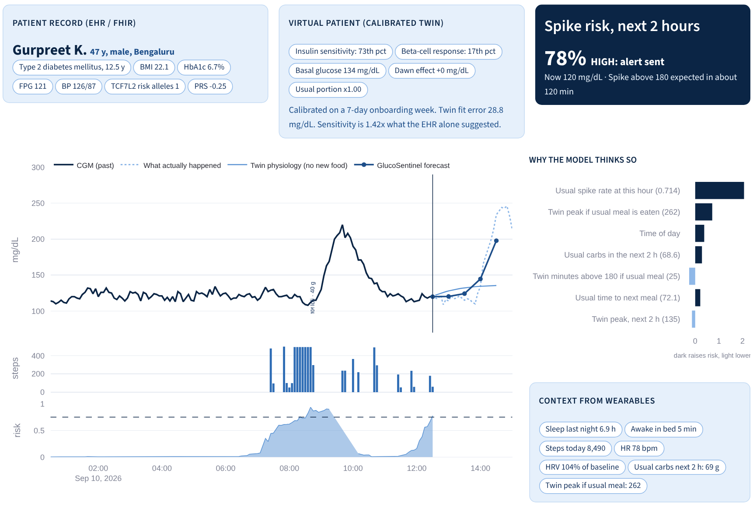
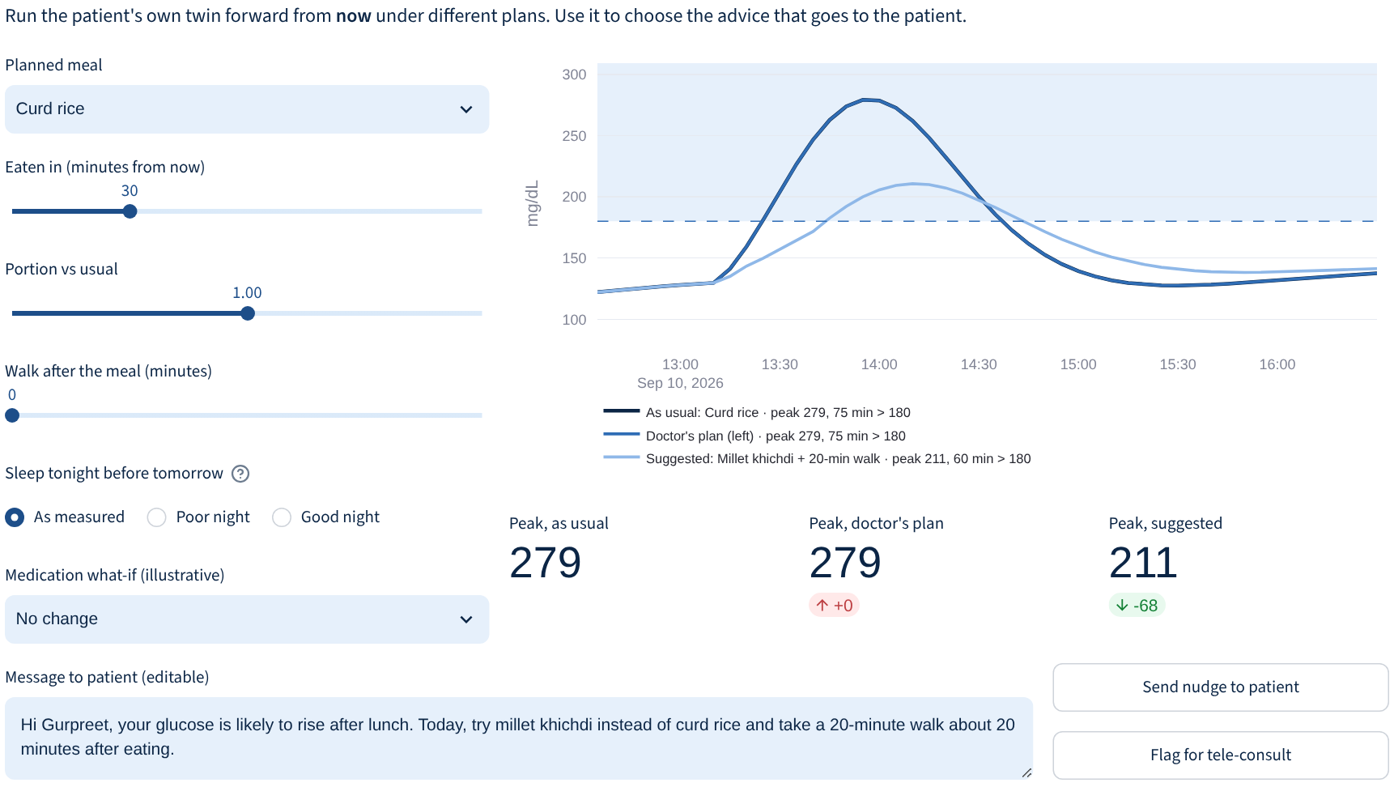

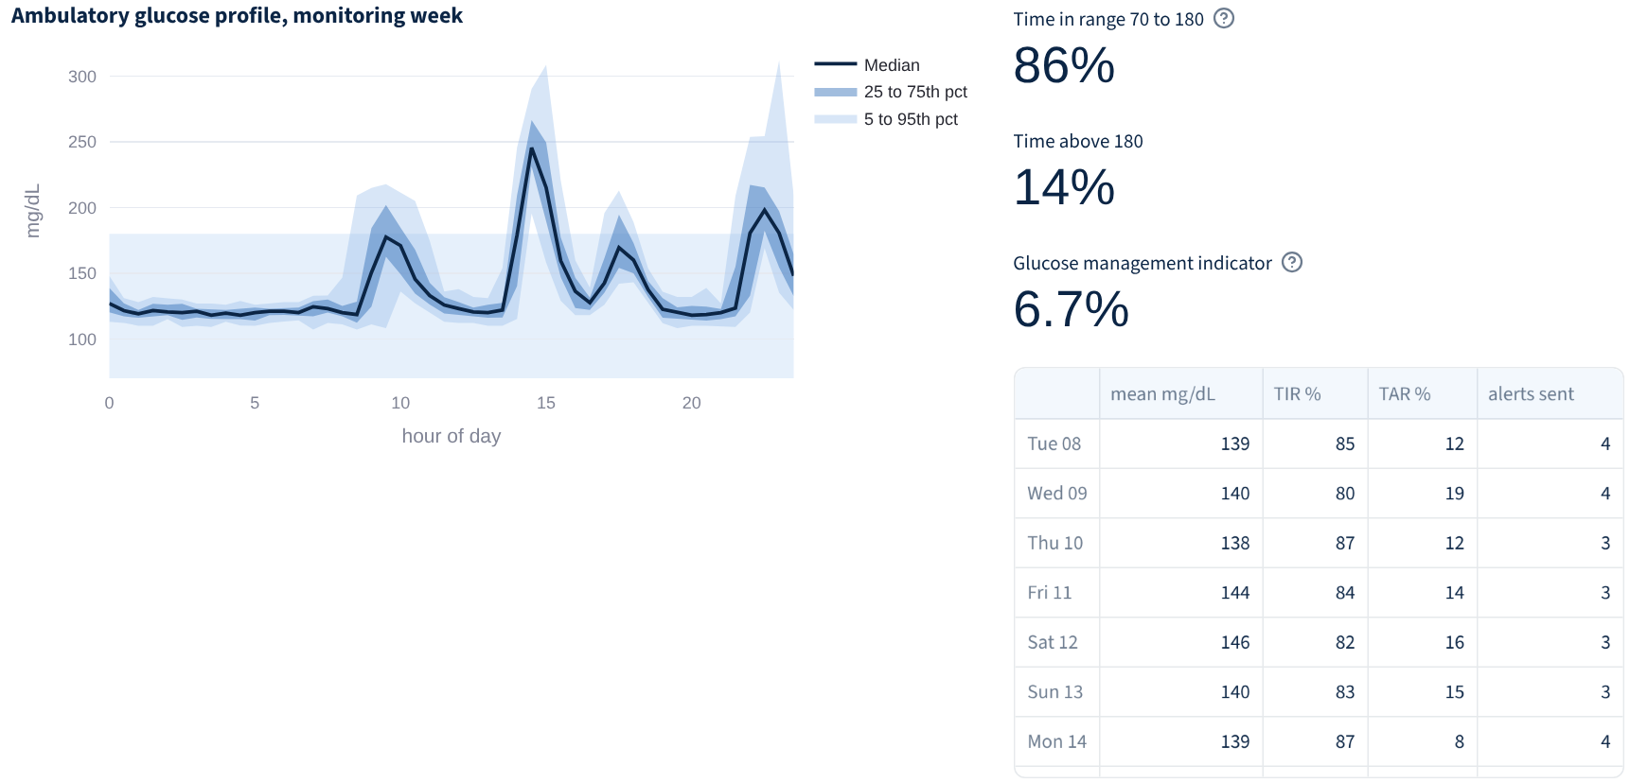
Executive Summary
Problem
Solution
Data
Twin Engine
AI Model
Results
Dashboard
Impact
Roadmap & Cost
The doctor console: one screen to see risk, understand why, test a plan and nudge the patient
Streamlit prototype on the test cohort; every number comes from the live twin and model in the repository
Patient view: FHIR record, virtual patient, risk, forecast, drivers
What-if lab: test the plan on the twin first
Week review (AGP) for the next visit
Pick patient
Read risk
See why
Test plan
Send nudge
Weekly review
Notes:
This is the doctor console; I will demo it live next. The FHIR record, the virtual-patient card with insulin sensitivity and beta-cell response as cohort percentiles, the risk card, twelve hours of CGM with the twin path and forecast, and the why panel. The workflow takes about a minute: pick a patient, read the risk, see why, test a plan, send the nudge, and review the week with the ambulatory glucose profile and time in range.

Slide 11












Executive Summary
Problem
Solution
Data
Twin Engine
AI Model
Results
Dashboard
Impact
Roadmap & Cost
Earlier warnings turn into avoidable spike-minutes for patients and focused time for doctors
What changes for each stakeholder, how we keep it safe, and what this proof of concept does not yet prove
Impact pathway
Who gains
Value per stakeholder
Patient
advice before the meal; 85% of spikes flagged early
Alert
~95 min ahead
Act
swap, smaller, walk
Lower peak
-108 mg/dL in twin
Less exposure
fewer min > 180
Doctor
one screen, not 4,032 readings; weekly triage
Doctor using the console
Insurer
measurable time in range for outcome-linked plans
Less time above range is linked with lower HbA1c and fewer complications. Proving that needs a trial; this proof of concept shows the warning arrives early enough to act on.
Patient
Doctor
ABDM
FHIR R4 in and out; fits health lockers
Public health
Insurer
ABDM
anonymised spike patterns by region and diet
Responsible AI built in
Limitations we state openly
Synthetic data
Routine
Meal logging
simulator and twin share a model family, so real-world accuracy will be lower
needs a stable week 1; shift workers, travel and fasting days are harder
imperfect in real life; we already simulate 20% missed meals and 22% carb error
Privacy
synthetic data only; real use needs DPDP Act consent, encryption, minimisation
Fairness
AUROC 0.957 to 0.974 across sex, region and diagnosis
Human in loop
doctor approves every nudge; SHAP shown with each alert
No hypo module
Medication what-if
Next proof
low-glucose alerts are needed for sulfonylurea and insulin users
effects are illustrative population values, not dose guidance
retrospective test on real CGM datasets, then an ethics-approved pilot
Notes:
The impact pathway: an alert about 95 minutes ahead gives time to swap, eat less or walk; in the twin one swap cut the peak by 108 mg/dL; less time above range follows. Long-term benefits need a trial, and we say so. Patients get advice before the meal, doctors one screen instead of four thousand readings, insurers a measurable outcome, and ABDM a FHIR-native service. Privacy, fairness and a doctor in the loop are built in, and we state the limits: synthetic data flatters accuracy, routine needs a stable week, there is no hypoglycaemia module yet, and medication what-ifs are illustrative.

Slide 12





Executive Summary
Problem
Solution
Data
Twin Engine
AI Model
Results
Dashboard
Impact
Roadmap & Cost
From proof of concept to a clinic pilot in 12 months, at almost zero marginal compute cost
The CGM sensor is the main cost per patient; the twin and the model run on a laptop CPU
12-month roadmap
2026 to 2027
Activity
Nov
Dec
Jan
Feb
Mar
Apr
May
Jun
Jul
Aug
Sep
Oct
Proof of concept (this repository)
done
Retrospective test on real CGM datasets
external validity
Hypo module, photo and voice meal logging
product
Ethics approval, clinic partner
IEC
Clinic pilot, 50 patients x 3 months
pilot
ABDM / FHIR integration, SaMD pathway
scale
Summit
Pilot start
Pilot readout
Cost to run one patient twin
Basis of estimates
Go-to-market options
Item | Per patient | Basis
CGM sensor, 15 days | Rs 3,100 to 4,600 | Indian retail, Sep 2026
Smartwatch data | Rs 0 | patient's own device
Twin calibration | 5.5 CPU-s | measured
Prediction | < 0.01 ms / reading | measured
Doctor review | ~1 min a week | console workflow
5 brands
15-day CGMs listed at Indian retail
Diabetes clinics
licence per active patient
331 s
120 twins on 2 CPU cores
Insurers, employers
outcome-linked programmes
53 ms
to score 20,000 readings
1 sprint
CGM per quarter keeps twin current (pilot)
CGM makers
twin as an app add-on
Compute for 10,000 patients fits on one small server; the sensor, not the AI, sets the price.
~1 min
doctor review per patient a week
Notes:
The roadmap: test on real CGM datasets for external validity; add a hypoglycaemia module and photo and voice meal logging; get ethics approval; run a 50-patient, three-month clinic pilot; then integrate with ABDM and prepare for the software-as-a-medical-device pathway. The CGM sensor dominates cost at about 3,100 to 4,600 rupees for fifteen days at Indian retail. The AI is nearly free: 120 twins calibrated in 331 seconds on two cores, 20,000 readings scored in 53 milliseconds. Routes to market are clinics, insurers and employers, or CGM makers. Thank you; everything is in the public GitHub repository under the MIT licence.

Slide 13



Executive Summary
Problem
Solution
Data
Twin Engine
AI Model
Results
Dashboard
Impact
Roadmap & Cost
Annexure: full metrics, reproducibility and repository map
Every number on the previous slides regenerates from one command; seeds are fixed
Full test metrics (24 patients, week 2)
Reproduce in 4 commands
Repository map
Approach | AUROC | AUPRC
CGM trend alarm (30-min projection) | 0.642 | 0.431
EHR + time of day | 0.904 | 0.781
Twin physiology alone | 0.921 | 0.844
Wearables only | 0.930 | 0.849
EHR + wearables (fusion) | 0.930 | 0.848
GlucoSentinel: EHR + wearables + twin | 0.961 | 0.908
pip install -r requirements.txt
python run_all.py
streamlit run dashboard/app.py
pytest -q
Folder | What is inside
src/glucosentinel | simulator, FHIR, twin, features, model
dashboard | Streamlit doctor console
data | EHR, FHIR, wearables, ground truth
models | LightGBM files, 120 twins (JSON)
reports | metrics.json, figures
docs | architecture, deck, video script
tests | unit tests: twin, labels, FHIR
run_all.py
data, FHIR, 120 twins, models, metrics, figures in 8 min
Episode metric | Trend alarm | Fusion | Ours
Warned 30+ min ahead | 27.5% | 77.1% | 84.7%
Warned at all | 83.7% | 88.0% | 91.8%
Median lead, min | 15 | 75 | 95
Alert precision | 65.2% | 78.6% | 79.1%
False alerts per day | 1.62 | 0.76 | 0.82
Alerts per day | 4.67 | 3.54 | 3.93
metrics.json
single source of every number in this deck
Ground truth
only validates the twin; never a model input
Licence
MIT; all data synthetic and free to reuse
Notes:
The annexure has the full metric tables, the four commands to reproduce everything, and a map of the repository.

